Slide 1
Work through level 3 process
Project Controlling SAP PS & Investment SAP IM

Slide 2
Content of level 3 process training
01 Project types in SAP PS
02 PDP project structure and nomenclature
03 Master data projects from PLM
04 Setup process new project
05 Month-end closing
Result analysis
06 SAP Invest management
07 Live Cycle Management

Slide 3
Project types in SAP PS
01

Slide 4

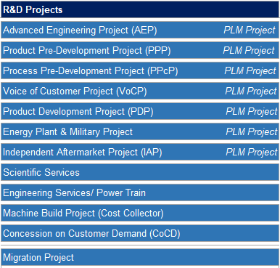
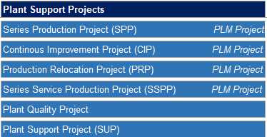
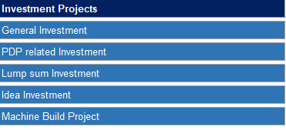
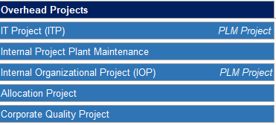
Project Controlling Project types in SAP PS
Work through Level 3 process
R&D Projects
Plant Support Projects
Overhead Projects
Investment Projects

Slide 5
PDP project structure and nomenclature
02

Slide 6
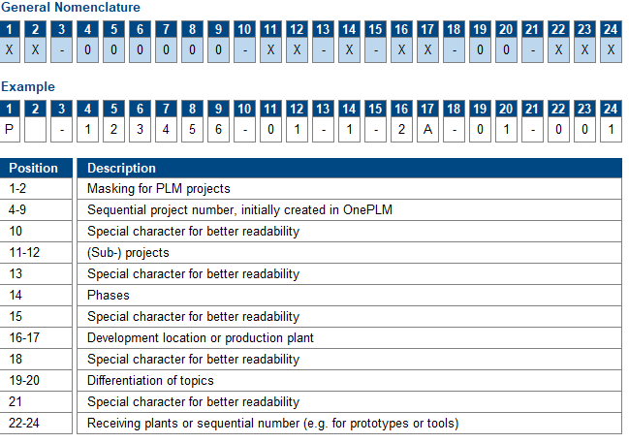
Nomenclature PLM projects
Work through Level 3 process

Slide 7
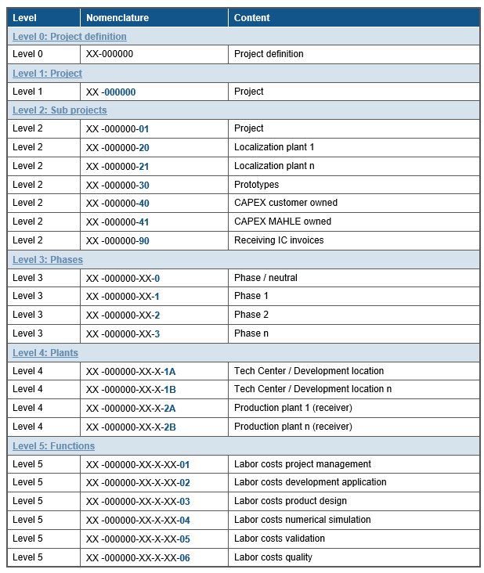
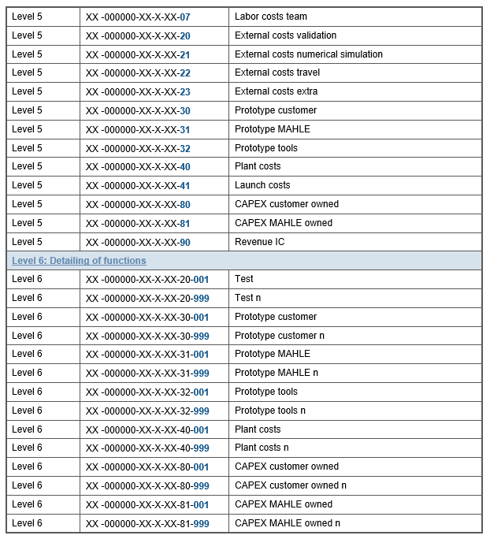
Project Nomenclature PDP P….
Work through Level 3 process

Slide 8
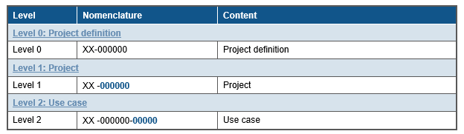
Project Nomenclature - Plant Support Projects (SUP) SU…..
Work through Level 3 process

Slide 9
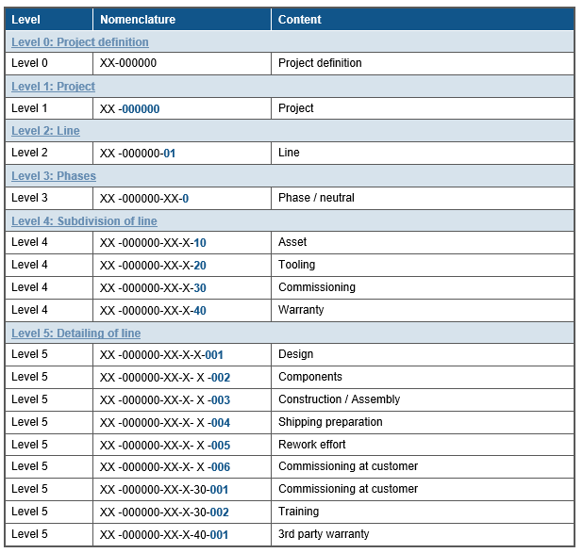
Project Nomenclature - Machine Build Projects MB….
Work through Level 3 process

Slide 10
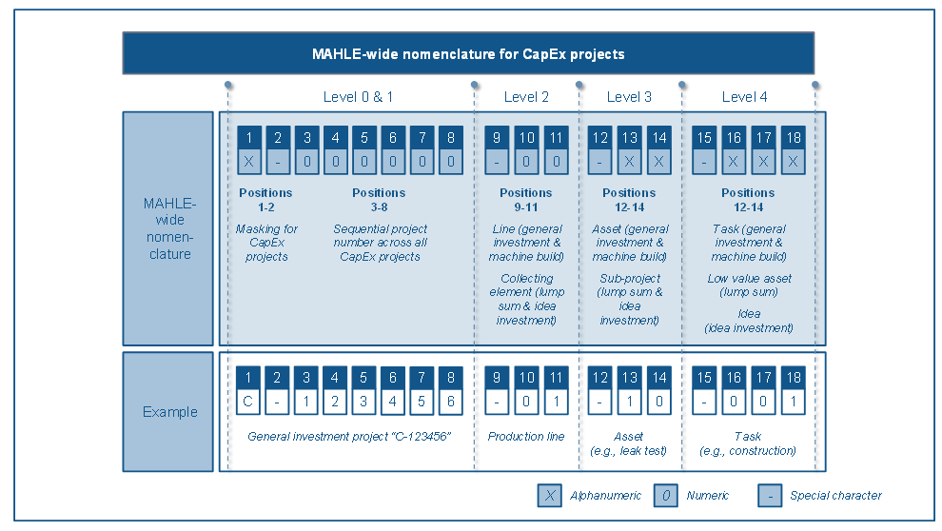
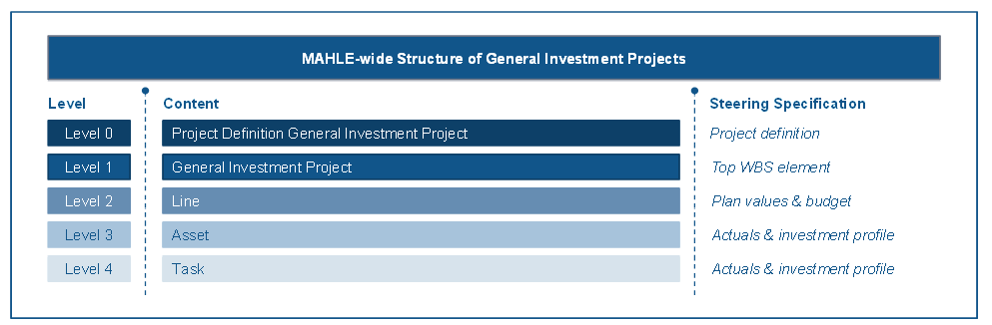
Project Nomenclature – General Investment C….
Work through Level 3 process

Slide 11
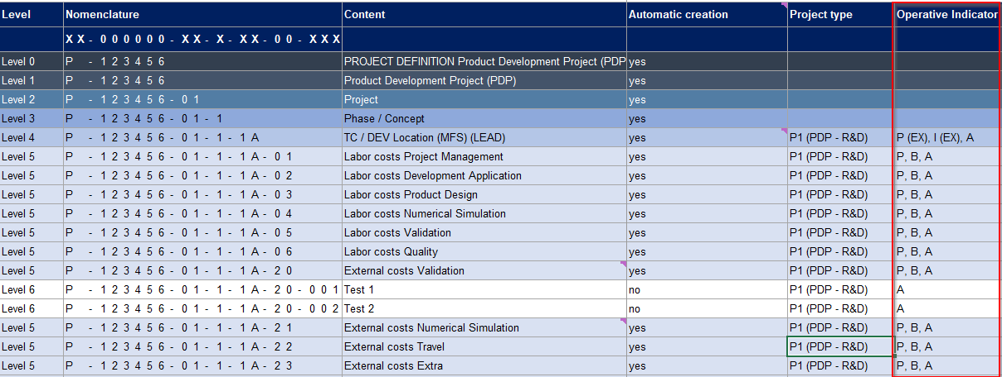
PDP project structure: planning, budget, actual, invoice ic, invoice ex
Work through Level 3 process
Planning of costs and budget are on level 5, planning for revenue are on level 4,
no planning and no budget on level 6 only actuals
Planning of costs is per year always on 12/YYYY and revenue per year and month
Budget in total per sub function
For planning is always used plan version PS0 for all project types. Means if hourly planning is done it need also the rates in version PS0 until the longest project end date.
The actual will calculated with the version 0

Slide 12
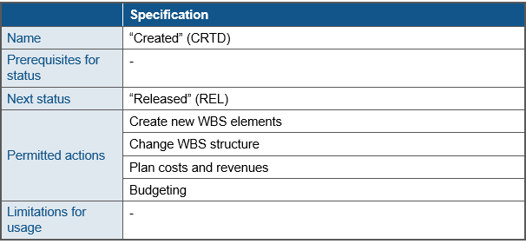
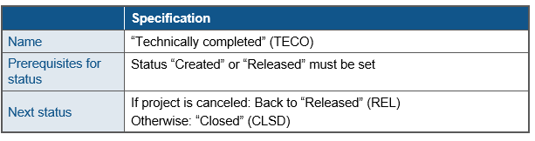
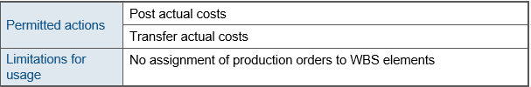
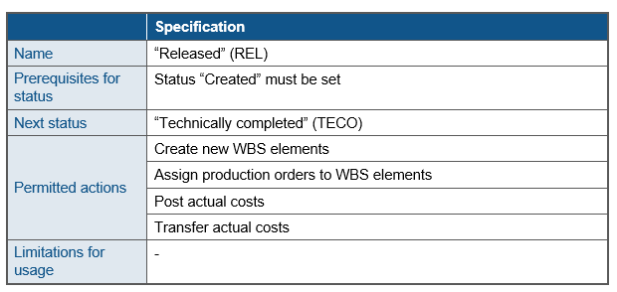
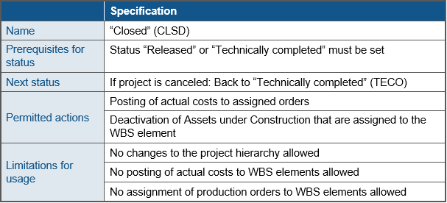
SAP PS system status / user status (additional restrictions to system status)
Work through Level 3 process

Slide 13
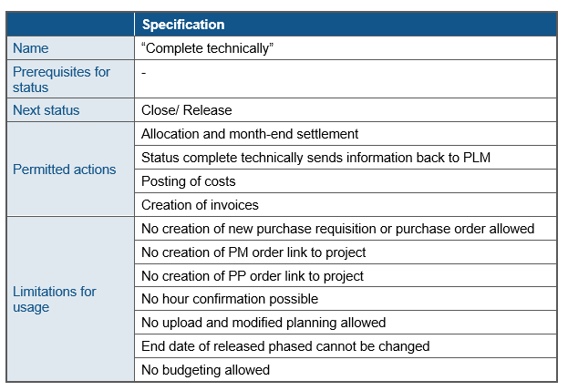
SAP PS user status (example: Complete technically)
Work through Level 3 process

Slide 14
Master data projects from PLM
03

Slide 15



Project Controlling SAP PS project master data from PLM system
Work through Level 3 process
Interface table PLM project master data ..PS_00003
ONE PLM
PM Software future and legacy
SAP MORE PS
2
ONE PLM
PM Software future and legacy
1
SAP MORE material master data
SAP MORE CO-PA
SAP MORE Reporting
1. Master data from PLM, update with every modification to a SAP MORE PS table ..PS_00003
2. Planning data: planned hours (effort) send to ONE PLM system
SAP BW

Slide 16
Project Controlling SAP PS fields from SAP PLM system in interface table PS_0003
Work through Level 3 process
Project definition | P-005000
Description | Oil Cooler Coolant Cooled (Engine)
Automotive/Non Automotive | true
Debtor | 1000017
Electrification type | PHEV
Engine Model | EG N63TUE/S63TUE
Engine Family | EG N63TUE/S63TUE
Engine Type | EG N63TUE/S63TUE
Fuel Type | D
Homeroom Location | 6101
Ice Dependency (ICE/Non-ICE) | true
Link development project (external) | P-005000
Link development project (Name) | BMW-EG N63TUE/S63TUE
Voltage | High
Market segment | 02
MARS ID (product group) | 1701
Model Code | EG N63TUE/S63TUE
Planned (X) / Unplanned ( ) | false
PPF Key | PRD_043119
Program (external) | P-006000
Program (Name) | BMW-EG N63TUE/S63TUE
Project Manager | FEIKEP1
Security level | 02
SOF number & Pos ID | O-12345-01-02-01
Technology | BRAZED
Vehicle platform | Grelta
Hybrid Type | FHEV
Old project number (legacy system) | H-15077-01
Product Hierarchy | E31A
PLM Project Type Number | PTN04
Won/Lost/Pending | WON
Project Profile | Y000001

Slide 17
Setup process new project
04

Slide 18
Setup process new project from PLM P….
Work through Level 3 process
ONE PLM
PM Software future and legacy
Automatic creation in MORE PS
Project will released in PLM, required Controlling information is maintained
Upload planning of cost and revenues
/MAHLE/PS_PLANNING with formatted excel sheet
Add budget
Copy plan to budget IMCCP3
Activate budget availability control
CJBN
Change of status phase
Change status phase 1 from created to release and sub project 90 phase 0 from created to released
Freeze planning versioning PS2….
Versioning freeze CN72 for final approve project budget start of development phase 2

Slide 19
Setup process new project general capex C….
Work through Level 3 process
Creation in MORE PS
/MAHLE/PS_MASSCREATE with formatted excel sheet
With change status from created to release in Capex projects the AUC is automatic created (also in PDP projects)
Upload planning of cost and revenues
CJR2 and csv template sheet
Add budget
Copy plan to budget IMCCP3
Activate budget availability control
CJBN
Change of status
Change status of project from created to release

Slide 20
Setup process new project plant support SU.. allocation projects A..
Work through Level 3 process
Creation in MORE PS
CJ20N with template structure
Upload planning of cost and revenues
No planning needed
Add budget
No budget needed
Activate budget availability control
CJBN
Change of status
Change status from created to release

Slide 21
Setup process new project machine build MB….
Work through Level 3 process
Creation in MORE PS
CJ20N with template structure
Upload planning of cost and revenues
CJR2 and csv template sheet
Add budget
Copy plan to budget IMCCP3
Change of status
Change status from created to release
Activate budget availability control
CJBN

Slide 22
Month-end closing
05

Slide 23
Month end closing
Work through Level 3 process
Different settlement structures and settlement accounts in one PDP project, belong to different project types
Project type
C1 (CapEx (fixed assets))
C2 (CapEx (current assets - customer owned))
I1 (Intercompany)
I3 (Intercompany Receiver)
P1 (PDP - R&D)
P2 (PDP - Localization)
P3 (PDP - Localization Plant)
P4 (PDP - Prototypes)
WBS elements with project type P1 are not directly settled to CO-PA
Costs are collected to level 4, calculated according to the volume split and reposted to invoicing WBS elements level 5 and are settled after the ic invoice to COPA.
WBS elements with project type C1 will settled to AUC
WBS elements with project type C2 need to run some result analysis before the will settled to CO-PA

Slide 24
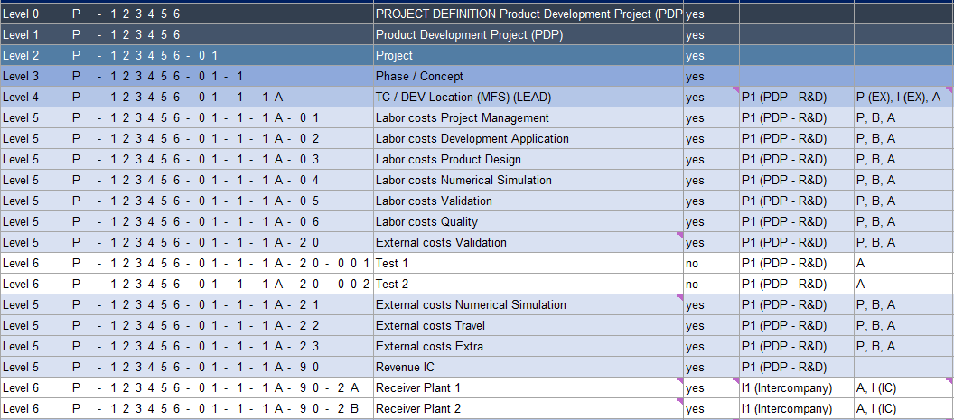
Month end closing
Work through Level 3 process
Different settlement structures and settlement accounts in one PDP project, belong to different project types
Sum up all costs, and calculate the volume split and rebook to the IC receiver plants
Settlement to COPA , and use the elements for the IC SD order

Slide 25

Month-end closing for Product Development Project (PDP) and Series Production Project (SPP)
Work through Level 3 process
Pre condition: cost and hours are booked in the settlement period
Generation of settlement rules
Example for Namestovo
CJB1/ use company settlement variant
Reposting program with volume split
/MAHLE/PS_WBS_VOL_SP – PS only for PLM projects
IC Invoice (SD)
Execution of result analysis
KKAJ use company settlement variant for customer own tooling, check report
S_ALR_87013531 Costs/Revenues/Expenditures/Receipts
Settlement run
CJ8G use company settlement variant
Check if all settlements are done
CJI3 / S_ALR_87013542

Slide 26

Month-end closing for general Capex projects C….
Work through Level 3 process
Pre condition: cost and hours are booked in the settlement period
Settlement run
Example for Namestovo
CJ8G use company settlement variant
Check if all settlements are done
CJI3 / S_ALR_87013542

Slide 27
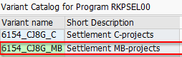
Month-end closing for machine build projects MB… only available if in the company is a tool shop
Work through Level 3 process
Pre condition: cost and hours are booked in the settlement period
Example for Namestovo
(in productive will not exist )
Generation of settlement rules
CJB1/ use company settlement variant
Execution of result analysis
KKAJ use company settlement variant for Customer own tooling, check report S_ALR_87013531 Costs/Revenues/Expenditures/Receipts
Settlement run
CJ8G use company settlement variant
Check if all settlements are done
CJI3 / S_ALR_87013542

Slide 28
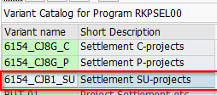
Month-end closing for Allocation A…, Support projects SU..
Allocation projects will only in central hubs like head quarters to distribute costs to there plants
Work through Level 3 process
Pre condition: cost and revenues allocated/ booked in the settlement period
Generation of settlement rules
Example for Namestovo
CJB1/ use company settlement variant
Settlement run
CJ8G use company settlement variant
Check if all settlements are done
CJI3 / S_ALR_87013542

Slide 29
SAP Invest management
06

Slide 30
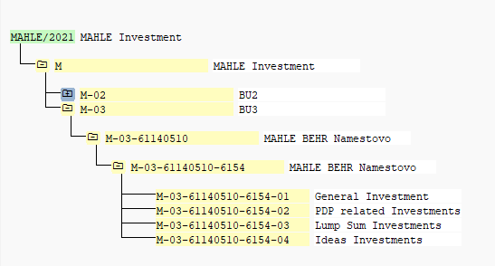
SAP Invest management
Work through Level 3 process
All MAHLE investments are linked to SAP-IM, means the investment budget could always compare to the active planned investment per year for C-projects/ P-projects on plant level. For all PDP projects the links to SAP–IM are automatically created. For all general investment it must maintained in the upload file.
The investment budget is maintained in SAP IM centralized once a year after the CAPEX business planning is fixed
General investment
C…..
PDP related investment P….

Slide 31
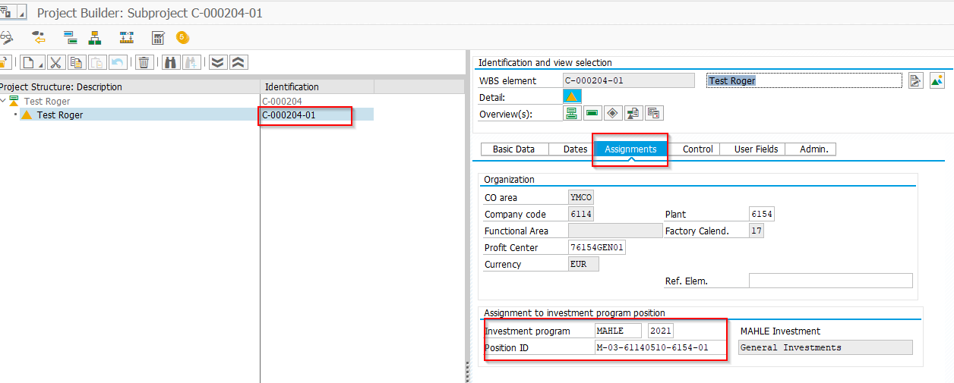
SAP Invest management
Work through Level 3 process
Find the link between SAP IM in SAP PS in the project builder CJ20N

Slide 32
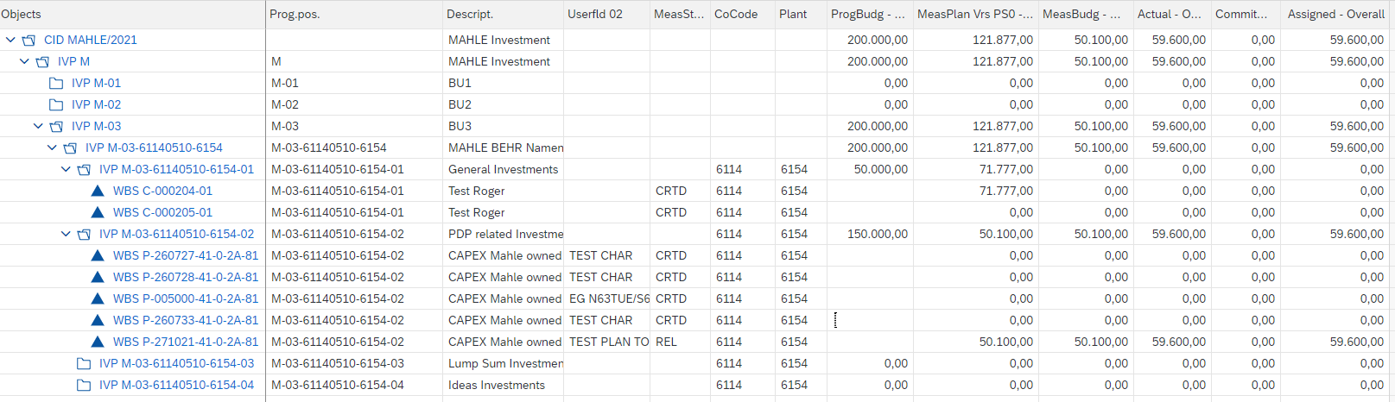
SAP Invest management
Work through Level 3 process
Roll-up of plan values from projects (PS)
IM34
Report Budget /Plan
IMR1_ALV
https://dest-q4ml01.sap.global.mahle:8300/sap/bc/ui2/flp?sap-client=100&sap-language=EN#IMR1_ALV-OpenIMR1_ALV?sap-ui-tech-hint=GUI

Slide 33
Product / Project Live Cycle Management
07

Slide 34
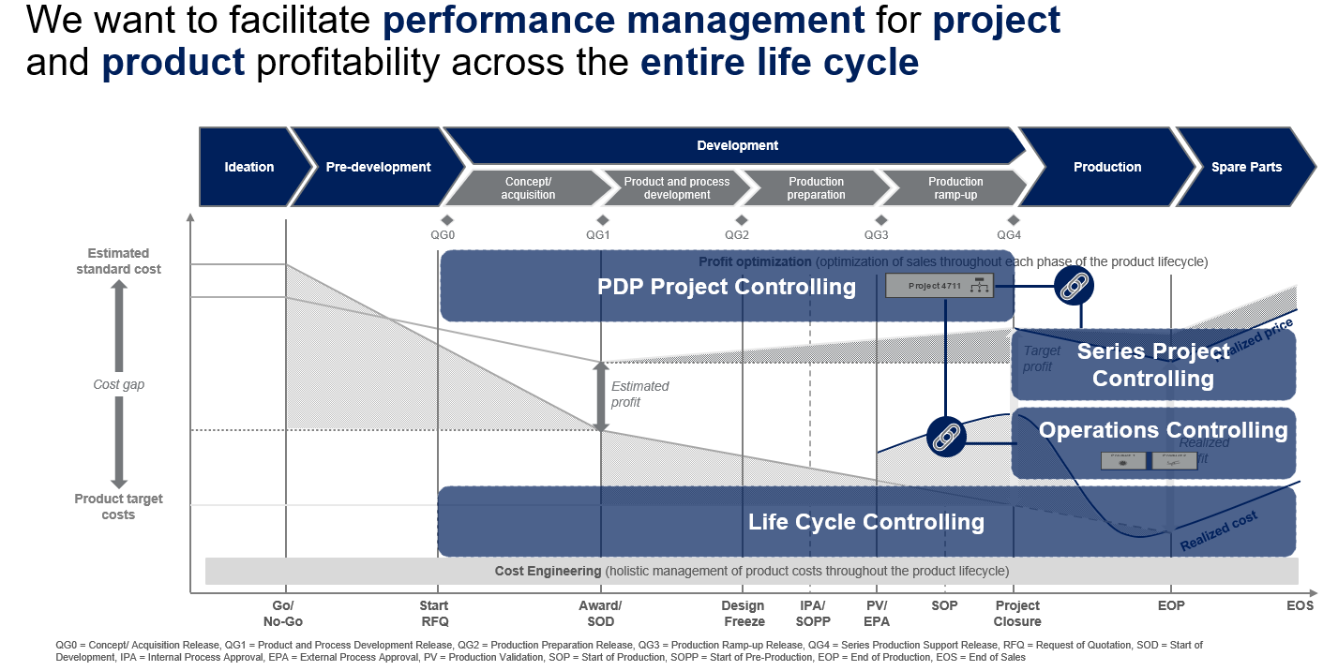
Product / Project Live Cycle Management
Work through Level 3 process

Slide 35
Thank you

