Slide 1
BU1 NA4_5 Russellville
Bi-Weekly meeting

Slide 2
Agenda
03 Project Organization
04 Organizational Structure
05 Deployment Planning
06 Training
07 Migration
08 Fit-to-Standard
09 Next Steps

Slide 3
Project Organization
03

Slide 4
Deployment Organization – Russellville (7565)
MORE Hub Americas – Deployment Organization
 | Business | IT
Plant Manager | Ilir Tallabaci | -
Hub Leads | Rodolfo Urquieta | Rodolfo Urquieta
Controlling Americas | Robert Lucas | -
Operations Americas | Jaime Alejandro Spinola | -
Business Transformation
Project Management
Deployment Team
 | Business | Local (Plant) | IT
Team Leads | David Campos | David Rodriguez | Chinmaya Jena
 |  | Business |  | IT
 |  | Regional | Russellville | Regional
 |  | Process Specialist (RPS) | Local Process Specialist (LPS) | IT Solution Owner iRSO
Shares Services | NPM Procurement | Juan Pablo Taboada & Elizabeth Sanchez (backup) Nadine Kalwig​​ (backup) | Amelia Quintana, Eric Sanchez and David Tereza | Isaac Vega​​
 | PM Procurement | Juan Pablo Taboada & Elizabeth Sanchez (backup) Nadine Kalwig​​ (backup) | Raul Solis & Pedro Romero | Isaac Vega​​
 | Sales | Brenda Scott Data Support - DM | Jeff Brown (PRD) David Rodriguez (PRD) Ana Fernanda Villarreal (PRD) Victor Proa (P4M) | Bill West
 | Finance | Carlos Coronado​​​ | Emilio Gonzalez (CM) Pedro Villanueva (AR) Karen Guevara (AP) David Villarreal (FA) Jenn Kinsella (GL/TAX)​​ | Marco Garcia
Process | Foreign Trade | Roberto Salazar​​​ | Leslie Harrell, Dana Waugh​ | Bill West​
 | Controlling | Leticia Mellado | Hayden Collins/Chris Anderson | Ileana Aguilar​​​
 | Inbound Logistics | Sundar Sundararajan | Jeff Brown | Kalyan Mukkala​​
 | Outbound Logistics | Loren Worley​ Daniel Arevalo​​​ | David Rodriguez | Kalyan Mukkala​​
 | Warehousing | Sundar, Sundar​ | David Rodriguez/New Hire | Erika Suarez
 | Production | ​Adrian Macias | Daxton Adaire/Francisco Montelongo | Jorge Vink
 | Quality | Sundar, Sundar​ | Mike Nicholas | Christopher Galaviz​
 | Asset Management | Horacio Aguirre​​ | Omar (Oswaldo) Sierra | Enzo Poiares
Process Functions
Regional Support Functions
 |  | Business |  | IT
 |  | Regional | Russellville | Regional | Local (Plant)
Support | Change Management | Adriana Peraza​ | Amber Bell | - | -
 | Methodology | Katelyn Kohler​ | - | - | -
 | PMO | Katelyn Kohler​ | - | - | -
 | Training Management | Katelyn Kohler​ | Amber Bell | - | -
 | Testing Management | Mia Montemayor​ | - | - | -
 | HR Interface | Kyle Barcomb​ | - | Kamil Lis | -
 | Data Management | Venkat Reddy | Daxton Adaire |  | -
 | PLM |  | -
 | BI | - | - | -
 | Infrastructure (incl. Authorizations) | - | Josh Palmer | Daniel Jorascu Jose Pablo Rodriguez
 | Migration coordination | - | - | Sudhakar Juttukonda, Venkateswara Reddy | -
 | EDI / PI | - | - | Refugio Granados | -
Deployment Organization – BU1.pptx
Notes:
David

Slide 5
Deployment Planning
05

Slide 6
Deployment Project Status
Pre-deployment
Deployment
Phases
Involve
Engage
Execute
Steps
Involve
Prepare
Initiate
Design
Realize
Deploy
Support
Q0
Q1
Q2
Q3
Q4
Q5
Q6
Activi-ties
Change Management (communication)
Regional Hub Project Plan
Plant Readiness Check
Kick-off / 1st walk-the-floor incl. Delta findings
Milestone planning
Local Cookie Cutter finalization
Finalize staffing
Onboarding & basis training for local deployment team
Cleansing Preparation
Fit-to-standard kick-off & execution
Methodology & Template trainings
Findings / gap finalization
Customizing Workshop 1*
Test Migration 0*
Test plan preparation*
Integration test 0*
Test migration 1
Test plan preparation
Integration test 1
Fit-to-standard detailed design
Fit-to-standard closing
Process scope and design approval
End-user-training design
Test migration 2
Integration test 2
Realize all plant customizing
Realize/develop fit-to-standard gaps
Develop & test interfaces
End user trainings
Go/no-go decision
Cutover/Go-Live SIM
System handover to operations
Go-live preparation
/ Cut-over Execution
Go-live
Hypercare activities
On-site and off-site support
System handover to governance
Ownership
Regional Team
Local Team
Notes:
David

Slide 7
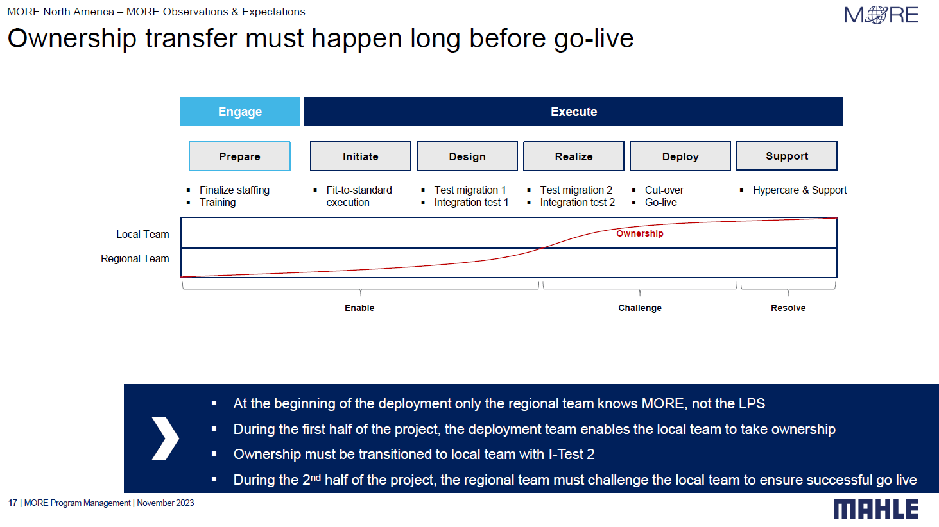
Deployment Project Status
MORE Deployment – AM4 NA1 Belmont
Notes:
Leandro Menezes

Slide 8
Wave 1 BU1 - High Level Milestones
March – Oct 2026
October 2026 – September 2027
Oct 2027
Involve
EXECUTE
ENGAGE
SUPPORT
March - September
Prepare
October - February
Initiate
March - May
Design
June - August
Realize
September
Deploy
Oct 1
Support
0
1
2
3
4
5
6
September
Kick-off Workshop
October
Fit-to-Standard
February
Integration Test 0
May
Integration Test 1
August
Integration Test 2
October
Go-live
September
Local Cookie Cutter
December
Finding final approval
April
Solution design finalization
June
Migration Workshop
August
FTS gaps realization
September
Cut-Over
October
January
April
July
Basic Customizing
TM0
TM1
TM2
August - September
October - June
July - September
Onboarding & Tool Training
LPS Process Training
End User Training
8
* - CW based on 2026 October GL
1
Quality Gate
TM
Test Data Migration
On Site Visit
Notes:
AM1 – Oct 12
AM3 – Oct 19
AM4 – Oct 5

Slide 9
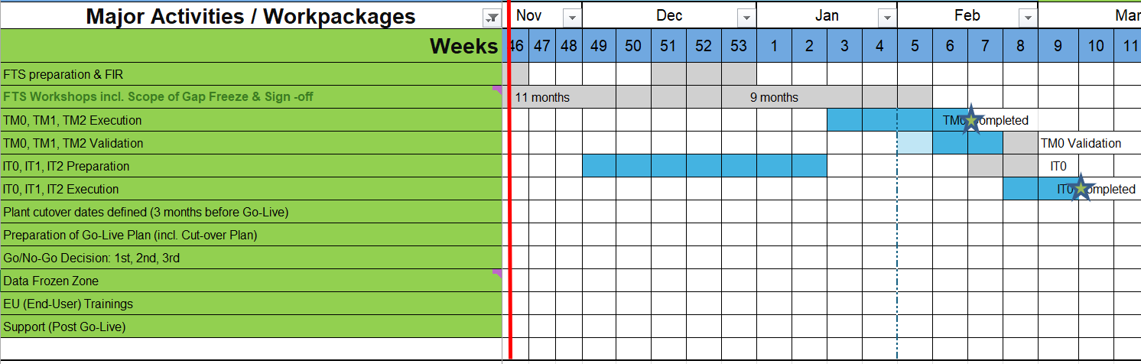
Project time line
MORE Hub Americas – NA4_5 Russellville Project
IT0 Preparation: CW46-50 (Mapping rules, Positive list, Cleansing)
IT0 Preparation: CW49-02 (Octane, tests, users)
TM0 Execution: CW03
TM0 Validation: CW05-07
IT0 Execution: CW08-CW09 (Onsite)
Notes:
Rodolfo to confirm AM – 5/28
WH – Inventory mgmt

Slide 10
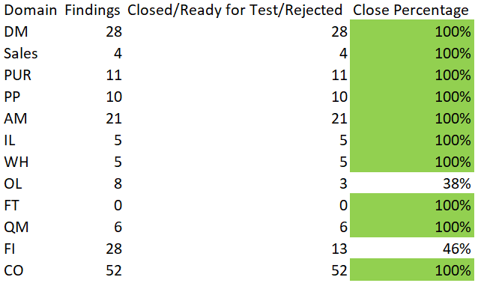
FTS status
MORE Hub Americas – NA4_5 Russellville Project
178 Findings collected / 158 are now ready for testing
Completion status 89%
Major findings:
Hardware acquisition is required
Customer requirements
Batch Management
Notes:
Rodolfo to confirm AM – 5/28
WH – Inventory mgmt

Slide 11
Organizational Structure
04

Slide 12
MORE
BU1 SAP Organization Structure (US only)
Organizational Structure
Target system – P4M CoCo 1010
Effective 1 October, 2027
Current State – Source System - PRD
MAHLE Engine Components USA, INC
MEC USA Russellville
Company code 7565
MEC USA Motorsports
Company code 5000
MEC USA Mfg Morristown
Company code 1000
MEC Frnkln Lnrs
Company code 7553
MAHLE USA Tech Center
Company code 4000
Plant 7565
MEC USA Russellville
Plant 5000
MEC USA Motorsports
Plant 1000
MEC USA Mfg
MEC USA St. Johns
Company code 7556
Plant 7556
MEC USA St Johns
Plant 4000
MAHLE USA Tech Center, Inc.
Plant 7553
MEC USA Frank Liner
(Assets & Liabilities)
MAHLE ENGINE COMPONENTS USA, INC
Plant 3554
Russellville
Company code 1010

Slide 13
Overview frozen zones
00

Slide 14
Frozen Zone Overview - Timeline
00 I Overview frozen zones
Update
Different types of frozen zones following project phases and milestones
Go-Live
Handover closing
Deployment
Support org.
Design
Realize
Deploy
Support
Test migration 1
Test plan preparation
Integration test 1
Fit-to-standard design
Fit-to-standard closing
Process scope and design approval
End-user-training design
Test migration 2
Integration test 2
P-Test
1. Go/No-Go decision
Go-Live SIM
Go-Live migration
2. Go/No-Go decision
Cutover
Final Go/No-Go decision
Go-live
On-site and off-site support
System handover to governance
Standard MAHLE 1. / 2. / 3. level support organization
1) Process & Function Frozen Zone
emergency concepts in place
2) Plant Layout Frozen Zone
3) Data Frozen Zone
4) Plant operation frozen zone
emergency concepts in place

Slide 15
Frozen Zone Overview - Description
00 I Overview frozen zones
Update
A frozen zone defines a period of time during which certain changes are not allowed
1) Process & Function Frozen Zone
2) Plant layout frozen zone
3) Data frozen zone
4) Plant operation frozen zone
Description
  No Finding/Process can be created or changed
  Baseline: agreed scope at Signoff
  Start: end of IT1 and latest 16 weeks after start of FTS
  End: Handover closing
  No physical layout changes in the plant possible anymore
  Baseline: agreed scope/layout after P-Test preparation, before IT2
  Start: Finalization of P-Test preparation, beginning of I-Test 2
  End: Go-Live
  Data Frozen Zone is the period during which no more master data changes can be done in the legacy systems, as they will not be migrated to the P4M system.
  Start with part 1 migration (after 1st Go/No-Go decision) and end with Go-Live → to be aligned with PLM team when interface PLM - P4M is opened
  No plant operations:
    No physical movements
    No production
    No good receipt (GR)
    No shipments
    No MRP runs
  Start: legacy system closure
  End: first activities in P4M after the Go-Live
  Frozen zone 1a:
  Start: End of IT1
  End: Start IT2
  Frozen zone 1b:
  Start: Start IT2
  End: Handover closing
  Frozen zone 1c:
  Start: Handover closing
  End: Handover closing + 3 month
Source schedule
  Global – Milestones Plans OnePager Excel
  LINK
  Deployment cutover dates: legacy system closure until Go-Live

Slide 16
Training
06

Slide 17
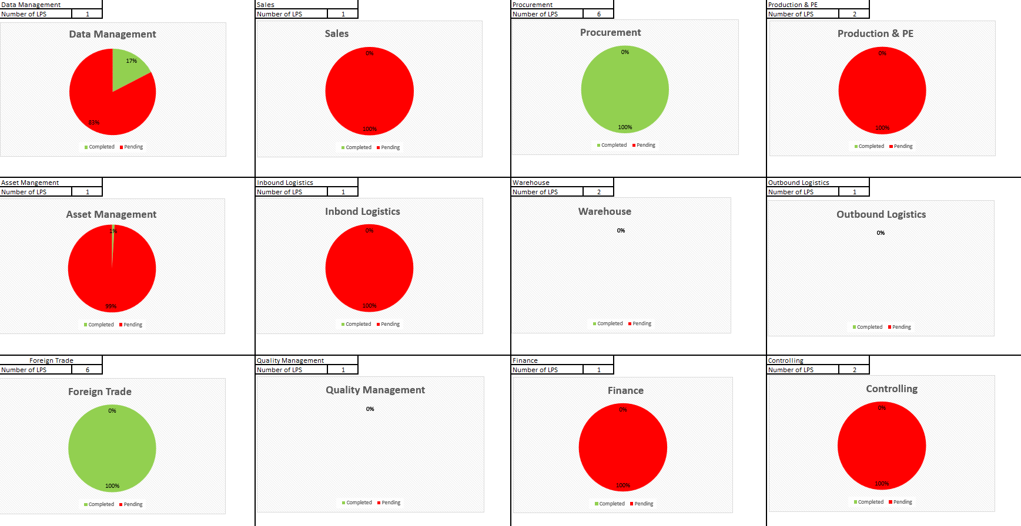
LPS Training Dashboard
Training Concept
LPS & End-User Training Track -RUS.xlsx

Slide 18
LPS training roadmap
Training Concept
Project milestones
Kick-off
FTS
I-test 1
I-test 2
Go live
LPS training
Phase 1
Phase 2
LPS to complete selected trainings in self-study:
  Basic deployment methodology and FTS training
  Overview of MORE template processes
On the job training by RPS during deployment activities like FTS & testing
Self-study of detailed process trainings by LPS
Specific training sessions by RPS where required
SAP Academy (training content for logistics) – available in Success Factors
LPS training to be completed until 2nd I-Test, to be able to execute end user trainings before go-live
Level 1 & Level 2 Overview
Notes:
Rodolfo

Slide 19
Train-the-trainer concept based on the training cascade
Training Concept
Knowledge transfer process
RPS
Project involvement &
Technical Training
LPS
Technical &
On the Job Training
End Users (and / or key users)
Start at beginning of the deployment
6-8 weeks before go-live
The LPS is via his role as trainer direct contact to the end users. In its role he/she does not just support the end users regarding the training content but also towards the acceptance of the system and new processes.
Notes:
Rodolfo

Slide 20
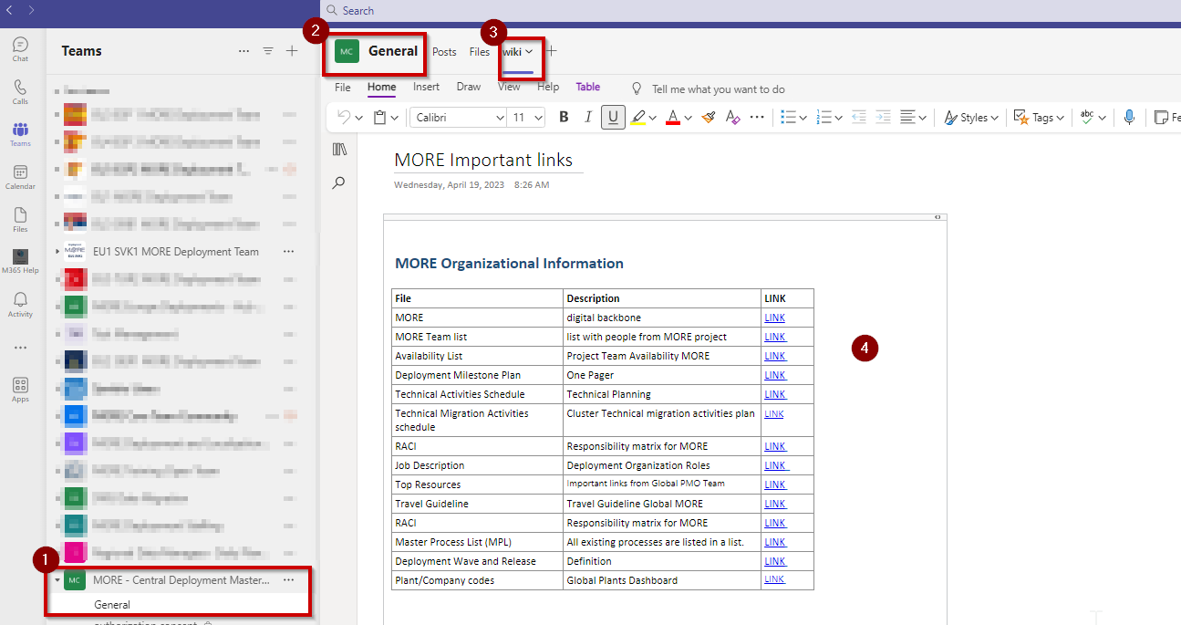

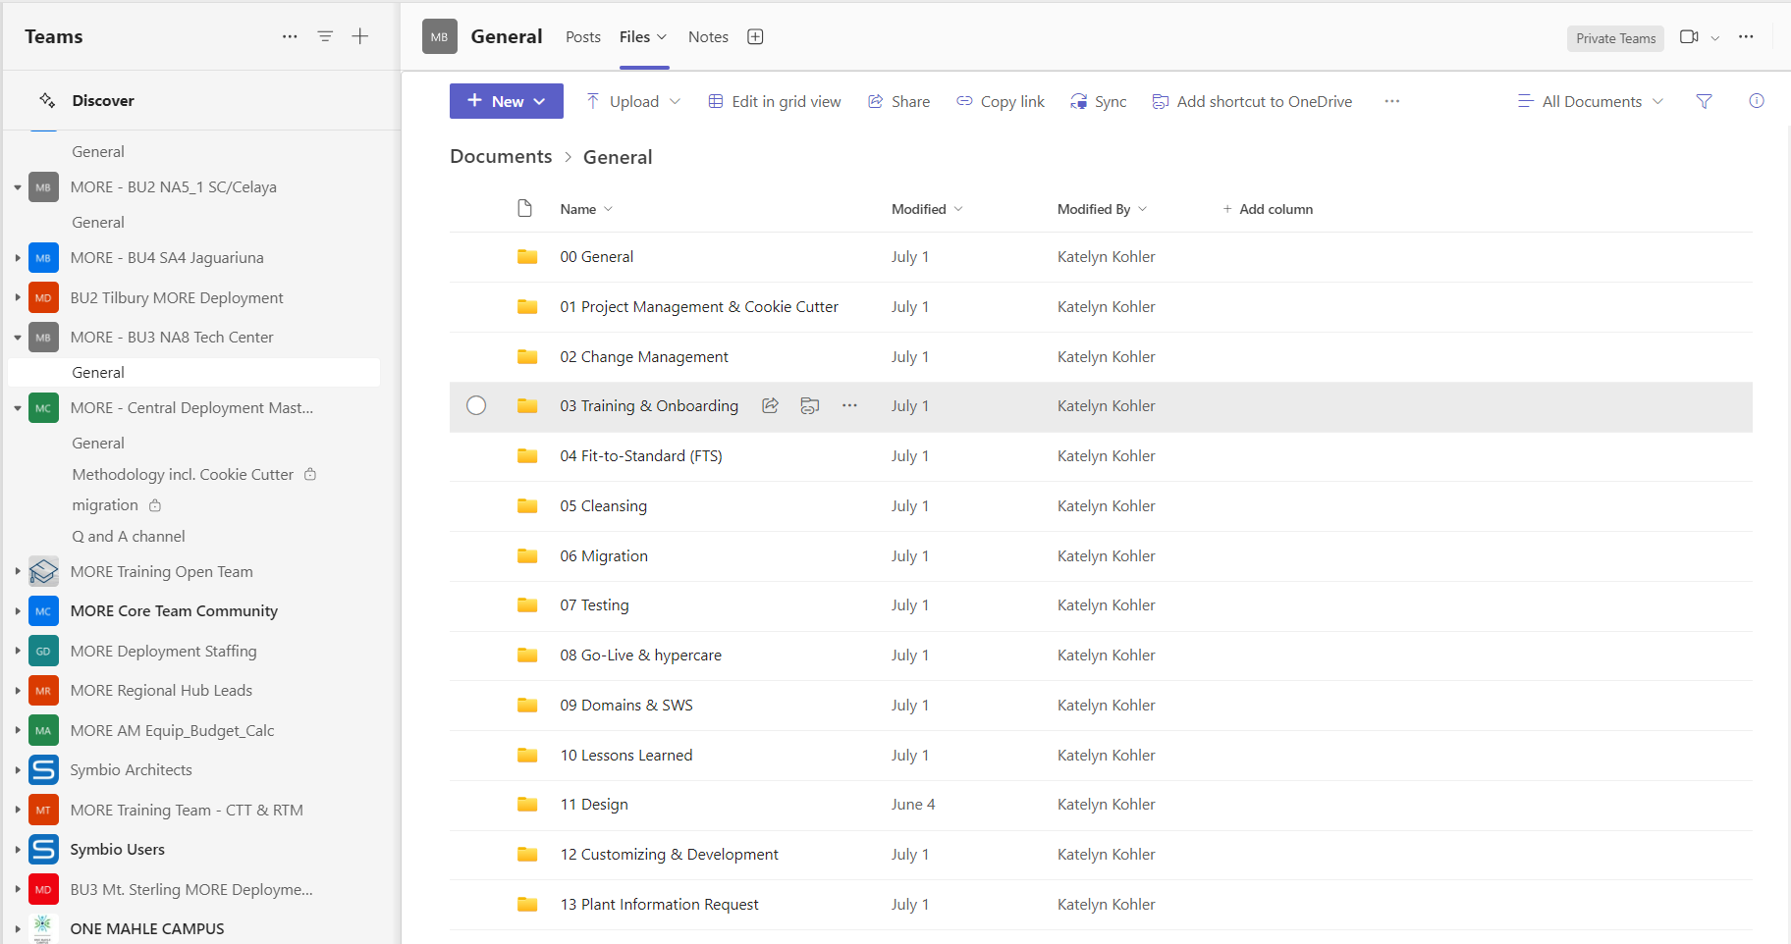
How to find the most useful links and documents
Deployment Planning
MORE - Central Deployment Master Documentation
Teams Channel
Deployment Teams Channel (BU1 MORE – Wave 1)
General Deployments channel where you will find all the global templates, methodology etc.
"Wiki" tab where you can find direct links to the most useful documents.
LINK
BU1 MORE – Wave 1 MORE Deployment Team
LINK
Notes:
David

Slide 21
Data Migration
07

Slide 22
Change Management
07

Slide 23

All Change Management Activities are regularly updated and tracked in the local Cookie Cutter
MAHLE Engine Components USA NA4_3A/B, NA4_5
Early alignment with plant Management: initiation & follow-up
Share LL* of previous deployments
Collect first Lessons Learned after FtS (optional – in soecial circumstances)
Pre-Go-Live & Frozen Zone end-user communication
Post-Go-Live end-user communication
Early recruiting & onboarding of Local Change Manager
Conduct Sentiment Check 1 after fit-to-standard
Communicate handover decision
Role-specific on-boarding of Local Change Manager
Share Lessons Learned for I-Tests
Conduct Sentiment Check 4 after Integration Test 2
Conduct Change Maturity Assessment 3 after Integration Test 2 and include results in Q-Gate 5
Conduct Sentiment Check 3 (Final)
Support kick-off execute phase with Plant Management & Local Deployment Team
Conduct Sentiment Check 2 after Integration Test 1
Conduct Change Maturity Assessment 1 & include results Q-Gate 0
Lessons Learned Ultimate Workshop & Post-Work (optional – in special circumstances)
Distribution of eLearnings
Organize Certificates for regional and local team
Staffing of plant deployment team
Fit-to-Standard
Integration Test 0
Integration Test 1
Integration Test 2
Deployment Campaign
Hypercare
Inform
Involve
Engage
Execute
Improve*
0 Involve
1 Prepare
2 Initiate
3 Design
4 Realize
5 Deploy
6 Support
Q-Gate 0
Q-Gate 1
Q-Gate 2
TM0
Q-Gate 3
TM1
Q-Gate 4
TM2
Q-Gate 5
Go-Live Comms
Stakeholder Management & Analysis
Share Lessons Learned before TM0
Group Picture
Share & Collect Lessons Learned in one combined session
Communicate result of 2nd Go/No-Go decision
Go-Live Mail
Celebrate Go-Live
Send out Welcome Mail to Plant Management
Send out HR Info Package & inform local worker's council (if relevant)
Organize Go-Live dinner
*LL= Lessons Learned
Agree on Buy-in campaign with the Local Team (focus on intorducng MORE to local staff)
Conduct Change Maturity Assessment 2 after FtS and before IT1 & include results Q-Gate 3
Enhance buy-in campaign with focus on target groups, end users, and local staff
Communicate result of 1st Go/No-Go decision
Communicate result of 3rd Go/No-Go decision
Celebration check-in
Continuous Change Management on demand

Slide 24

Regional Change Management status update for
NA4_5 Russellville
Topic | Status description | Results & Comments | Status
Check Ups | Maturity Assessment → Done! Managers Survey → In Progress Sentiment Check → Planned for next week
Buy in Campaign & Communications | Early alignment with plant Management: initiation & follow-up → Done! MORE Notebook→ In Progress New T-shirt for BU1 Deployments → In Progress FTS Communication and Coordination → Done! M🌐RE Starts With Us → In Progress
Others | MORE (P4M) End User Survey – Your Voice Matters! → Done
  Upcoming Activities
🚨 Action Required: Photo & Video Consent Form for MORE Activities
On schedule
No issues or any special challenges
Schedule is at risk
Issues are currently being addressed
Schedule exceeded
Support/escalation required to fix issue
24

