Slide 1
THE INFLUENCE OF NATIONAL HEALTH INSURANCE SCHEME ON QUALITY OF HEALTHCARE IN THE WENCHI MUNICIPALITY
by
AGYEMANG ERIC
BSc. Actuarial science
FMS/0670/11
SUPERVISOR:MR. Anang Clottey Richard
(DEPARTMENT OF STATISTICS)

Slide 2
OUTLINE
Introduction
Problem statement
Research objectives
Significance of study
Methodology
Research results and discussion
Major findings
Conclusion
Recommendation

Slide 3
INTRODUCTION
Healthcare issues are of greater concern to every nation because her economic development is closely linked to the health status of its population. (Cracium et al., 2004).
About a hundred million (100,000,000) people become impoverished by paying for healthcare and about one hundred and fifty million (150,000,000) more face financial hardship from healthcare cost world wide. (WHO ,2005).
Ghana introduced a National Health Insurance Scheme (NHIS) as part of a major development policy framework-Ghana Poverty Reduction Strategy (GPRS) implemented in 2003 .

Slide 4
PROBLEM STATEMENT
Poor service delivery at health facilities in the municipality under the influence of the National Health Insurance Scheme is leading to lost of hope by the people in the Scheme and its objectives.
The people perceive the municipality is moving from an unaffordable ‘‘cash and carry’’ regime to another unaffordable health Insurance Scheme.

Slide 5
OBJECTIVES
To examine the socio-economic conditions that influence the enrollment and utilisation of the scheme by people in the municipality
To determine the difference in perception of the people who are insured and that of those not insured about the quality of healthcare they receive at various health facilities in the Municipality.

Slide 6
SIGNIFICANCE OF THE RESEARCH
The research is useful for highlighting some major contributions of the National Health Insurance Scheme to the people’s healthcare and the need to ensure its benefit to insured people .
The research highlights the various factors that influence people’s accessibility and utilisation of the scheme in different geographic settings and the kind of challenges they face in utilizing the scheme.
The research will contribute to strengthening the policies of the scheme, improving its services to increase its enrollment and the utilisation of the scheme by the people.

Slide 7
METHODOLOGY
Data collection: The study employed questionnaire, in-depth interview and direct observation to collect primary data from 330 people from the field.
Method of data collection. Four communities were selected using purposive sampling and simple random sampling method was used for collecting primary data from 330 people from the field.
Anderson Darling Normality test of the variable in the data: The hypothesis to be tested
H₀: The data follows a normal distribution.
H_{1:} The data does not follow a normal distribution at 5% level of significance.
Decision rule: Reject H₀ if p≤ α

Slide 8
METHODOLOGY cont’d
Binary logit model was used to show the relationship between demographic, institutional factors and people enrollment on the scheme.
Mann-Whitney U test was used to determine the difference in
perception of the people who are insured and that of those not
insured about the quality of healthcare they receive at the health
Centres.

Slide 9
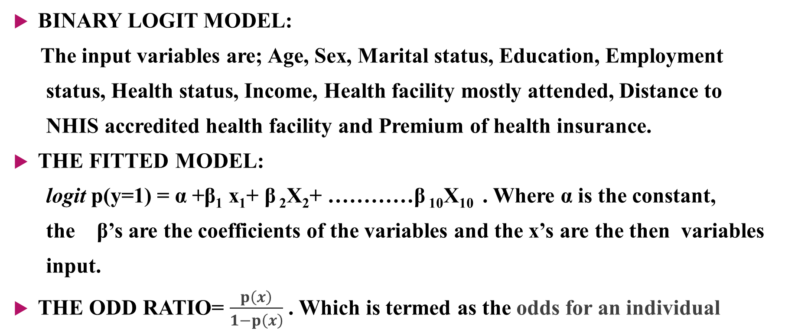
METHODOLOGY cont’d
BINARY LOGIT MODEL:
The input variables are; Age, Sex, Marital status, Education, Employment
status, Health status, Income, Health facility mostly attended, Distance to
NHIS accredited health facility and Premium of health insurance.
THE FITTED MODEL:
logit p(y=1) = α +β₁ x₁+ β ₂X₂+ …………β ₁₀X₁₀ . Where α is the constant,
the β’s are the coefficients of the variables and the x’s are the then variables
input.
THE ODD RATIO= $\frac{p\left(x\right)}{1−p\left(x\right)}$ . Which is termed as the odds for an individual

Slide 10
METHODOLOGY cont’d
_{THE ADEQUACY OF THE MODEL:}
The adequacy of the fitted model is tested by the overall goodness of-
fit test and examination of influential observation
_{THE HYPOTHESIS TO BE TESTED.}
H₀: The model fits the data
H₁: The model does not fit the data at 5% level of significance
Decision rule: Reject H₀ if p≤ α

Slide 11
METHODOLOGY cont’d
Mann-Whitney U test: Is a nonparametric test used to compare two independent samples.
Testing for difference in perception: the hypothesis to be tested:
H₀: There is no significant difference in the perception of the insured
and the uninsured people about the quality of healthcare they
receive at the health facilities.
H₁: There is a significant difference in the perception of the insured and
the uninsured people about the quality of healthcare they receive
at the health facilities at 5% significance level.
Decision rule: Reject H₀ if p≤ α.

Slide 12
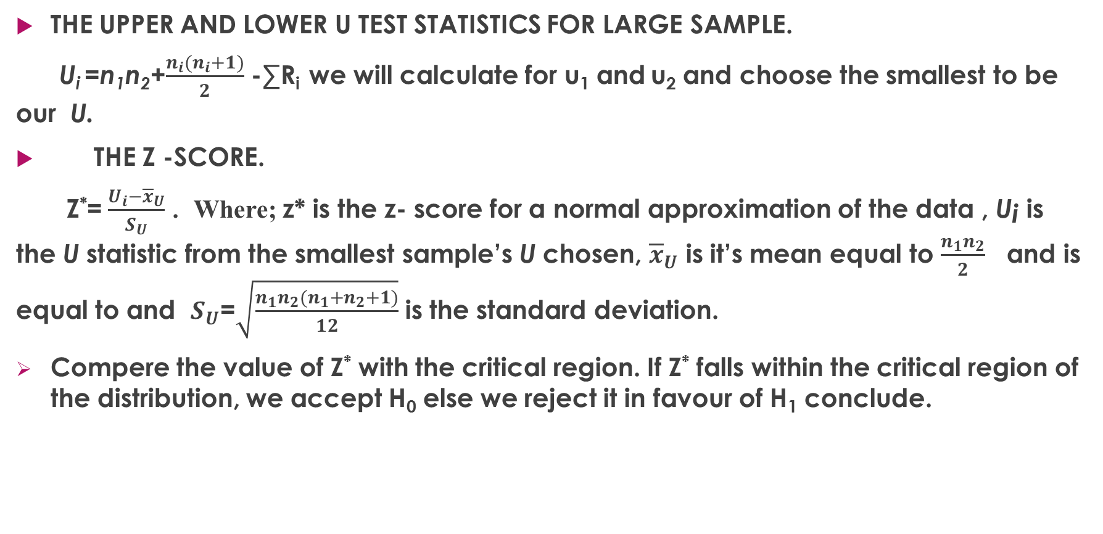
METHODOLOGY cont’d
THE UPPER AND LOWER U TEST STATISTICS FOR LARGE SAMPLE.
U_{i} =n₁n₂+$\frac{n_{i}(n_{i}+1)}{2}$ -∑R_{i} we will calculate for u₁ and u₂ and choose the smallest to be our U.
THE Z -SCORE.
Z*=$\frac{U_{i}−{\overline{x}}_{U}}{S_{U}}$ . Where; z* is the z- score for a normal approximation of the data , U¡ is the U statistic from the smallest sample’s U chosen, ${\overline{x}}_{U}$ is it’s mean equal to $\frac{n_{1}n_{2}}{2}$ and is equal to and $S_{U}$=$\sqrt{\frac{n_{1}n_{2}(n_{1}+n_{2}+1)}{12}}$ is the standard deviation.
Compere the value of Z* with the critical region. If Z* falls within the critical region of the distribution, we accept H₀ else we reject it in favour of H₁ conclude.

Slide 13
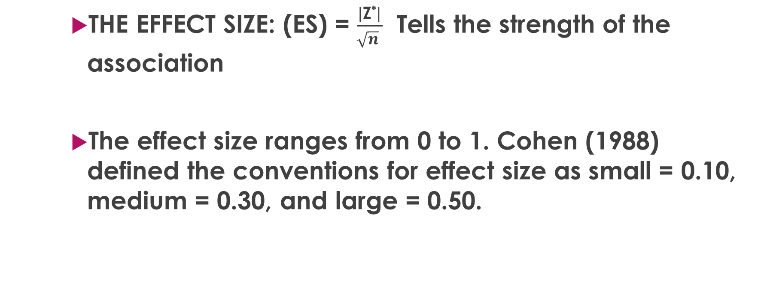
METHODOLOGY cont’d
THE EFFECT SIZE: (ES) = $\frac{\left|\text{Z}\text{∗}\right|}{\sqrt{n} }$ Tells the strength of the association
The effect size ranges from 0 to 1. Cohen (1988) defined the conventions for effect size as small = 0.10, medium = 0.30, and large = 0.50.

Slide 14
RESEARCH RESULTS and Discussions cont’d
Spss output for the binary logit model.
No. Observations: 330
Pseudo R² : 0.7282
-2Log likelihood :404.125
Hosmer and Lemeshow: 0.075
Variables |  | B | Std. Error | Odds | P-value | 95% C.I .for EXP(B)
 |  |  |  |  |  | Lower | Upper
 | Age | -0.571 | 0.410 | 0.763 | 0.657 | 0.231 | 2.520
 | sex | -0.755 | 0.305 | 0.470 | 0.013 | 0.258 | 0.855
 | Edu | -0.717 | 1.100 | 0.488 | 0.043 | 0.244 | 0.976
 | Es | -1.698 | 0.354 | 0.183 | 0.123 | 0.021 | 1.579
 | Ms | 0.978 | 0.323 | 2.659 | 0.002 | 1.411 | 5.012
 | Inc | -0.506 | 0.375 | 0.603 | 0.177 | 0.289 | 1.257
 | Prem(GHȻ) | 20.630 | 43131.45 | 907749609.8 | 0.996 | 0.000 | -
 | Hs | -0.773 | 0.310 | 2.167 | 0.010 | 1.200 | 3.912
 | DtH | -0.018 | 0.310 | 1.018 | 0.004 | 3.554 | 1.870
 | Hfm | -0.315 | 0.315 | 3.852 | 0.000 | 2.096 | 7.078
 | Constant | 1.197 | 1.126 | 3.311 | 0.288 | - | -

Slide 15
RESEARCH RESULTS and Discussions cont’d
Difference in People’s Perception about Quality of Healthcare in Health Facilities.
SPSS Output for The Mann Whitney U-Test.
PERSON’S ENROLLMENT ENROLLED NOT ENROLLED z Mann-Whitney U P-Value ES
Membership 228 102
Mean Rank 79.91 356.81
Sum of Ranks 18220.00 36395.00
Values -1.697 10289.00 0.029 0.093

Slide 16
RESEARCH RESULTS and DISCUSSION Cont’d
THE BINARY LOGIT MODEL
The fitted model is given as : Logit p(Him)=1.197 – 0.571Age – 0.755Sex – 0.717Edu – 1.698Es +
0.978Ms – 0.506Inc + 20.630Prem -0.773Hs– 0.018DtH – 0.315Hfm.
The R² value of 0.7282 indicates that 72.8 percent of variations have been explained .
The Mann –Whitney U test.
By implication, insured and uninsured did not have the same satisfaction with the quality of
healthcare they receive. The insured perceive to be receiving healthcare that is not quality
as compared to that receive by those not enrolled.
This outcome contradicts with a study done by Turkson (2009).

Slide 17
MAJOR FINDINGS and conclusion
The study revealed through in- in-depth interview that, the implementation of the scheme has generally contributed positively to the people’s healthcare in the municipality in areas such as;
significant reduction in general mortality since the inception of the scheme.
A general increase in out- patience and in-patience attendance in hospitals.
providing protection against the financial risks associated with illness.
socio-economic factors such as age, sex, educational status, employment status, income status, health status, distance to NHIS accredited health facility and type of health facility mostly attended, negatively influenced enrollment of the people on to the scheme.
On the other hand, marital status highly significant at 1% and premium of the scheme not significant at 5% level influenced the people positively to be enrolled.

Slide 18
MAJOR FINDINGS and conclusion cont’d
Those enrolled receiving healthcare that is not quality as compared to the quality of healthcare receive by those not enrolled. This may lead to lost of interest in the scheme if quality of healthcare is not improved for the insured.
Finally, for the overall results, almost all the variables that pertained to the use of health facilities impacted negatively on the people’s continuous use of the NHIS. In other words people who used the services of the NHIS will not hesitate to stop using the scheme if they do not receive the services they expect from providers

Slide 19
RECOMMENDATION
Decentralization of the National Health Insurance Scheme in the Municipality.
Regular Monitoring and Strengthening of the Collaboration between the Scheme and the Accredited Health Facilities.
Improvement in the Quality of Healthcare Services for Insured People.

Slide 20
ACKNOLEDGEMENT
THANK YOU

