Slide 1
IT 170 Scripting Languages and Automation
Course Overview

Slide 2
Outline
Course Overview
Course Objectives
Tentative Schedule
Course resources
Required work: labs, project, assignments
Grading

Slide 3
Course Prerequisite
IT 168 (High-level Programming Language 1)

Slide 4

Computer Programming
What is computer programming?
A process of how humans instruct computers to solve problems
Nature Language (NL) – e.g., “Hello, World!”
Machine language (ML) – e.g.,
Programming Language (PL) is between NL and ML
The goal of programming is to solve problems E.g., find the avg of 1, 3, 5, 7
Humans: 1. add up all digits; 2. divide the sum by the total number of digits
(algorithm in informal NL called pseudocode)
PL helps human write down their solutions (algorithms)
Once converting PL to ML, computers can work for us!
Notes:
Computer network
http://en.wikipedia.org/wiki/Computer_network

Slide 5
Course Objectives
Introduction to computer programming in Python emphasizing algorithms for scientific applications and data analysis:
Demonstrate proficiency with general Python programming knowledge.
Use loops and conditionals to make logical decisions in the program flow.
Select appropriate data structures to solve problems.
Read and write files in different formats.
Understand how to apply Object Oriented Programming
Utilize regular expressions to search for targeted patterns in files.

Slide 6
Course Resources
The following is the required textbook:
Automate the Boring Stuff with Python, 1st Ed. by Al Sweigart, No Starch Press https://automatetheboringstuff.com/
A Byte of Python: https://python.swaroopch.com/
My Jupyter notebook manuscripts
Other references:
Python Notes: http://thomas-cokelaer.info/tutorials/python/index.html
How to Think Like a Computer Scientist: https://openbookproject.net/thinkcs/python/english3e/

Slide 7
Course Grading Policy
For undergraduate:
Midterm Exams (25%)
Quizzes (20%)
Programming Assignments (40%)
Final Exam/Course Project (15%)
Class Participation (Extra credit: 5%)
A 90% - 100%
B 80% - 89.99%
C 70% - 79.99%
D 60% - 69.99%
F 0% - 59.99%

Slide 8
Student Tasks
Readings: Reading assignments will be given on Reggienet. Students are expected to finish the readings in time. The related information from the readings will be reflected in Quizzes and Exams.
Exams: There are two midterm exams that must be taken in the classroom (or informed otherwise) during the specified time. No makeup exam.
Quizzes: There are about 10 quizzes and you have about 15-20 minutes (or as specified time) to finish each quiz. Each quiz will be open during a specific time window (typically open at Wednesday midnight and due on the following Sunday midnight), to assess the student's completion of the reading assignment and lectures. No makeup quiz.
Programming Assignments: Each programming assignment is designed to allow you practice different programming skills.
Final Exam/Course Project: The course project also serves as the final exam. It requires students comprehensively to apply what they will have learned to develop a Python application. The project should be independently designed and implemented by each student based upon given requirements.

Slide 9
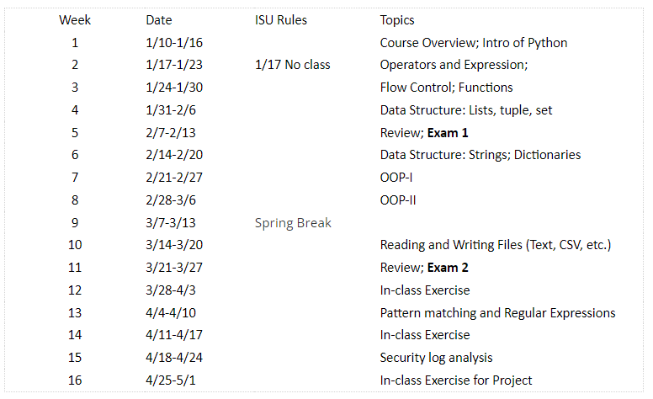
Tentative and Adjustable Schedule

Slide 10
Instructor
Yongning Tang, Professor
Office: OU 107
E-mail: ytang@ilstu.edu
Email is the best way to contact me for Q&A
When you send me an e-mail, please put “IT170” at the beginning of the subject line
Office hours:
See syllabus

Slide 11
Basic Class Rules
No talking, no cell phone, no pager during the class.
Questions (any time) are encouraged.
Print and bring the lecture notes to the class as you need

Slide 12
Ethical Conduct, Academic Integrity and Plagiarism
Illinois State University, its colleges and department expect students to maintain a high standard of ethical conduct in the completion of their studies. Plagiarism is not tolerated in this course. You can work with other students in understanding assignments and labs. The work you turn in should be your own, which means you should NOT copy the work of another and submit it for credit. A student will receive zero points for any assignment, quiz or test in which they have copied the work of another. Repeated violations will result in removal from the course. It’s your responsibility to read and understand ISU Code of Student Conduct, which is available in the following web site: http://deanofstudents.illinoisstate.edu/students/get-help/crr/code-of-conduct.shtml.
Feel free to ask your advisor or myself if you have any questions.

Slide 13
Tips for getting a good grade
The pace of this course is fast. You need to digest all learned materials timely
Come to all classes; take notes and ask questions
Make a lot of things (e.g., HW, quizzes, exams) much easier
Save you a lot of time after class
Finish all homework on time
Evaluate your understanding of the course materials
Pay attention on my review for exams
Every word is meaningful ☺
Start project earlier; put enough time
Don’t expect a last-minute or cut-paste work receive a good result.

