Slide 1
IT 170 Scripting Languages and Automation
Expressions, Data Types & Flow Control

Slide 2
Outline
Expressions
Data Types
Flow Control

Slide 3
Expressions in Python
An expression is a combination of operators and operands that is interpreted to produce some other value.
With different operators, you may create different expressions:
Constant expression: x = 2
Arithmetic expression: x = 2 * 3
Relational expression: x = 2 > 3
Logical expression: x = (2 > 3) or (7 > 5) (Result: x = True)
Bitwise expression: x = 12 >> 2 (Result: x = 3)

Slide 4
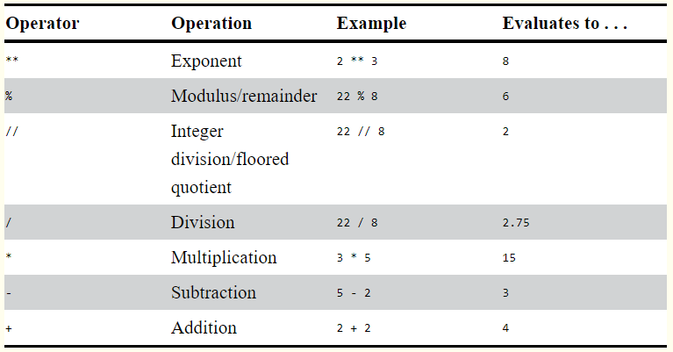
Arithmetic Operators

Slide 5
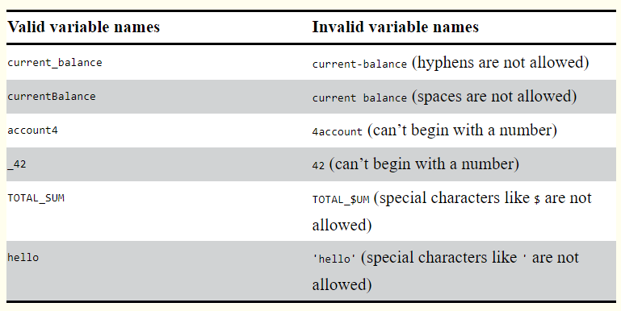
Variable Names
Three rules
It can be only one word with no spaces.
It can use only letters, numbers, and the underscore (_) character.
It can’t begin with a number.

Slide 6
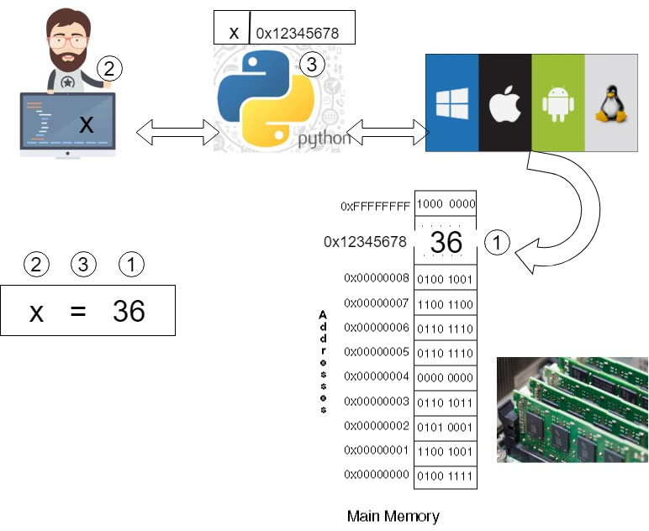
Storing Values in Variables
x = 36

Slide 7
Three Steps behind an assignment statement: x = 36
Step 1: The programmer writes the instruction "x=36" and gives it to the Python; the Python can understand the intend of the programmer, and then instruct the OS find a block of space in its managed memory space, create an Integer 36 (It is essentially an int object, which we will discuss later). In this case, the OS returns the memory address 0x12345678 to the Python.
Step 2: The programmer prepares a label (i.e., a variable) x in order to refer to the value 36 later.
Step 3: The Python attaches the label x to the memory storage block, which is represented by its address 0x12345678. Please note: the same label can be used later for a different storage box with different information.

Slide 8
Scalar Types
Built-in data types with “single value”
int: 123 arbitrarily large integers
float: 1.23 double-precision (64-bit) value
string: ‘one str’ or “another str”
‘’’For multiline strings with line breaks, use
triple quotes’’’
Boolean: True or False
None: the null value type. E.g., a = None

Slide 9
Type Casting
Built-in functions: str(); int(); float()
“type casting” should follow some common sense:
int(“123”) is fine
int(“abc”) syntaxError

Slide 10
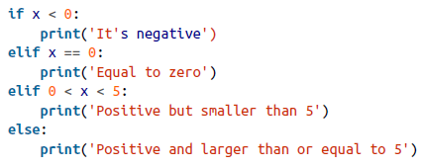
Control Flow
if, elif, else
“if” checks a condition that returns a Boolean value (True or False)
Flexible use
if …
if … else …
or:

Slide 11
Ternary expressions
A ternary expression in Python allows you to combine an if-else block that produces a value into a single line or expression. The syntax for this in Python is:
value = true-expr if condition else false-expr
E.g., Code: x = 5 'Non-negative' if x >= 0 else 'Negative’
Output: 'Non-negative'

Slide 12
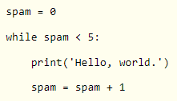
Control Flow
while loop
A while loop specifies a condition and a block of code that is to be executed until the condition evaluates to False or the loop is explicitly ended with break:
You can use continue in the code block. When the program execution reaches a continue statement, the program execution immediately jumps back to the start of the loop and reevaluates the loop’s condition

Slide 13
Control Flow
for loop
for loops are for iterating over a collection (like a list or tuple)
E.g., for item in [1, 3, 5]:
print(item)

Slide 14
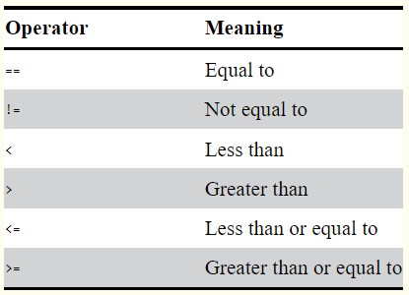
Conditions for Flow Control
A condition can be formed via Comparison Operators and Boolean Operators
Comparison Operators
x = 5
x > 5

Slide 15
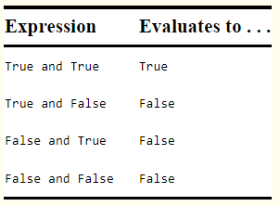
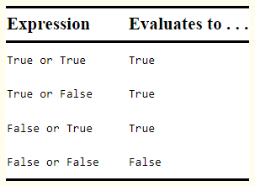
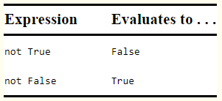
Conditions for Flow Control
Boolean Operators
AND Operators
OR Operators
NOT Operators
(x = 5) and (y > 0)
(x = 5) or (y > 0)
not (y > 0)

Slide 16
Do Nothing in Python: pass
pass is the “no-op” statement in Python. It can be used in blocks where no action is to be taken (or as a placeholder for code not yet implemented)

Slide 17
range() function
The range function returns an iterator that yields a sequence of evenly spaced integers
Function range() can be called with multiple arguments: range(start, stop, step)
range(10): start = 0, stop = 10, step = 1
range(5, 10): start = 5, stop = 10, step = 1
range(5, 10, 2): start = 5, stop = 10, step = 2
Code: for num in range(5):
print(num)
Output: 0, 1, 2, 3, 4

