Slide 1
IT 170 Scripting Languages and Automation
Data Structures

Slide 2
Outline
Some built-in Data Structures
Sequence and also iterable
Tuple
List
String (later slides)
Iterable but not sequence
Dictionary (or dict)
Set

Slide 3
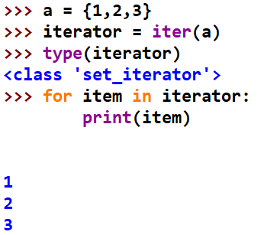
Python Iterables
An iterable is an object that includes zero or multiple items. An iterable can return its items one at a time.
We can use “for” loop to iterate over an iterable
Iterator: the agent that performs the iteration
Use iter() to get an iterator from an iterable

Slide 4
Python Sequences
A sequence is a positionally ordered (i.e., indexed) collection of items
Built-in sequence types: strings, lists, tuples, range objects byte sequences, byte arrays
Mutable (list) vs. immutable (tuple, str)
Homogeneous (str) or heterogeneous (tuple, list)

Slide 5
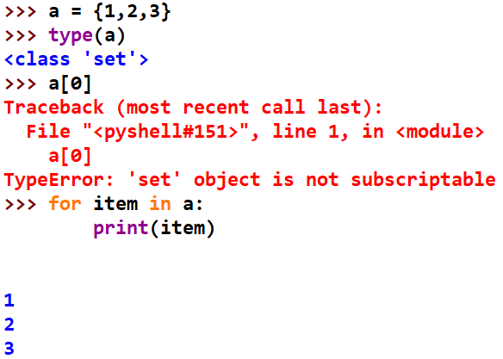
Iterables vs. Sequences
Sequence type vs. iterable type
An iterable is a collection of objects you can access one by one. Therefore, any sequence is iterable
An iterable may not be a sequence type. For example, a set is iterable but it’s not a sequence.
Both dict and set are not indexed, and thus not sequence

Slide 6
Tuple
A tuple is a fixed-length, immutable sequence of Python objects (also called items). The easiest way to create one is with a comma-separated sequence of values
Items can be in different types
Multidimensional
Immutable: immutable item cannot be changed. However, if item itself is mutable (e.g., a list), you still can modify it in-place
tup = 1, 2, 3 or tup = (1, 2, 3)
tup = (1, “2”, True)
tup = ((1, 2), 3)

Slide 7
Immutability
For example:
Code: tup = (1, “2”, [1, 2, 3])
tup[0] = 2
Output: syntaxError
Code: tup[2].append(4)
print(tup)
Output: (1, “2”, [1,2,3,4])

Slide 8
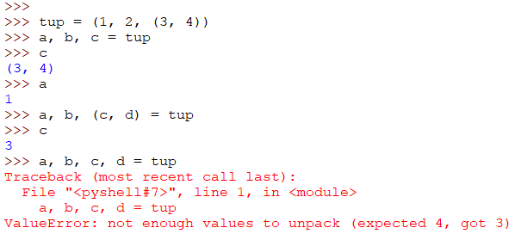
Unpacking Tuples/Lists
If you try to assign to a tuple-like expression of variables, Python will attempt to unpack the value on the righthand side of the equals sign:

Slide 9
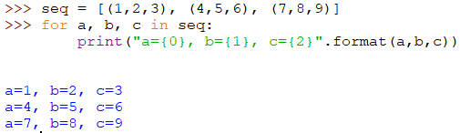
Unpacking with iteration
Note: positional string formatting is used above. In the string:
{}:a placeholder, replaced by the value in format()
The number in {}: index for the values in format()

Slide 10
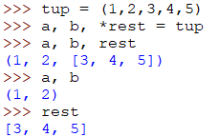
Unpacking with *varname
If only need a few items from a sequence (e.g., tuple, list), we can use *varname to receive the rest as a list from the sequence

Slide 11

Tuple Methods
count(): the number of occurrences of a value

Slide 12
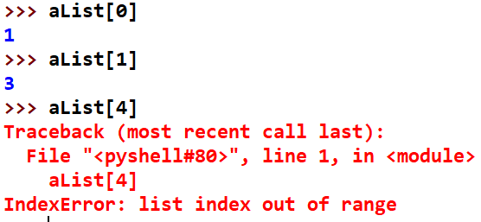
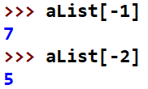
List
Lists are variable-length and their contents can be modified in-place.
Define a list using square brackets []
Access an item in a List with Index
Negative Index. -1 refers to the last index in a list; -2 refers to the second-to-last

Slide 13
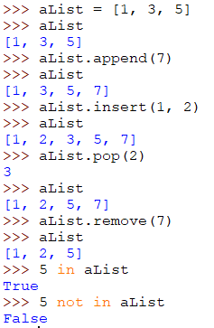

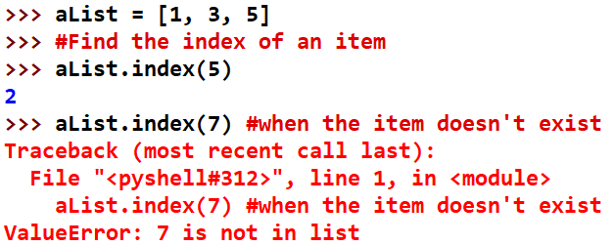
List Methods: append; insert; pop; remove; extend; index

Slide 14
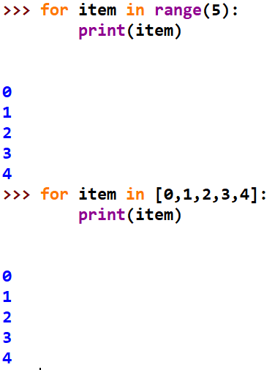
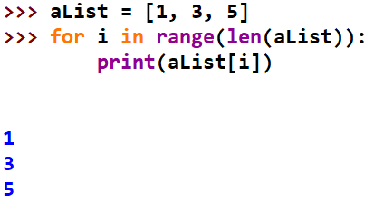
Traverse a List using for Loop
Note: range() returns a “range” object; but you can “for” loop over it as an iterable object. list(range(5)) returns a list

Slide 15

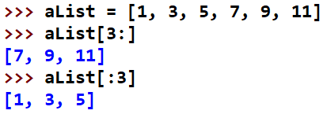
Slicing
You can select sections of most sequence types (e.g., Tuple, List) by using slice notation, which in its basic form consists of seqName[startIndex:stopIndex]
Either the startIndex or stopIndex can be omitted, in which case they default to the start of the sequence and the end of the sequence

Slide 16
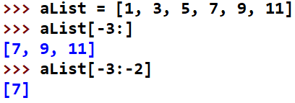
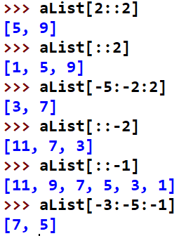

Slicing
You can use negative index in slicing
A positive or negative step can also be used after a second colon
You can assign new values to a slice

Slide 17
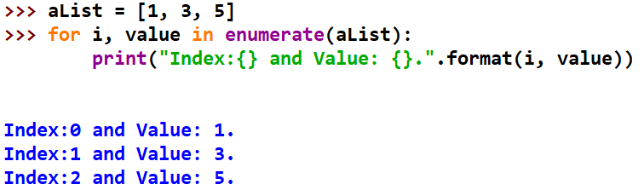
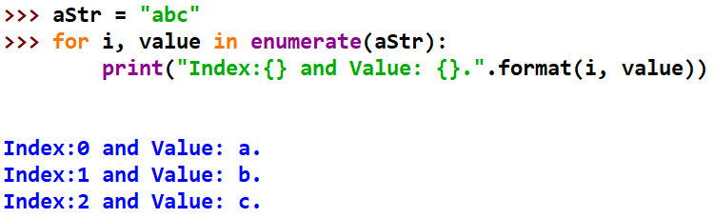
Built-in Sequence Function: enumerate()
Returns a sequence of tuples, each tuple contains (index, value) of each item in a sequence (e.g., List, Tuple, String)

Slide 18
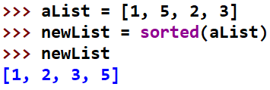
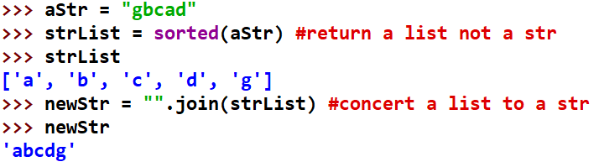
Built-in Sequence Function: sorted()
Returns a new sorted list from the elements of any sequence

Slide 19
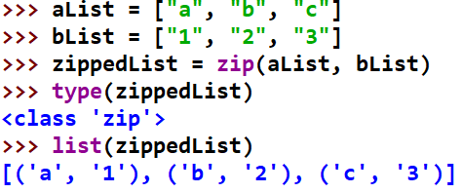
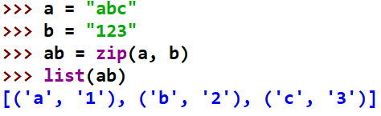
Built-in Sequence Function: zip()
zip “pairs” up the elements of multiple (2 or more) lists, tuples, or other sequences to create a list of tuples:

Slide 20
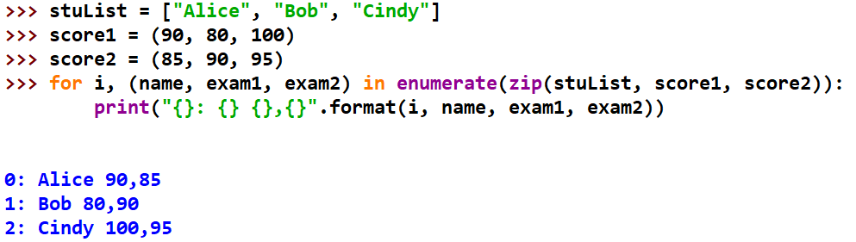
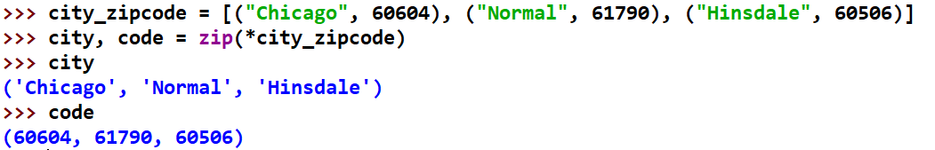
Common Uses of zip()
Simultaneously iterating over multiple sequences, possibly also combined with enumerate
“unzip” via zip() (a magical * syntax below)

Slide 21
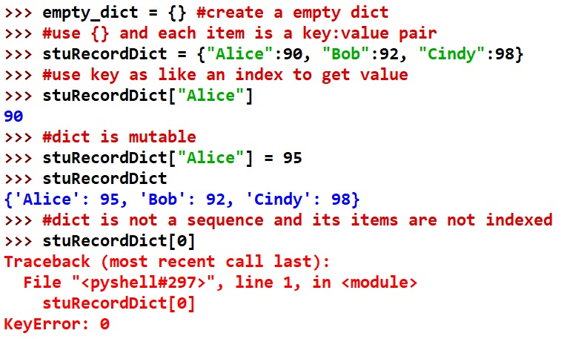
dict
A flexibly sized, mutable collection of key-value pairs, where key and value are Python objects.

Slide 22
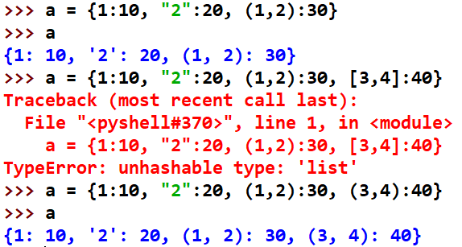
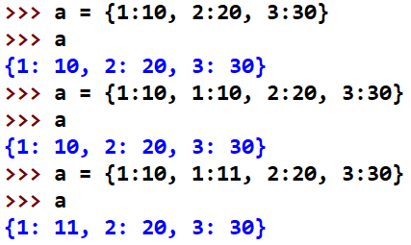
dict
Key in a dict must be immutable type
Dict does not allow duplications

Slide 23
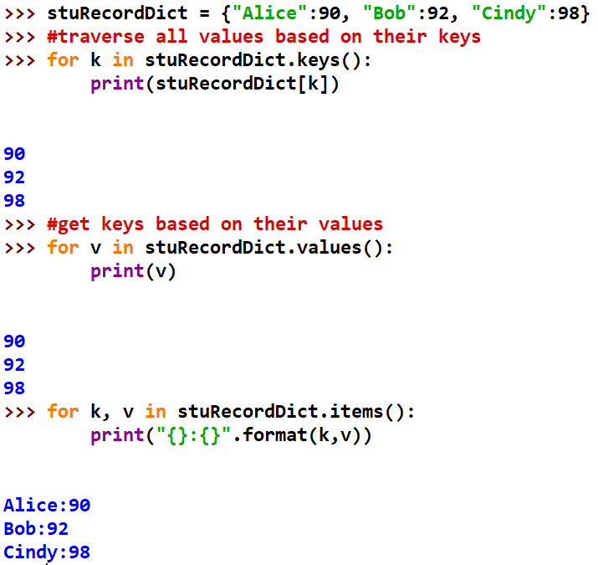
dict functions: keys(), values(), items()

Slide 24
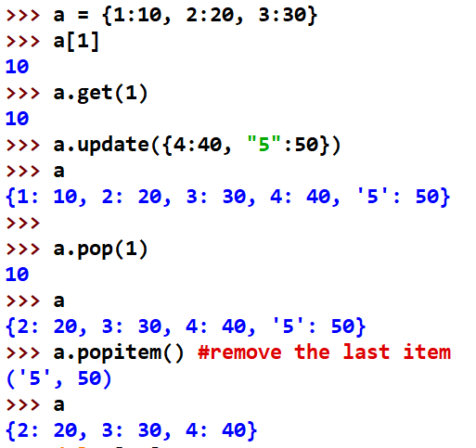

dict functions: get(); update(); pop(); popitem()

Slide 25
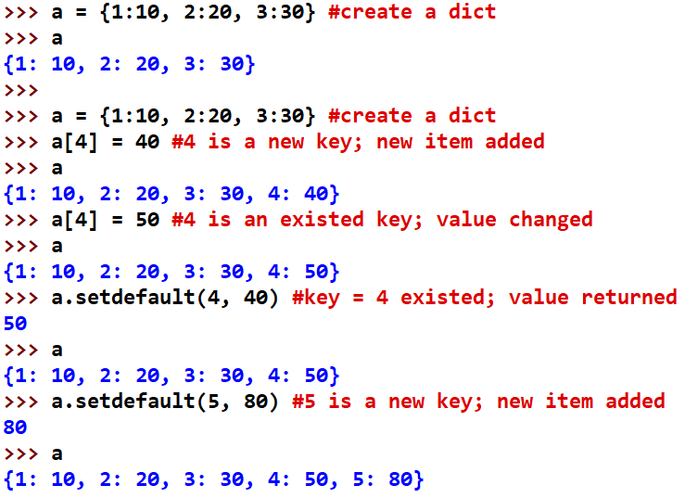
Dict: setdefault()
setdefault(k, v) adds (k, v) to a dict if the same key (i.e., k) doesn’t exist; otherwise, it returns the value of the key

Slide 26
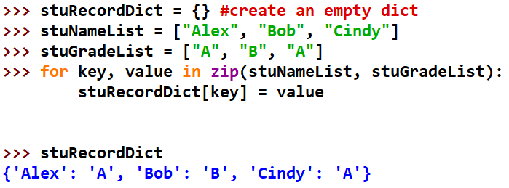
Creating dict from sequences

Slide 27
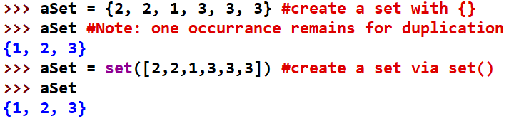

Set
A set is an unordered (not indexed, not a sequence) collection of unique elements. You can think of them like dicts, but keys only, no values (no duplication).
A set is unsorted

Slide 28
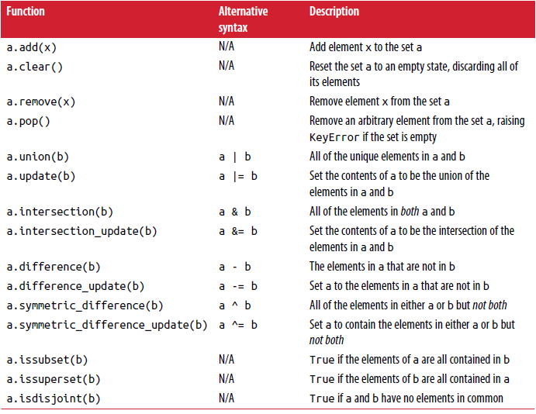
Python Set Operations

Slide 29
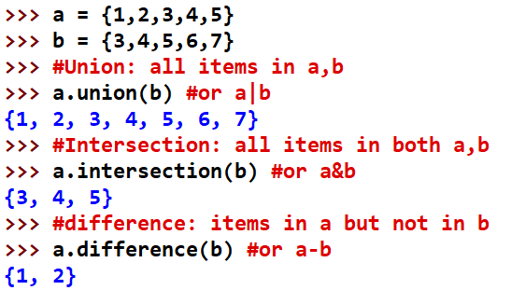
Set Operation Examples union(); intersection(); difference()

