Slide 1
IT 170 Scripting Languages and Automation
List Comprehension & String

Slide 2
Outline
List Comprehension
String

Slide 3
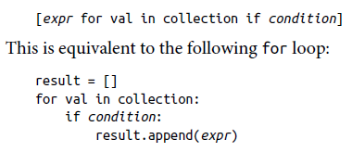
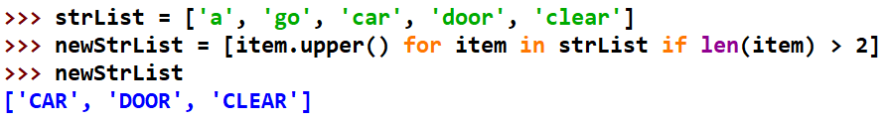
List comprehensions
To concisely form a new list by filtering the elements of a collection, transforming the elements passing the filter in one concise expression
The basic form of a list comprehension:

Slide 4
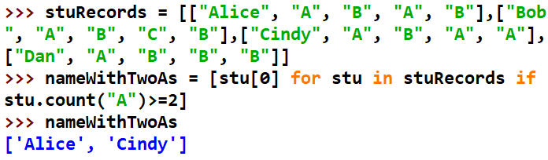
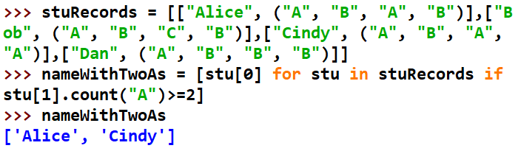
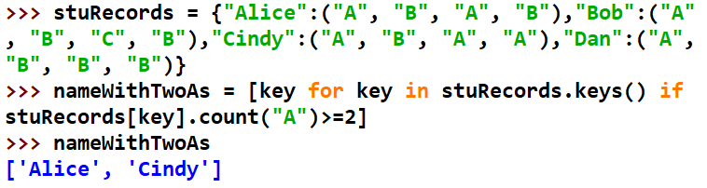
Nested List Comprehensions
Find students with at least two “A”s
Case 1
Case 2
Case 3

Slide 5
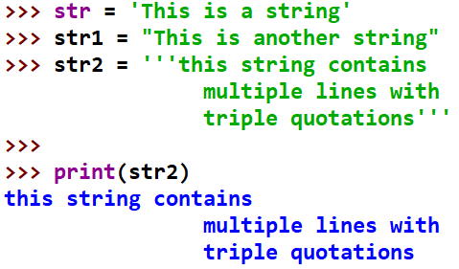
Strings
Strings are sequence of immutable characters and can be declared by either single, double, or triple quotes

Slide 6
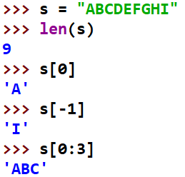
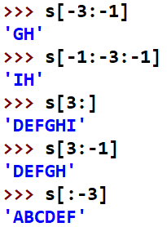
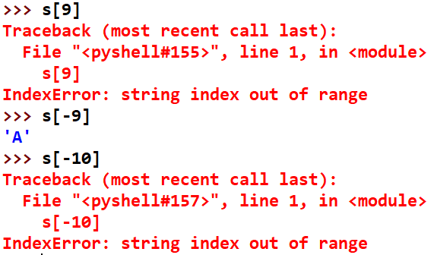
Strings – Indexing and Slicing
Strings are ordered sequences. We can perform indexing and slicing to grab a sub-section of the string. Indexing notation uses [ ] after string variable
String Character | A | B | C | D | E | F | G | H | I
Index | 0 | 1 | 2 | 4 | 5 | 6 | 7 | 8 | 9
Reverse index | -9 | -8 | -7 | -6 | -5 | -4 | -3 | -2 | -1

Slide 7
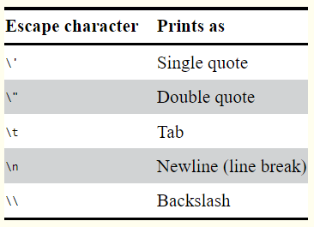
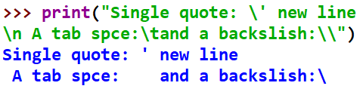
String – Escape Characters
An escape character lets you use characters that are otherwise impossible to put into a string
An escape character consists of a backslash (\) followed by the character you want to add to the string.

Slide 8
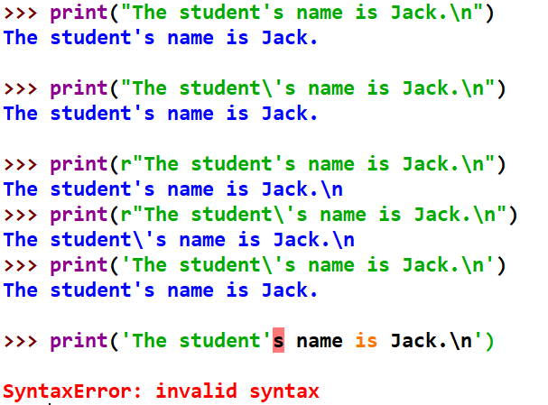
Raw String
You can place an r before the beginning quotation mark of a string to make it a raw string. A raw string completely ignores all escape characters and prints any backslash that appears in the string.

Slide 9
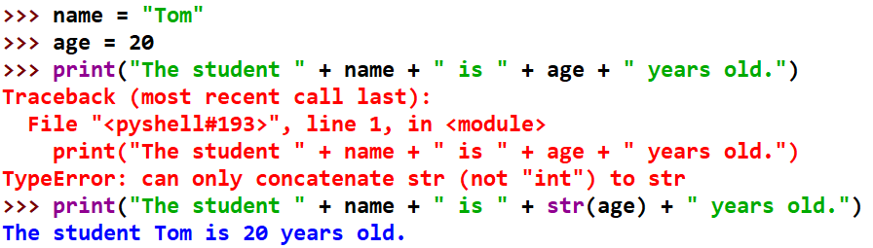
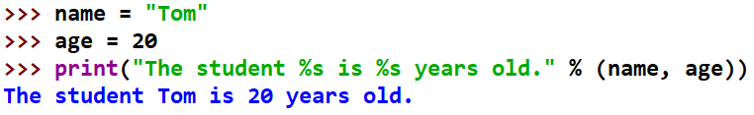
String Concatenation
using the + operator
using string interpolation:
The %s operator inside the string acts as a marker to be replaced by values following the string
No need to use str() to convert other types

Slide 10
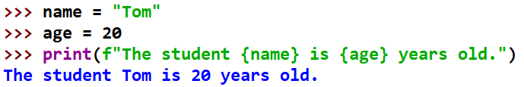
String Concatenation
using f-strings: similar to string interpolation; but use the prefix f and use {} instead of %s

Slide 11
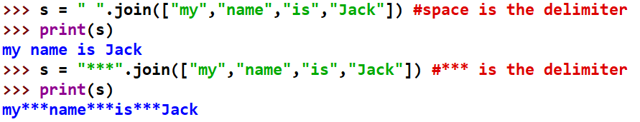
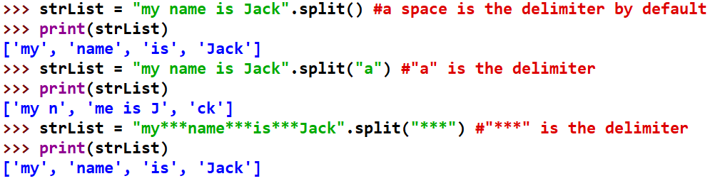
String Functions: join(); split()
The join() method is to combine a list of strings to a single string value with a delimiter.
The split() method is to separate a single string to a list of strings using a specified delimiter.

Slide 12
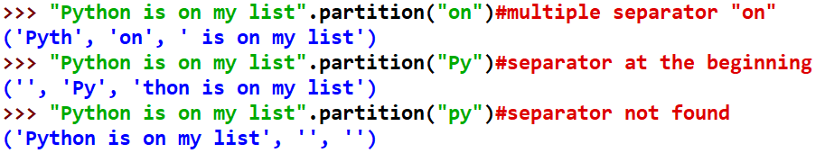
String Function: partition()
Given a separator, partition() splits a string and returns a tuple of three substrings for the “before,” “separator,” and “after” substrings
If the separator occurs multiple times, the method splits the string only on the first occurrence
If the separator not found, the original string returns as the first string in the tuple, and the other two strings will be empty

Slide 13
String Functions: isX()
To check if a string has certain property
isupper() returns True if all letters are uppercase
islower() returns True if all letters are lowercase
isalpha() Returns True if the string consists only of letters and isn’t blank
isalnum() Returns True if the string consists only of letters and numbers and is not blank
isdecimal() Returns True if the string consists only of numeric characters and is not blank
isspace() Returns True if the string consists only of spaces, tabs, and newlines and is not blank
istitle() Returns True if the string consists only of words that begin with an uppercase letter followed by only lowercase letters

Slide 14
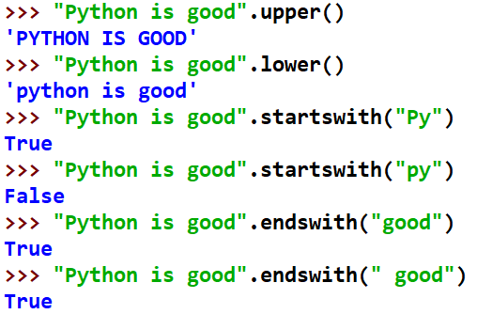
String Functions: upper(); lower(); startswith(); endswith()

Slide 15
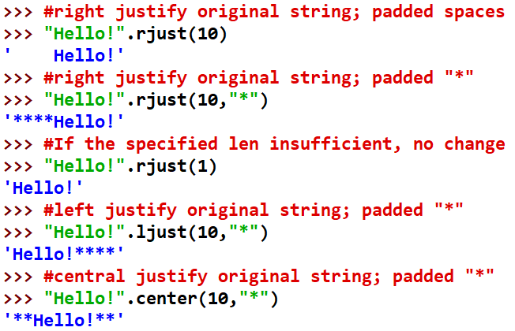
String Functions: rjust(); ljust(); center()

Slide 16
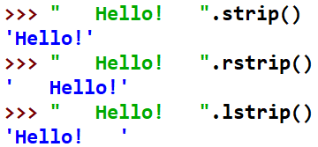
String Functions: strip(); rstrip(); lstrip()
strip() returns a new string without any whitespace characters (space, tab, and newline) at the beginning or end. lstrip() and rstrip() remove whitespace characters from the left and right ends

Slide 17
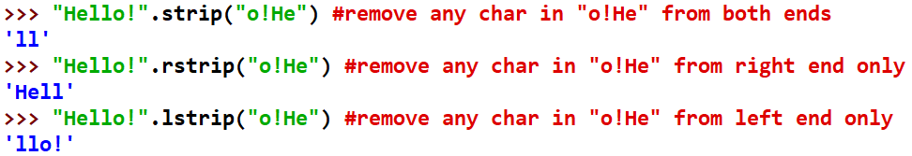

String Functions: strip(); rstrip(); lstrip()
strip(), lstrip(), rstrip() remove specific chars (given in any order) from both, left, right ends

Slide 18
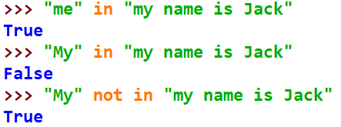
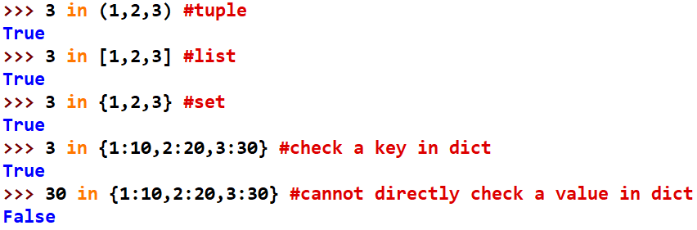
String Operators: in & not in
To check if a string is a substring of another
Both in & not in are also applicable to other collections, e.g., list, tuple, set, dict

