Slide 1
IT 170 Scripting Languages and Automation
Functions & Modules

Slide 2
Outline
Function
Positional and keyword arguments
VarArgs arguments
Local and global variables
Return values
Anonymous (Lambda) Functions
Modules

Slide 3
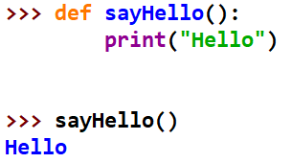
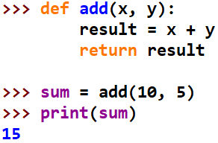
Functions
A function is a reusable piece of code that is only run when it is called. Functions can have optional inputs, and they can optionally return outputs
Functions are declared with the def keyword and optionally returned from with the return keyword. If no return statement, None will be returned

Slide 4
Positional Arguments
In the following example, there are two positional arguments, x and y, respectively. When you call this function, the first value you pass in will be assigned to x, and the second value will be assigned to y

Slide 5
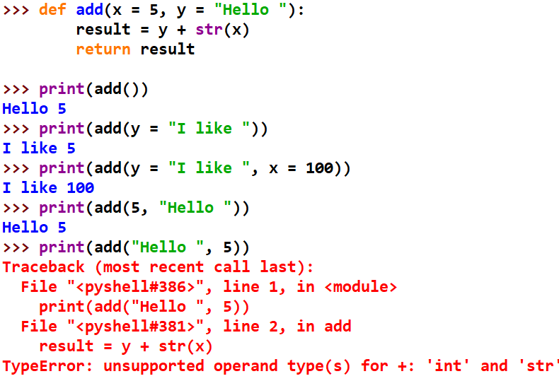
Keyword (aka named) Arguments
These arguments (inputs) can be given in any order and have a default value if the function is called without the keyword argument specified.

Slide 6
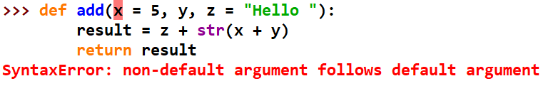
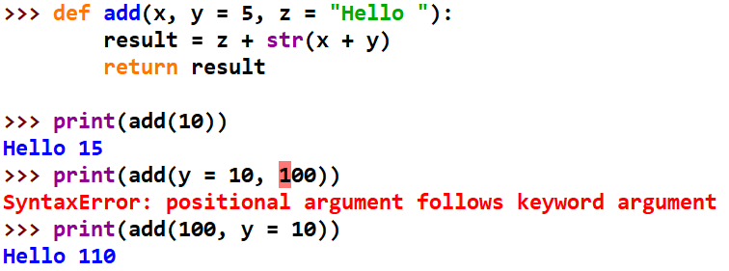
Positional & Keyword Arguments
If both types of arguments used together, positional arguments first

Slide 7
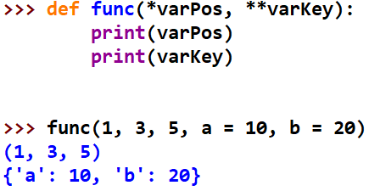
VarArgs Arguments
Sometimes we want to define a function that can take any number of positional and keyword parameters. We can use Variable number of Arguments, which can be done by using stars
def func(*varPos, **varKey): pass
When declare a starred parameter such as *varPos, then all the positional arguments from that point till the end are collected as a tuple called ‘varPos’.
When declare a double-starred parameter such as **varKey, then all the keyword arguments from that point till the end are collected as a dictionary called ‘varKey'.

Slide 8
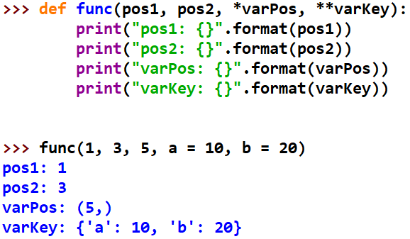
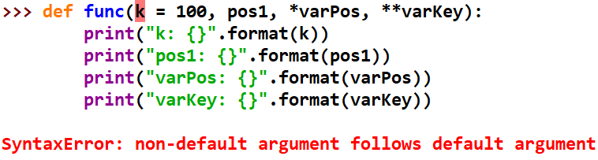
VarArgs mixed with positional arguments
Positional arguments cannot be declared after keyword arguments

Slide 9
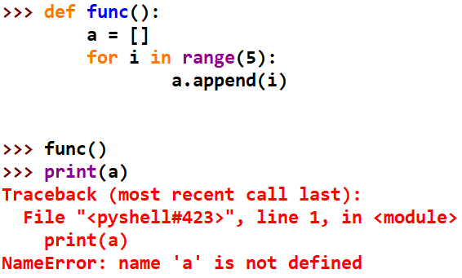
Variable Scope (aka Namespace)
Local namespace: if a variable defined inside a function, it has a local namespace (created after the function is called and disappeared after the function is finished)

Slide 10
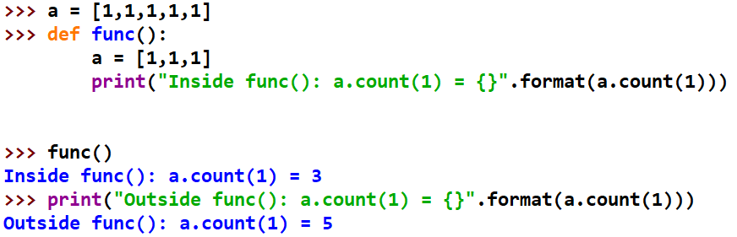
Global Variable (1)
All variables (e.g., a) defined outside of a function are global variables; no need to put “global” in front of the variables. But if you define a variable inside a function using the same name, the keyword “global” will specify if the variable is a global one or local one.
“global” not used inside a function:
There exists one global and one local variables, both are called “a”

Slide 11
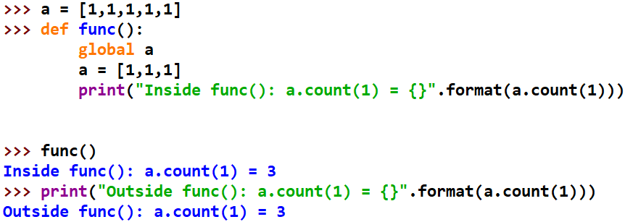
Global Variable (2)
Using “global” inside a function
There exists only one global variable called “a”

Slide 12
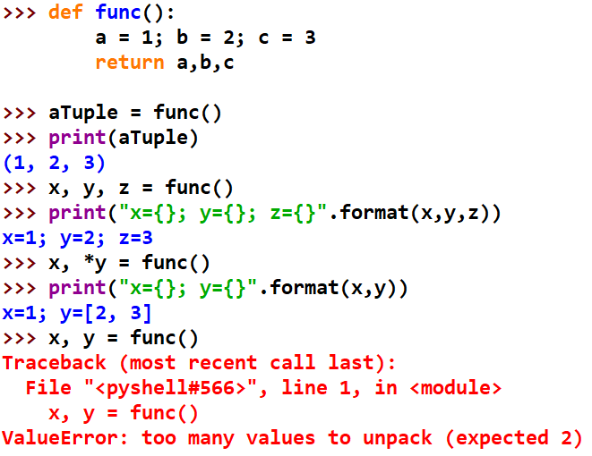
Returning Multiple Values
A function can return multiple values, which can be received as a tuple, or individual variables (unpacking tuple)

Slide 13
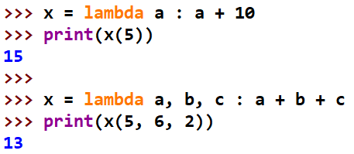
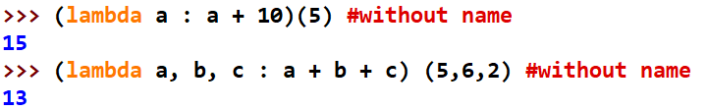
Anonymous (Lambda) Functions
Anonymous or lambda functions are functions consisting of a single statement, the result of which is the return value.
A lambda function can take any number of arguments, but can only have one expression.
lambda arguments : expression

Slide 14
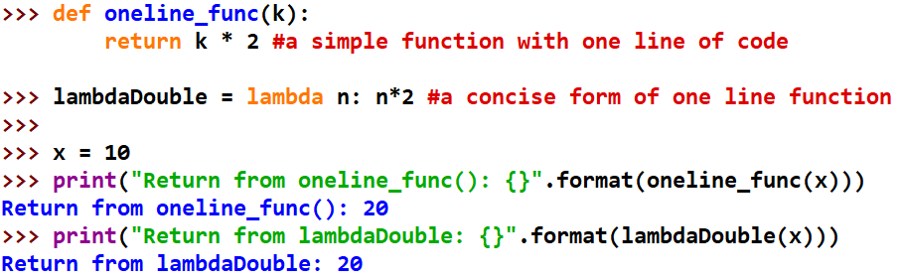
Anonymous (Lambda) Functions
A Without using Lambda: Here, both of func doubles a given number. But, while using def, we needed to define a function with a name and needed to pass a value to it. After execution, we also needed to return the result from where the function was called using the return keyword.
Using Lambda: Lambda definition does not include a “return” statement, it always contains an expression that is returned. We can also put a lambda definition anywhere a function is expected, and we don’t have to assign it to a variable at all. This is the simplicity of lambda functions.

Slide 15
Modules
A module is a Python file (e.g., module.py) that contains variables, functions, classes
A module can be from the Python language directly, e.g., Python standard library (math, sys, os); or from a third party (numPy, pandas)
To use the functions/classes in a module, the module needs to be imported first.
Python (PVM) searches for an imported module in the current directory and in several standard paths. If a module coming from a third party package installation, then its path will be recorded

Slide 16
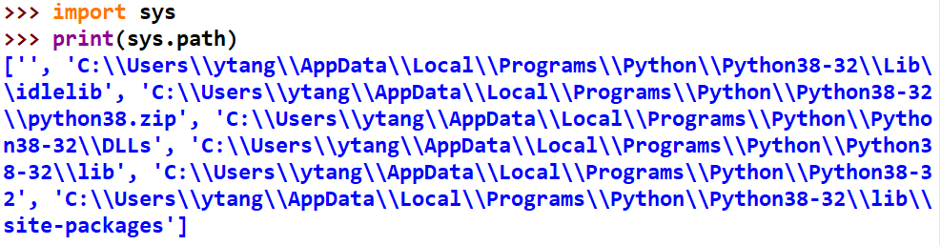
import
You can import a module with an import statement. E.g., import math, random, sys
You can also remove/unimport modules: del math
The searching paths for an imported module can be checked via sys.path, which contains a list of Python pathes (including current directory), and can be shown below:

Slide 17


from … import
You can import a specific function from a module using from … import. E.g., from random import randint
With from module import function, you don’t need to use module name when call a function

Slide 18
A module’s __name__
To import a module, the module should be placed either in the same directory as the program from which we import it, or in one of the directories listed in sys.path.
Every Python program is also a module
Each module has an attribute (__name__), which is the same as the module’s filename
The value of __name__ of a module if retrieved in the module itself is __main__
If a module (e.g., Module_B) imported by another one (e.g., Module_A), the value of __name__ of Module_B if retrieved in Module_A is Module_B
Example in next slide

Slide 19
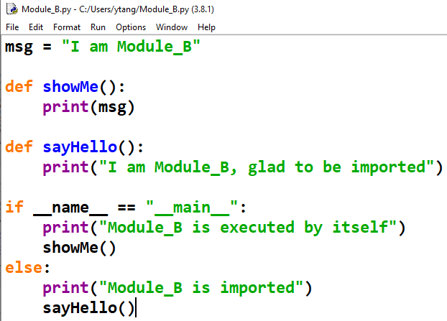
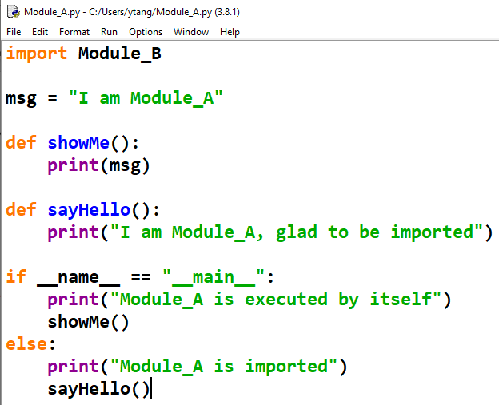
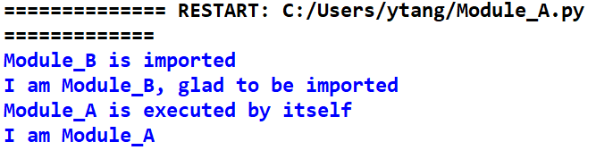
A module’s __name__
Module_B
Module_A
Executing Module_A

Slide 20
Packages
Packages are just folders of modules with a special __init__.py file that indicates to Python that this folder is special because it contains Python modules.
__init__.py can be as simple as an empty Python file;
or can contain some variables, import modules at a package level, etc.
Packages should be placed under a folder in sys.path

