Slide 1
IT 170 Scripting Languages and Automation
Files

Slide 2
Outline
Unicode and Encoding (ASCII, UTF)
File/Path Manipulations
File Input/Output

Slide 3
Unicode
Data needs to be first represented in Code Points
Unicode is a standard that defines the codepoints for 144,697 characters. Unicode works like a dictionary: a char ←→ a codepoint (a different numerical value)
Data, after represented in codepoints, needs to be encoded into a binary format so the computer can parse it
In 8-bit OS, 7-bit (extended to 8-bit later to support other language) ASCII is used to encode all English letters, numbers, punctuation signs
Variable-width encoding like UTF is more efficient, e.g., UTF-8; UTF-16; UTF-32
Unicode can be encoded in different schemes. Currently, Unicode uses UTF encoding scheme.
Notes:
ASCII: American Standard Code for Information Interchange
UTF: Unicode (or Universal Coded Character Set) Transformation Format

Slide 4
How UTF works?
All UTF encodings (UTF-8/16/32) work in roughly the same manner (An example in next slide):
choose a unit size, e.g., 8 bits in UTF-8, 16 bits in UTF-16, and 32 bits in UTF-32.
The standard then defines a few of these bits as flags: if they're set, then the next unit in a sequence of units is to be considered part of the same character. If they're not set, this unit represents one character fully.
Thus, the most common (English) characters only occupy one byte in UTF-8 (two in UTF-16, 4 in UTF-32), but other language characters (even using UTF-8) can still occupy six bytes or more (aka variable-width encoding).
Notes:
UTF: Unicode (or Universal Coded Character Set) Transformation Format

Slide 5

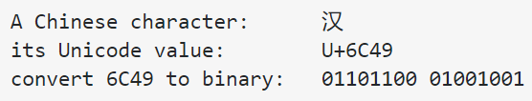
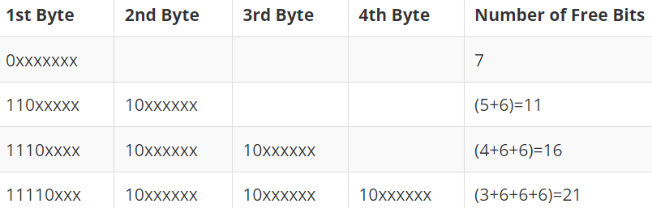
How UTF-8 encodes a Chinese char:
Given this Chinese (i.e., Han), we 1) find its Unicode value (0x6C49); and 2) convert its Unicode to binary (01101100 01001001)
Assume we use UTF-8. Clearly, we need to tell a computer to treat 2-byte Unicode as this Chinese character.
Based on UTF-8 encoding scheme table above, the UTF-8 code is: 11100110 10110001 10001001 (Codes in Red above represent a UTF-8 encoding scheme as highlighted in the table; Codes in blue is the embedded Unicode of this Chinese character)

Slide 6
File System in OS
A file system is a method and data structure that the operating system uses to control how data is stored and retrieved
Space management
Filenames
Directories
Metadata, that define the type, size, permissions, create/modify datetime, status of files/directories
File systems in different OS could be different
Unix-like OS:
Windows OS:

Slide 7


File Manipulations - Path
A file has two properties: filename and path
Folder & file names are case-sensitive on Linux; but not on Windows & MacOS
Path:
Root folder:
On Windows: C:\; D:\
On Linux/MacOS: /
Backslash on Windows vs Forward Slash on macOS/Linux You could add an if statement that checks sys.platform to decide what kind of slash to use. But this is bug-prone
If you pass it the string values of individual file and folder names in your path, Path() function in the pathlib module will return a string with a file path using the correct path separators

Slide 8


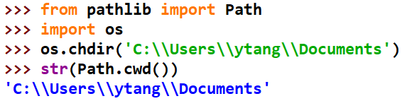

File Manipulations - Path
Use “/” to join path
Current Working Directory (CWD)
Change Directory
Home Directory (defined in a user’s profile)

Slide 9
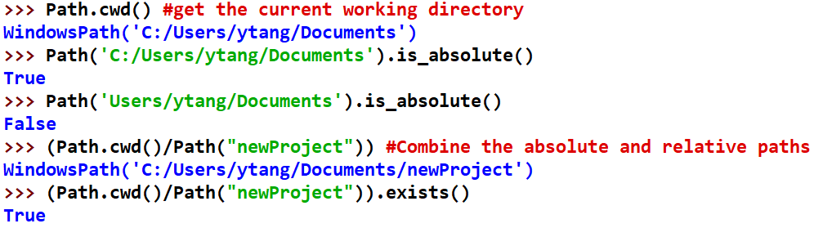
File Manipulations - Path
Absolute vs. Relative Paths
An absolute path, which always begins with the root folder
A relative path, which is relative to the program’s current working directory

Slide 10
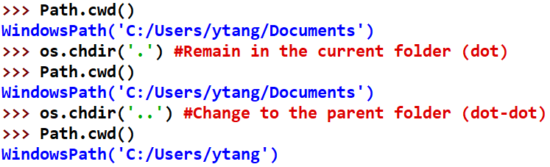
File Manipulations - Path
The dot (.) and dot-dot (..) folders
“dot” as a folder name is shorthand for “this directory
” Two periods (“dot-dot”) means “the parent folder.”
Creating a new folder

Slide 11


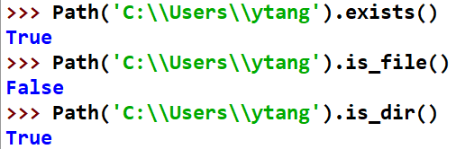
File/Folder Manipulations
Find a list of files and subfolders under a path
Get the size (bytes) of files under a path
Checking path validty

Slide 12
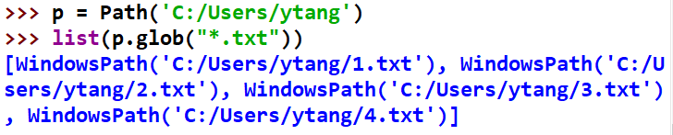
Search a Folder using Glob() Patterns
Path objects have a glob() method for listing the contents of a folder according to a glob pattern. Glob patterns are like a simplified form of regular expressions often used in command line commands (e.g., *.*, *.txt, ?a*.exe).

Slide 13
Types of Files
Plaintext Files vs. Binary Files
Plaintext files: include only text characters
Binary files: include text and various control characters (e.g., Word, Excel, PDF). Parsing control characters should be handled differently with different Python modules
For example: Python Third-Party Library pandas provides APIs to access csv/excel files

Slide 14
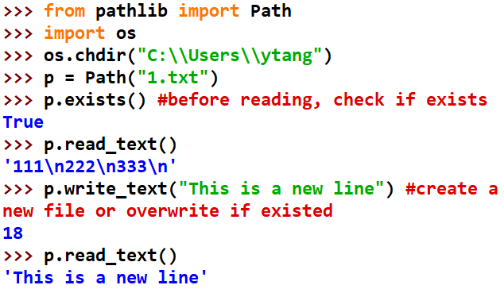
Path(filename).read_text() Path(filename).write_text() (basic but not often used methods)
Path(filename).read_text(): if the file doesn’t exist, errors
Path(filename).write_text(): create a new file; or overwrite the content of an existed file.

Slide 15
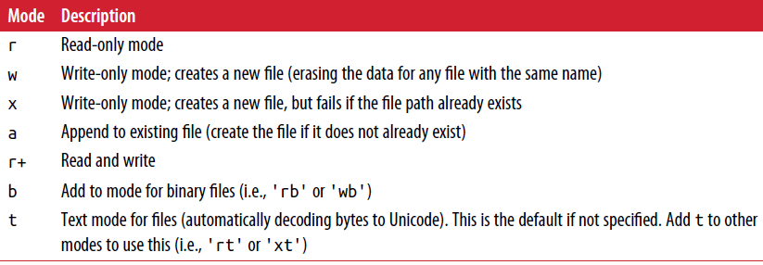
File I/O: open-read-close
open():
Two Parameters: 1) a Path object; or a string with (an absolute/relative path + filename); 2) mode (r, w, etc.)
Return a file object
read(): read the entire file as a string
readlines(): return a list: one item each line
close():
(Default)

Slide 16
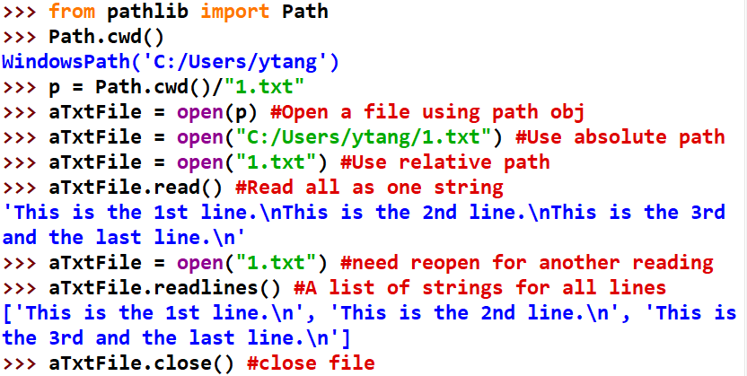
Open-Read-Close
Example:
Open(): open a file by default in “read” mode
Read(): read all as string
Readlines(): read each line as an item into a list; and Use a for loop to go line by line

Slide 17
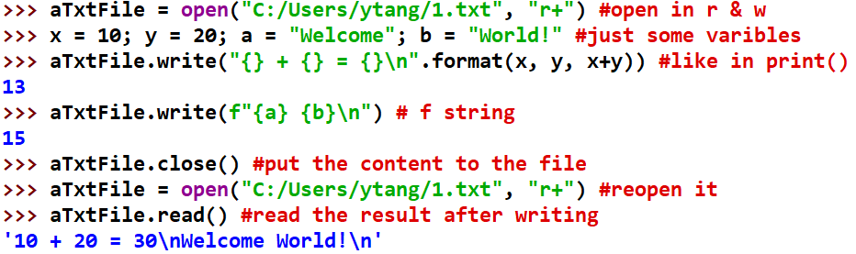
File I/O: open-write-close
To write to a file, you need to open the file in “r+” read and write; “w” (overwrite if existed); or “a” (append if existed)
You can write to a text file using the similar syntax as the function print()

Slide 18
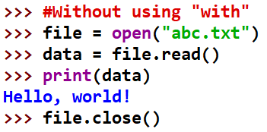
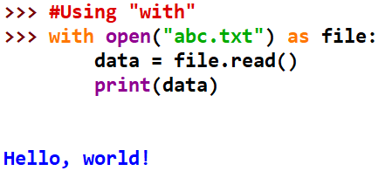
Using “with” statement to access files
Using “With” statement, you get better syntax and exceptions handling.
it will automatically close the file. The with statement provides a way for ensuring that a clean-up is always used.

