Slide 1
IT 170 Scripting Languages and Automation
Object-Oriented Programming

Slide 2
Outline
Objects & Classes
Define a class: methods & variables
Inheritance

Slide 3
Procedural Programming (PP) vs OOP
The focus of PP is to break down a programming task into a collection of variables, data structures, and subroutines or functions
OOP is to break down a programming task into objects that expose behavior (methods) and attributes (data, members or fields) using interfaces.
The most important distinction is:
PP uses procedures to operate on data structures
OOP bundles the two together. So an object, which is an instance of a class, operates on its own data structure.

Slide 4
Why OOP?
OOP is one of the most effective approaches to develop software
In OOP, you write classes that represent real-world things and situations, and you create objects based on these classes
When you write a class, you define the general behavior that a whole category of objects can have
When you create individual objects from the class, each object is automatically equipped with the general behavior. You can then give each object whatever unique traits you desire
You’ll be amazed how well real-world situations can be modeled with OOP

Slide 5
Classes vs. Objects
A class is a blueprint or a template for creating objects.
An object can carry data (instance variables) and perform actions (methods).
OOP uses objects and their interactions to achieve the programming purpose.

Slide 6
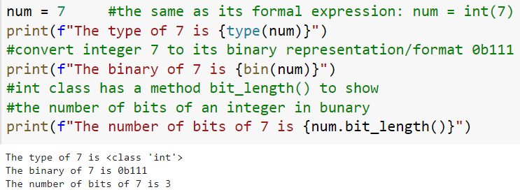
Everything is an object
Everything in Python, from numbers (e.g., int, float) to data structures (e.g., List, Tuple), is an object.
However, Python sometimes hides the appearance of objects by means of special syntax.

Slide 7



Define a class
Define a class by using the class keyword
We define a class called “Person” without any detail (“pass” is like a placeholder)
We create an object called “someone” based on the “Person” template
The prefix __main__ appears in front of '.Person' because we define and execute the code in the same Python module.
All classes are automatically inherited from a top class called “Object”
We can find the root (base) class via the Class variable __bases__

Slide 8
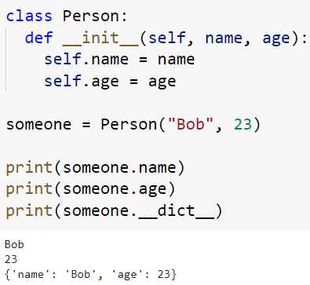
__init__() function (method) (to define instance/object variables)
Instance variables that are the attributes for each created object are defined under the constructor method/function called __init__()
However, you don’t have to include __init__ if no instance variables defined. If so, the __init__ function will be implicitly inherited from its parent class “Object”
For example:
__init__ is automatically called
__dict__ is a special attribute inherited from “Object”, showing all attributes of an object.

Slide 9
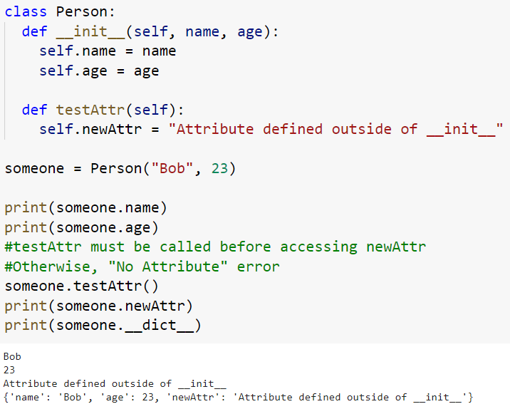
Creating object/instance variables outside of __init__
We can also define instances variables in other methods besides __init__; but we have to invoke those methods before accessing those defined instance variables

Slide 10
The self parameter for instance methods
The self variable represents the instance of the object itself.
Most OOP languages pass this as a hidden argument, however, Python does not, which means you need to declare it explicitly.
Every instance method needs to have the self parameter.
All instance methods should include self inside its parameter list as the first parameter.
You do not have to use the term, self, which means you can change its name, but it is a good behavior to follow the convention.

Slide 11
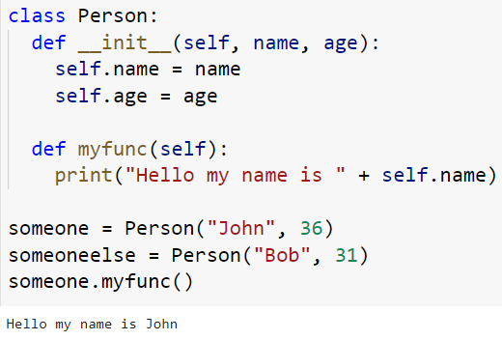
Instance/Object Methods
Methods defined in a class are similar to general Python function; but use “self” as the first input parameter

Slide 12
Class Variables
A class variable, of course, belongs to the class, which can be accessed by all instances of that class. There is only one copy of the class variable and when any one object makes a change to a class variable, that change will be seen by all the other instances.
We typically use the class name to access these class variables.
In contrast, object variables are owned by each individual object/instance of the class. In this case, each object has its own copy (not shared) of the field

Slide 13
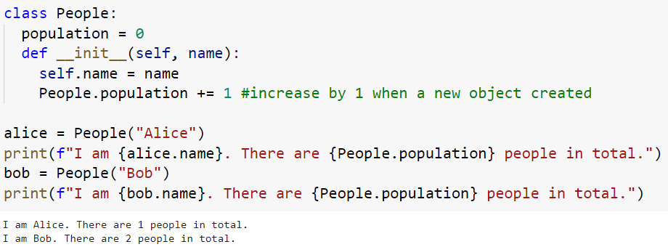
Example: Class Variables vs Object Variables

Slide 14
Class and Static Methods
We use decorator @classmethod to declare a class method, which uses cls as the first argument
just like self for instance method
A class method is bound to the class (not objects), which can access class variables but not object variables
Similarly, we use @staticmethod as a function decorator to declare a static method, which does not use cls (nor self) as its first argument.
A static method is also bound to the class and not the object of the class.
A static method can’t access or modify class variables.
It is present in a class only if it makes sense for the method to be present in class.

Slide 15
Class Methods vs Static Methods
Here is a quick summary of the differences between Class method and Static Method:
A class method takes cls as first parameter while a static method needs no specific parameters.
A class method can access or modify class variable while a static method can’t access or modify it.
In general, static methods know nothing about class state. They are utility type methods that take some parameters and work upon those parameters.On the other hand, class methods must have cls as its first parameter.
We use @classmethod decorator to create a class method and use @staticmethod decorator to create a static method.

Slide 16
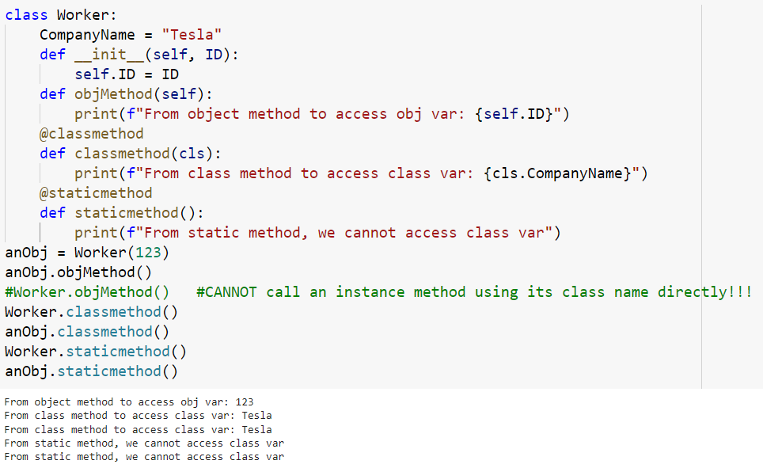
Example: Class Method vs Static Method

Slide 17


Inheritance between Superclass & Subclass
Inheritance allows you to make classes (subclasses) that can use the methods or the variables that have been defined in an existing class (superclasses).
Technically, any user defined class is inherited from the root class, which is the object class.
To express this explicitly, we can write the Student class as:
the two class definitions
are the same

Slide 18
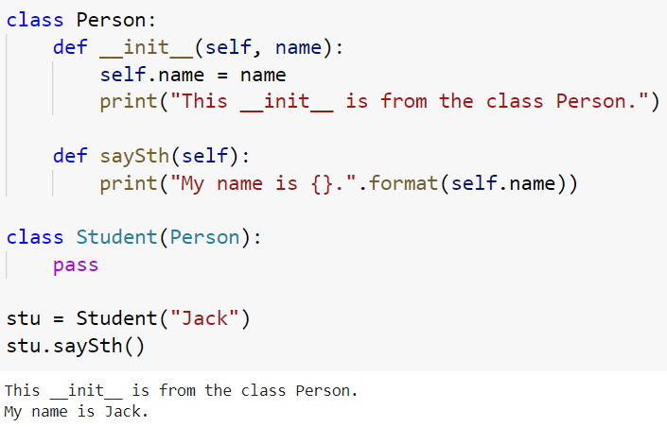
A subclass (Student) inherits from a superclass (Person)
Three actions when a subclass inherits from a superclass: Copy-Override-Append
Copy: Student copy all from Person

Slide 19
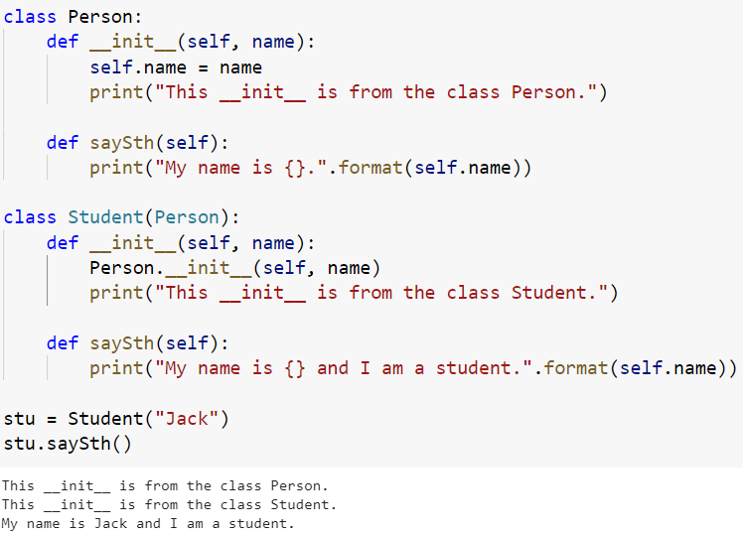
A subclass (Student) inherits from a superclass (Person)
Three actions when a subclass inherits from a superclass: Copy-Override-Append
Override: Student override the same methods from Person

Slide 20
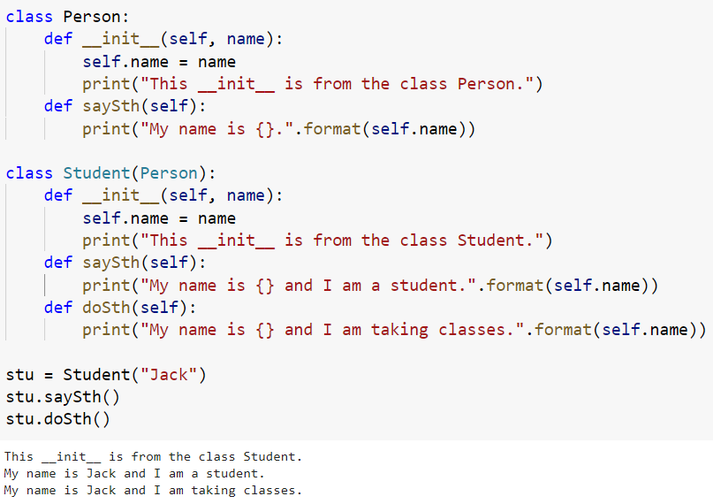
A subclass (Student) inherits from a superclass (Person)
Three actions when a subclass inherits from a superclass: Copy-Override-Append
Append: Student append with new methods

