Slide 1
IT 170 Scripting Languages and Automation
Regular Expression

Slide 2
Outline
Pattern Matching
Regular Expression

Slide 3
Information retrieval
In the big data era, we often need to search for or retrieve useful information everyday.
In general, Information retrieval (IR) is the activity of obtaining relevant information from a collection of (commonly massive) information resources.
Information retrieval is the science of searching for information in a document, searching for documents themselves, and also searching for the metadata that describes data, and for databases of texts (TextRetrieval), videos (VideoRetrieval), images (ImageRetrieval) or sounds (MusicRetrieval).

Slide 4
Find a Pattern
Searches can be based on full-text or other content-based indexing (e.g., search engine).
There are many ways to find useful information. The manual approach (e.g., searching a webpage by pressing CTRL-F and entering the targeted word) is often used but only applicable when the scope of searched information is small.
Sometimes, we need find exact information (e.g., name). More often, we need find information that follows certain rules or pattern (e.g., email address). Let's start with a simple example.

Slide 5
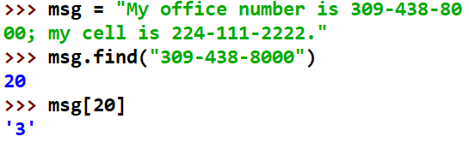
Search a string
Python string method find() determines if string str occurs in string, or in a substring of string if starting index beg and ending index end are given. Please note the function find() is case sensitive.
str.find(str, beg=0, end=len(string))
Parameters:
str − This specifies the string to be searched. beg − This is the starting index, by default its 0. end − This is the ending index, by default its equal to the length of the string
Return Value: Index if found and -1 otherwise.

Slide 6
Pattern Matching
You often need search for a type of information, other than exact and specific information.
For example, we need find any or all phone numbers, or IP addresses, or emails from a given text.
The challenge here is how we should describe what we want to search, which is so called "pattern".
Apparently, finding information matching a pattern from a given string is much more challenging than finding an exactly matched substring.

Slide 7
Direct Approach: findPhoneNumber
Problem: find a phone number from a string below
"My office number is 309-438-8000; my cell is 224-111-2222."
The basic idea is to divide the original problem of findPhoneNumber into multiple subproblems of verifying multiple conditions. As long as all conditions are satisfiable or true, then we can claim we have found a phone number.

Slide 8
findPhoneNumber
For a phone number: “224-111-2222”
It is a 12-character long string;
The first three characters are digits;
The fourth character is hyphen;
The next three characters are digits;
The eighth character is hyphen;
The last four characters are digits.
One drawback is we have to hard code all searching rules. Accordingly, if any change on the searching rules, we have to modify the rules/code.
For example, if a phone number can also be written as "309.438.8000" or "(309)-438-8000" or "(309)438-8000", we have to make a big change on the original code.
Do we have a better way to do this job? Fortunately, yes, we do have a better way to do this, which is to use Regular Expression.

Slide 9
Regular Expression
Regular expressions (called REs, or regexes, or regex patterns) are essentially a tiny, highly specialized programming language.
You may regard a regular expression as a special sequence of characters using a specialized syntax that define a search pattern to help you match or find such a pattern in other strings.
Regular expression is an independent language, which doesn't rely on any specific programming language.
Python makes it available through the re module.

Slide 10
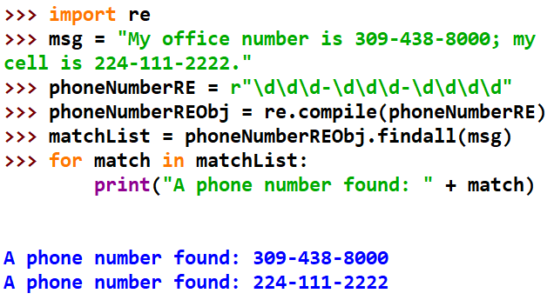
findPhoneNumber w/ Regular Expression

Slide 11
How to Use Regular Expression
Import the regex module with import re.
Define the targeted pattern using a raw string: phoneNumberRE = r"\d\d\d-\d\d\d-\d\d\d\d"
Create a Regex object with the re.compile() function: phoneNumberREObj = re.compile(phoneNumberRE)
Pass the string you want to search into one of the Regex object’s methods (e.g., findall, search, match): matchList = phoneNumberREObj.findall(msg)
Print the result. The returned data types are different from different methods of a Regex object. Thus, the corresponding result should be processed accordingly.

Slide 12
Common Methods in a RE Object
findall(): Perform a global search over a whole string. Returns a list containing all matches, or an empty list if no matches are found.
search(): Returns a Match object if there is a match anywhere in the string.
match(): Returns a Match object if there is a match found at the beginning of a string.

Slide 13
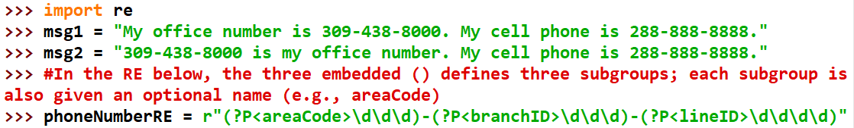
Match Object
A Regex object’s search() or match() method searches the string it is passed for any matches to the regex. The search() method will return None if the regex pattern is not found in the string. If the pattern is found, the search() method returns a Match object,
A Match Object has a group() (same as group(0)) return the actual matched text from the searched string. As the example shown below, we can further define multiple subgroups using "()" in a regular expression, and each subgroup can also have different names using "?P<subgroupName>". group(k) returns the value of the kth subgroup.

Slide 14
Recap: findall()
findall() method will return as a list of the strings of every match in the searched string.

Slide 15
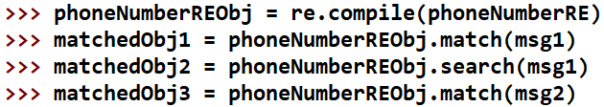
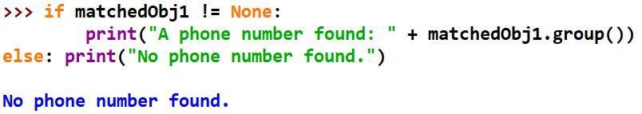
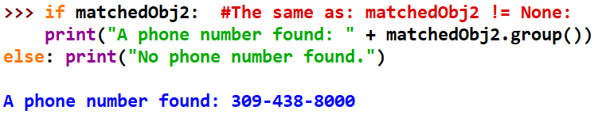
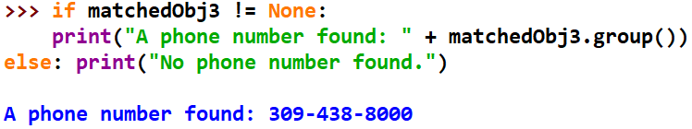
search() & match()

Slide 16
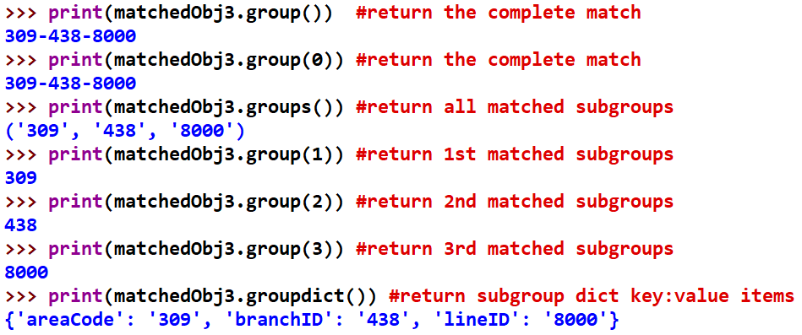
group() in Match Object

