Slide 1

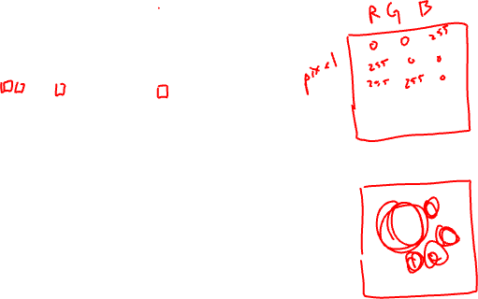

Slide 2
Genomic Data Visualization Final Presentations
2023

Slide 3
Final presentation teams
Todd, Xinyue -> Espeon
Gohta, Ryan -> Glaceon
Gwyn, Eric -> Jolteon
Wendy, Gary -> Flareon
Moneera, Kalen -> Vaporeon
Rafael, Rebeca -> Umbreon
Andrew, An -> Leafeon
Undergrads
Grads

Slide 4
Final presentation goals
Analyze dataset together
All team members should have the same dimensionality reduction and clustering results for example
Each team member responsible for interpreting one cell-type
Use data visualizations to convince the class that your cell-type interpretation is appropriate
Speculate on the colocalization patterns of your cell-types
Why do you think the cell-types you’ve identified are organized the way they are?
Include a discussion of next steps / future work if you were able to have more time to work with this data
20 minute presentation with 5 to 10 mins for questions

Slide 5
Data visualizations required (minimum)
QC (genes detected per cells, etc)
If you remove cells, why did you remove them?
If you normalize data, why did you do so?
Kmeans clustering
Justify choice of K
Reduced dimensional representation of cell clusters
Tissue representation of cell clusters
Summary of differentially expressed genes for cell-types of interest
Examples of differentially expressed genes for cell-types of interest on reduced dimensional and tissue embeddings

Slide 6
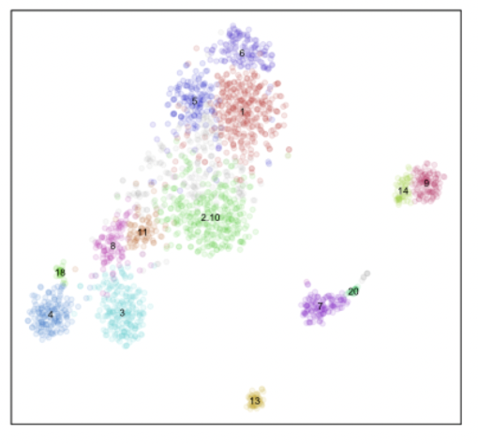
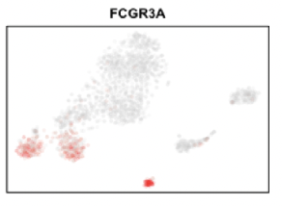

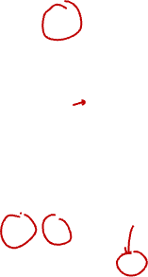
Feedback from HWs
Clusters
Consider: You and your team member identified cell clusters,
Your team member performed differential expression, and found FCGR3A (CD16A) as upregulated in cluster 3
They read about CD16A and learn that it is upregulated in monocytes (among other cell-types like macrophages and NK cells)
They create the following visualizations and claim that cluster 3 is monocytes
What do you think?

Slide 7
Final presentation datasets
Pick from the hat:
3 CODEX datasets of spleen
4 MERFISH datasets of brain
All different structures, different organizational patterns

Slide 8
bit.ly/GDV23_vaporeon
bit.ly/GDV23_jolteon
bit.ly/GDV23_flareon
bit.ly/GDV23_espeon
bit.ly/GDV23_umbreon
bit.ly/GDV23_leafeon
bit.ly/GDV23_glaceon

