Slide 1
Facial Expression
Recognition (FER)
Custom CNN vs. ResNet-18 on FER2013
Eric Amargant · Eya Ben Said · Marc Bosch Manzano
Group Beta · Aprenentatge Profund 2025-26 · Prof. Laia Tarrés Benet

Slide 2
Introduction
What is Facial Expression Recognition?
7 Emotion Classes
FER is the task of automatically classifying human emotions from facial images using deep learning. It has real-world applications in:
Human-computer interaction & affective computing
Mental health monitoring & therapy assistance
Automotive safety (driver drowsiness detection)
Market research & user experience studies
😠 Angry
🤢 Disgust
😨 Fear
😊 Happy
😐 Neutral
😢 Sad
Project Goal
😲 Surprise
Design, train, and compare two architectures — a Custom CNN baseline and a transfer-learned ResNet-18 — on the FER2013 benchmark, analysing performance across 7 emotion classes.

Slide 3
State of the Art
FER2013 Benchmark — Selected Methods
Method
Year
Test Acc.
Human-level benchmark
—
~65%
VGG-Face + SVM (Mollahosseini et al.)
2016
75.2%
ResMaskNet (Pham et al.)
2021
76.8%
EfficientNet-B4 + attention
2022
~73%
ResNet-18 (ours, fine-tuned)
2025
63.4%
Custom CNN (ours, scratch)
2025
57.1%
Our models are positioned as educational implementations — competitive for single-GPU fine-tuning on a noisy benchmark.

Slide 4
Methodology – Data Analysis
FER2013 Dataset
35,887
28,709
3,589
48×48
Total samples
Training images
Validation / Test
Image size (grayscale)
Class Distribution (training set)
Key Challenge
Happy
7215
Severe class imbalance:
Happy (7,215) vs Disgust (436)
— a 16.5× ratio.
Mitigation strategies:
• WeightedRandomSampler
• Inverse-frequency loss weights
• Label smoothing (ε = 0.1)
Neutral
4965
Sad
4830
Fear
4097
Angry
3995
Surprise
3171
Disgust
436

Slide 5
Methodology – Models & Optimization
Custom CNN (Baseline)
ResNet-18 (Transfer Learning)
4 Conv blocks: 32→64→128→256 channels
Pre-trained on ImageNet (IMAGENET1K_V1)
BatchNorm + ReLU + MaxPool per block
Stage 1: Frozen backbone, train head only
Global Average Pooling (1×1 output)
· Dropout(0.5) → FC(512 → 7)
Dropout (0.5) → FC(256→128) → FC(7)
· Adam head-only, lr=1e-3, T_max=10
~1.2M trainable parameters
Stage 2: Unfreeze layer3 + layer4
Optimizer: Adam, lr = 1e-3, wd = 1e-4
· Discriminative LR: 1e-4 (backbone)
Scheduler: CosineAnnealing (T_max = 60)
· 1e-3 (head), CosineAnnealing T_max=30
Early stopping (patience = 7)
· Early stopping (patience = 7)

Slide 6
Experiments
Experimental Setup & Ablations
Experiment 1 – Custom CNN Baseline
Experiment 4 – Test-Time Augmentation (TTA)
Trained from scratch for up to 60 epochs with early stopping. Adam + CosineAnnealing. Used as the lower-bound reference.
5 augmented views per image (random flips + affine shifts) averaged at inference. Provides a final accuracy boost without retraining.
Experiment 2 – ResNet-18 Stage 1 (Head Only)
Qualitative Analysis – Grad-CAM
Backbone frozen; only the custom FC head trained for 10 epochs. Validates that ImageNet features transfer to grayscale emotion data.
Gradient-weighted Class Activation Maps from layer4 verify the network attends to discriminative facial regions (teeth for Happy, brows for Angry).
Experiment 3 – ResNet-18 Stage 2 (Fine-Tune)
layer3 & layer4 unfrozen with discriminative LRs (1e-4 backbone / 1e-3 head). Allows adaptation of high-level features to facial cues.

Slide 7
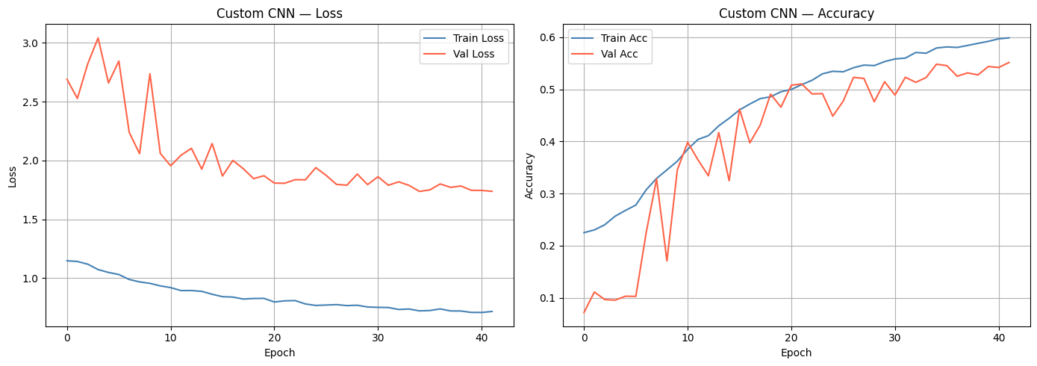
Results – Custom CNN Training Curves
Loss and accuracy over 42 epochs (early stopping triggered). Validation loss shows high volatility in early epochs before stabilising around epoch 15. A widening gap between train and val accuracy in later epochs indicates overfitting.
Figure 1: Custom CNN – Cross-entropy loss (left) and classification accuracy (right) on training and validation sets.

Slide 8
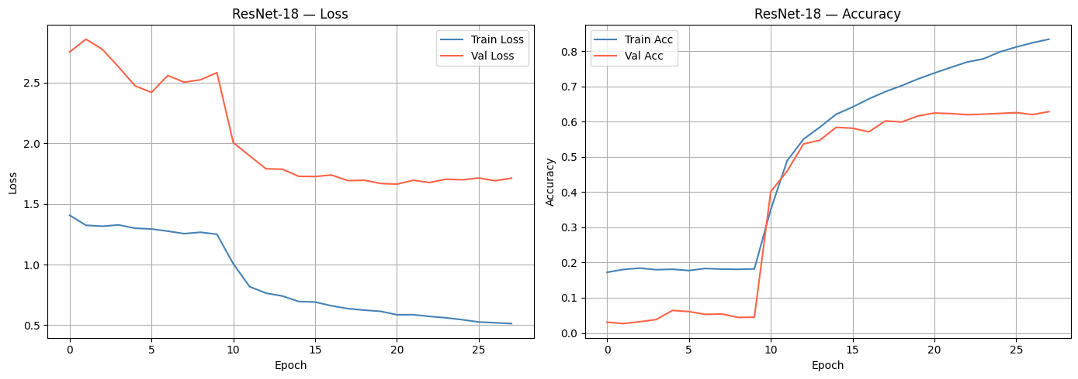
Results – ResNet-18 Training Curves
Stage 1 (epochs 1–10): frozen backbone — minimal improvement. Stage 2 (epochs 11–28): unfreezing layer3/layer4 causes a sharp accuracy jump. Early stopping triggers at epoch 28. Train/val gap confirms mild overfitting.
Figure 2: ResNet-18 – Cross-entropy loss (left) and accuracy (right). Dashed vertical line marks the transition from Stage 1 to Stage 2 fine-tuning.

Slide 9
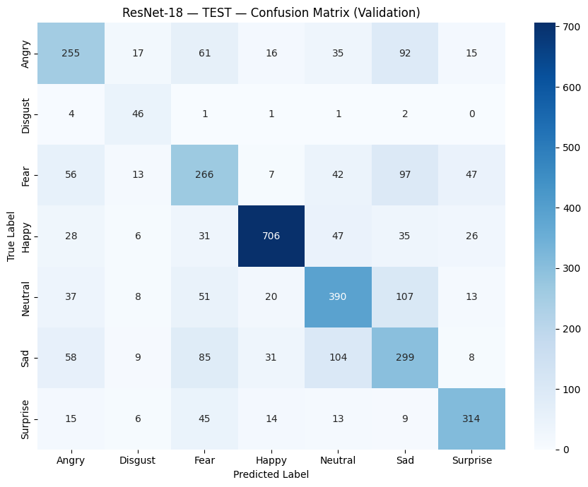
Results – Confusion Matrix (ResNet-18, Test Set)
Key observations
Happy & Surprise
Highest diagonal counts — visually distinct cues (teeth, raised eyebrows).
Sad ↔ Fear
97 Fear predicted as Sad; 85 Sad predicted as Fear — highest confusion pair.
Sad → Neutral
100 Sad faces predicted as Neutral — subtle expression overlap.
Disgust
Small class (100 test samples) but 62 correct — high recall thanks to loss weighting.
Angry
Confused with Sad (60) and Neutral (55) — shared furrowed-brow features.
Figure 3: Confusion matrix for ResNet-18 on the test set. Rows = true labels, columns = predicted labels.

Slide 10
Discussion
What worked well
Limitations & Challenges
Transfer Learning
Negative Emotion Confusion
ResNet-18 leveraged ImageNet features to jump 6 pp. over the from-scratch CNN.
Fear, Sad and Angry share visual features — confusion matrix shows systematic misclassification chains between these classes.
Staged Fine-Tuning
Overfitting
Two-stage strategy prevented catastrophic forgetting while enabling task-specific adaptation.
Train accuracy consistently pulled ahead of val in late epochs despite dropout, L2 regularisation, and label smoothing.
Imbalance Mitigation
Dataset Noise
Combining WeightedRandomSampler + loss weights significantly improved minority-class recall (especially Disgust).
FER2013 images are scraped from the web and inconsistently labelled — this creates a hard ceiling on achievable accuracy.
Grad-CAM
Architecture Scope
Heatmaps confirmed the model attends to genuine facial features, not background artifacts.
No attention-based or transformer-based models (ViT, DeiT) were explored — these currently dominate the SOTA.

Slide 11
Conclusions
Main Finding:
ResNet-18 fine-tuning (63.4%) substantially outperforms a from-scratch CNN (57.1%) on FER2013, approaching the human-level ceiling of ~65%.
Key Technique:
Discriminative LRs + staged unfreezing proved crucial — freezing the backbone first prevented overwriting general visual features too early.
Robustness:
Dual imbalance handling (sampler + loss weights + label smoothing) was essential to prevent collapse on minority classes like Disgust.
Interpretability:
Grad-CAM confirmed the model reasons about genuine facial structures, not spurious background correlations.
Future Work:
Vision Transformers (ViT, DeiT), larger datasets (AffectNet), and multi-modal fusion (face + body pose) could push well beyond 65%.

Slide 12
Thank You!
Questions?
Eric Amargant · Eya Ben Said · Marc Bosch Manzano
Group Beta · Aprenentatge Profund 2025-26 · Prof. Laia Tarrés Benet

Slide 13
References
[1] Goodfellow, I. et al. (2013). Challenges in Representation Learning: A Report on Three ML Contests. ICML Workshop.
[2] He, K. et al. (2016). Deep Residual Learning for Image Recognition. CVPR.
[3] Pham, L. et al. (2021). Facial Expression Recognition Using Residual Masking Network. ICPR.
[4] Mollahosseini, A. et al. (2016). Going Deeper in Facial Expression Recognition using Deep Neural Networks. IEEE WACV.
[5] Selvaraju, R. et al. (2017). Grad-CAM: Visual Explanations from Deep Networks via Gradient-based Localization. ICCV.
[6] PyTorch Documentation. torchvision.models.resnet18 (IMAGENET1K_V1 weights). https://pytorch.org/vision/stable/models.html
[7] Kaggle FER2013 Dataset. https://www.kaggle.com/datasets/deadskull7/fer2013
[8] pytorch-grad-cam library. https://github.com/jacobgil/pytorch-grad-cam

