Slide 1
Business Analytics Toolbox
BA775
Fall 2023
Lecture 04
Professor: Mohammad Soltanieh-ha

Slide 2

Previous class overview
Databases
BigQuery
MySQL (via Cloud SQL)
Basic SQL syntax

Slide 3
Topics covered
Teaming
Completing the Hands-on practice from last class
Interact with BQ using Vertex AI notebooks
Nested query statements
Interactive querying on large datasets

Slide 4

Teaming + Slack channel
Class list with teams info can be found here:
Cohort A
Cohort B

Slide 5
Create Slack channels
PMs: set up Slack channels
Setup two private channel
Invite your teammates only
Call it ba775-b01-fall23 (team 1 cohort B, for instance)
Invite your teammates + the instructor + TA (Mugdha)
Call it ba775-b01-fall23-w-prof (team 1 cohort B, for instance)

Slide 6
Create a GCP project for your team
PMs: set up a GCP project
Give the project a good name
From GCP menu go to Billing > Go to linked billing account. Make sure that you see your project name under your coupon
Share the project with your teammates
From GCP menu go to IAM & admin
From the top “Add” a member
In the box use your team members’ BU email address
For role: give them project > owner
Then send the invitation
Others follow the link in your email and accept the invitation
Note: it could take a while for everyone to receive the invitation.

Slide 7
Team Project
PMs:
Please set up a time so your team can discuss the potential projects that everyone is interested in.
Once you all agree on the problem definition and dataset Slack me (within the private channel with me and your teammates). This short response should explain what dataset you are planning to use and what problem you would like to tackle. Please include a link to the source of your dataset. Your problem formulation should be clear and around one paragraph.
Phase 1) Project proposal - details: dataset + team project proposal
Deadline: 11/7 - or sooner
Phase 2) Team assignment
Deadline: 11/28
Phase 3) Final project deliverables
Deadline: 12/11 @ 6 p.m.
Final presentation
12/12

Slide 8
Team Assignment
Phase 2: Due Nov 28
This assignment is to create a report of your project’s dataset. You must clean and describe your data using SQL, and provide helpful summary and visualization (optional).
The deliverable is an easy-to-read and well-organized Vertex AI/Colab notebook that includes:
the business problem that you are trying to solve + a brief description of your data and its source
the exploratory phase of your project
some basic questions about your data and answers to them
This assignment doesn’t have solid rules. However, it is expected from you to do data profiling of your dataset. The more you dig into your data the better your final project outcome would be.
By the end of this assignment you may decide that you need to change your original problem slightly and that’s totally OK, given that you provide appropriate reasons for your decision.
Please share your notebook (.ipynb) with me via your team’s Slack channel.

Slide 9

Vertex AI Notebooks
An easy to use interactive tool for data exploration, analysis, visualization and ML.
Vertex AI is based on Jupyter (formerly IPython) so you can use a large number of existing packages for statistics, machine learning, etc.
Vertex AI Workbench management fees in addition to your infrastructure usage: $0.05/hour/vCore as of Nov 2023. (Machine type: n1-standard-1)
Here is an example.
Note 1: Enable object versioning for you bucket (Best for data recovery). Attach bucket to the instance.
Note 2: before running the queries make sure that your query works fine and the volume of the data processed is reasonable. Within Colab or Vertex AI notebooks the volume to be processes is not shown by default.

Slide 10
Delete/Stop Your VM

Slide 11
Accessing BigQuery from Colab
In this example we will see how Colab notebooks can access the data in BigQuery.
Note: before running the queries make sure that your query works fine and the volume of the data processed is reasonable. Within Colab or Vertex AI notebooks the volume to be processes is not shown by default.

Slide 12


Slide 13
CASTing
Consider the following query:
SELECT * FROM `bigquery-public-data.noaa_gsod.gsod2023`
WHERE CAST(year AS INT64) = 2023
AND CAST(mo AS INT64) = 10
AND CAST(da AS INT64) = 29
AND stn = "994971" -- Boston
CAST() function is used to convert the type of a column.
Note: we can use “--” to leave comments inside our query. Any character after that will be ignored.

Slide 14
CONCAT() Function
We can concatenate strings with the CONCAT() function. E.g.:
SELECT CONCAT(year,"-",mo,"-",da) AS date2, *
FROM `bigquery-public-data.noaa_gsod.gsod2023`
WHERE stn="994971" -- Boston
Note: This only works with characters. If you need to concatenate integers or other types you can first convert their type with a CAST and then concatenate them.

Slide 15
EXTRACT() & TIMESTAMP() Functions
In the following query we are using a subquery to extract the day component of the timestamp:
SELECT EXTRACT(day FROM timestamp) AS day, timestamp FROM
(
SELECT TIMESTAMP(CONCAT(year,"-",mo,"-",da)) AS timestamp, *
FROM `bigquery-public-data.noaa_gsod.gsod2023`
WHERE stn="994971" -- Boston
)

Slide 16
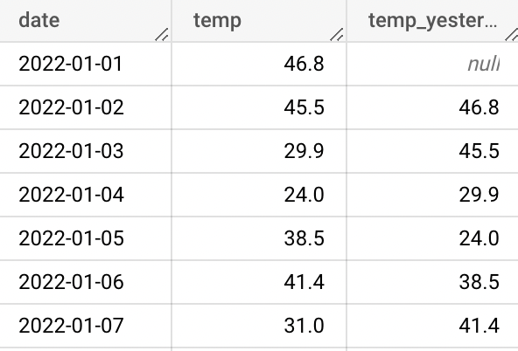
LAG()
Returns the value of the expression on a preceding row:
SELECT
date,
temp,
LAG(temp) OVER(ORDER BY date) AS temp_yesterday
FROM `bigquery-public-data.noaa_gsod.gsod2023`
WHERE stn="994971" -- Boston
ORDER BY date

Slide 17
IF(cond, true_result, else_result)
If cond is true, returns true_result, else returns else_result. E.g.:
SELECT
TIMESTAMP(CONCAT(year,"-",mo,"-",da)) AS timestamp,
IF(dewp = 9999.9, NULL, dewp) AS dewp
FROM `bigquery-public-data.noaa_gsod.gsod2023`
WHERE stn="994971" -- Boston

Slide 18

Activity
Final reminder: Apply to get a free 1-year Tableau student license
Complete the Labs F, G & H as well as “Hands-on practices”
DataCamp - According to syllabus
Assignment 1
Accessible from Blackboard under Assessments - GitHub was updated on Nov 2
Make sure you provide rationale for each question. The correct answer in the multiple choice section gives you 50% of the points, the rest is the rationale you provide.
Due Thursday - 11/9
Dataset + Project Proposal
Due Tue - 11/7
Team Assignment
Due Tue - 11/28
Quiz on Tuesday

Slide 19
Your Turn - Home Session
Lab F: Analyzing Natality Data Using Vertex AI and BigQuery - 00:30
What you will learn in this lab
Launch AI Platform notebook
Invoke a BigQuery query
Create charts in Jupyter
Export data for machine learning
NOTE: There are some Python script in this lab...please copy/paste/run the scripts but don’t worry if you are not familiar with the syntax.

Slide 20

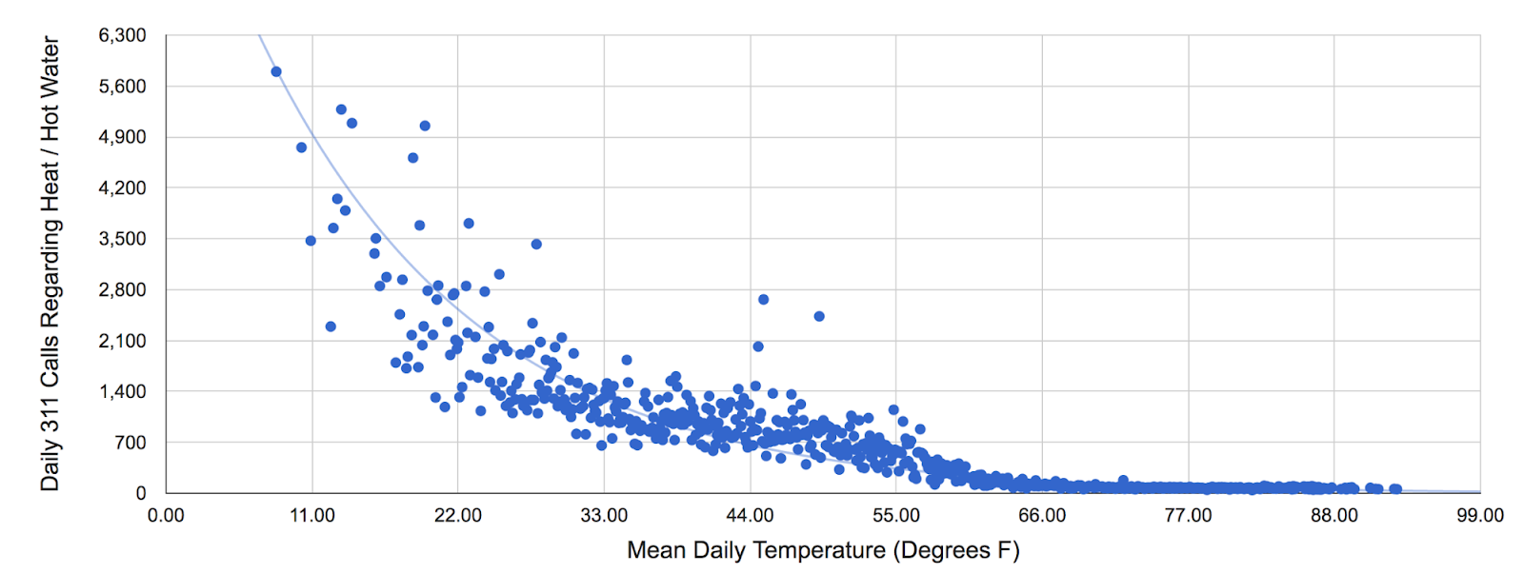
Your Turn - Home Session
Lab G: Weather Data in BigQuery - 00:45
What you will learn in this lab
Carry out interactive queries on large datasets
Combine and run analytics on multiple datasets
Understand nested query statements with multiple functions
Get familiar with table and column alias
Hint: When you are asked to update the project ID typically it is safe to remove <YOUR-PROJECT-NUMBER>. all together since you are already in that project. A better practice would be to provide the ID but in this case it’s a long temporary ID and takes time to copy/paste.
NOTE: In this lab you will be using a JOIN command to “join” two tables. Don’t worry if you haven’t encountered it before. We will discuss it in depth in the future lectures.

Slide 21
Your Turn - Home Session
Lab H: Exploring NCAA Data with BigQuery - 00:45
What you will learn in this lab
Query the NCAA Public Dataset
Writing and executing more queries

