Slide 1
Wild Mustangs Analytics
Brewery Location / Craft Beer Acquisition Assessment
Anheuser-Busch

Slide 2
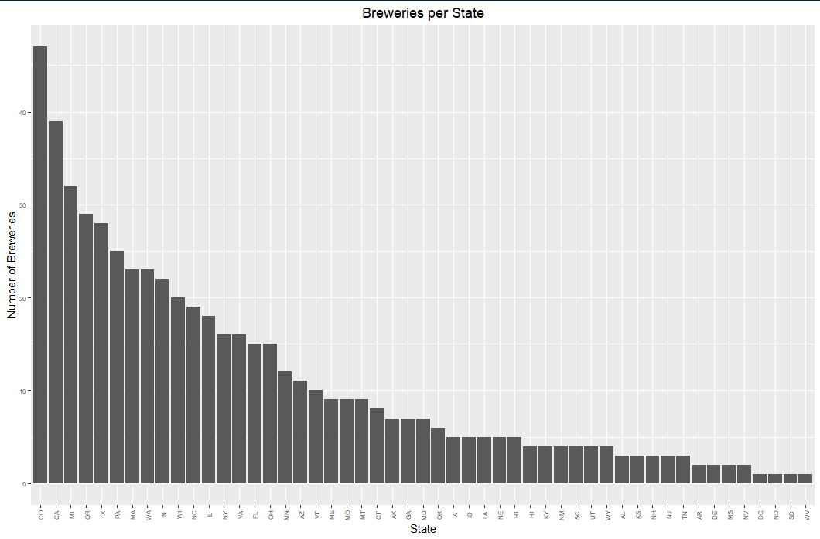
Number of Breweries per State

Slide 3
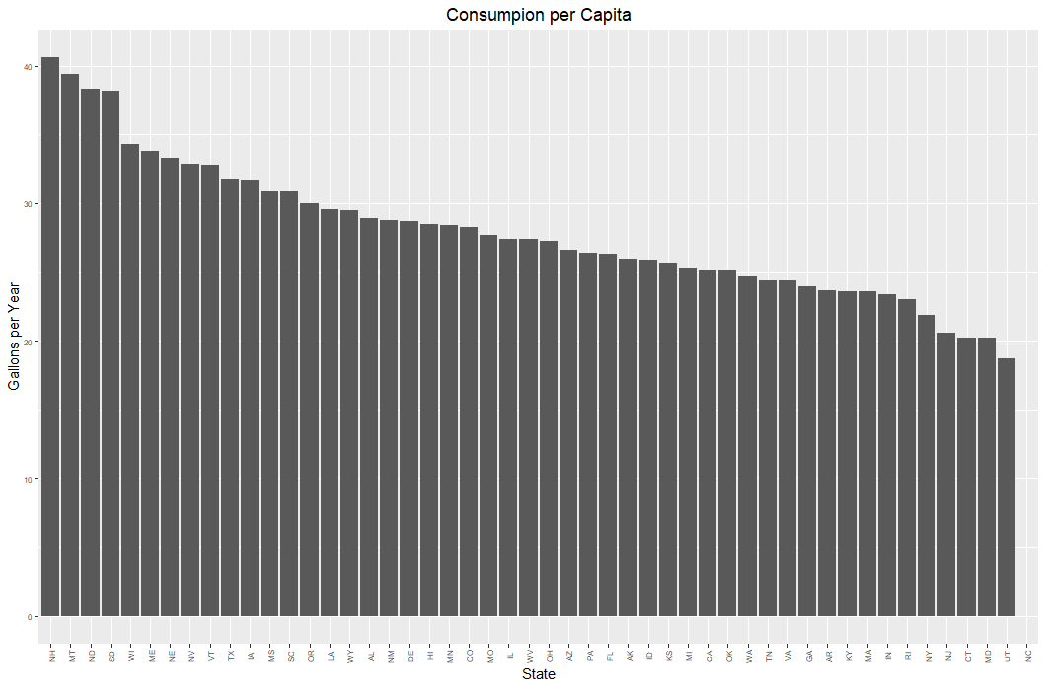
Beer Consumption

Slide 4
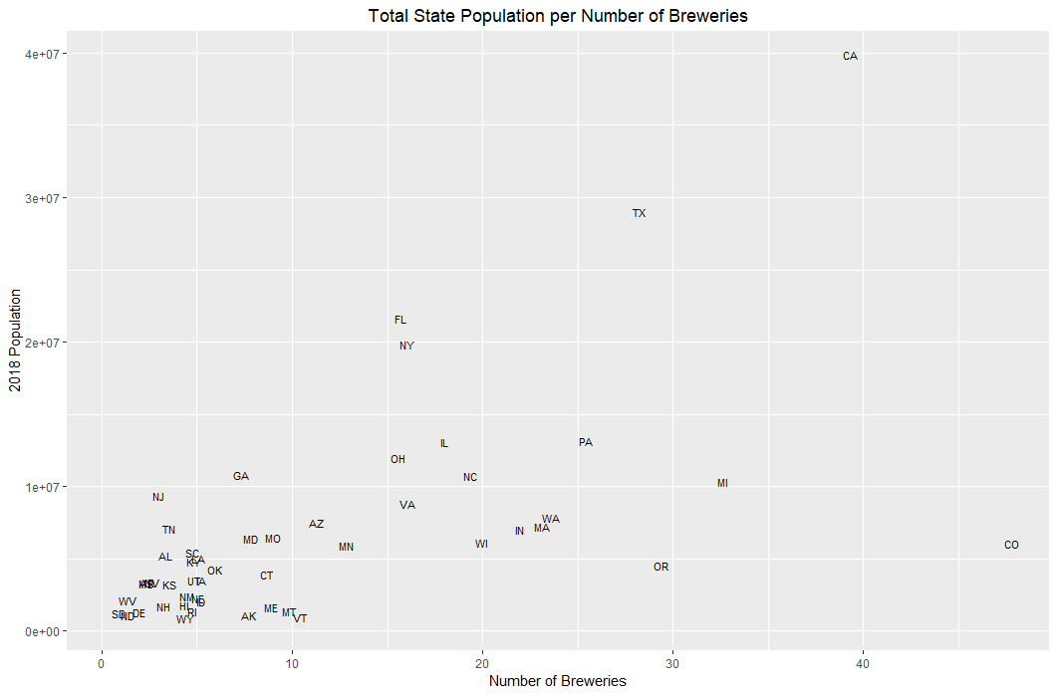
Is Population a Factor?

Slide 5
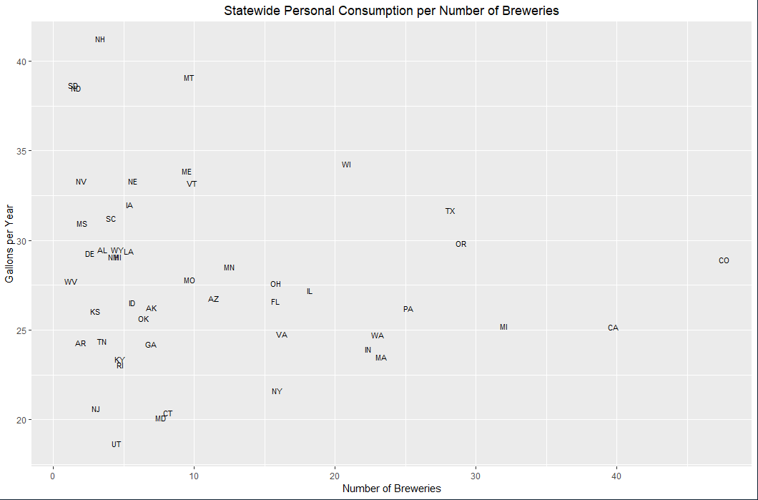
Where Do They Drink the Most?

Slide 6
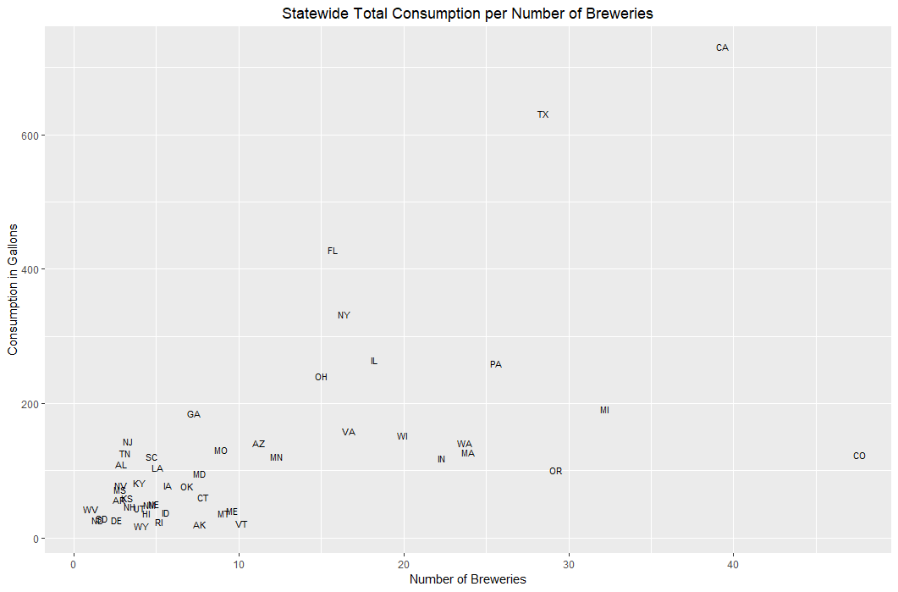
Which States Drink the Most?

Slide 7
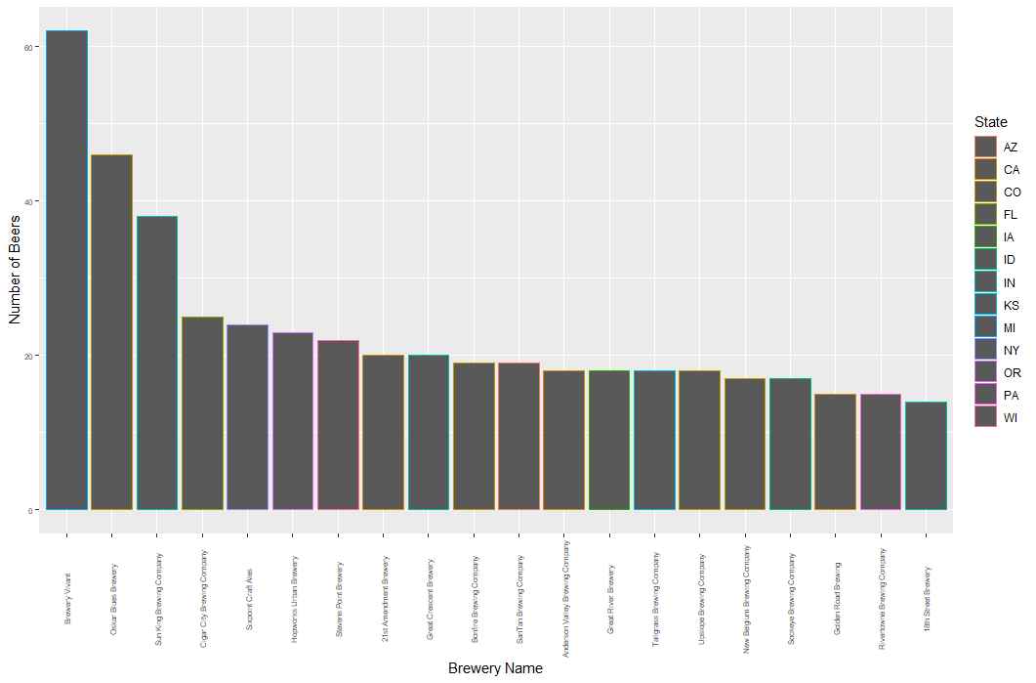
Top 20 Breweries By Beer Selection

Slide 8
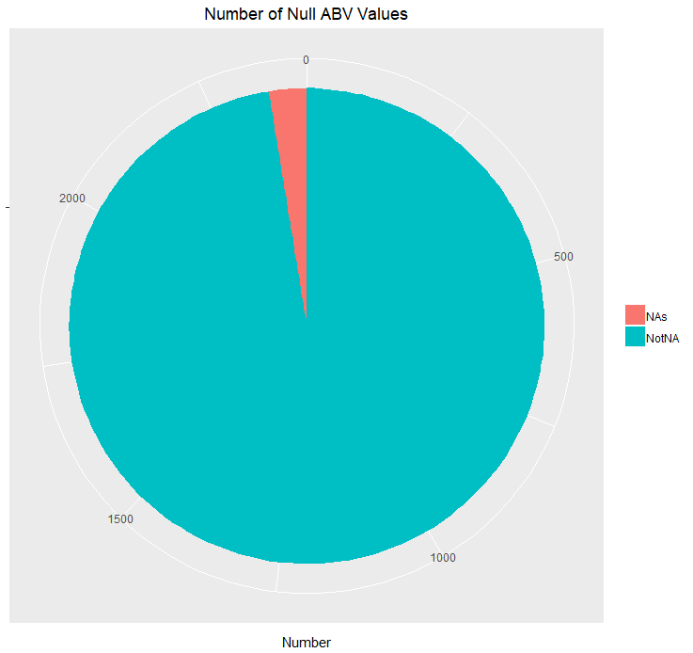
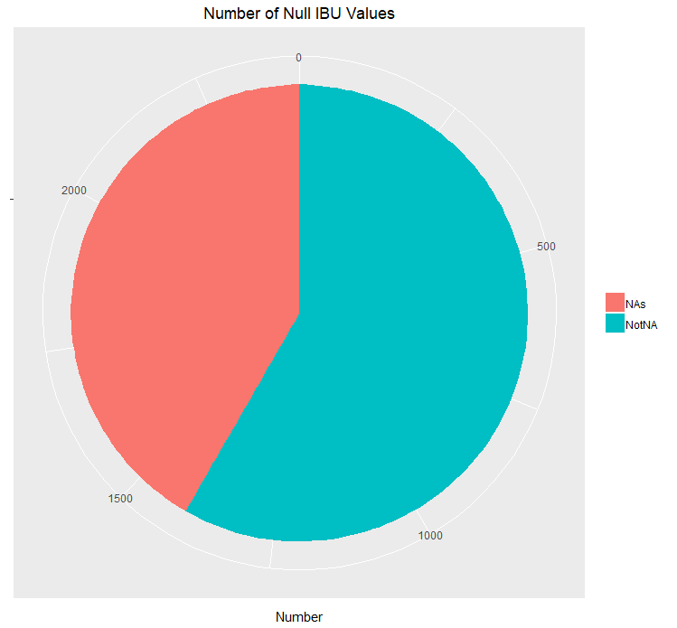
Reported ABV and IBU Values

Slide 9
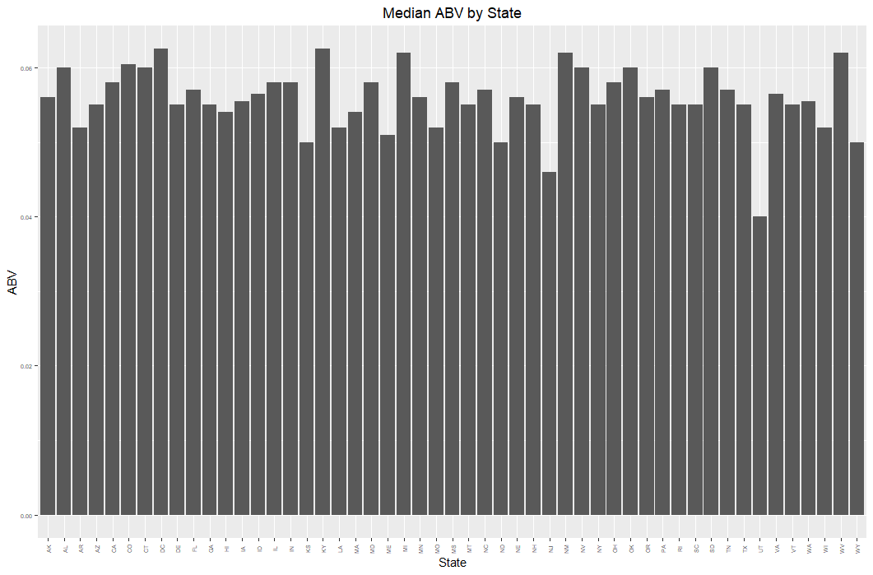
Beer Strength

Slide 10
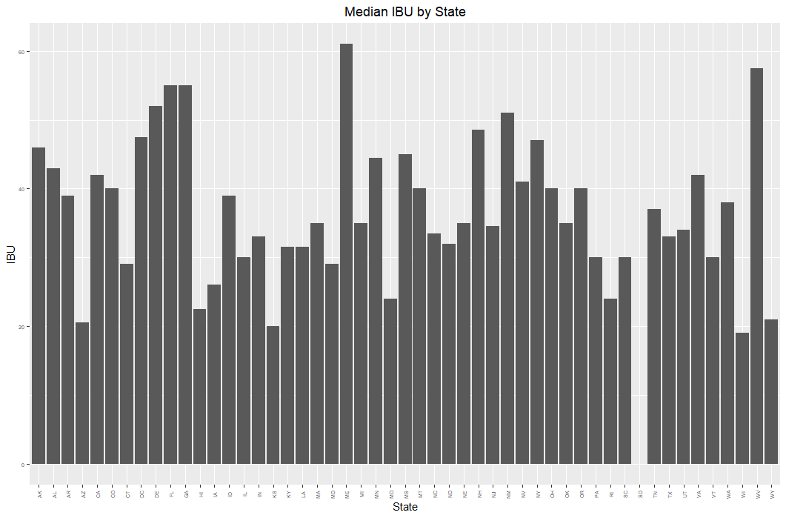
Beer Bitterness

Slide 11
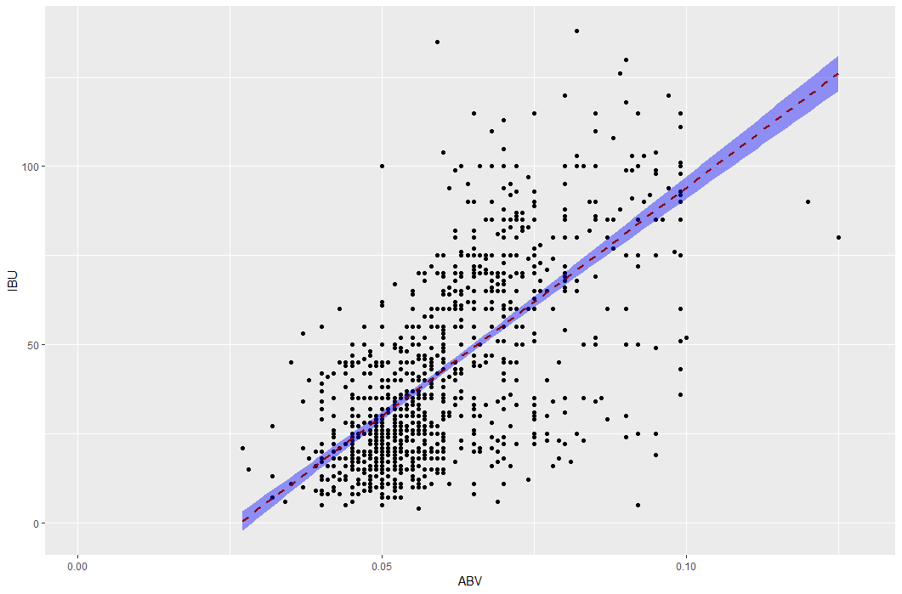
IBU and ABV Relationship

Slide 12
