Slide 1
Wild Mustangs Analytics
Brewery Location / Craft Beer Acquisition Assessment
Anheuser-Busch
http://www.screencast.com/users/EricBalke/folders/Default/media/01216e5d-d033-4c18-817a-ee0e17c98af3

Slide 2
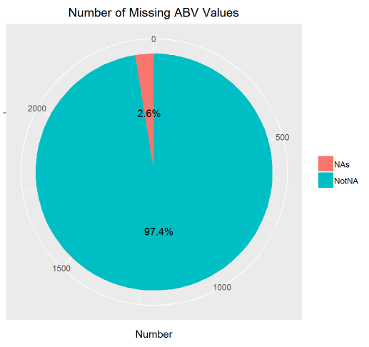
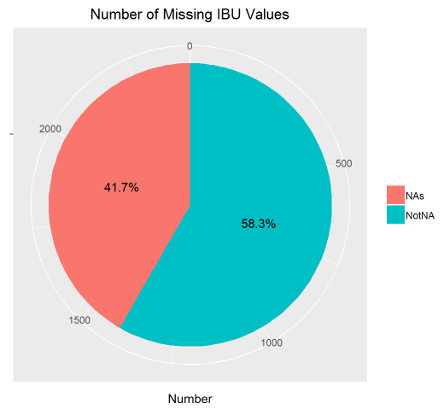
Missing ABV and IBU Data

Slide 3
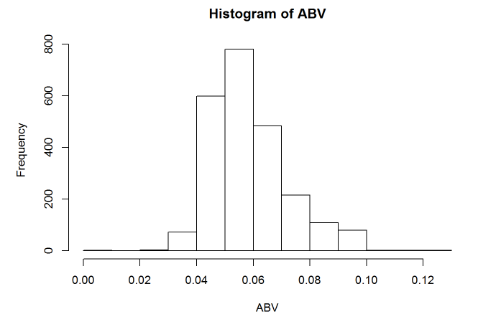
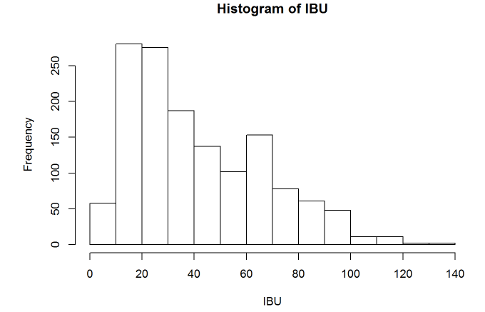
Histograms: ABV and IBU Values

Slide 4
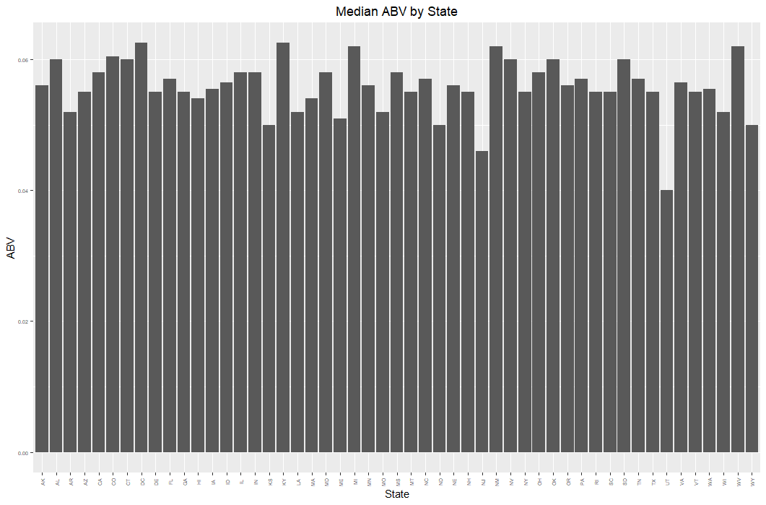
Median Beer Strength by State

Slide 5
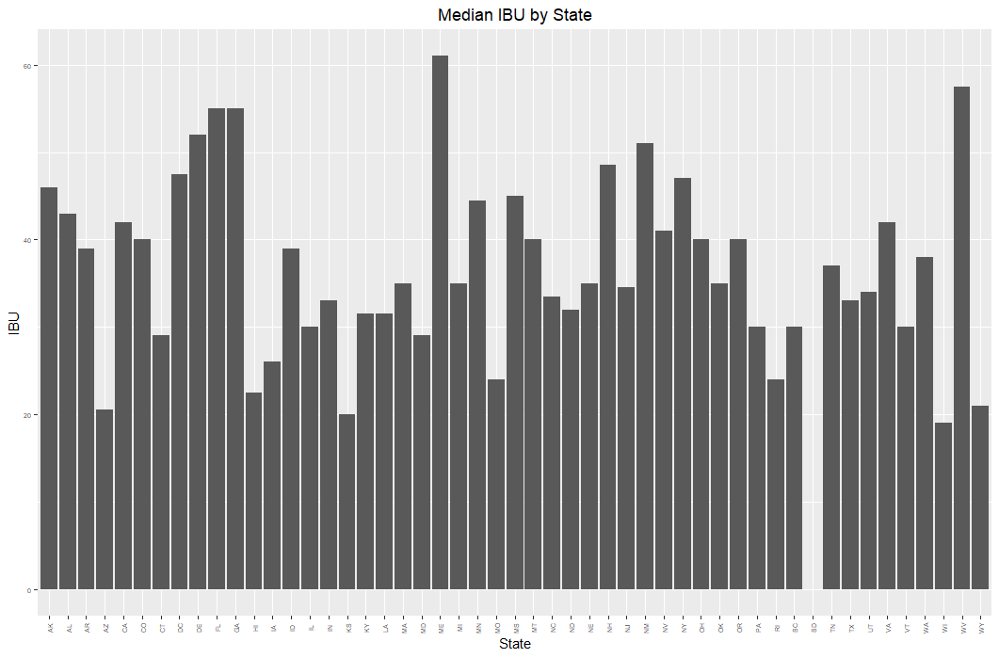
Median Beer Bitterness by State

Slide 6
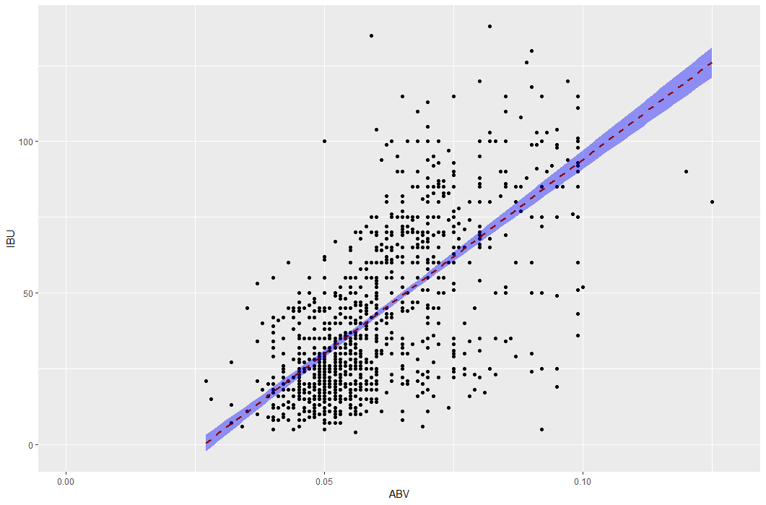
IBU and ABV Relationship

Slide 7
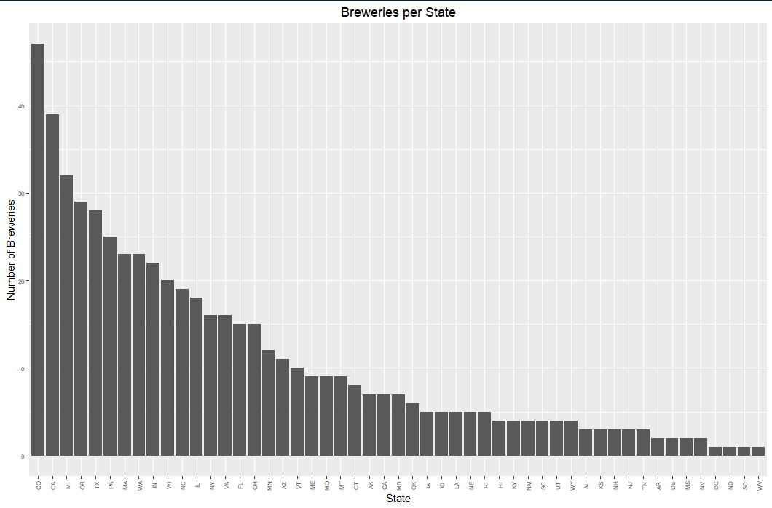
Number of Breweries per State

Slide 8
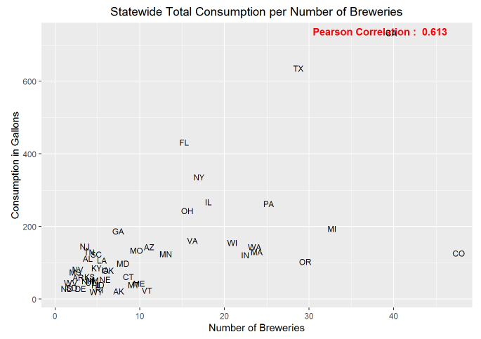
Which States Drink the Most Total Gallons?

Slide 9
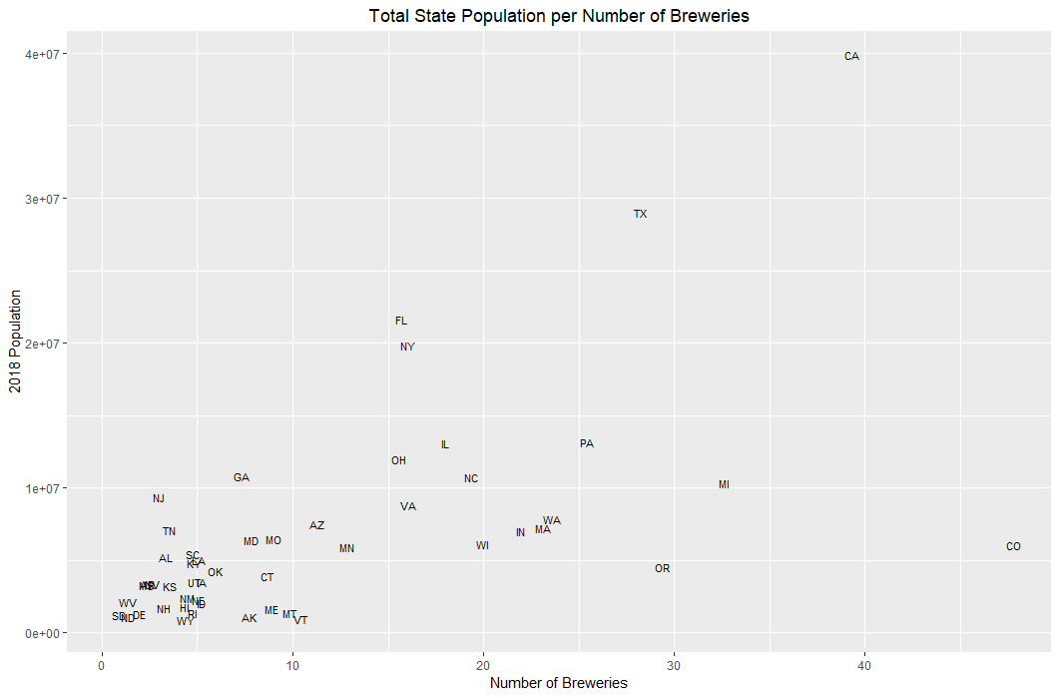
Is Population a Factor?

Slide 10
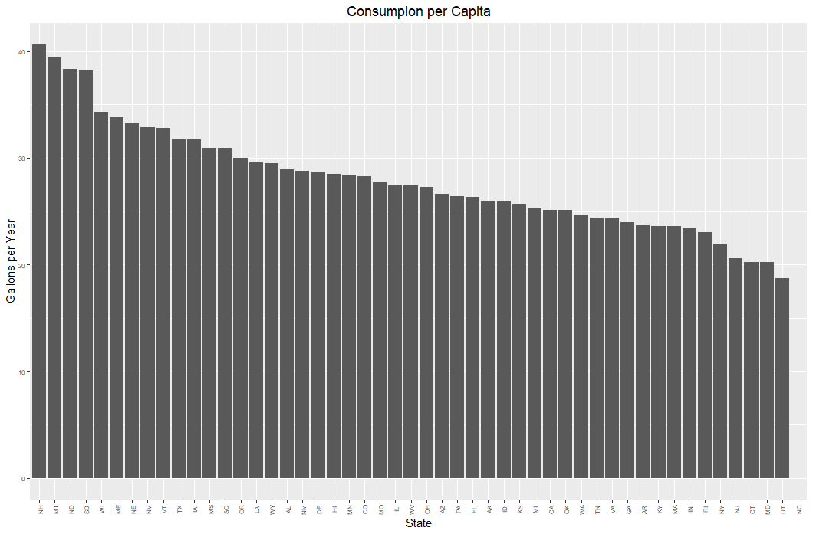
Beer Consumption per Person by State

Slide 11
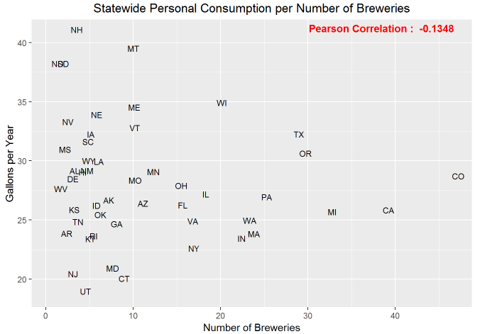
Market Expansion Opportunities

Slide 12
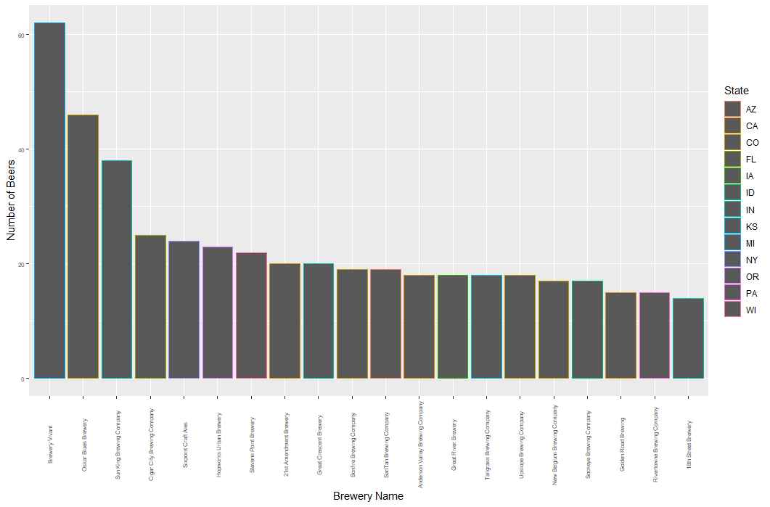
Top 20 Breweries By Beer Selection

Slide 13
