Slide 1
DDS Analytics
Exploratory and Predictive Analysis on Attrition and Salary
Frito-Lay
VIDEO: https://www.screencast.com/t/QWcxlSEB
GITHUB: https://github.com/EricBalke/CaseStudy2DDS
Notes:
In today’s presentation, we will be exploring the Frito-Lay dataset to better understand what factors are associated with two important variables: attrition and salary.

Slide 2
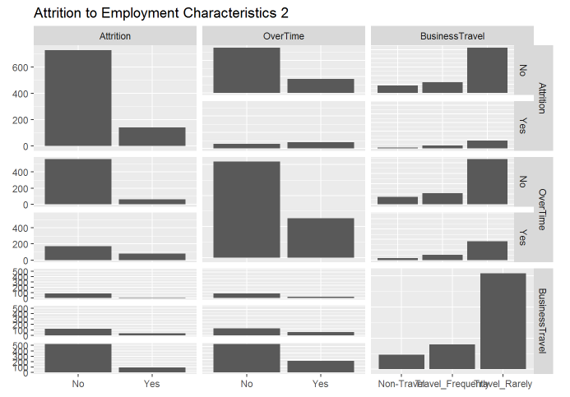
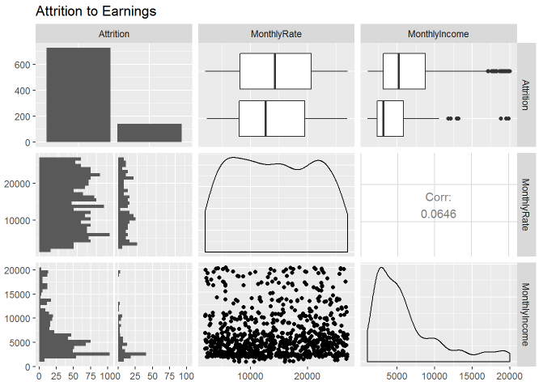
Exploratory Data Analysis: Attrition
Notes:
Analyzing the pair-wise associations between all possible predictor variables and the response variable, attrition, can give us a good indication which variables are potentially related to attrition and which are probably not related to attrition. As you can see in the images, it appears both Over Time and Monthly Income are related to attrition. We will explore that possibility in more detail in the next slide.

Slide 3
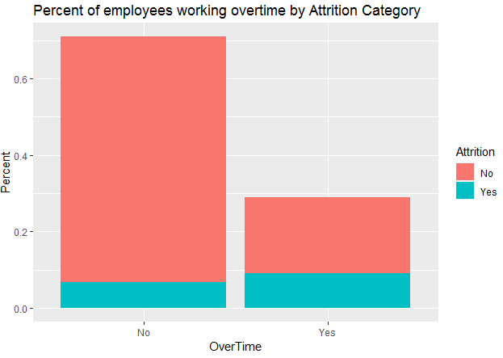
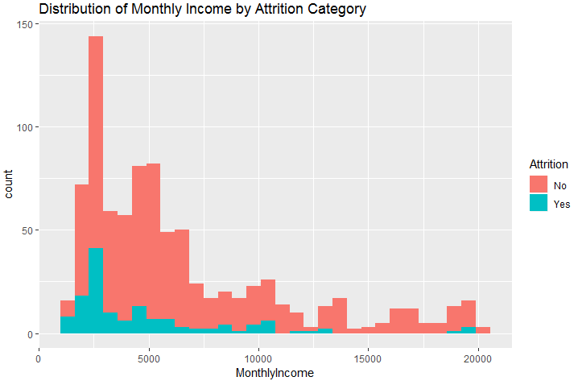
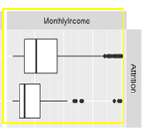
Exploratory Data Analysis: Attrition
Notes:
In the image on the left we are looking at percentage of employees that worked Over Time in addition to their attrition status. For employees that did not work Over Time, only 1 out of 10 quit or left employment. In contrast, for employees that did work Over Time, nearly 1 out of 3 quit or left employment. In the image on the right, we can see the distribution of monthly income has less spread and lower values between the 25th and 75th percentiles as well as a lower average for employees that quit or left employment. Clearly, Over Time status and Monthly Income are related to Attrition and should be explored further.

Slide 4
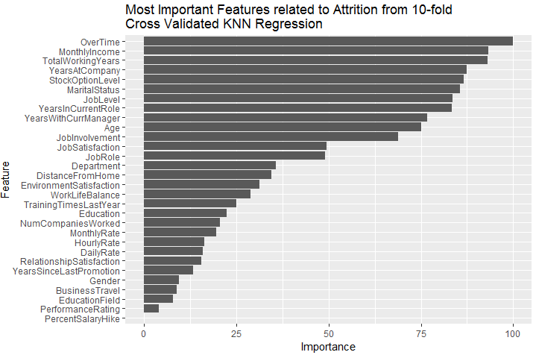
Predictive Modeling: Attrition
Notes:
In the first part of the predictive modeling portion of the analysis of attrition, I ran a K-Nearest Neighbors analysis using Attrition as the response and all possible input variables as the potential predictors to better understand which input variables are most related to Attrition. Based on the graph above, the top three variables include two we’ve already uncovered, Over Time and Monthly Income, as well as Total Working Years. Conversely, Percent Salary Hike is the least related to attrition which leads us to believe campaigns designed to reduce Attrition rates should not include a salary increase component.

Slide 5
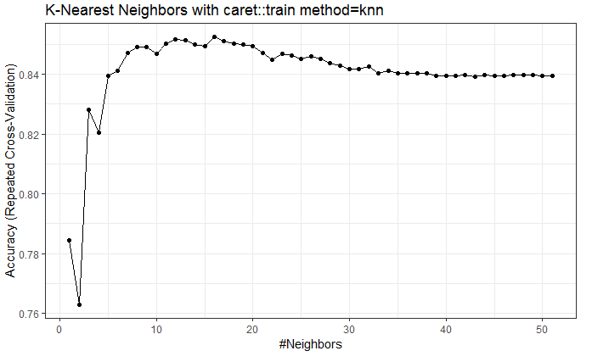
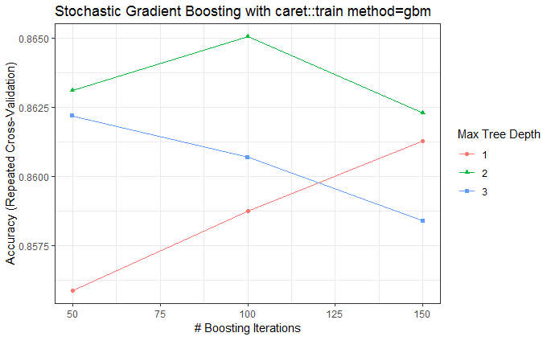
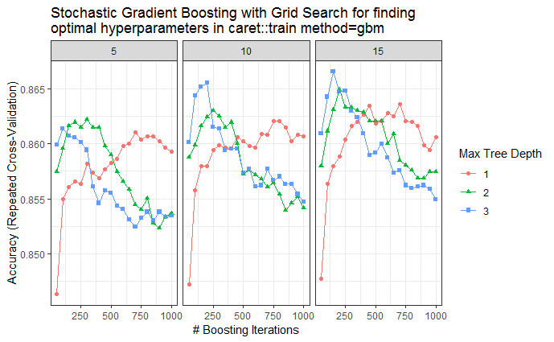
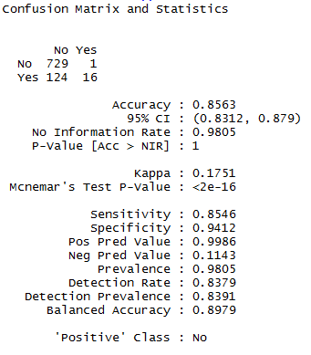
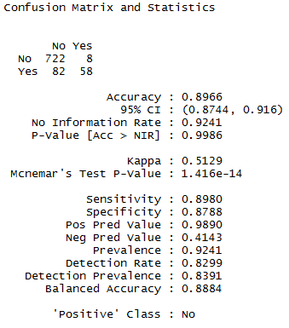
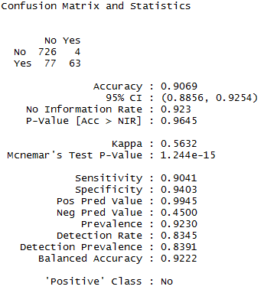
Predictive Modeling: Attrition
Notes:
In order to best predict whether an employee will quit or not, I created three KNN based classifiers using the input dataset. In all three views, 10 fold cross validation was used to determine which configuration of hyper-parameters yielded the highest accuracy. In the first view, the basic KNN classifier from the Caret package yields the highest accuracy when k, the number of nearest neighbors used in the classification, is set to 16. In the second view, the Stochastic Gradient Boosting tree based classifier performs best in terms of accuracy with a Max Tree Depth of 2 and Boosting Iterations of 100. In the final view, a grid search was performed to best optimize the hyper-parameters for model accuracy and resulted in an optimal setting of Max Tree Depth of 3, Boosting Iterations of 150 and Minimum Node Observations of 15. This third model performed better than the previous two attaining a Sensitivity of 0.9041 and Specificity of 0.9403.

Slide 6
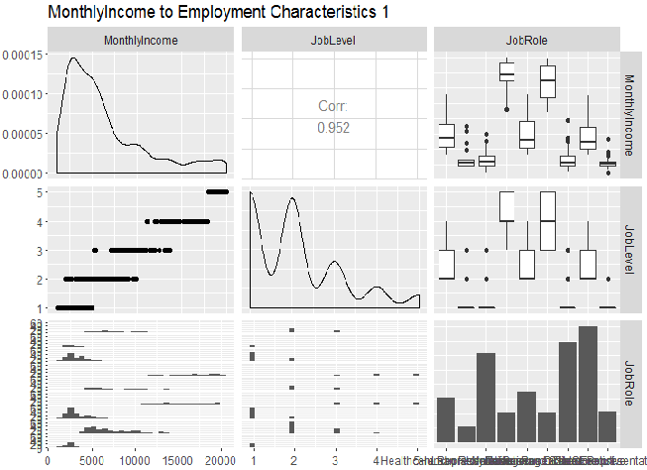
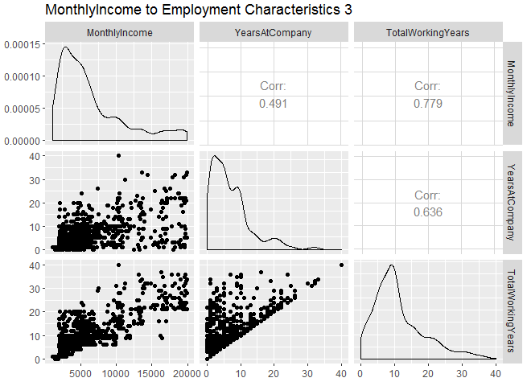
Exploratory Data Analysis: Salary
Notes:
Analyzing the pair-wise associations between all possible predictor variables and the response variable, Monthly Income or salary, can give us a good indication which variables are potentially related to salary and which are probably not related to salary. As you can see in the images, it appears both Job Level and Total Working Years are related to salary. We will explore that possibility in more detail in the next slide.

Slide 7
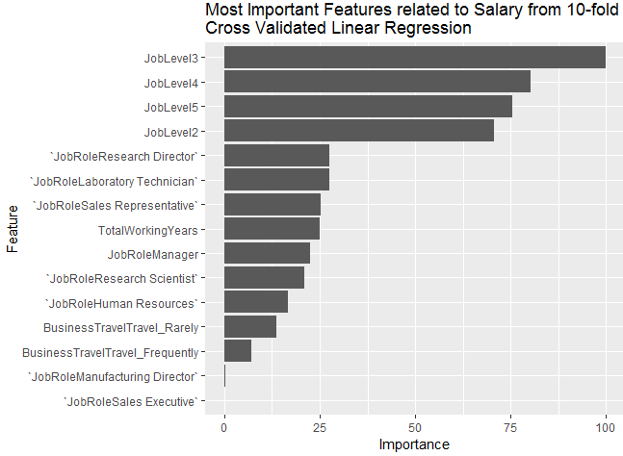
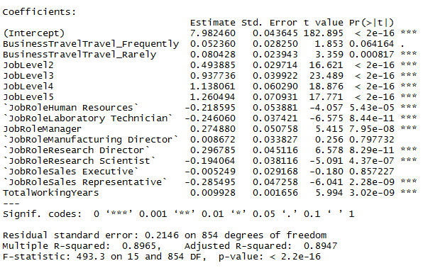
Predictive Modeling: Salary
log(MonthlyIncome) = β₀ + β₁*BusinessTravel + β₂*JobLevel + β₃*JobRole + β₄*TotalWorkingYears
Notes:
In order to eliminate assumption violations, I modeled the log of Monthly Income as the response and regressed it on the explanatory variables: Business Travel, Job Level, Job Role and Total Working Years. All of the corresponding parameter coefficients were statistically significantly different than zero (excluding a few levels of the Job Role variable) at a higher than 99.9% confidence level. In the image on the left, you can see Job Level, specific levels of Job Role, and Total Working Years are the most important explanatory variables associated with salary.

Slide 8
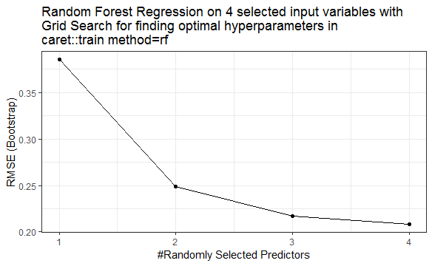
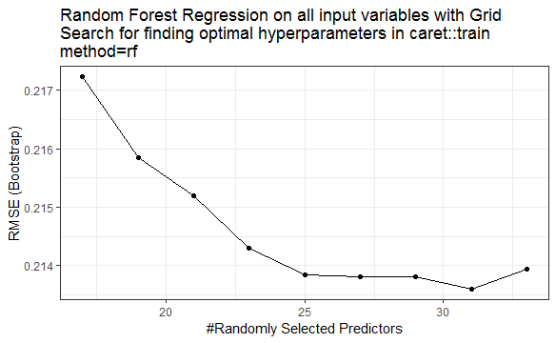

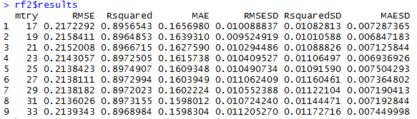
Predictive Modeling: Salary
Notes:
In order to predict salary as well as understand if any other variables (other than Business Travel, Job Level, Job Role and Total Working Years) should be included in a model that predicts salary, I created two Random Forest based regression models. The first model on the left randomly selects one or more of the four previously mentioned predictors to predict salary, and ranks the 4 different resulting models according to Root Mean Square Error, or RMSE. The best performing model was the one with all 4 predictors included, and resulted in an RMSE of 0.2084. The second model on the right randomly selects one or more of all of the input variables to predict salary, and ranks all of the resulting models according to their RMSE. The best performing model in this exercise was the model with 31 randomly selected variables with an RMSE of 0.2136. In conclusion, the random forest model with only our 4 previously identified predictor variables outperformed the model with all possible predictor variables included, indicating we can safely predict salary with just the four variables: Business Travel, Job Level, Job Role and Total Working Years.

Slide 9
Questions?
Notes:
Thank you for your time. Please let me know if you have any questions.

