Slide 1
DDS Analytics
Exploratory and Predictive Analysis on Attrition and Salary
Frito-Lay
VIDEO: post link here
GITHUB: https://github.com/EricBalke/CaseStudy2DDS

Slide 2
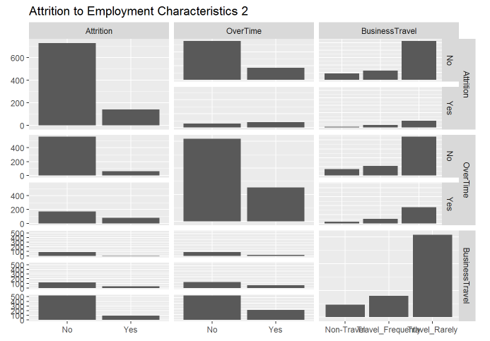
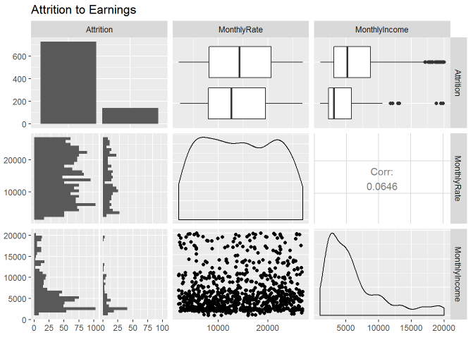
Exploratory Data Analysis: Attrition

Slide 3
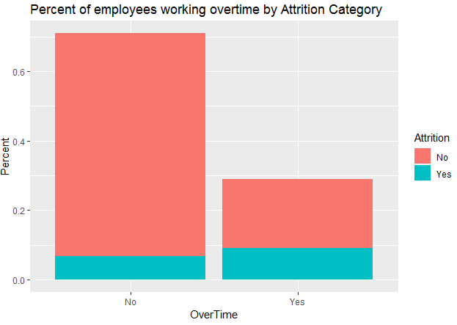
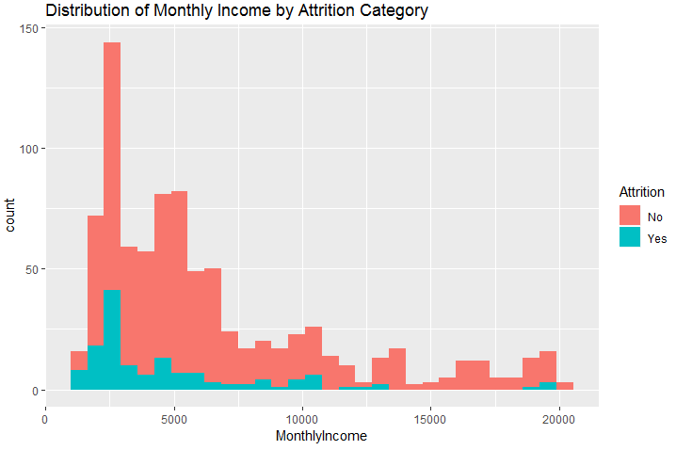
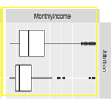
Exploratory Data Analysis: Attrition

Slide 4
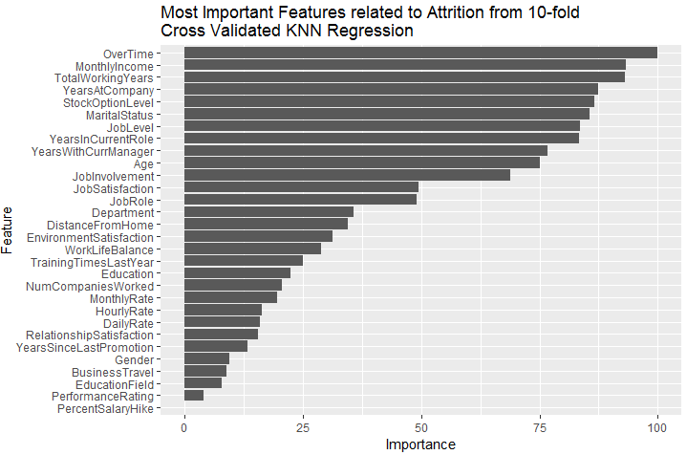
Predictive Modeling: Attrition

Slide 5
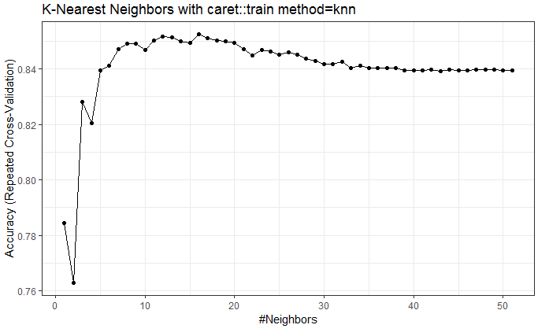
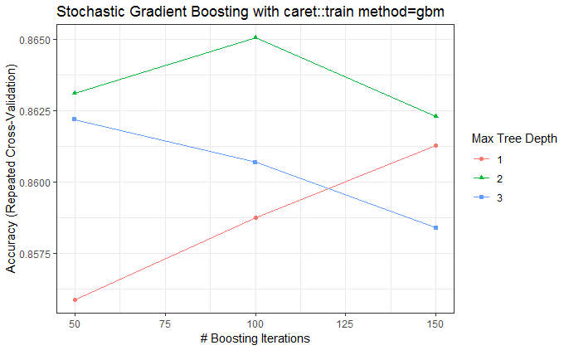
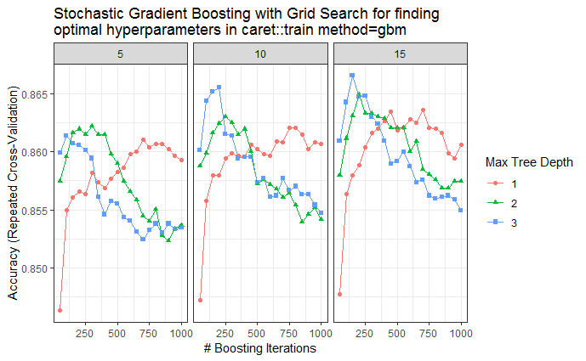
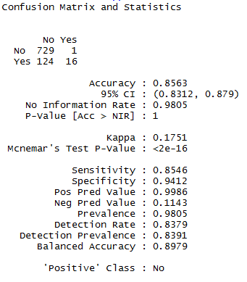
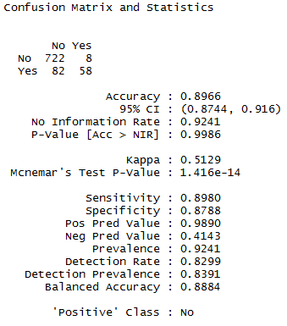
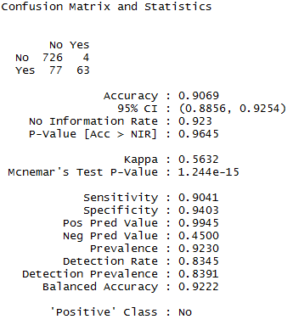
Predictive Modeling: Attrition

Slide 6
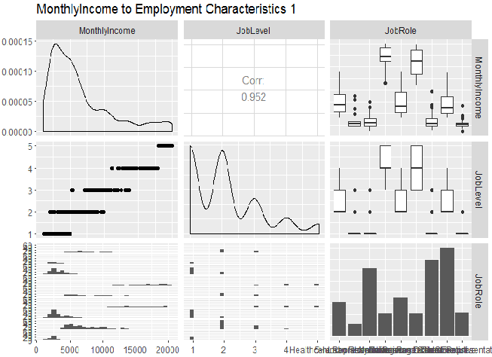
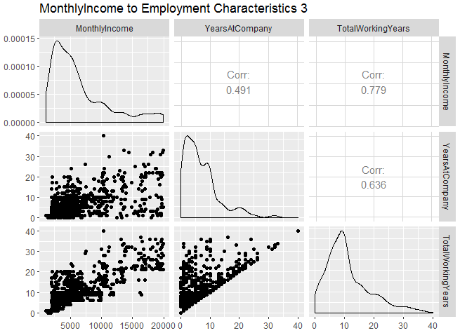
Exploratory Data Analysis: Salary

Slide 7
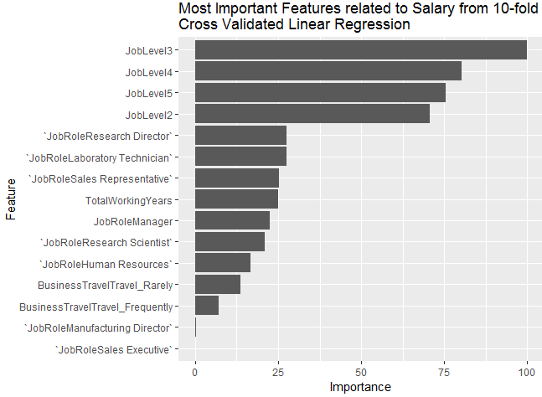
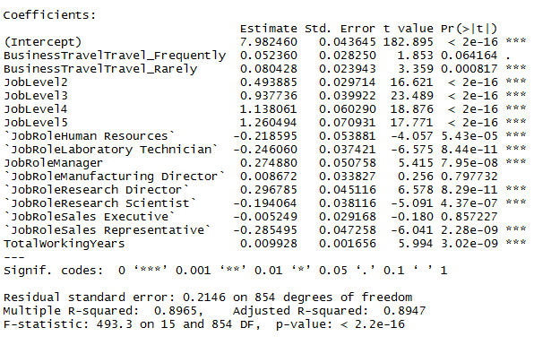
Predictive Modeling: Salary
log(MonthlyIncome) = β₀ + β₁*BusinessTravel + β₂*JobLevel + β₃*JobRole + β₄*TotalWorkingYears

Slide 8
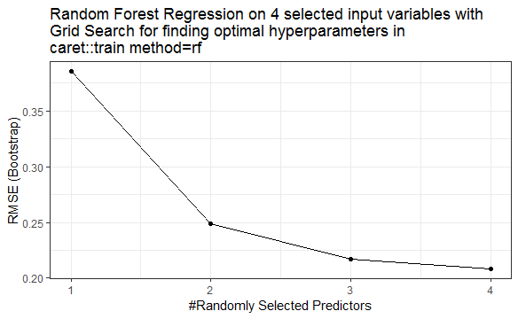
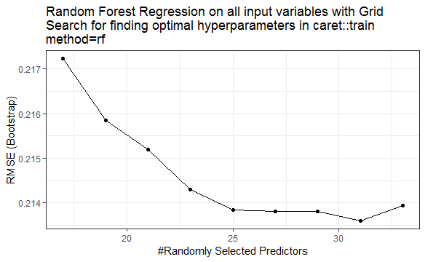

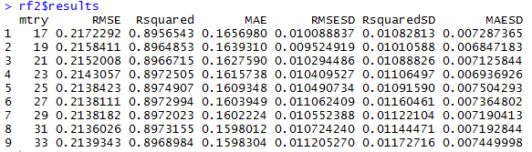
Predictive Modeling: Salary

Slide 9
Questions?

