Slide 1
The role of social information in cross-situational word learning
Kyle MacDonald
12/9/14

Slide 2

Reducing uncertainty during labeling (social cues)
Baldwin (1995); Bloom (2002); Tomasello (2009)
Notes:
This is the proposal put forth by Social-Pragmatic theories of language acquisition that argue that the word to object mapping problem is simplified because children learn words in social contexts.
So in this example, because the child and his father are mutually engaged with one object in the scene the child does not have to consider all possible word-object meanings and can just focus on inferring his father’s communicative intent.

Slide 3
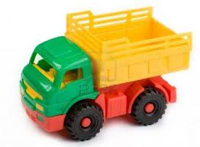

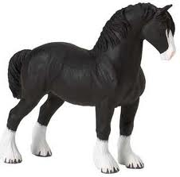

Reducing referential uncertainty
“Truck”
“Ball”
“Truck”
Social cues to reference
Cross-situational
statistics
Notes:
Point → two ways to reduce referential uncertainty: social cues and cross-situational statistics.

Slide 4
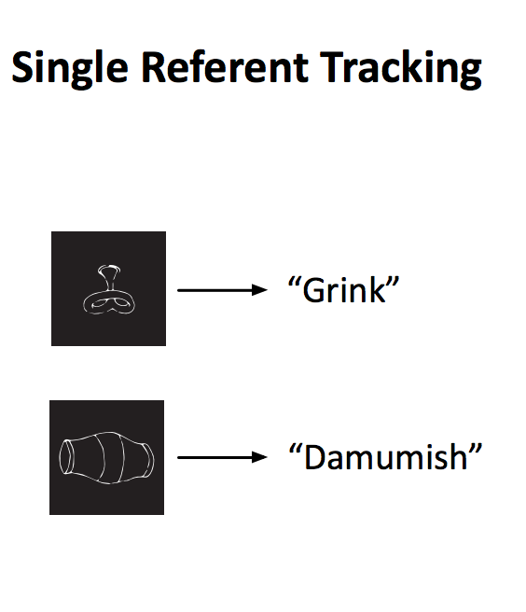
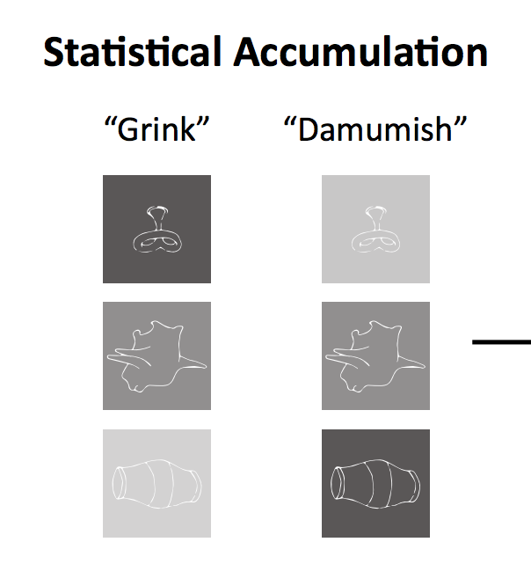
Hypothesis: the presence of social information reduces referential uncertainty, making the learner more likely to track a single referent
uncertainty
Low
High
Notes:
Hypothesis of current experiment

Slide 5
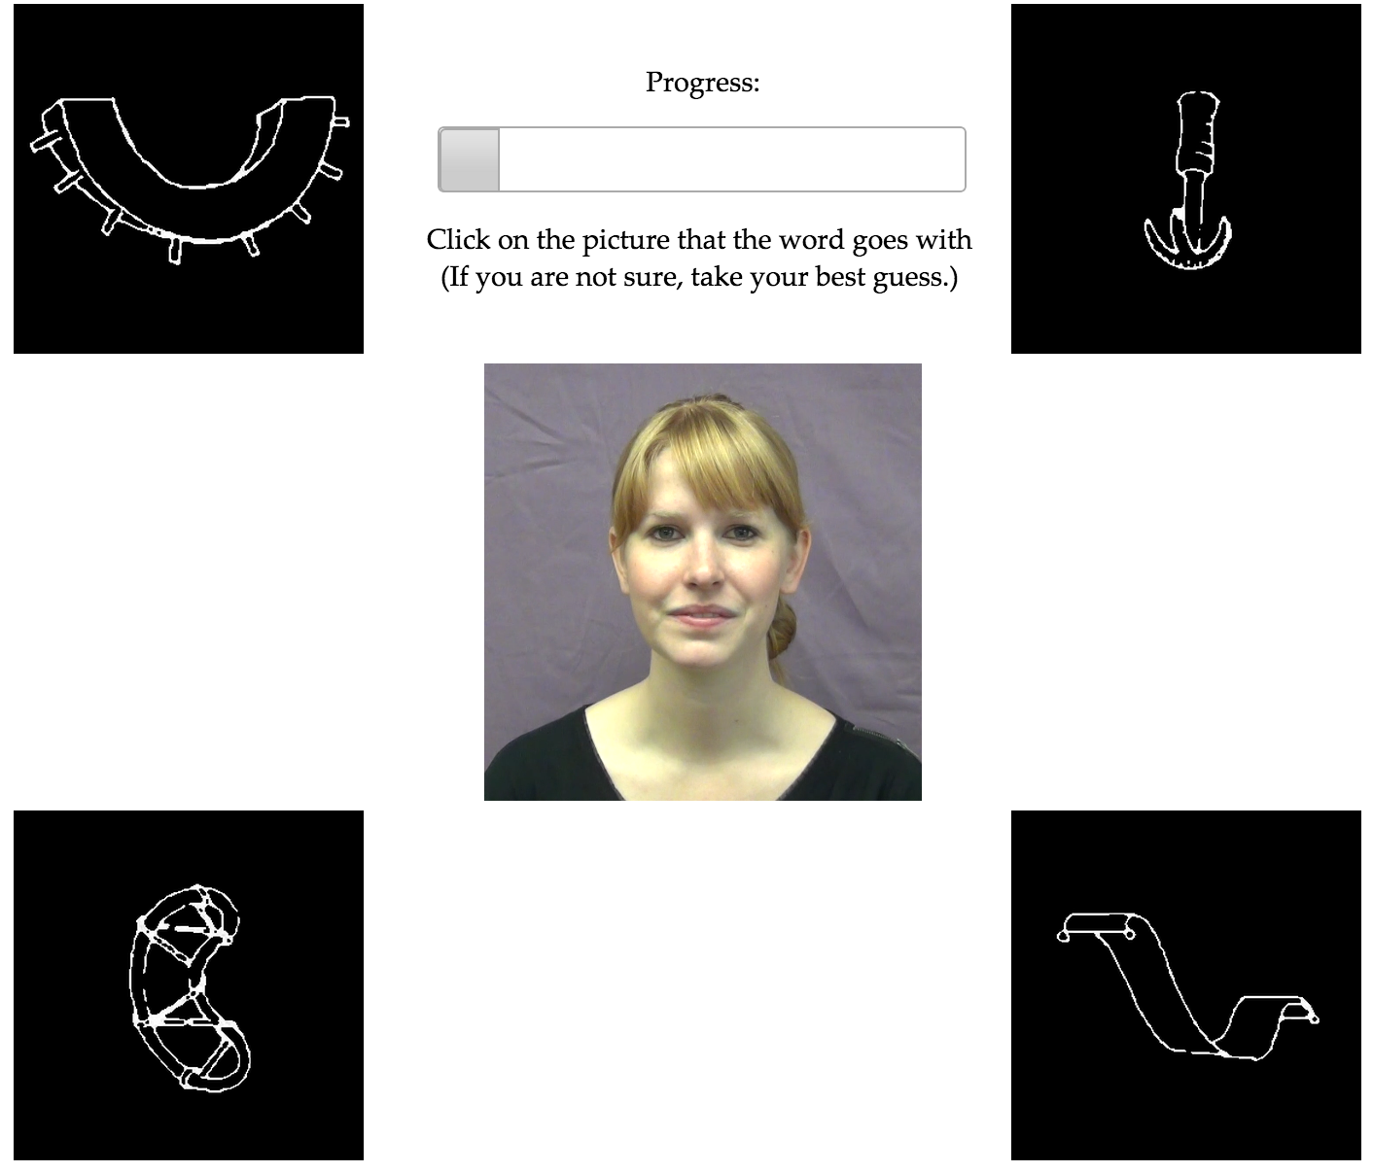
Non-social learning trials
“Grink”

Slide 6
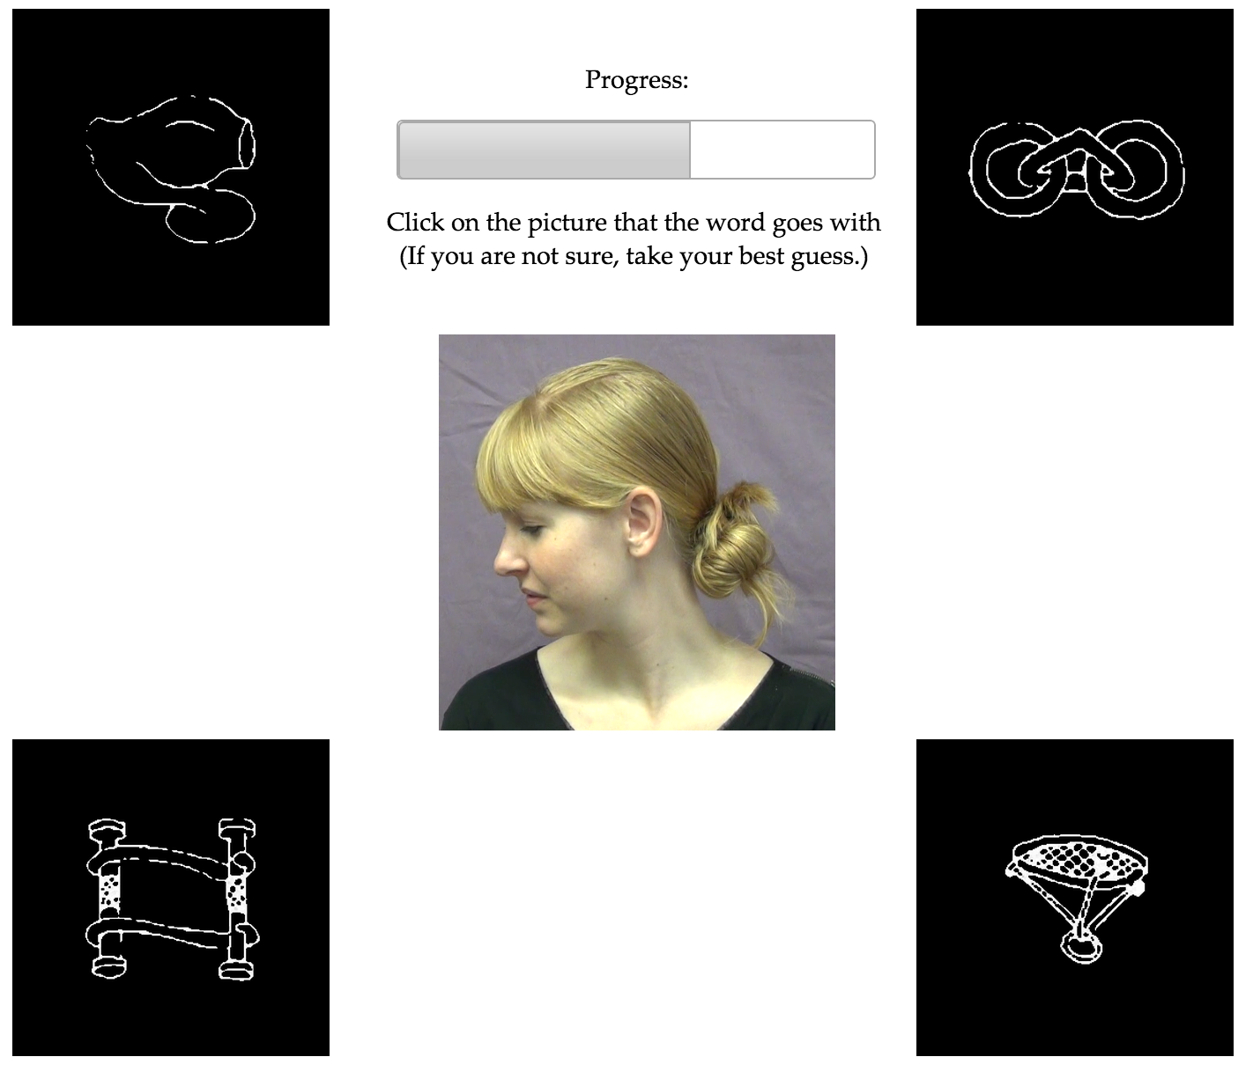
Social learning trials
“Grink”

Slide 7
All test trials (same/switch) were “non-social”
“Grink”
Notes:
This was a within-subjects design with Social/No-social trials presented in blocks of 8. The order of blocks was counterbalanced across participants. I will present the results collapsed across the two orders.

Slide 8
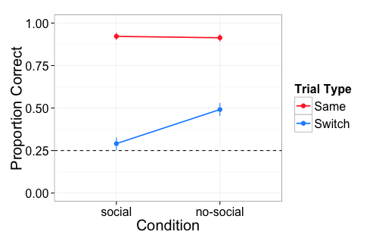
Accuracy on same/switch trials
200 adults on Mechanical Turk
Notes:
92% of exposure trials participants chose the target of eye gaze
With a social cue during exposure, participants were less likely to track alternative hypotheses, showing behavior more consistent with a single-hypothesis tracking algorithm

Slide 9
Resource rationality
Make decisions that are utility-maximizing given that cognitive resources are limited.
Decide when to reduce uncertainty by pursuing information

Slide 10
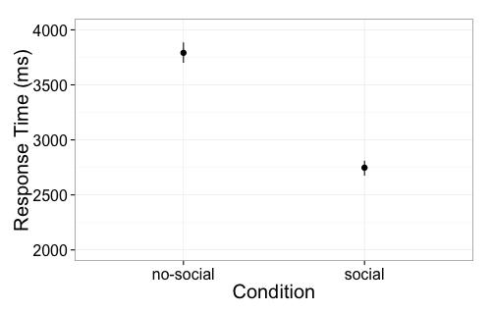
Resource rational?
Participants take longer to respond on no-social exposure trials

Slide 11
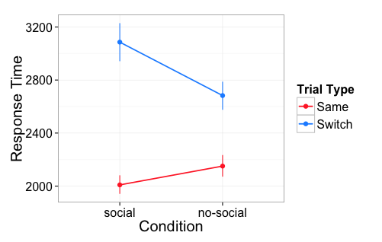
Resource rational?
Participants take longest to respond on social switch trials

Slide 12
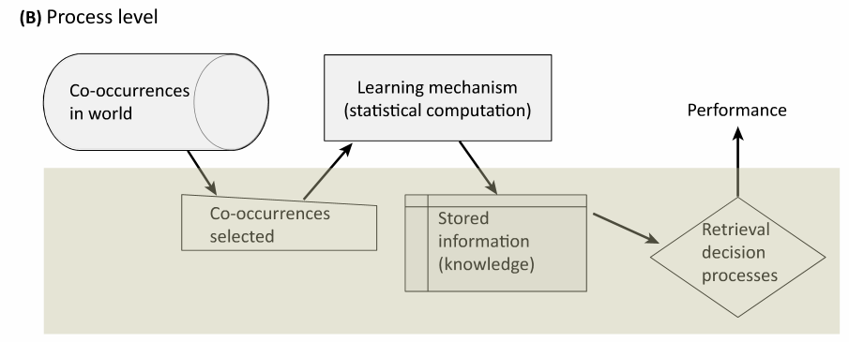
Connections to active learning
Notes:
What role does the learner have in generating the data from the world and/or selecting which data to attend to?
Similar to Dan, I’m also interested in the implicit/explicit dimension of uncertainty in this task. Do you need to have access to your own uncertainty or is it more about the uncertainty of the input. Does this matter?
And very recently I’ve become interested in the role that question-asking might play in word learning.

Slide 13
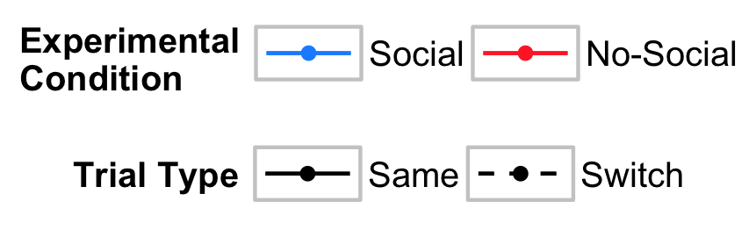
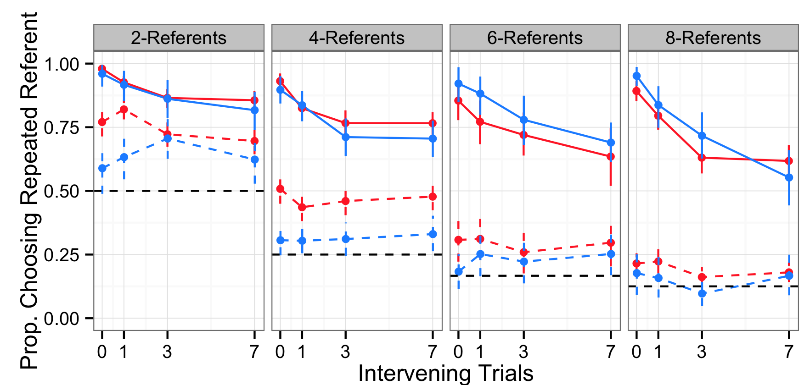
Accuracy
Notes:
Reliable effect of condition on switch trials. Participants were worse in the social condition.
Small effect of condition on same trials at higher numbers of referents. Participants were better in the social condition.
Taken together, this suggests that there is a tradeoff between the presence of social information and learners tracking of multiple alternatives.

Slide 14
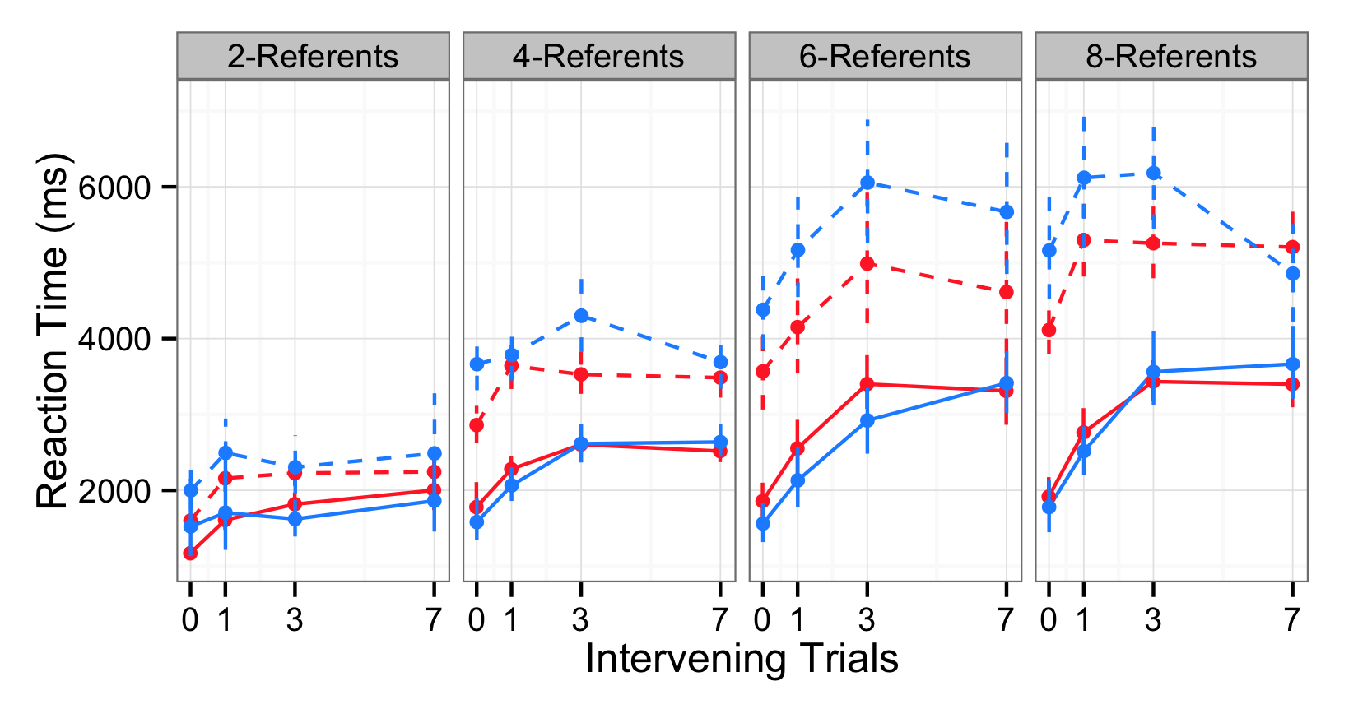
Reaction time
14
Notes:
Orient to axis
See additional evidence that social-switch trials were the hardest – participants took the longest to respond on these trials.

Slide 15
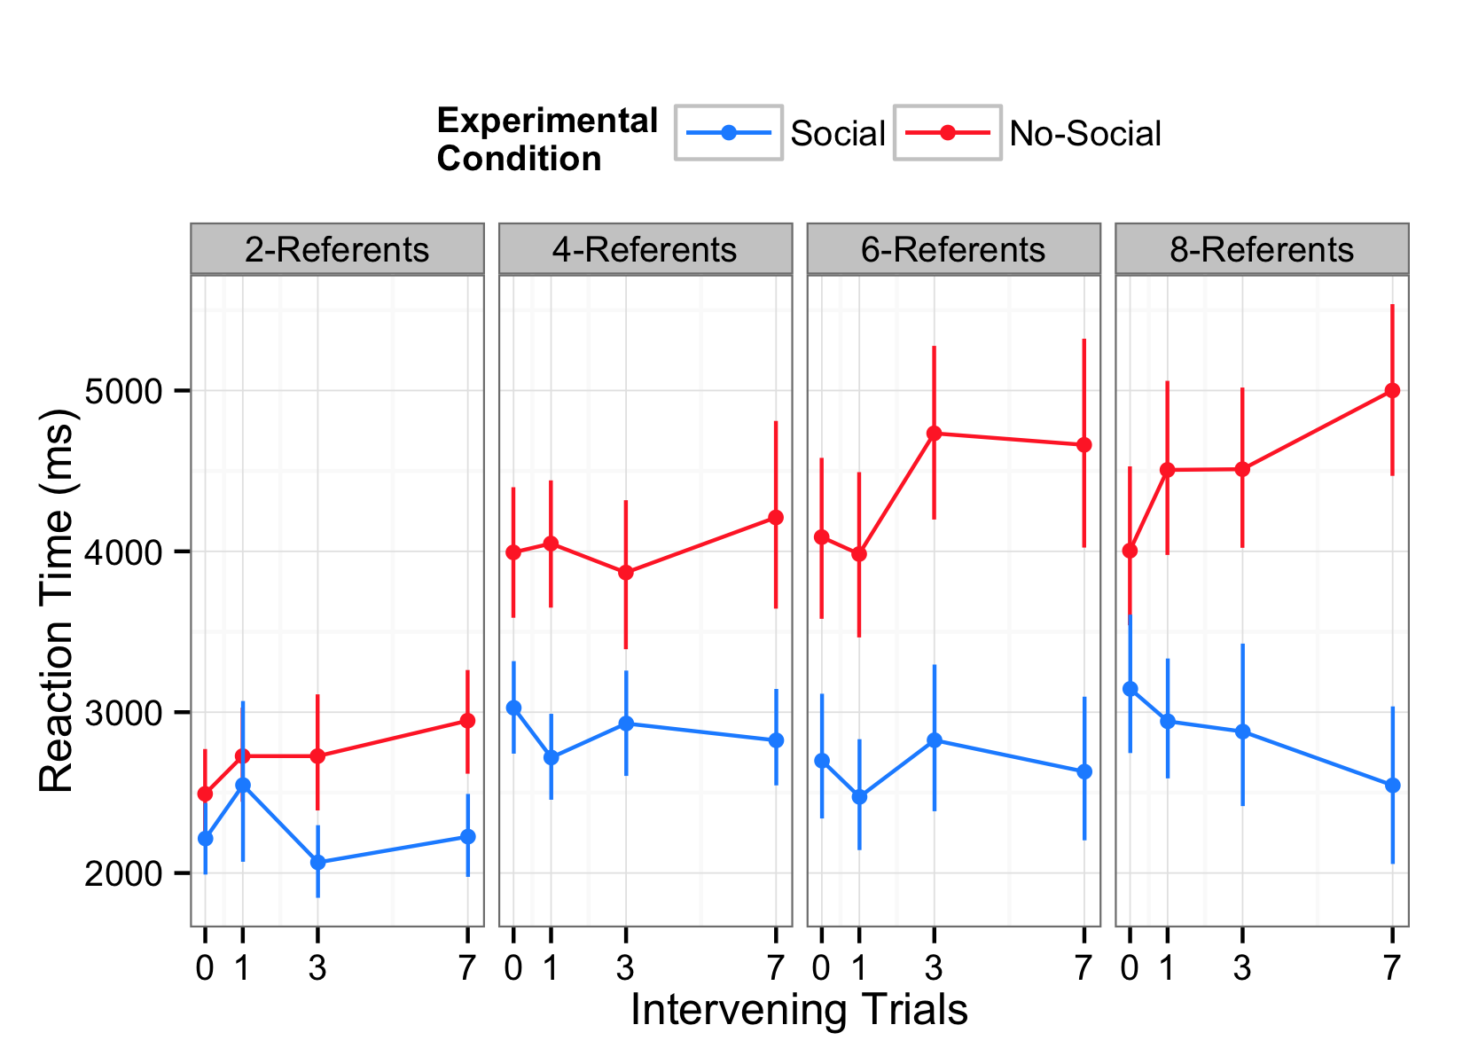
Participants in the Non-social condition took longer to respond on exposure trials
Notes:
Effect of experimental condition – participants responded faster in the social condition.
As the number of referents increased participants took longer to respond, and the difference between social and no-social increased.

