Slide 1
Exploring the interaction of social cues, attention, and memory during cross-situational word learning
Kyle MacDonald
Developmental Brownbag
5/21/14

Slide 2
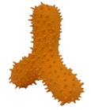


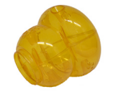
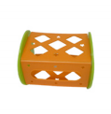

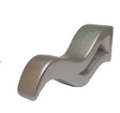
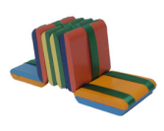
Pifo

Slide 3



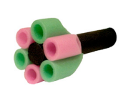


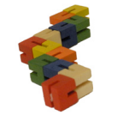
Pifo

Slide 4
Pifo

Slide 5
Pifo

Slide 6
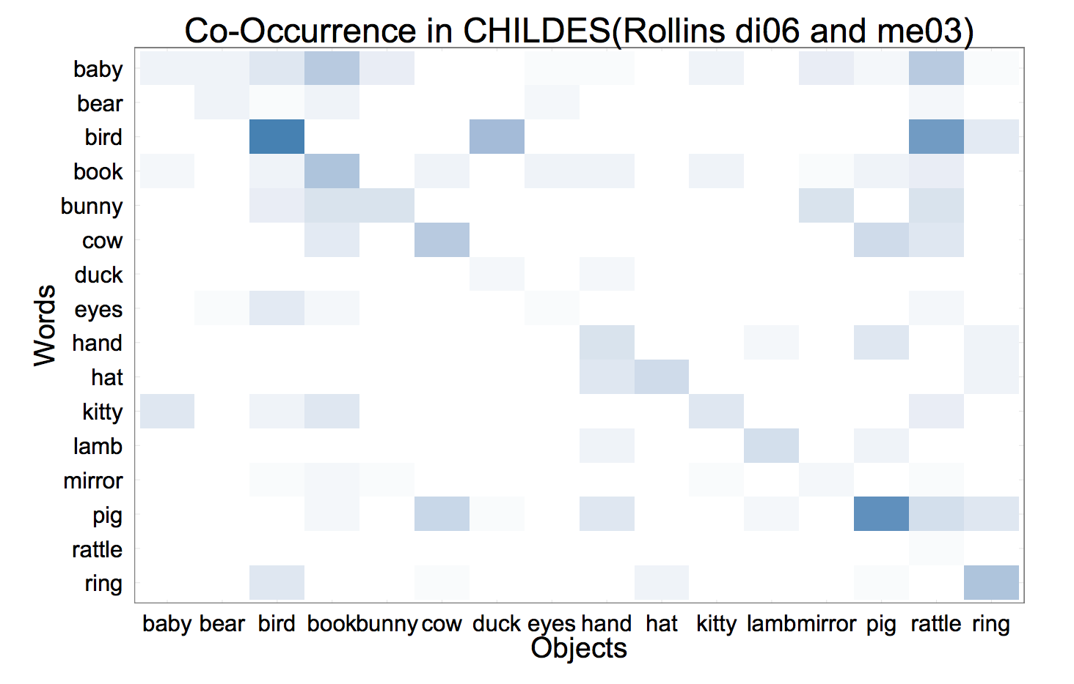
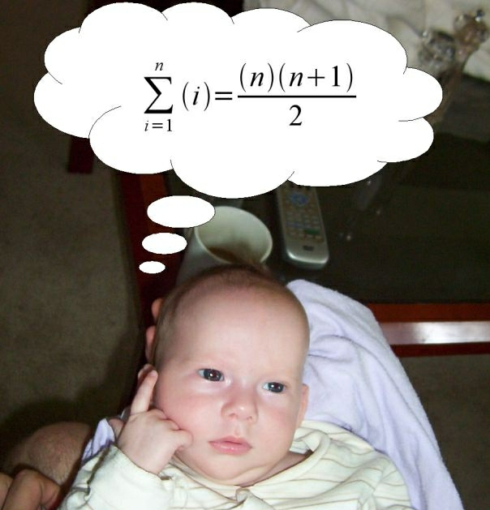

“Learning” behavior may look very different with different levels of attention and memory constraints
BALL

Slide 7
Roadmap
The puzzle of word learning and solutions to the problem of referential uncertainty
Word learning as Bayesian Inference
captures uncertainty in learning
A novel, large-scale experiment and computational model

Slide 8
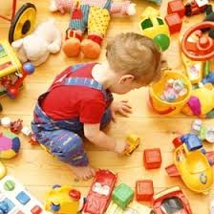
The problem of referential uncertainty
Notes:
So what: Explain why language acquisition might be a difficult challenge
Subtask of the lexical acquisition process – word-to-meaning mappings
Quine, Siskind

Slide 9
Reducing uncertainty with social information
Notes:
Chen Yu
Linda Smith
Kenny Smith
Siskind, Pinker, Fiser

Slide 10
Reducing uncertainty with cross-situational statistics
Notes:
Bloom
Baldwin
Brooks & Meltzoff

Slide 11
Within each view, there are debates about the underlying mechanism
Single vs. Multiple Hypotheses testing
Social cues as
spotlights for attention
revealing intention
Notes:
Bloom
Baldwin
Brooks & Meltzoff

Slide 12
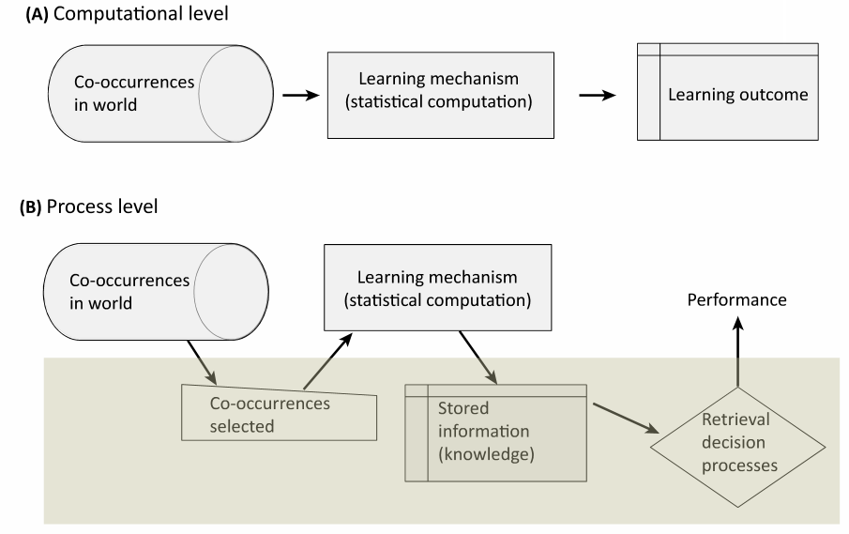
Researchers debate the underlying mechanism that supports cross-situational word learning
Notes:
Trueswell & Medina, 2012
Yurovsky & Frank, under review

Slide 13
Social cues: constraints, communicative, or pedagogical?
Yu and Ballard, 2007 – constraints
Frank, Goodman, & Tenenbaum, 2009 – communicative
Xu & Tenebaum, 2007 – strong sampling v. weak sampling
A rich literature demonstrates that social pragmatic cues, such as pointing and eye-gaze, are highly beneficial in early word learning
Akhtar and Tomasello, 1996; Moore et al., 1999; Graham et al., 2010; Grassmann and Tomasello, 2010)

Slide 14
Integrating statistical and social word learning
Yu and Ballard, 2007
Frank, Goodman, & Tenenbaum, 2009
Wu et al., 2012
Caza & Knott, 2012

Slide 15
Roadmap
The puzzle of word learning and solutions to the problem of referential uncertainty
Word learning as Bayesian Inference
captures uncertainty in learning
A novel, large-scale experiment and computational model

Slide 16
Large-scale experiment manipulating attention and memory demands in a cross-situational learning task
XXX participants on Amazon Mechanical Turk
Restricted to US IP addresses and > 95% approval rate

Slide 17



Same trials
Exposure Trial
Test Trial
Notes:
Focusing on the role of social information during initial exposure to word-object mapping
My experiment is not really xsit learning, but one shot exposure.
So really exploring the role of social cues in the inferences that learners’ make during initial bouts of learning (referent selection)

Slide 18
Switch trials
Exposure Trial
Test Trial
Notes:
Focusing on the role of social information during initial exposure to word-object mapping
My experiment is not really xsit learning, but one shot exposure.
So really exploring the role of social cues in the inferences that learners’ make during initial bouts of learning (referent selection)

Slide 19

Including social information
“You will meet a speaker named Tina, who
will look at some objects and talk about them.”

Slide 20
Non-social exposure trials

Slide 21
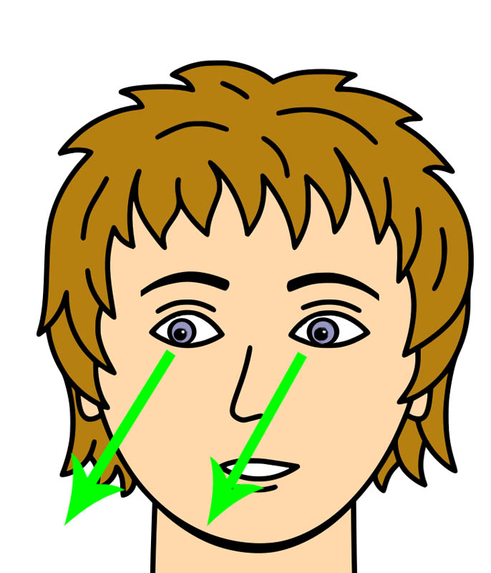
Social exposure trials

Slide 22
All test trials were “non-social”

Slide 23






Varied the number of referents on exposure trials

Slide 24
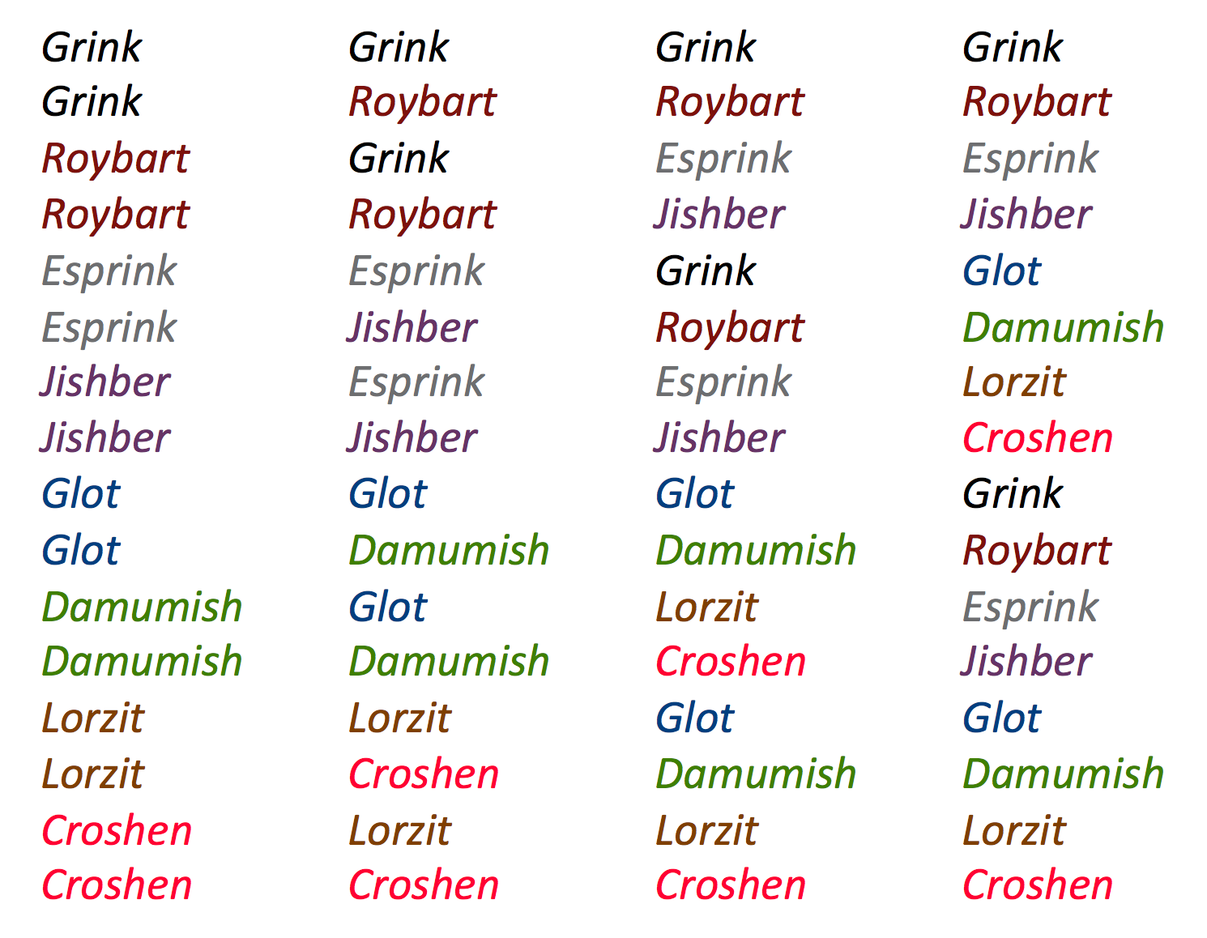
Varied the delay between exposure and test
Zero
One
Three
Seven

Slide 25
Exposure trials

Slide 26
Accuracy

Slide 27
Reaction time

Slide 28
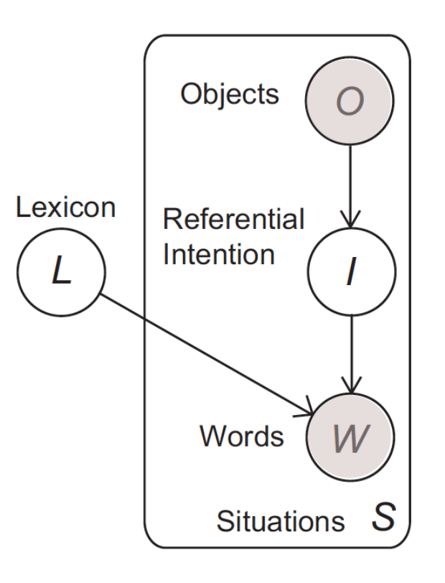
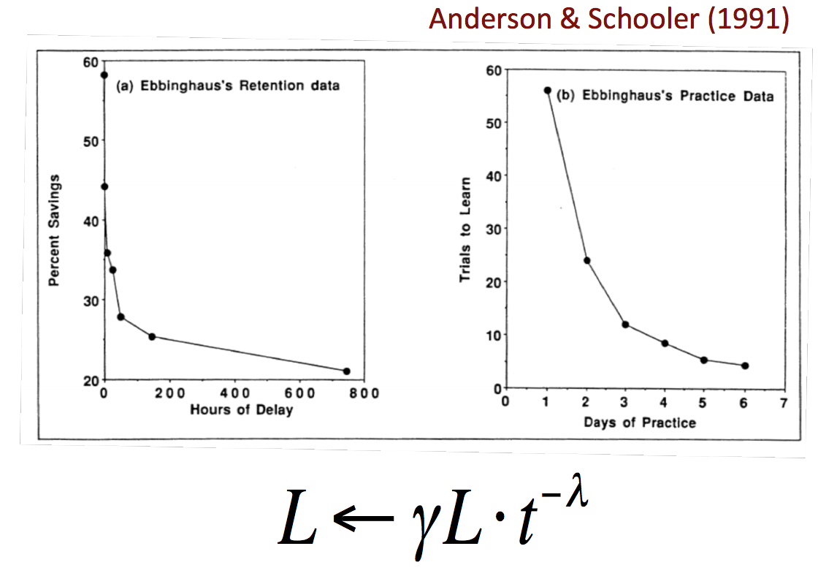
Word learning as joint inference about a speaker’s referential intent and the correct word-object mapping

Slide 29
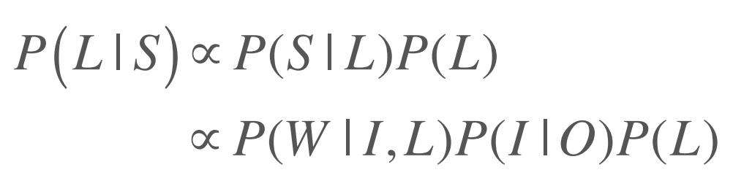
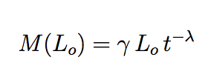
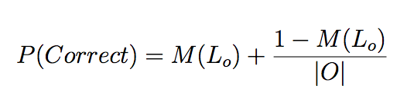
Word learning as joint inference about a speaker’s referential intent and the correct word-object mapping

Slide 30
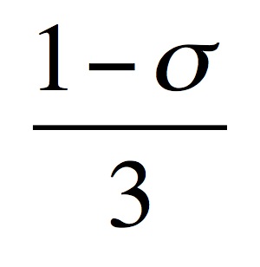

The model includes parameters that capture:
belief
memory

Slide 31
Varying single parameters does not capture human performance

Slide 32
Simulations

Slide 33
Eye gaze as pedagogy
Bonawitz, 2011
Shafto et. al, 2012
Gergely & Csibra, 2009

Slide 34
Conclusions

Slide 35
Developmental predictions
Dan’s data show that kids aren’t great at switch trials, but this is an explicit judgment. What if you could use eye gaze like Chen and Smith to investigate how social information interacts with XSL online?

Slide 36
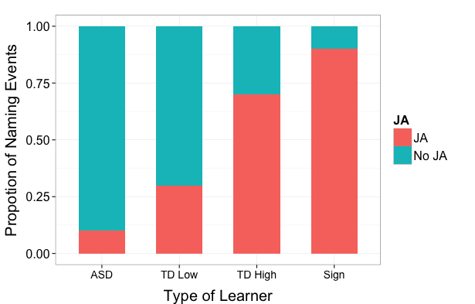
Hypothetical distribution of labeling events with social cues

Slide 37
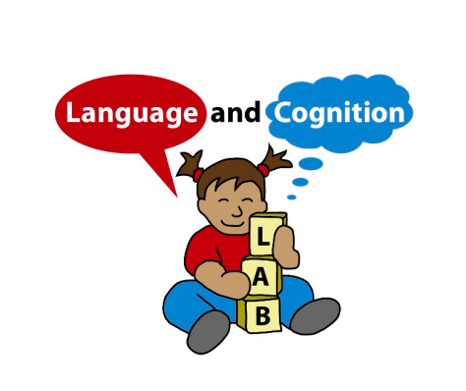
Acknowledgements
Michael Frank
Dan Yurovsky
Frank Lab
Markman Lab
Devostuds
First-year cohort
Thank you for your attention and memory (hopefully)

Slide 38
Statistical learning at scale
These differences may make
contenders for the label’s referent more memorable
across trials, and they may limit the number of
contenders – even when not clearly indicating the
correct one.
The accessibility of (potentially misleading)
social cues may also differ between the views.
For instance, mother’s gaze does not reliably predict refer-
ence in many naming events (Frank et al., in press).
While analyses of head-camera views suggest that
children access their mother’s gaze infrequently (Fran-
chak, Kretch, Soska & Adolph, 2011; Smith et al.,
2011), the third-person view makes gaze more readily
available.

Slide 39
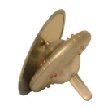

Dofa

Slide 40
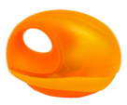
Dofa

