Slide 1
Referential cues modulate the allocation of attention during cross-situational word learning

Slide 2
Resource rationality
Learners must deal with referential ambiguity in order to learn new words.
Learners have limited cognitive resources (attention, memory), and need to make decisions about the optimal way to use these limited resources.
How learners choose to allocate attention to possible referents varies based on the presence of referential cues.
Notes:
During word learning, if you could store and retrieve all the objects that you see when you hear a new word, then the problem becomes trivial. But since attention and memory are limited resources, there is a debate about whether learning looks more like single hypothesis tracking or a more distributed form of co-occurrence or hypothesis tracking.

Slide 3
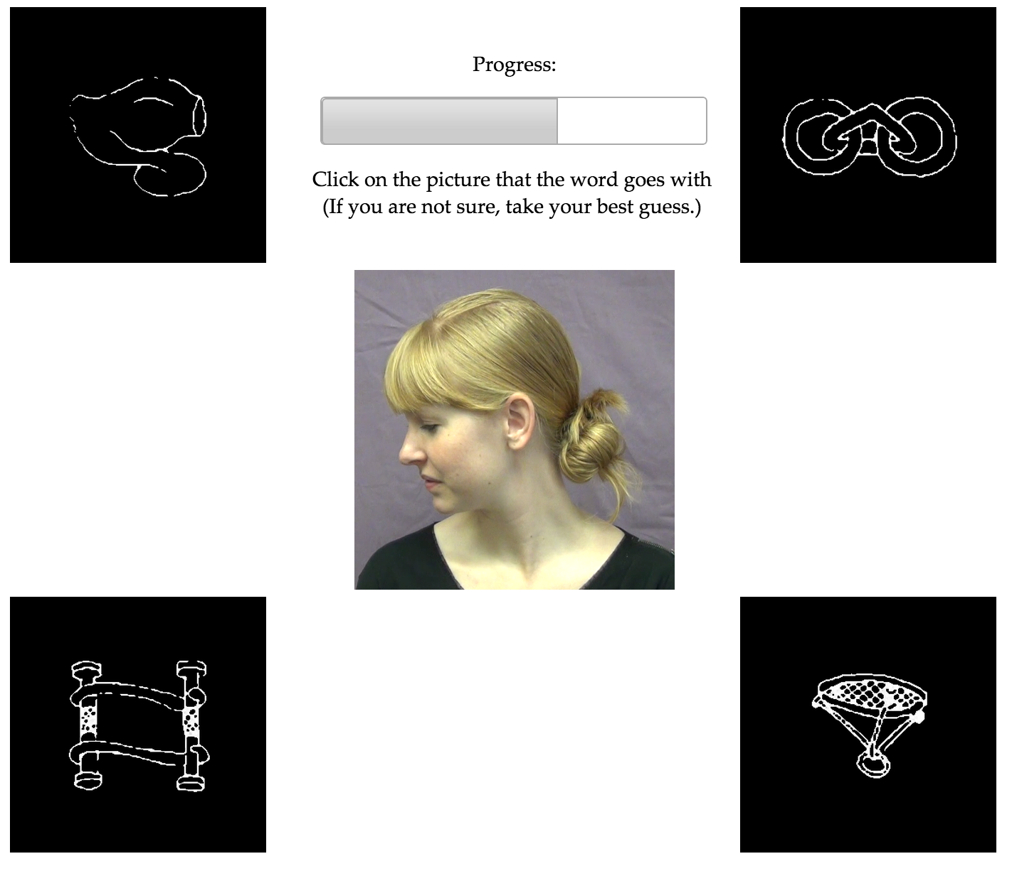
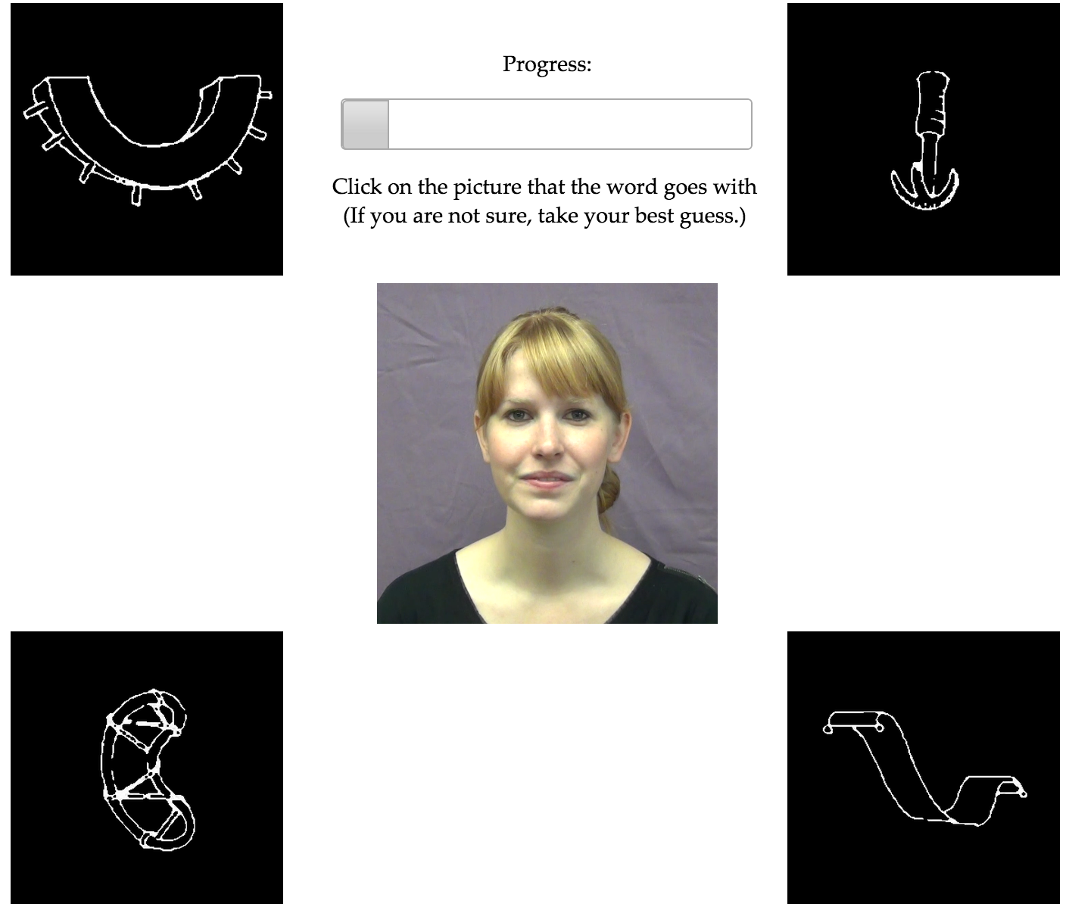
Social learning trials
Non-social learning trials

Slide 4
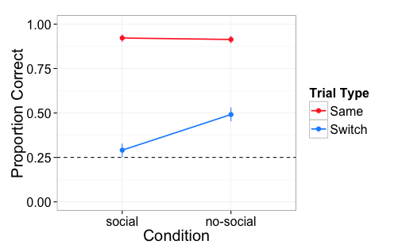
Accuracy on same/switch trials
Notes:
92% of exposure trials participants chose the target of eye gaze
With eye gaze during exposure, participants spent less time making a decision and did not show evidence of tracking the alternative referents. I think this shows evidence that participants were allocating resources differently based on the evidence they were given.

Slide 5
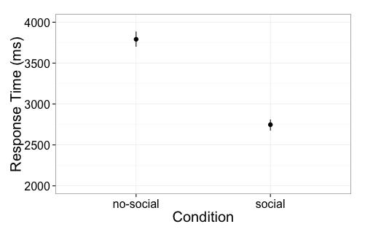
Participants take longer to respond on no-social exposure trials

