Slide 1
XSIT_SOC

Slide 2
Experiment 0
methods

Slide 3
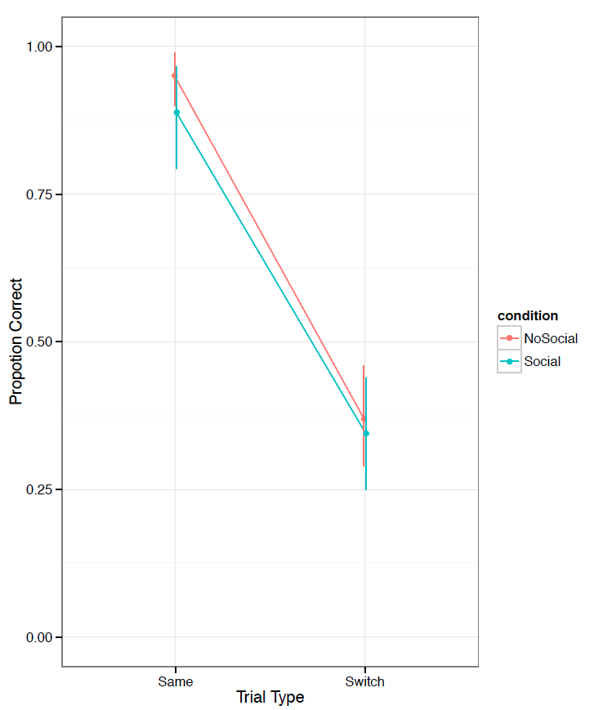
Experiment 0: Data
Failure
No diff between social and no-social conds
Participants not choosing the target of gaze on exposure trials

Slide 4
Experiment 1
Changes
Name of speaker: Tim → Tina
Arrows from eyes to make target of gaze more clear

Slide 5
Experiment 1 data

Slide 6
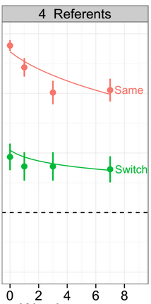
Side by side with Dan’s data

Slide 7
Does sigma create predicted pattern?
No.

Slide 8
How about lambda?
No.

Slide 9
How about gamma?

