Slide 1
SOC_XSIT

Slide 2
Experiment 0
Methods
Adapt Dan’s xsit_min paradigm to include social cue to reference during exposure trials
4 referents → chosen because this is where we might see the biggest difference between social and no-social
0 intervening words → chose simplest interval condition

Slide 3
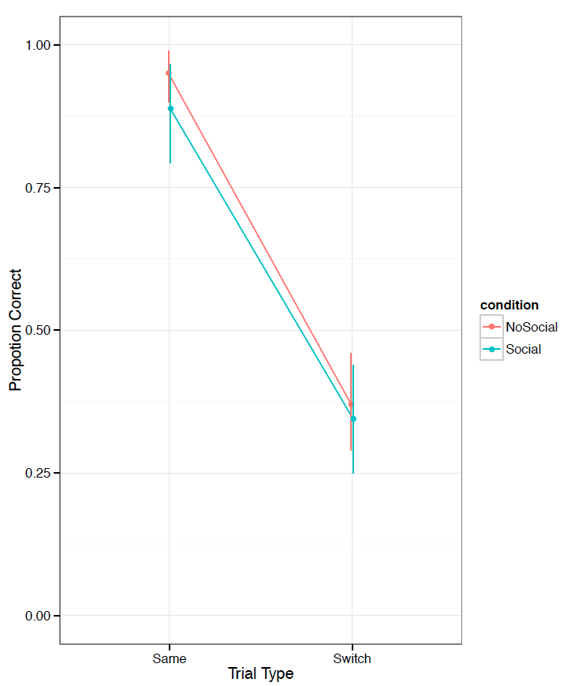
Experiment 0: Data
Failure
No diff between social and no-social conds
Participants not choosing the target of gaze on exposure trials

Slide 4
Experiment 1
Changes
Name of speaker: Tim → Tina
Arrows from eyes to make target of gaze more clear

Slide 5
Experiment 1 data
Three way interaction between condition, trial type, and interval

Slide 6
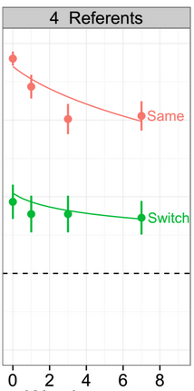
Side by side with Dan’s data

Slide 7
Model
same_trial_strength <- gamma * sigma * (int+1)^-lambda
switch_trial_strength <- gamma * ((1-sigma) / (numPic-1))*(int+1)^-lambda
gamma=1.5, # strength of initial encoding
lambda=.15, # rate of memory decay
sigma=.5, # amount of intention to initial hypothesis
numPic=4, # number of intervening words
int=0 # number of pics

Slide 8
Does sigma create predicted pattern?
No.

Slide 9
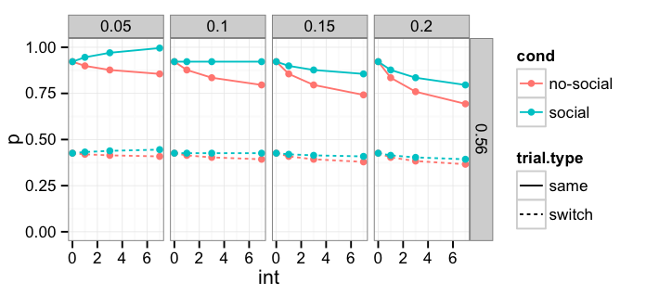
How about lambda?
No.

Slide 10
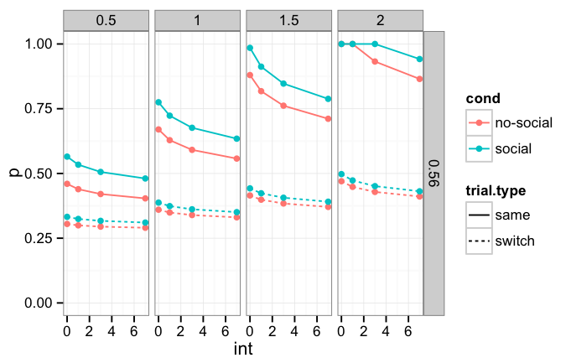
How about gamma?
No.

Slide 11
How about ?

Slide 12
Experiment 2: Replication
Replication of three-way interaction
Included more interval conditions
0, 1, 3, 7

Slide 13
Experiment 2 data

