Slide 1

Airport and Airline Management System
PL/SQL Oracle Database Capstone Project
Name: Eric BIKORIMANA ID: 27928 Group: D (Thursday)
AUCA -Database Development with PL/SQL
(INSY 8311)

Slide 2
Problem Statement
Issue
Airport operations require managing complex relationships between flights, passengers, aircraft, and bookings, which manual systems cannot efficiently handle, leading to errors and data inconsistency.
Context
Manual processes lead to data inconsistency, booking conflicts, and inefficient resource utilization
User
Airport staff, airline operators, booking agents, and system administrators

Slide 3

Solution Overview
Objectives
Centralized database system with automated business logic and real-time data management
Scope
Flight scheduling, passenger bookings, aircraft management, ticketing, and revenue tracking
Features
Advanced PL/SQL implementation with packages, triggers, procedures, and
comprehensive audit trails
Benefits
Data integrity, automated workflows, role-based access, and business intelligence

Slide 4
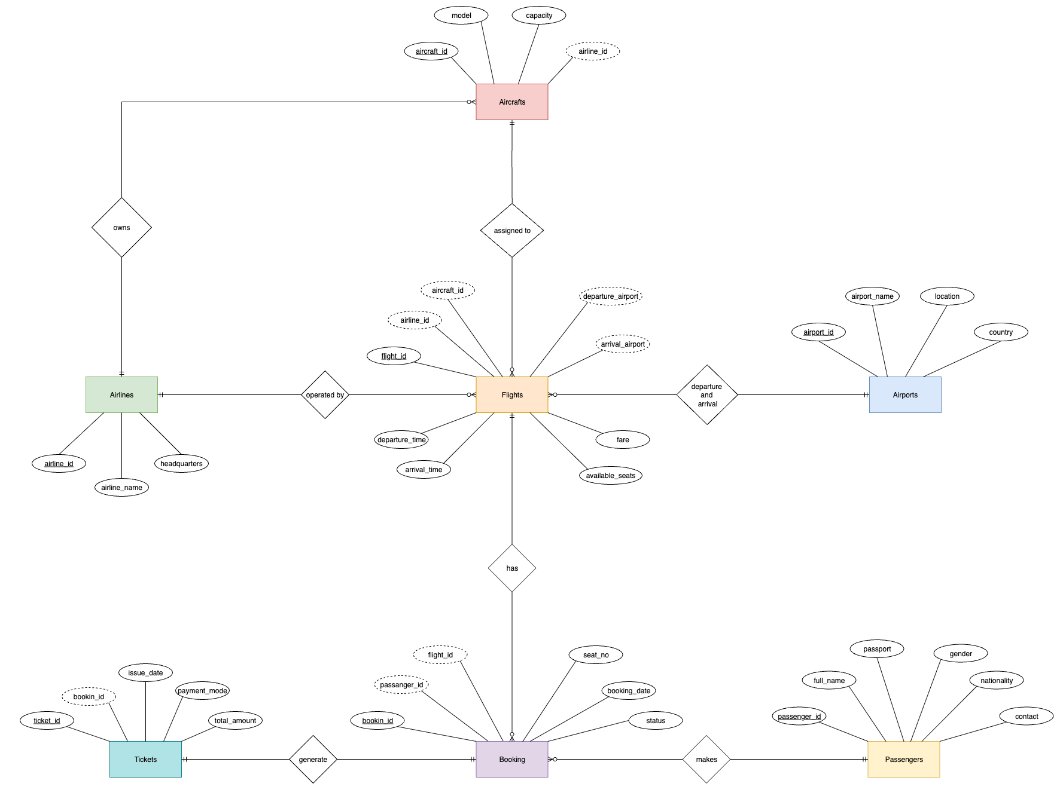
Database Architecture
ER Diagram
Table
Core Entities((7 tables)
Employees table
Holidays table
Airports table
Aircrafts table
Airlines table
Flights table
Booking table
Tickets table
Passengers table
Audit tables
Audit_log table
Flight_audit_log table

Slide 5
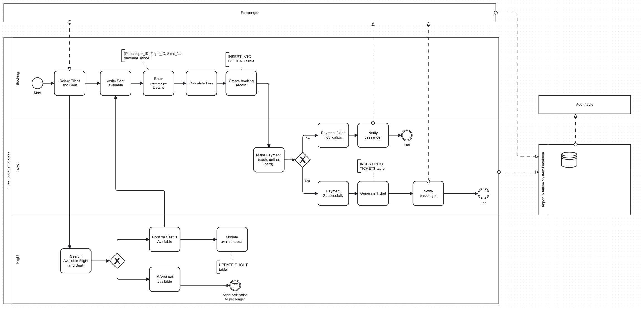
Business Process Workflow
Ticket Booking Process

Slide 6
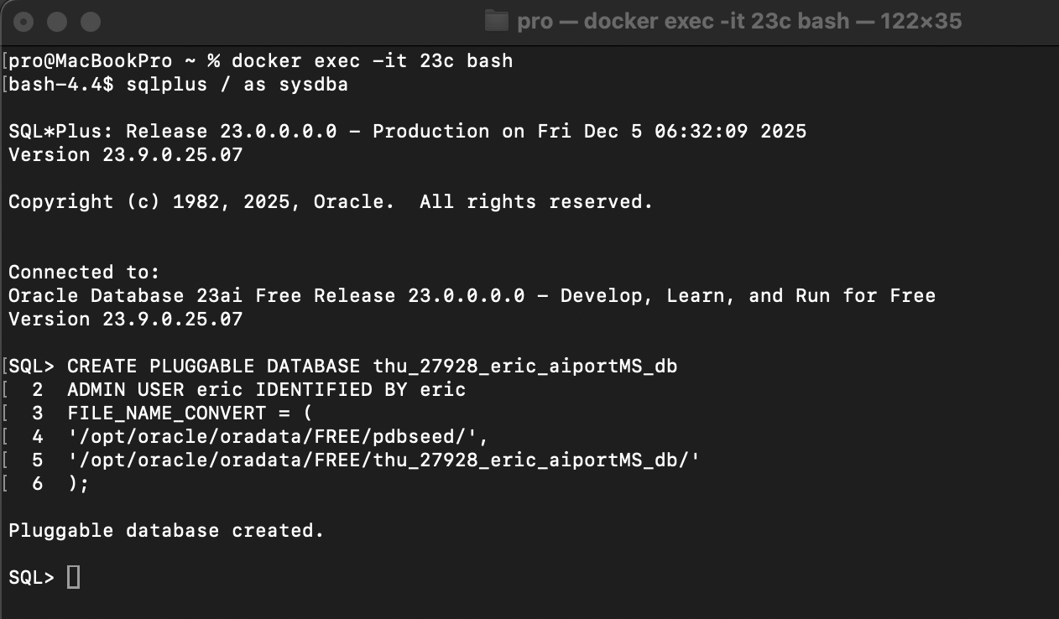
Technical Implementation
Technology:
Oracle Database 23c
SQL Developer
Visual Studio Code
Draw.io
Pluggable Database: thu_27928_eric_aiportMS_db(PDB)
Database name: eric
Database user: eric
PL/SQL Logic:
Package: airport_mng_pkg encapsulates all logic.
Procedures(9): add_flight, book_ticket, cancel_booking, update_flight_details, list_flights_from_airport, passenger_flight_summary, show_upcoming_flights, show_flight_passengers, generate_revenue_report.
Functions(5):
get_available_seats, calculate_flight_duration, get_total_revenue, get_booking_count, is_seat_available.

Slide 7

Advanced Features: Triggers, Auditing & Security
Trigger System (14 Triggers)
Comprehensive Auditing
Universal audit (8), Flight audit (1)
PRAGMA AUTONOMOUS_TRANSACTION ensures audit logs survive rollbacks
Role-Based Security
ADMIN, MANAGER, AGENT roles with granular permissions and time-based restrictions

Slide 8
BI & Analytics
The BI solution uses Oracle Database with PL/SQL as the primary data source and supports analytical queries, and management reports.
The BI system aims to:
Monitor daily passenger traffic and booking volumes
Analyze revenue performance by route and country
Identify booking and cancellation trends
Key Performance Indicators (KPIs)
Daily Passenger Traffic:
Shows the number of passengers traveling each day
2. Revenue Per Route:
Calculates total revenue for each flight route
3. Booking Trends Analysis:
Analyzes booking patterns by day of week and month

Slide 9
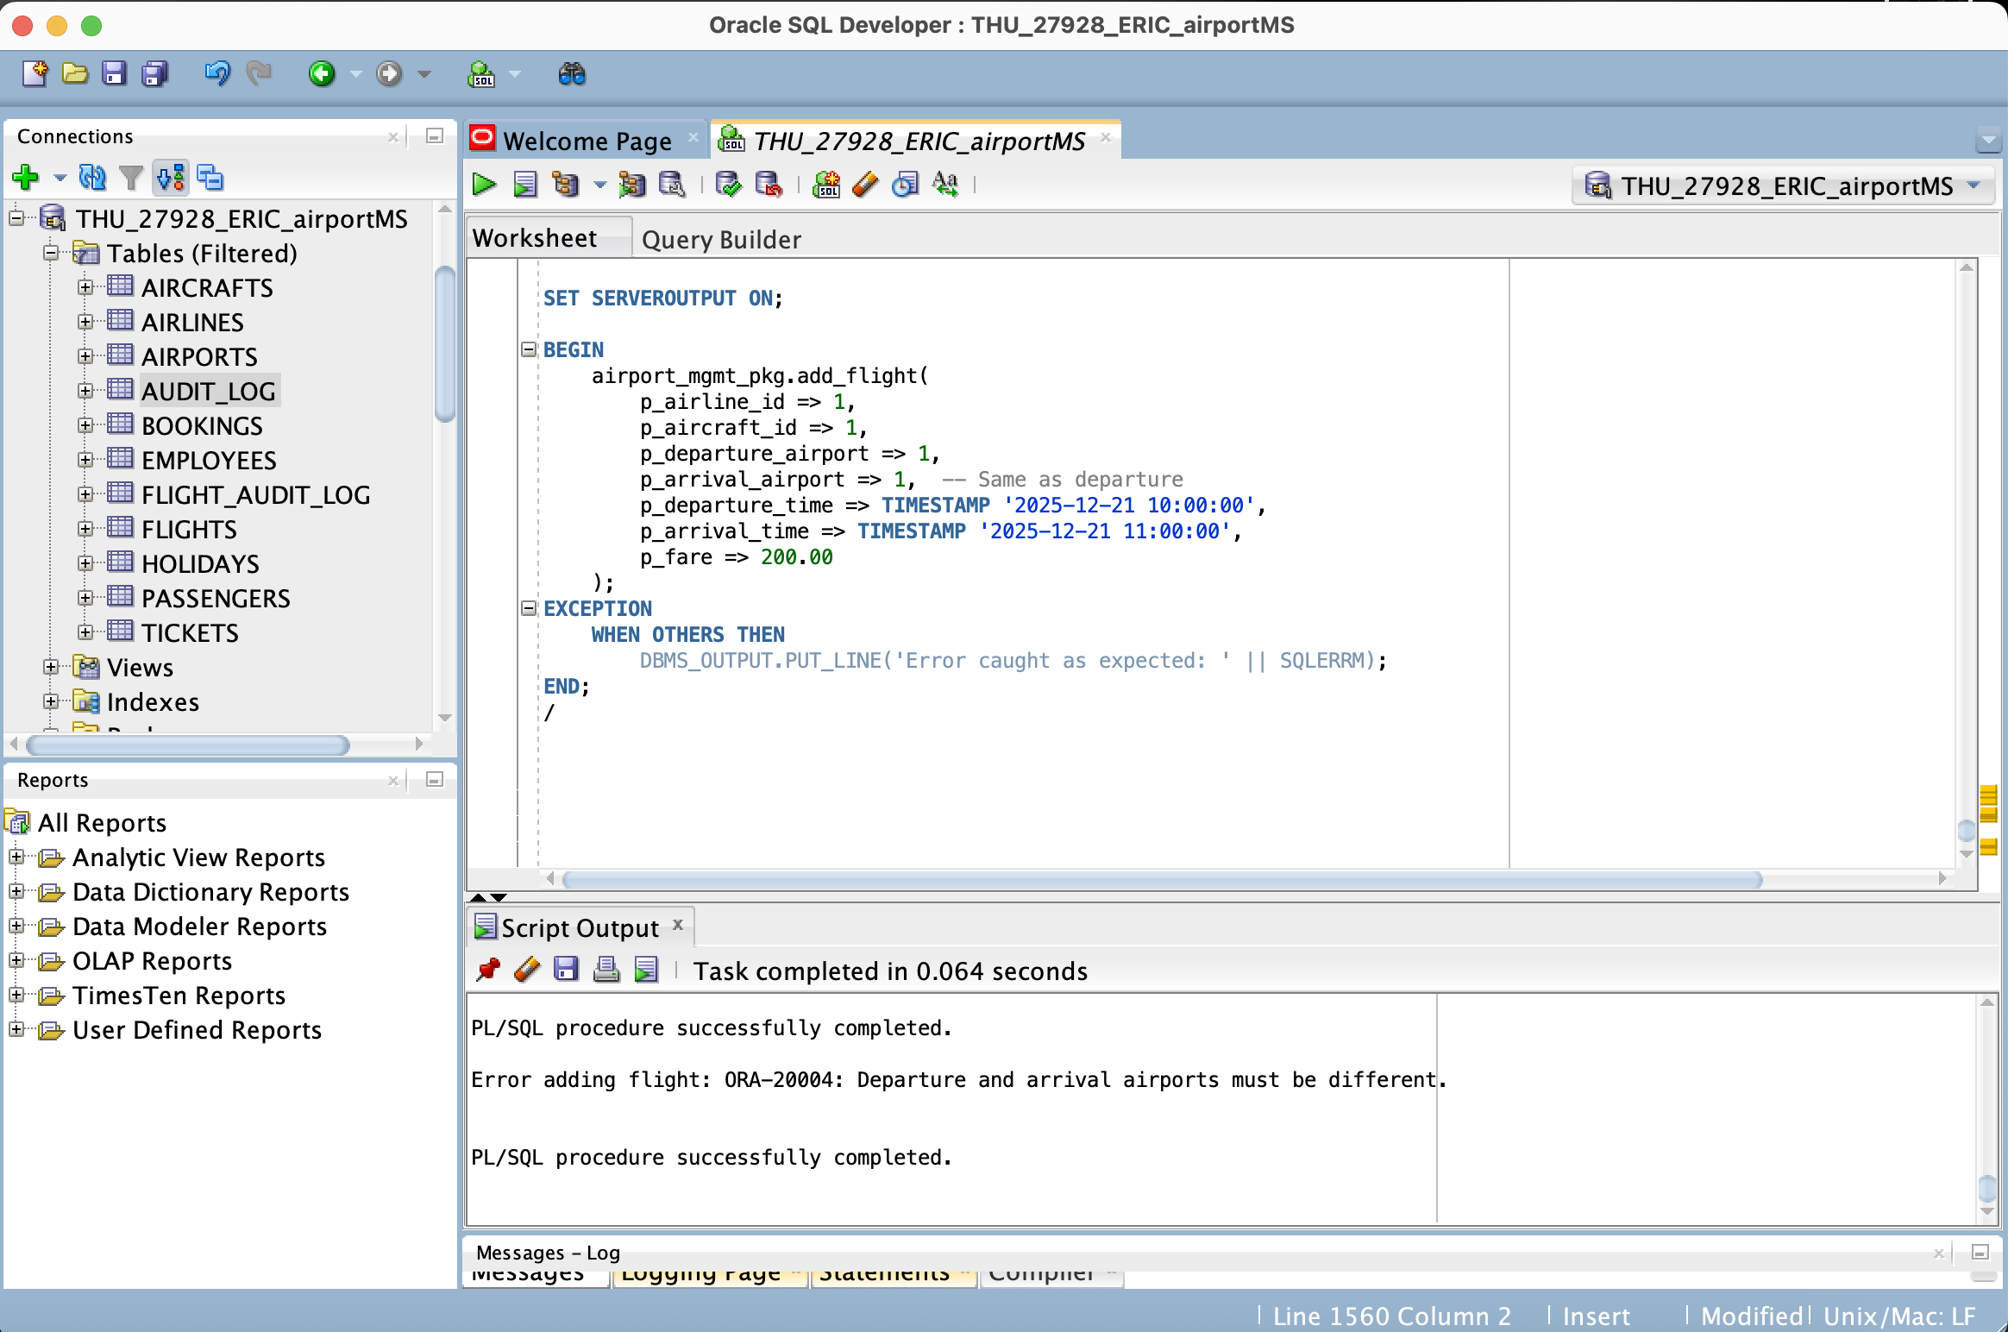
Test Results
Business rule enforcement: Constraints validating that CHECK(departure_time < arrival_time)
Transaction Safety: The system blocks flights with identical departure and arrival airports, raising exception to enforce business logic and protect data integrity. (Rollback on error).
Test Evidence:

Slide 10
Conclusion & Future Enhancements
Achievements:
Fully functional, secure PL/SQL backend.
Implemented complex logic (Triggers, Packages).
Met all security and auditing requirements.
Lessons Learned: Importance of Autonomous Transactions for security logging.
Future Enhancements:
Integration with Real-Time Flight Tracking Systems
Intelligent Baggage Tracking System
Advanced Business Intelligence and Predictive Analytics
Weather Impact Analysis

