Slide 1
Free IPTV
App Description Document
Eric Blanquer

Slide 2
Revision History
Version | Date | Description | Author
1.0 | 2026-03-29 | Initial submission | Eric Blanquer
1.1 | 2026-03-31 | Added app preview images and screenshots | Eric Blanquer

Slide 3
Contents
1. UI Structure
2. Usage Scenario
3. Menu & Function Description
4. Key Policy
5. How to Change Languages

Slide 4
1. UI Structure
Home Screen
├── Live TV → Browse (categories + channel list) → Player
├── Movies (VOD) → Browse (categories + movie grid) → Details → Player
├── Series → Browse (categories + series grid) → Details (seasons/episodes) → Player
├── Manga → Browse (filtered VOD + Series)
├── Sport → Browse (filtered VOD)
├── Entertainment → Browse (filtered VOD)
├── History → Browse (watch history) → Player
├── Downloads → Browse (offline content) → Player
└── Settings
├── Manage Playlists (add/edit/delete M3U or API Server)
├── Language
├── Remote Configuration (QR code)
├── Text Size (small/medium/large)
├── Text-to-Speech
├── Stream Proxy
├── APIs (TMDB, OpenSubtitles, SubDL)
└── Premium / Support
Note: Live TV and Settings are always visible.
Movies, Series, Sport, Manga, Entertainment and History sections appear only when an API Server playlist is configured.

Slide 5
2. Usage Scenario
First Launch (No playlist configured)
1. App launches and shows Home screen with only "Live TV" and "Settings" buttons
2. User navigates to Settings
3. User selects "Manage playlists" and presses Enter
4. User selects playlist type: "M3U" or "API Server"
5. For M3U: user enters a playlist URL (e.g., https://iptv-org.github.io/iptv/index.m3u)
6. For API Server: user enters server URL, username, and password
7. User selects "Save" and returns to Home
8. App loads playlist data and shows all available sections
Watching Live TV
1. From Home, user selects "Live TV"
2. Browse screen shows categories on the left, channels on the right
3. User navigates categories and selects a channel
4. Player starts streaming the selected channel
5. User can change channels with Up/Down keys
6. Press Return to go back to channel list

Slide 6
2. Usage Scenario (continued)
Watching a Movie (VOD)
1. From Home, user selects "Movies"
2. Browse screen shows movie categories and movie posters
3. User selects a movie to see details (synopsis, cast, rating from TMDB)
4. User selects "Play" to start playback
5. During playback: Left/Right to seek, Enter to pause/resume
6. User can select subtitle tracks and audio tracks
Remote Configuration
1. User opens Settings
2. Under "Remote Configuration", a QR code is displayed
3. User scans QR code with phone/computer
4. Opens iptv.blanquer.org where user can configure playlists remotely
5. Configuration is synced to the TV app

Slide 7
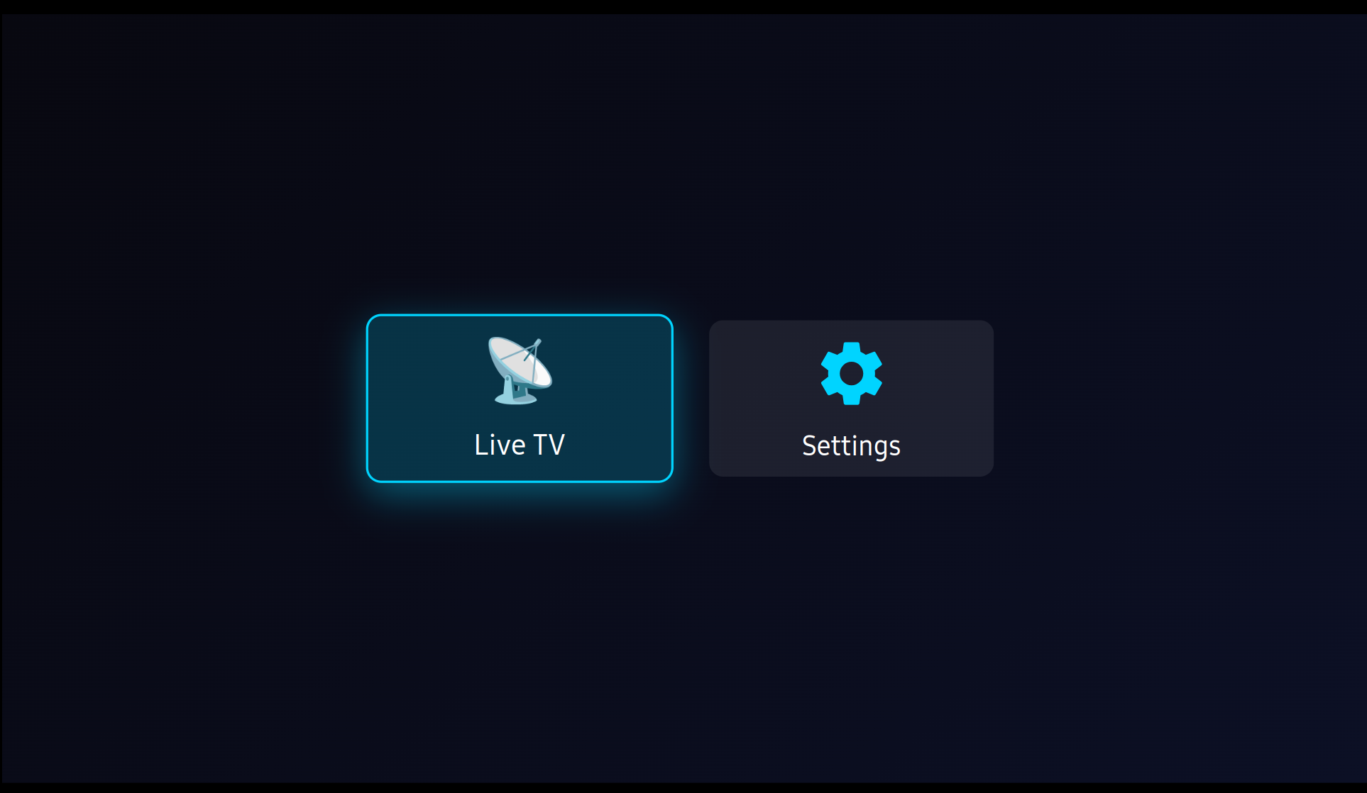
3. Menu & Function Description
3.1 Home Screen
Grid of buttons to access available sections. Live TV and Settings are always visible.

Slide 8
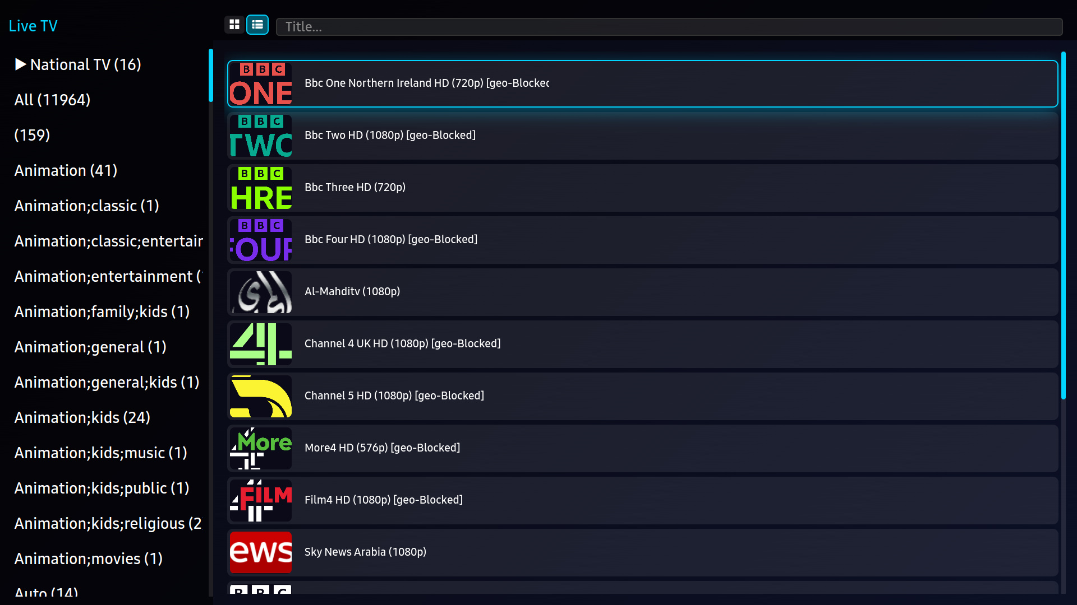
3. Menu & Function Description
3.2 Browse Screen (Live TV)
Left panel with categories. Right panel showing channels. Navigate with Up/Down, select with Enter. Grid or list view toggle available (RED key).

Slide 9
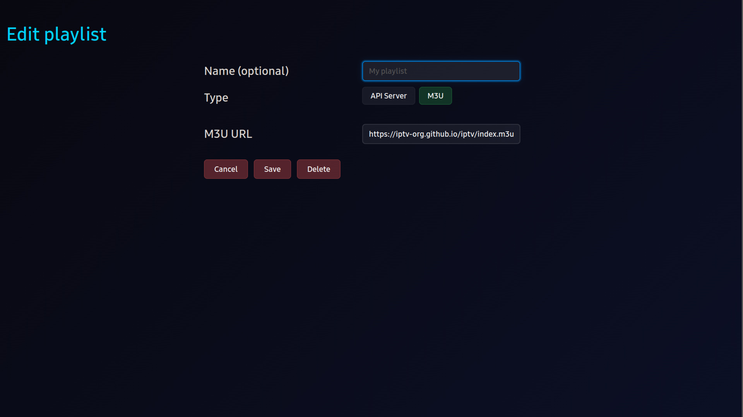
3. Menu & Function Description
3.3 Playlist Management
Add, edit, delete M3U playlists or API server connections. Supports M3U URL and Xtream API server credentials.

Slide 10
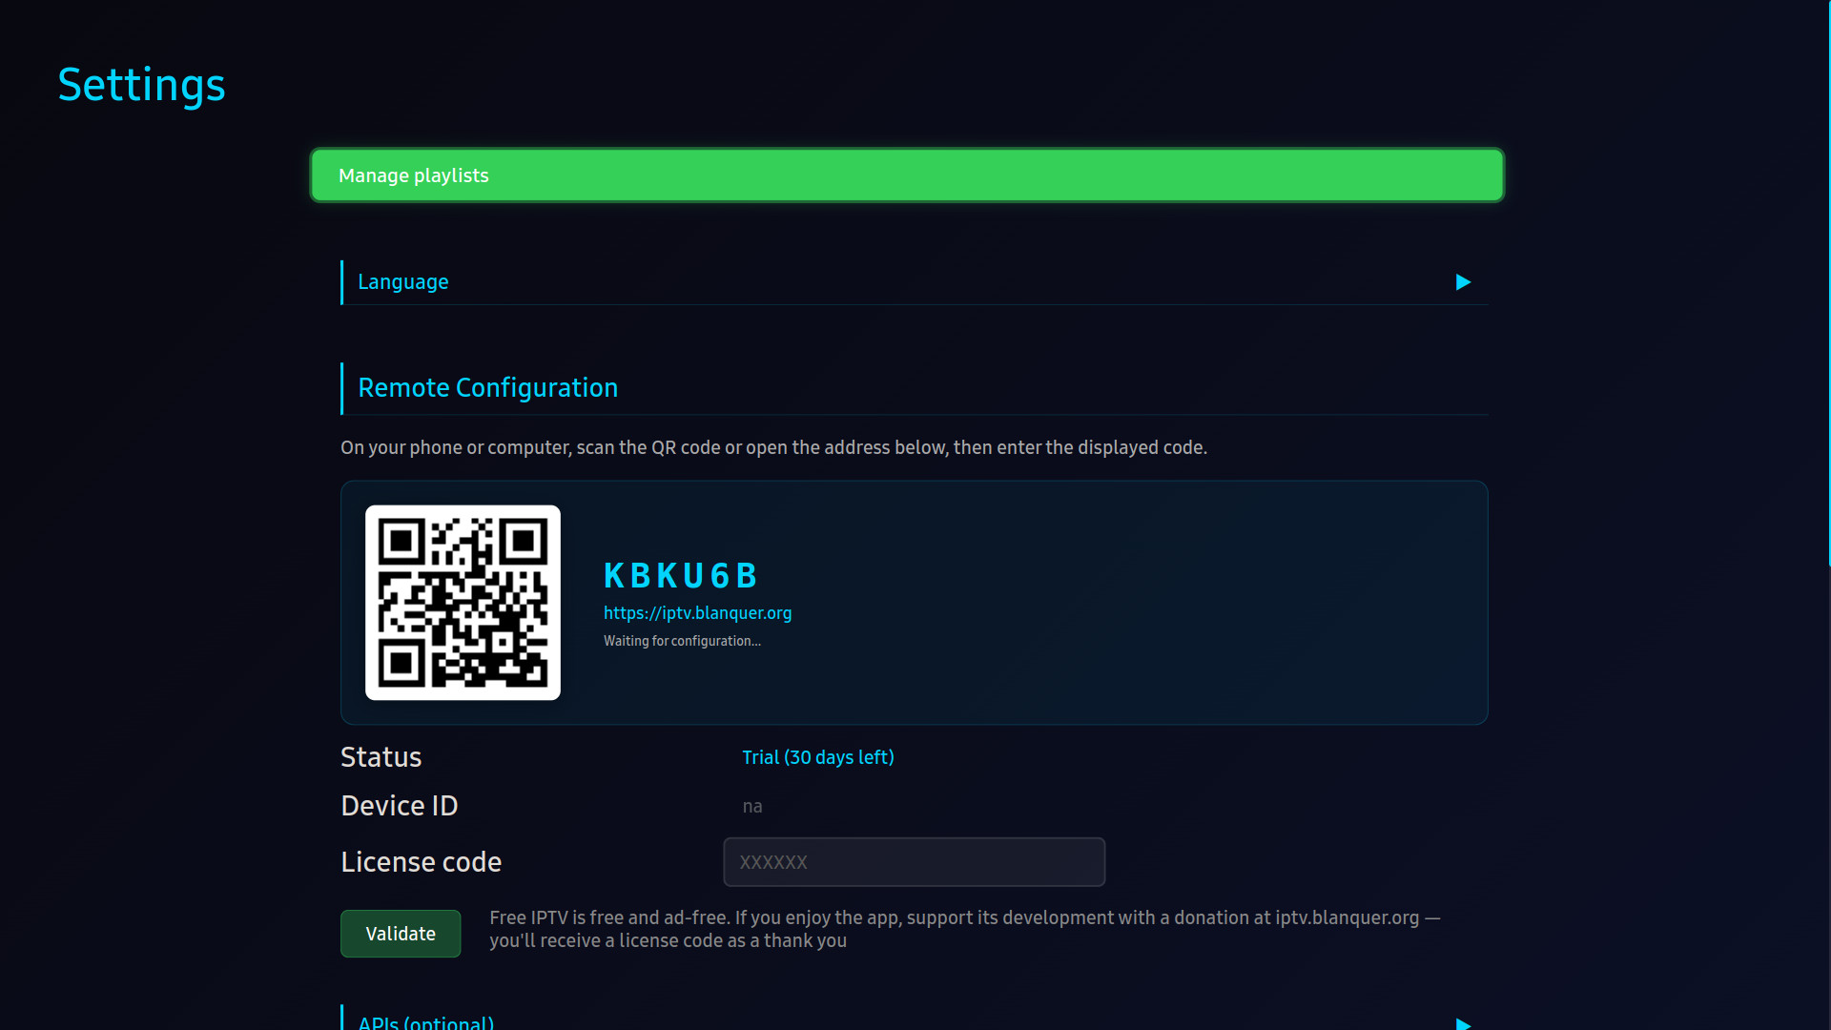
3. Menu & Function Description
3.4 Settings Screen
Configuration options: playlist management, language selection, remote configuration via QR code, license status, API keys, text size, text-to-speech.

Slide 11
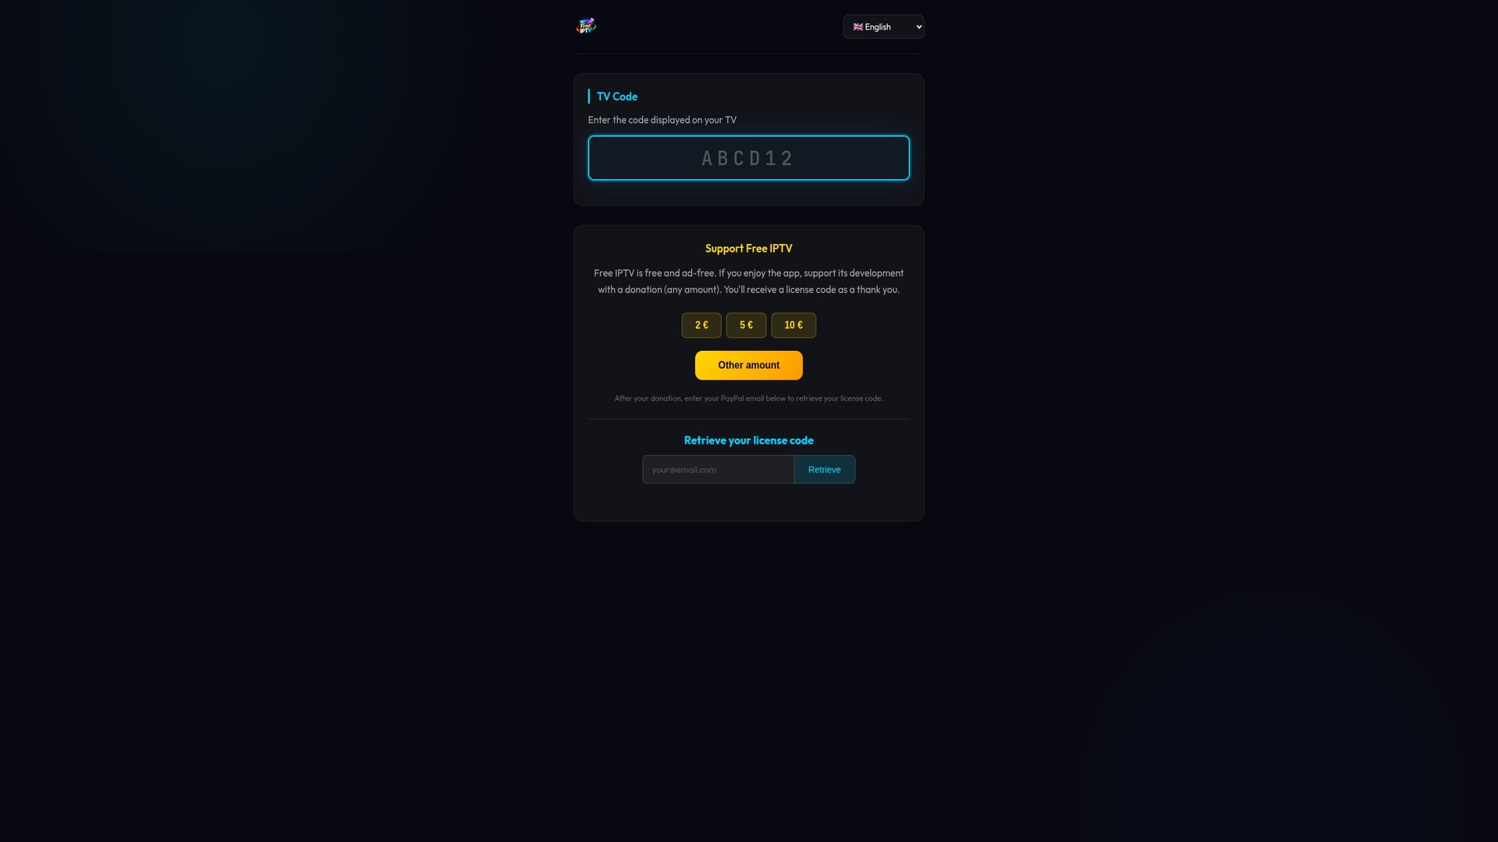
3. Menu & Function Description
3.5 Remote Configuration
QR code displayed in Settings. User scans with phone/computer to configure playlists remotely — configuration is synced to the TV app via iptv.blanquer.org

Slide 12
3. Menu & Function Description
3.6 Function Reference
Screen | Function | Description
Home | Section Navigation | Grid of buttons. Live TV and Settings always visible. Other sections with API Server playlists
Browse | Category Sidebar | Left panel with categories. Navigate with Up/Down, select with Enter
Browse | Content Grid | Right panel showing channels/movies/series. Grid or list view toggle available
Browse | Search | Press Enter on search bar to filter content by title
Details | Movie/Series Info | Shows poster, synopsis, cast, rating (from TMDB if API key configured)
Details | Season/Episode Nav | For series: navigate seasons and episodes
Player | Playback Controls | Play/Pause, Seek (Left/Right), Channel switch (Up/Down for live)
Player | Audio/Subtitle Tracks | Select audio language and subtitle track during playback
Settings | Playlist Management | Add, edit, delete M3U playlists or API server connections
Settings | Remote Configuration | QR code to configure playlists from phone/computer via iptv.blanquer.org
Settings | Language | Change app UI language (11 languages available)
Settings | Text Size | Adjust text size: Small, Medium, Large
Settings | TTS | Enable/disable Text-to-Speech voice guidance

Slide 13
4. Key Policy
Button | Action | Remarks
ENTER | Select / Play / Pause
UP / DOWN | Navigate menus. In player: change channel (live)
LEFT / RIGHT | Navigate menus. In player: seek backward/forward
Ch. Up / Down | Page up/down in lists
PLAY / PAUSE | Play or pause playback
STOP | Stop playback and return to browse
RED | Toggle grid/list view
GREEN | Add/remove favorites
YELLOW | Sort options
BLUE | Filter options
RETURN | Go back to previous screen | Samsung Mandatory
EXIT | Close the app | Samsung Mandatory

Slide 14
5. How to Change Languages
Item | Details
How to change languages | Go to Settings → Language → Select desired language from the list. Supported languages: English, French, German, Spanish, Italian, Portuguese, Dutch, Polish, Russian, Arabic, Turkish. The app UI language changes immediately after selection. No restart required.

