Slide 1
V2X communication overview and V2I traffic light demonstrator
Martin Eder, Michael Wolf
Embedded Computing Hauptseminar, Prof. Dr-Ing. Hobelsberger
17.1.2017

Slide 2
V2I traffic light demonstrator V2X communication overview
V2X
V2I
Standards and associations
5G Cellular-V2X
IEEE 802.11p
Discussion
V2I Demonstrator
Conclusion

Slide 3
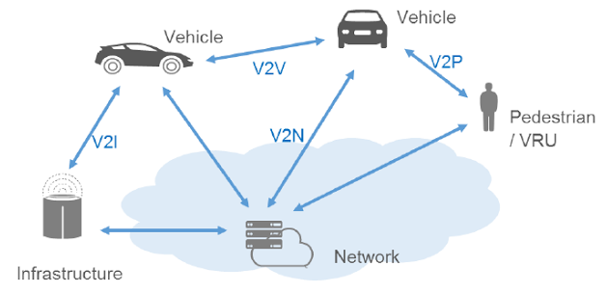
V2X communication overview
[1]
V2X vehicle-to-everything
V2V vehicle-to-vehicle
V2I vehicle-to-infrastructure
V2P vehicle-to-pedestrian
V2N vehicle-to-network

Slide 4
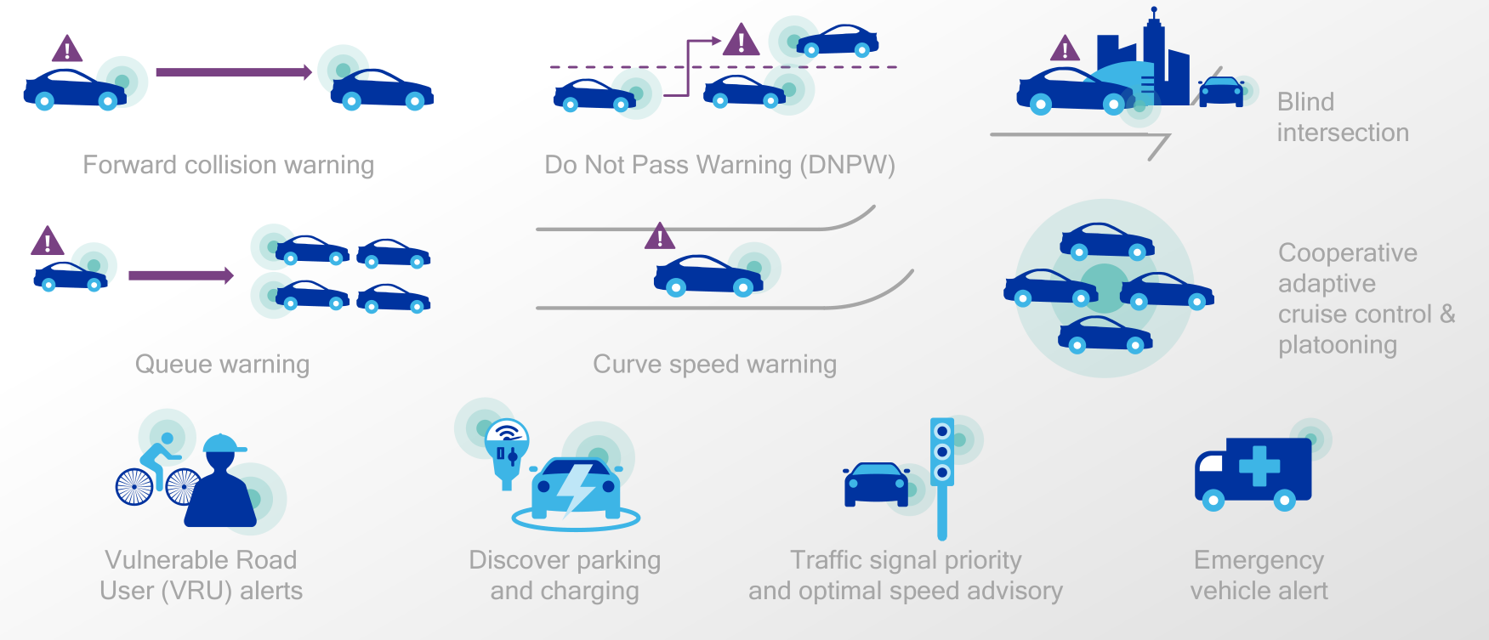
V2X use cases
[2]

Slide 5
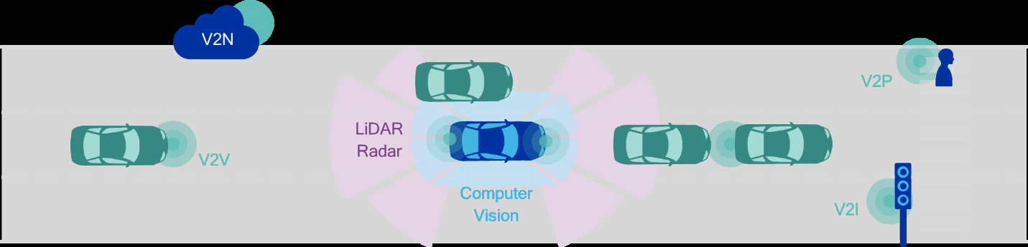
Sensor-fusion and V2X
[3]
World view: each car has global view over itself
Combing on-board sensor data with V2V and V2I data
Belief-Desire-Intention algorithm

Slide 6
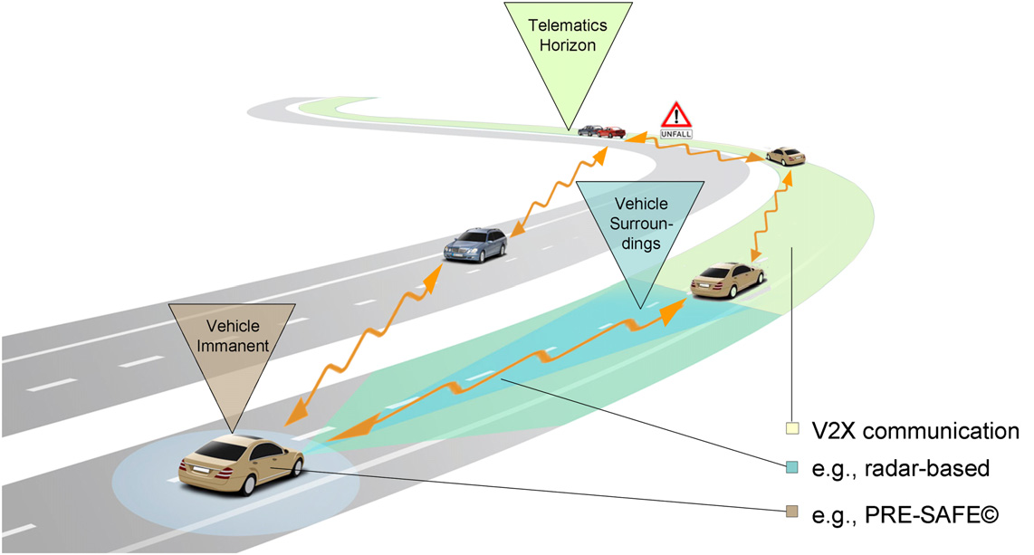
V2V extends safety
[4]
Extensive view of surrounding
Telematics Horizon

Slide 7
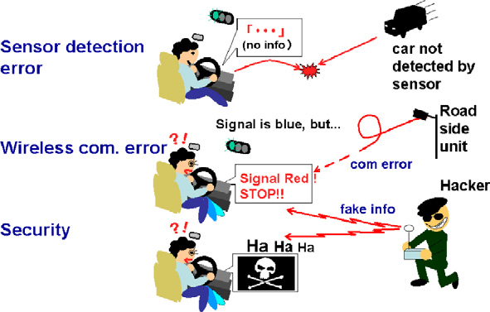
V2I / V2X security issues
[5]
Countermeasures
treat V2X information as suggestion only
Verify, authenticate emergency vehicle by RSU
Peer-to-Peer verification of emergency vehicle (V2V)

Slide 8
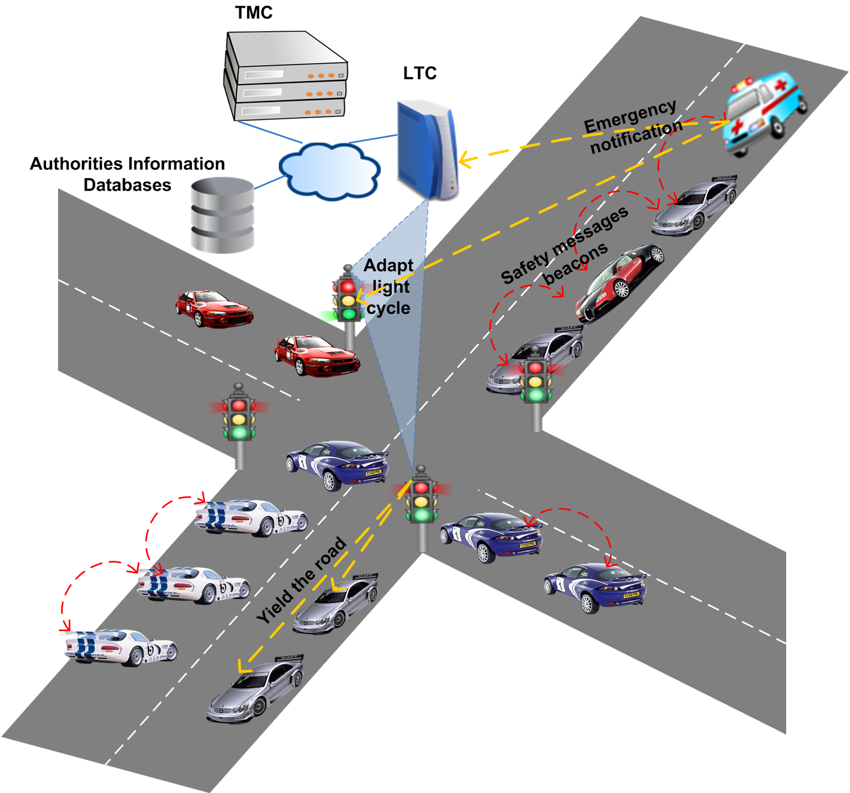
V2I approaching emergency vehicle
[6]

Slide 9
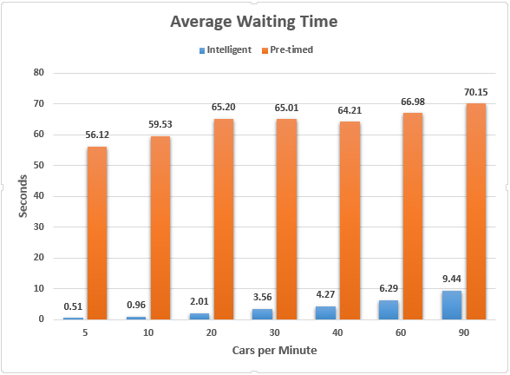
V2I dynamic intersection management
[7]
For each vehicle individually:
dynamically assign time slot to pass intersection
vehicle notifies RSU, if it left intersection
Pedestrians ?

Slide 10
Standards and associations
C2C-Consortium:
Car manufacturers, component suppliers, technology companies and research institutions
Goal: Standard for a Cooperative Intelligent Transportation System (C-ITS) in Europe
Focus on a validation process for V2V and contribute to European standardization authorities
5GAA:
Telecommunication providers, car manufacturers, component suppliers and technology companies.
Pushing 5G LTE services for V2X

Slide 11
Standards and associations
3GPP:
Standardization body for specifying mobile communication standards
Important for V2X: Releases 14/15 (5G LTE)
IEEE:
Standardization committees of a wide range of technologies
IEEE 802.11p Wireless standard

Slide 12
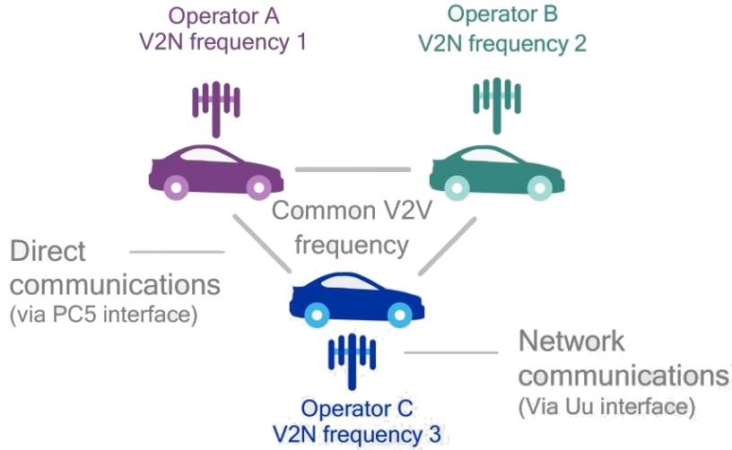
5G Cellular V2X
C-V2X / LTE-V2X based on LTE-Direct
70 MHz of bandwidth
Direct communication over PC5-Interface
Network communication over Uu-Interface
3GPP Release 14 and 15
Ready for market 2018
[8]

Slide 13
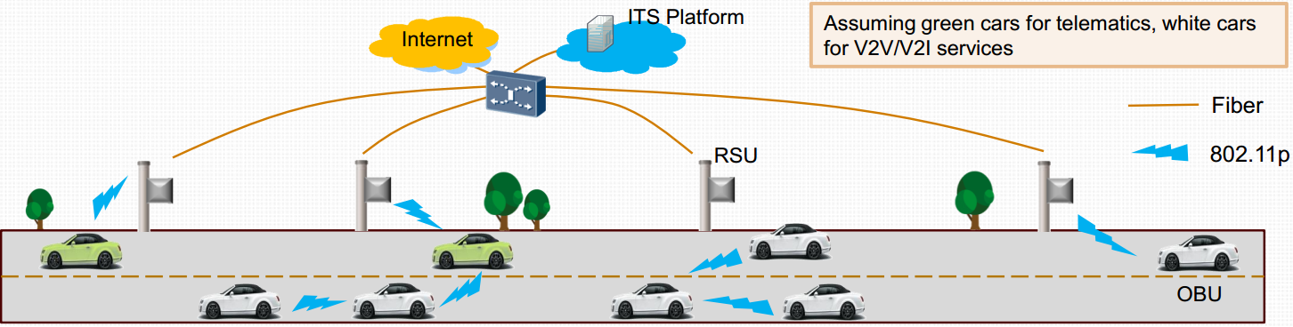
IEEE 802.11p WAVE
Continuation of the IEEE 802.11 radio standard
Low latency V2X use cases
Challenge:
interferences between channels
Network infrastructure:
RSUs needed
Radio equipment needed
Frequency:
5,9 GHz band
restricted
Communication setup:
Solution for slow communication setups
Wave BSS
[9]

Slide 14
C-V2X versus IEEE 802.11p
Different approaches: cellular / WiFi
Performance issues, if IEEE 802.11p has low market share, rural regions
Cellular 4G 5G can provide support
High infrastructure deployment costs
Evolved Packet Core -> 5G (see Europe / Asia)
RSU with IEEE 802.11p Access points
Frequencies must be released for 5G / IEEE 802.11p
IEEE 802.11p is already deployed for V2V
C-V2X is ready for market in 2018
Business model is clear for 5G services, but not for IEEE 802.11p

Slide 15
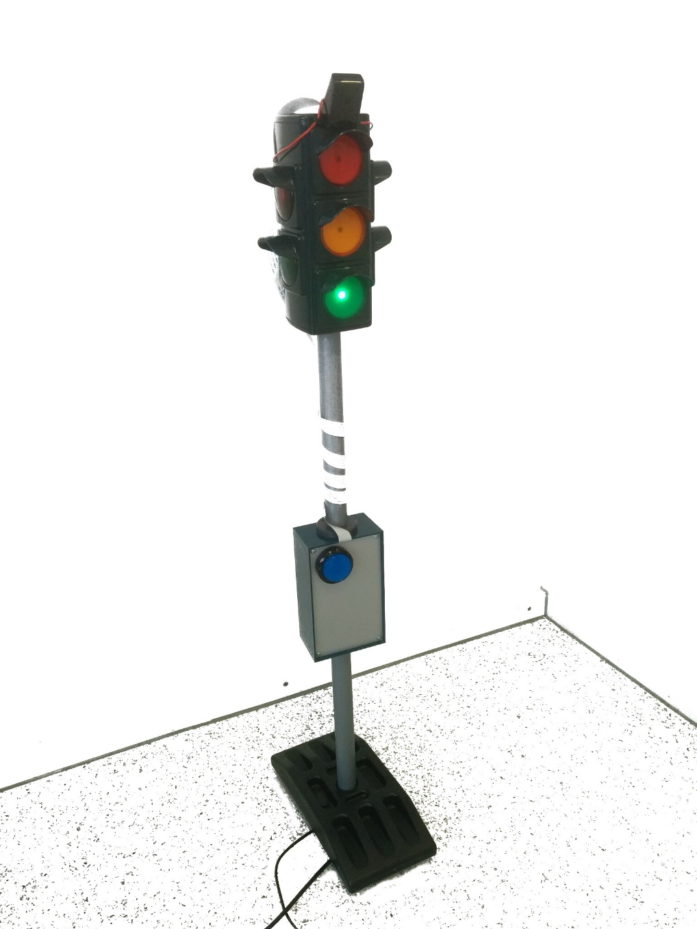
V2I traffic light system

Slide 16
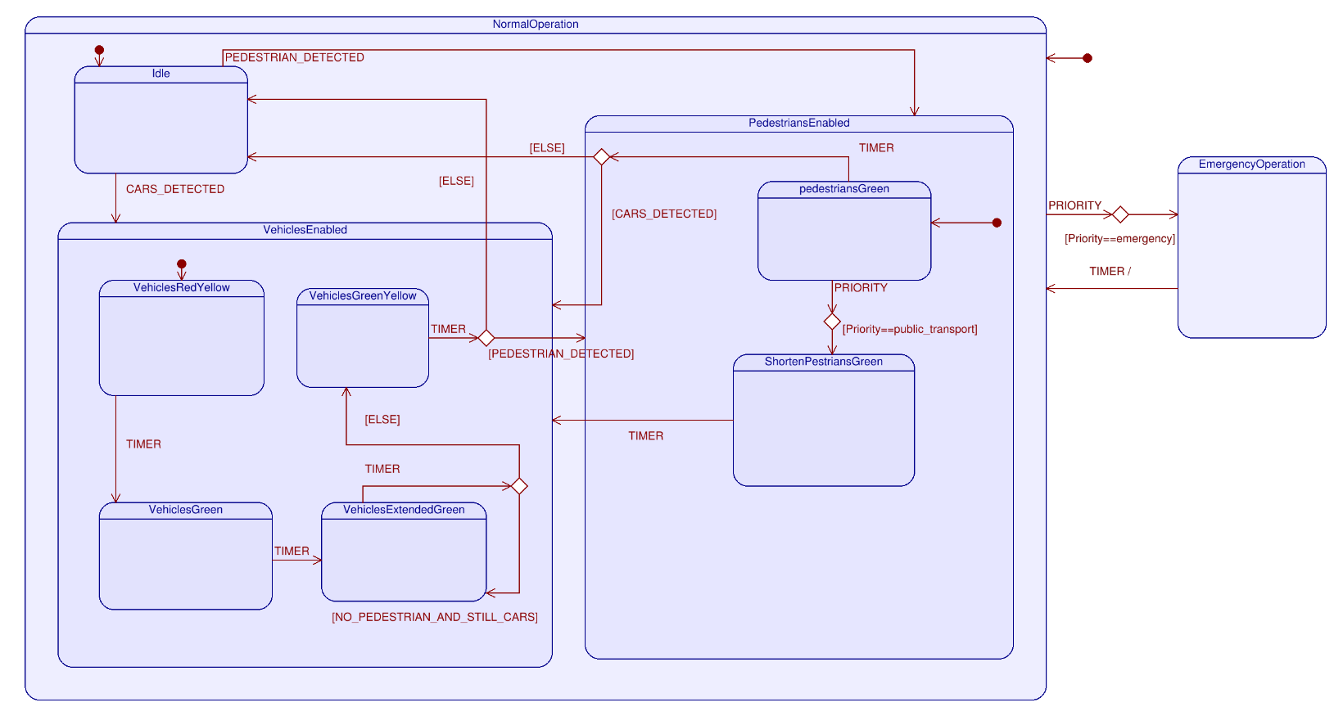
V2I traffic light system UML

Slide 17
Use cases
Green wave
Dynamic traffic light signal cycles
Traffic light status request
Crossing priority for emergency vehicles
Numeric signal cycle indicator for pedestrians

Slide 18
Use cases
Communication interface for pedestrians
Simplified crossing for handicapped pedestrians
Road toll collection
Traffic education
Augmented reality advertisement

Slide 19
Conclusion
V2X key technology for autonomous driving
Paper gives an overview over V2X, V2I
V2X will be deployed in several phases
We are at the beginning of the first phase
Our provided use case contribute to this (V2I, I2P)
Demonstrator underpins use cases

Slide 20
References
[1]
3G4G blog. (2016, 11) The 3g4g blog. [Online]. Available:
http://blog.3g4g.co.uk/search/label/Release/%2014
[4]
C. Weiß, “V2x communication in europe–from research projects towards standardization and field testing of vehicle communication technology,”
Computer Networks, vol. 55, no. 14, pp. 3103–3119, 2011.
[5]
M. Fukushima, “The latest trend of v2x driver assistance systems in japan,” Computer Networks, vol. 55, no. 14, pp. 3134–3141, 2011.
[6]
S. Djahel, M. Salehie, I. Tal, and P. Jamshidi, “Adaptive traffic management for secure and efficient emergency services in smart cities,” in 2013 IEEE International Conference on Pervasive Computing and Communications Workshops (PERCOM Workshops), March 2013, pp.340–343.
[7]
M. Al-Mashhadani, W. Shu, and M. Y. Wu, “Enhancing traffic flow using vehicle dashboard traffic lights with v2i networks,” in 2015 IEEE Global Communications Conference (GLOBECOM), Dec 2015, pp. 1–5.
[8] [3] [2]
Qualcomm, Leading the world to 5G Cellular Vehicle-to-Everything (C-V2X) technologies, San Diego, Kalifornien, U.S.A.: Qualcomm, Juli 2016.
[9]
Y. Shi, „LTE-V: A Cellular-Assisted V2X Communication Technology,“ in ITU Workshop, Peking, China, 28.-29. Juli 2015.

