Slide 1
Tracking Cardiovascular Disease
Group: 312 A
By: Colm, Hojun, Sanaya, Yingwei

Slide 2
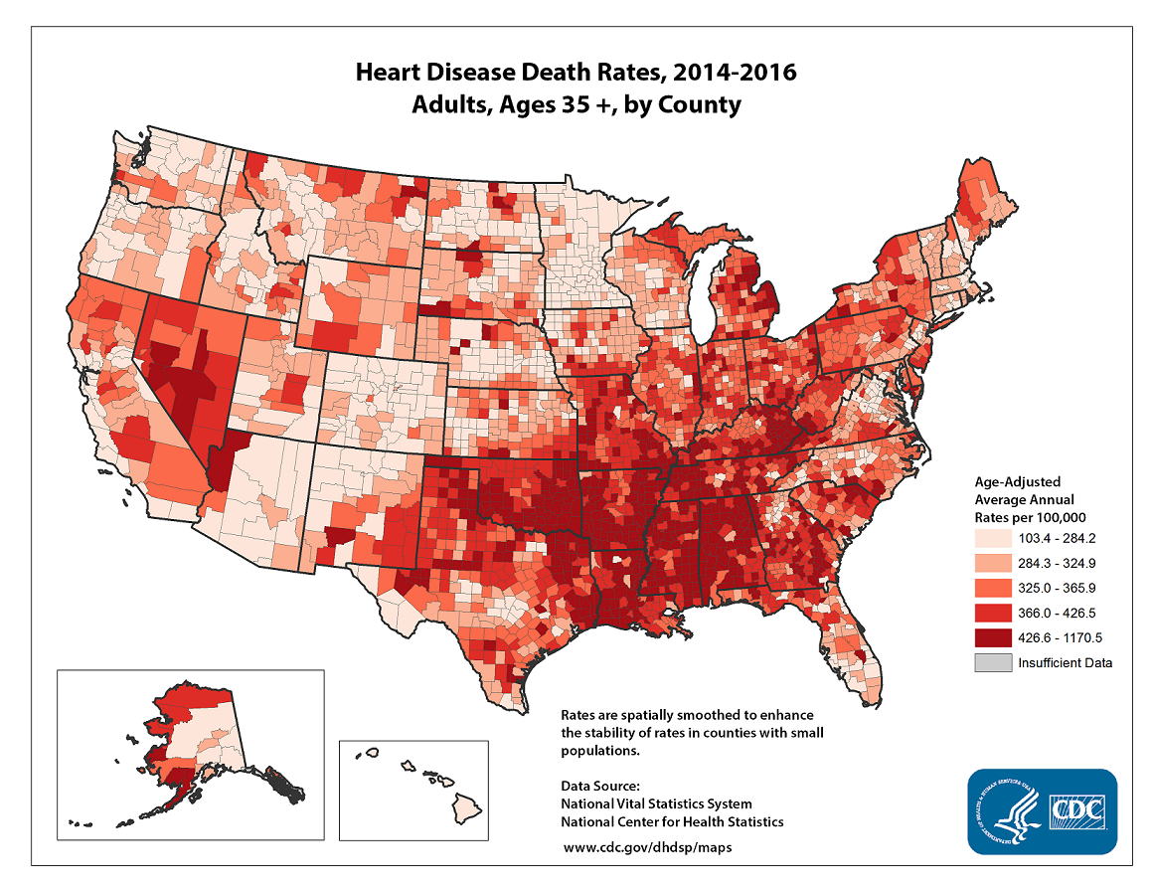
Background information
Cardiovascular Disease is the leading causes of death in the United States
Gaining more information on what factors might lead to having it is important.

Slide 3

Data Information
The data is a sample from a larger dataset that was created in 1983
The original dataset used males in high risk heart disease locations from rural locations in Western Cape, South Africa.
5 key variables used
Sbp: systolic blood pressure (millimeters of mercury (mmHg))
Tobacco: cumulative tobacco (kg)
Famhist: family history of heart disease:
Either “Absent” or “Present”
Alcohol: current alcohol consumption
Age: age at onset
chd: response, coronary heart disease
Notes:
For this project, we chose to work with the Cardiovascular Disease Data Set1, which was submitted by Yassine Hamdaoui on Kaggle. The data set is a retrospective sample from a recorded detailed a larger data set in 1983. There are roughly two controls per case of coronary heart disease. The larger original cardiovascular disease data set consists of 462 observations with 10 variables. The data set is a retrospective sample of males in a heart-disease high-risk region of the Western Cape, South Africa. And the full data set was described in Rousseauw et al, 1983, South African Medical Journal. The detailed source is: Rousseauw, J., du Plessis, J., Benade, A., Jordaan, P., Kotze, J. and Ferreira, J. (1983). Coronary risk factor screening in three rural communities, South African Medical Journal 64: 430–436.2
Due to the original data being only retrieved from high-risk heart-disease areas in Africa, the geographical limitations may affect the interpretation of results. But by analyzing the data from the high-risk areas, the significant relationships between features can be found.

Slide 4
Key Questions
What factors are correlated with Cardiovascular disease?
Is there a relationship between age and having Cardiovascular Disease?
Will unhealthy behaviors like drinking and smoking) will lead to Cardiovascular Disease?
Can Cardiovascular Disease be classified as a genetic disease?

Slide 5
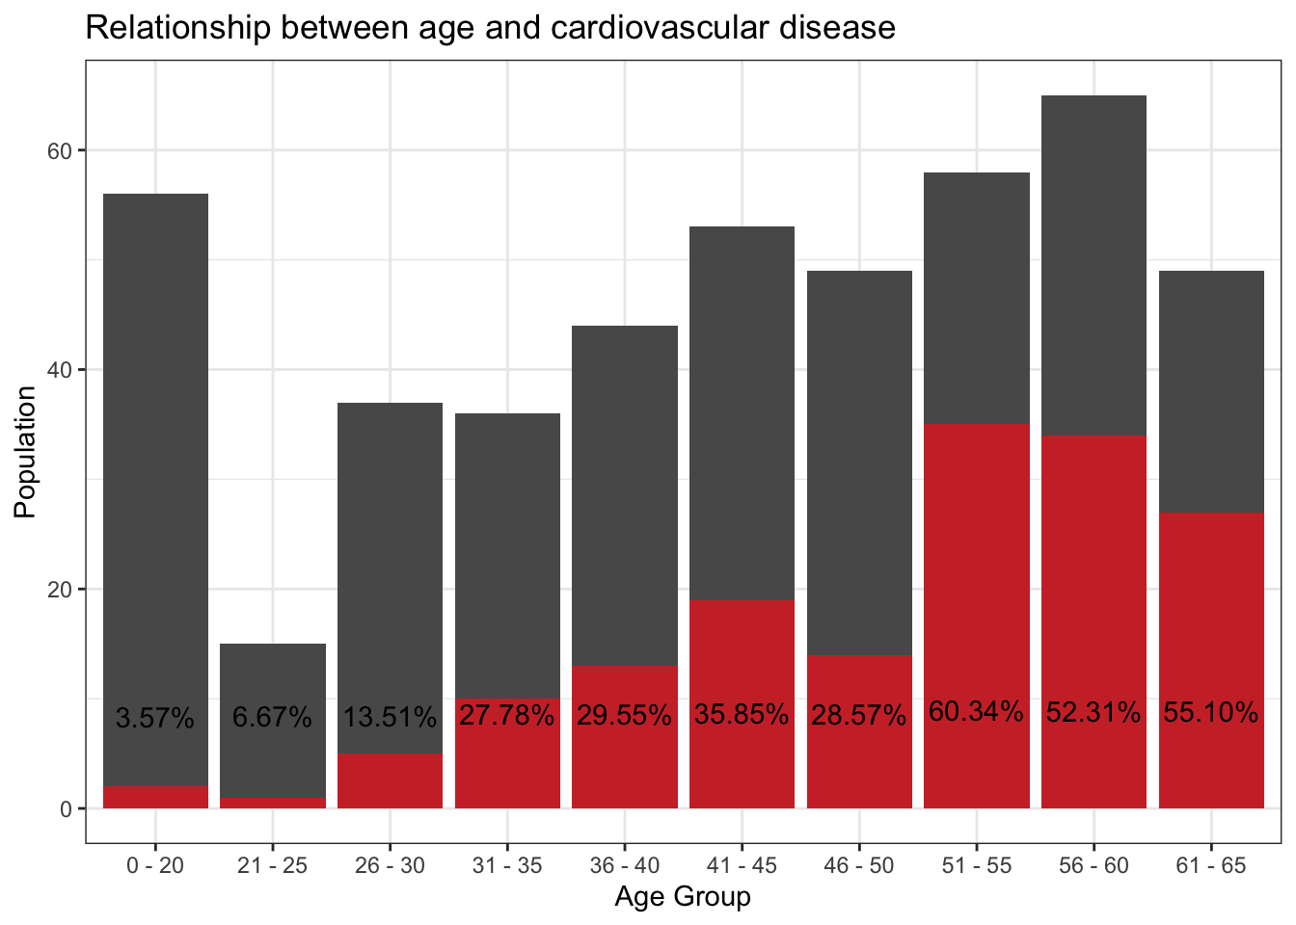
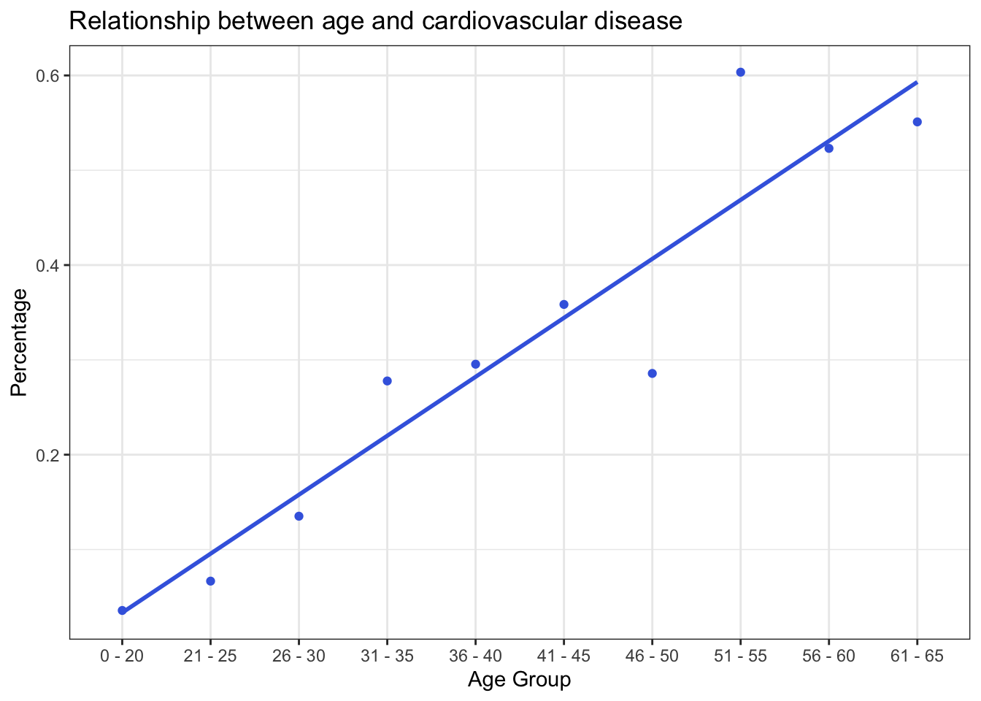
Relationship between Age and Cardiovascular Disease Risks
The grey bars represent the number of people in that age group in the data. The overlapping red bars represent the percentage of that age group that has cardiovascular disease
Then make the prediction of percentage and age groups. As people get older, a greater percentage have cardiovascular disease

Slide 6
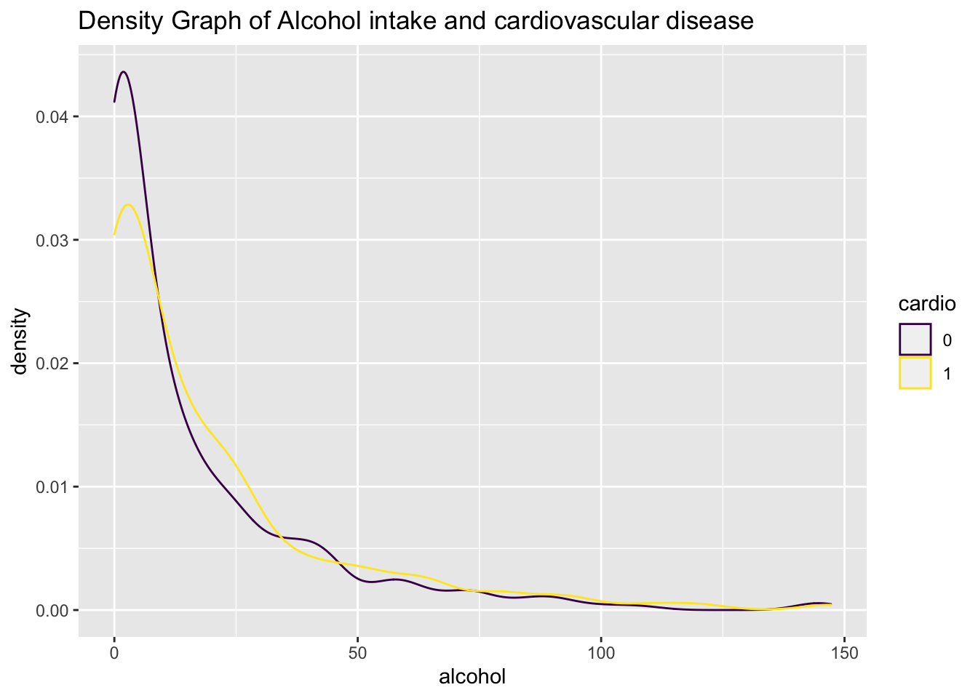
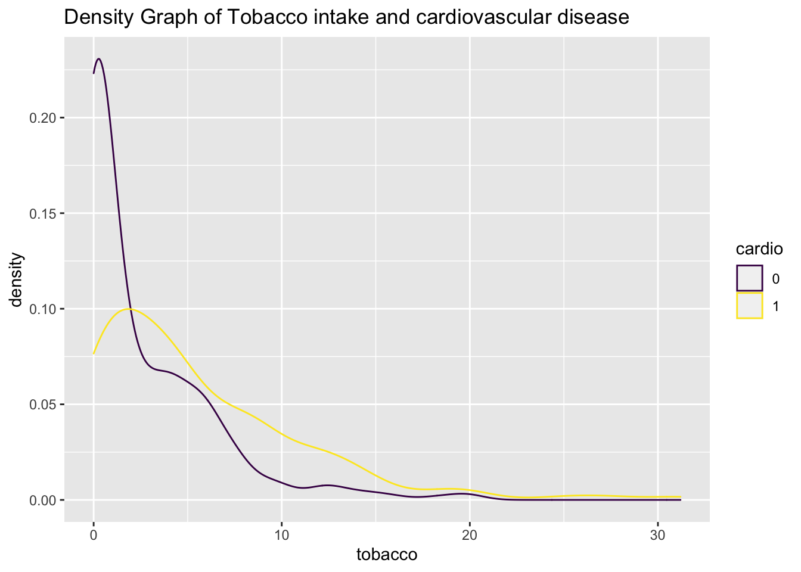
Alcohol, tobacco and Cardiovascular Disease...
The purple lines, which represent the healthy people’s percentage, share the most proportion of the density graph at the low-level alcohol/tobacco areas.

Slide 7
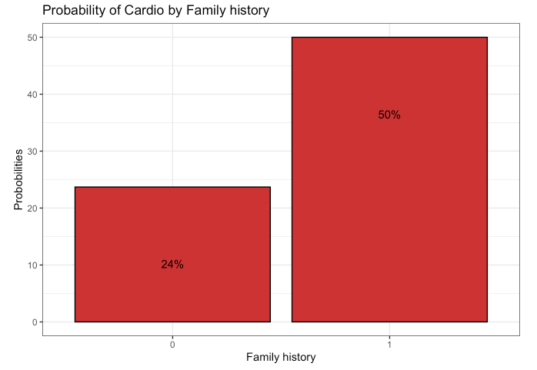
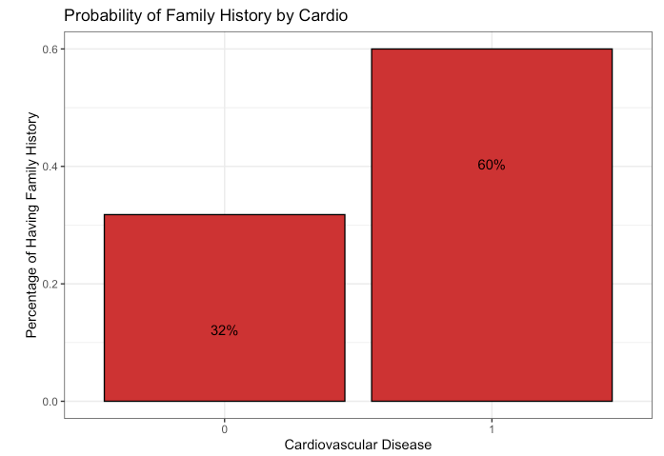
Is Cardiovascular Disease a genetic disease?
Facts:
50% of people who have a family heart disease history will have cardiovascular disease
60% of the people who have a cardiovascular disease have a family history

Slide 8
Conclusion
Strong positive relationship between age and Cardiovascular Disease
People that drink are more likely to have Cardiovascular Disease
People that smoke/ingest tobacco are more likely to have Cardiovascular Disease
People that have a family history of heart disease are more likely to have it as well.
There is strong indication that cardiovascular disease could be classified as a genetic disease
Potential shortcomings:
Visual interpretation might be inaccurate
Limited by dataset
Thanks for listening!

