Slide 1

Project 1: COVID-19
Presentation by:
Eric Croston
Sarah shuda
Meenakshi Tiwary kleiman

Slide 2

What are the trends and relationships between new cases, active cases and deaths worldwide?
What are these trends and relationships in the countries with the most COVID cases and how do they compare worldwide?
Presentation by
Eric Croston
05/22/2024

Slide 3
The Data
The CSV dataset was pulled from the worldometers.info and made available at https://www.kaggle.com/datasets/josephassaker/covid19-global-dataset
Daily COVID Data
225 Countries
New Cases, Active Cases and Cumulative Cases
New Deaths and Cumulative Deaths
Data Cleaning
184,787 rows data in the original data set
844 rows data in the world average and totals data sets
29 rows of data in the individual country data sets

Slide 4
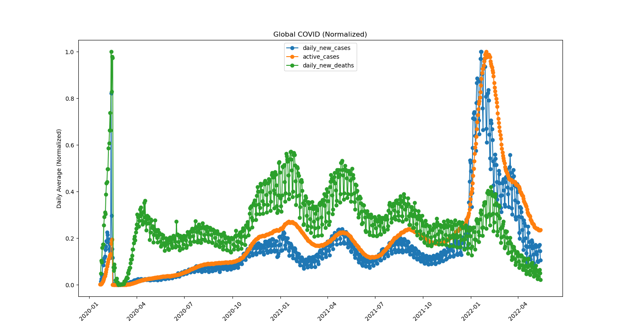
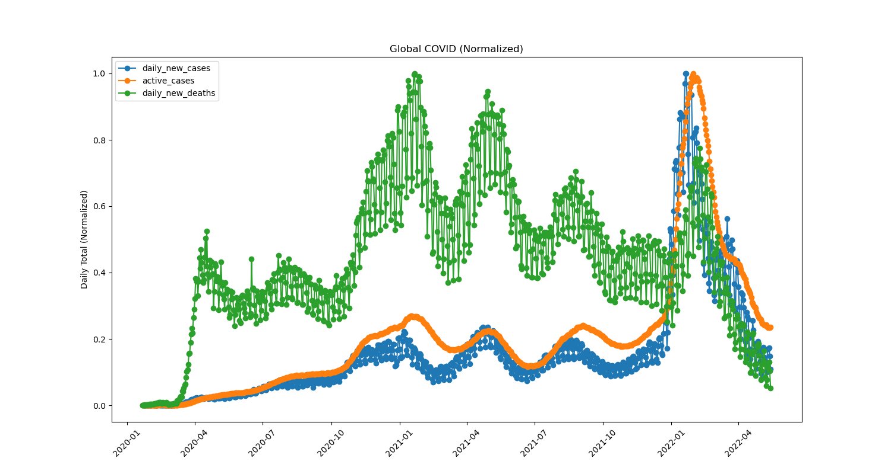
What are the trends and relationships between new cases, active cases, and deaths worldwide?
Daily Average of All Countries
Daily Totals of All Countries

Slide 5
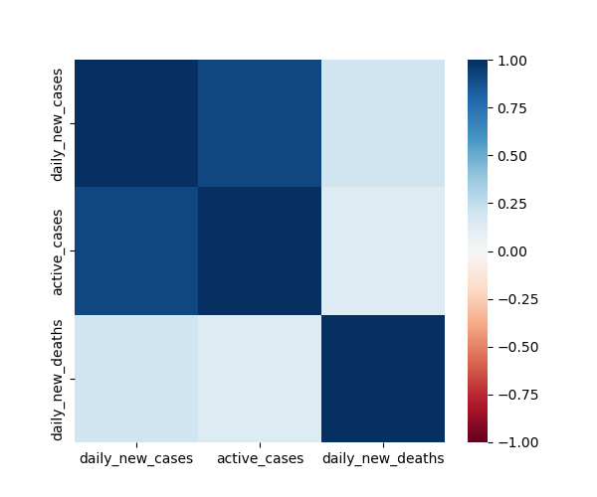
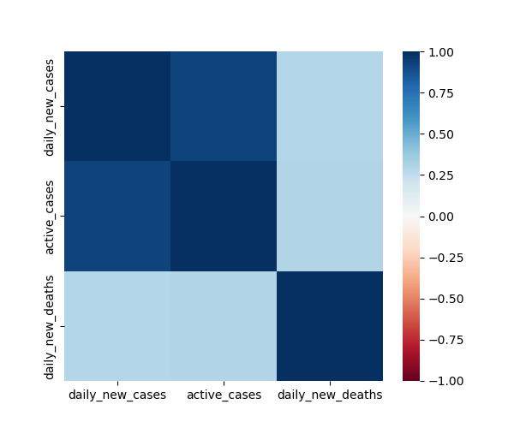
Worldwide Trends and Relationships
Daily Average of All Countries
Daily Totals of All Countries

Slide 6
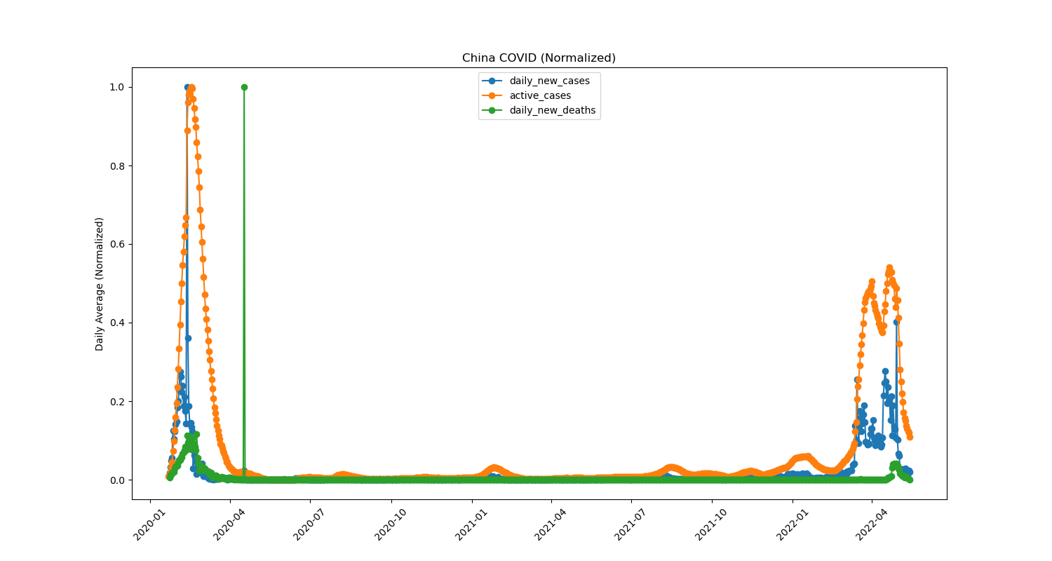
What caused the daily average data spike in early 2020?
Daily Totals in China

Slide 7
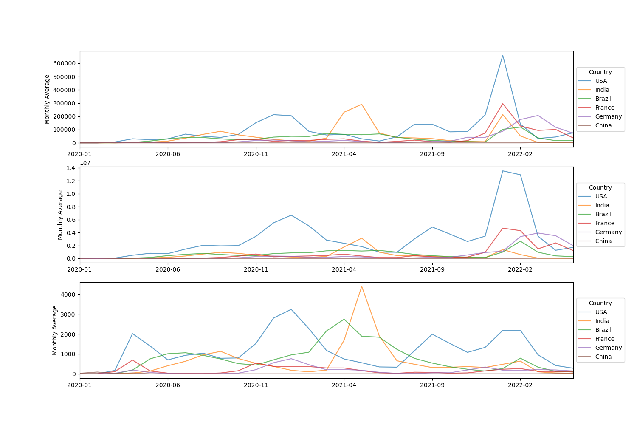
How do these trends differ in the countries with the highest COVID-19 case counts compared to global patterns?
Daily Averages for Most COVID Countries
Daily New Cases by Country
Active Cases by Country
Daily New Deaths by Country

Slide 8
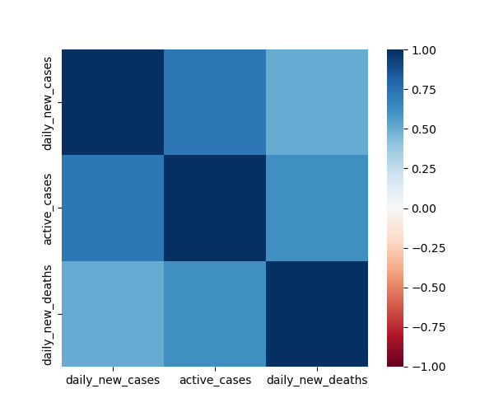
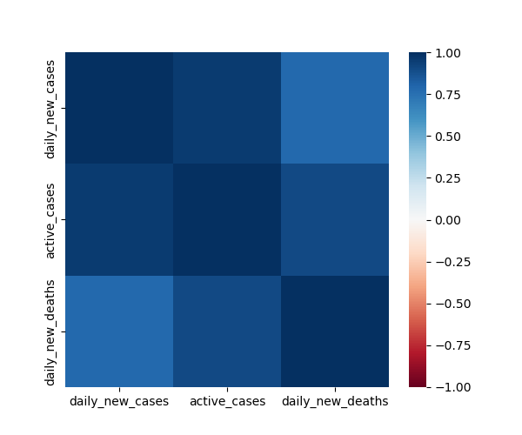
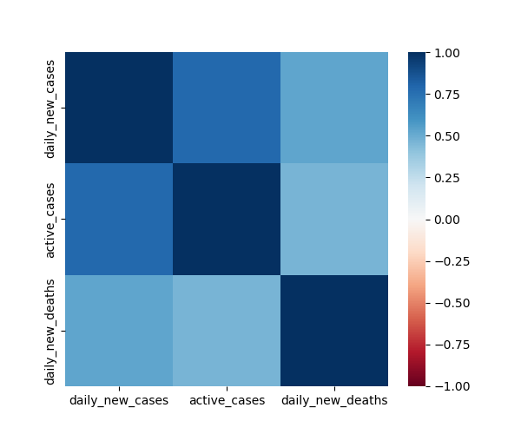


How do these trends differ in the countries with the highest COVID-19 case counts compared to global patterns?
USA Heatmap
India Heatmap
Brazil Heatmap
France Heatmap
Germany Heatmap
France Correlations
New Cases to Deaths .089
Active Cases to Deaths .121
Germany Correlations
New Cases to Deaths .181
Active Cases to Deaths .126
India Correlations
New Cases to Deaths .784
Active Cases to Deaths .903

