Slide 1






Message Complexity of Population Protocols
$$01010100$$
$$10100101$$
$$01000001$$
$$11010001$$
$$01010101$$
$$10100101$$
$$01011101$$
$$01010101$$
$$11010001$$
$$11010101$$
$$01010100$$
$$10100101$$
$$01000001$$
$$11010001$$
$$01010101$$
$$10100101$$
$$01011101$$
$$01010101$$
$$11010001$$
$$11010101$$
$$01010100$$
$$10100101$$
$$01000001$$
$$11010001$$
$$01010101$$
Eric Severson
UC Davis
DISC 2020
$$10100101$$
$$01011101$$
$$01010101$$
$$11010001$$
$$11010101$$

Slide 2


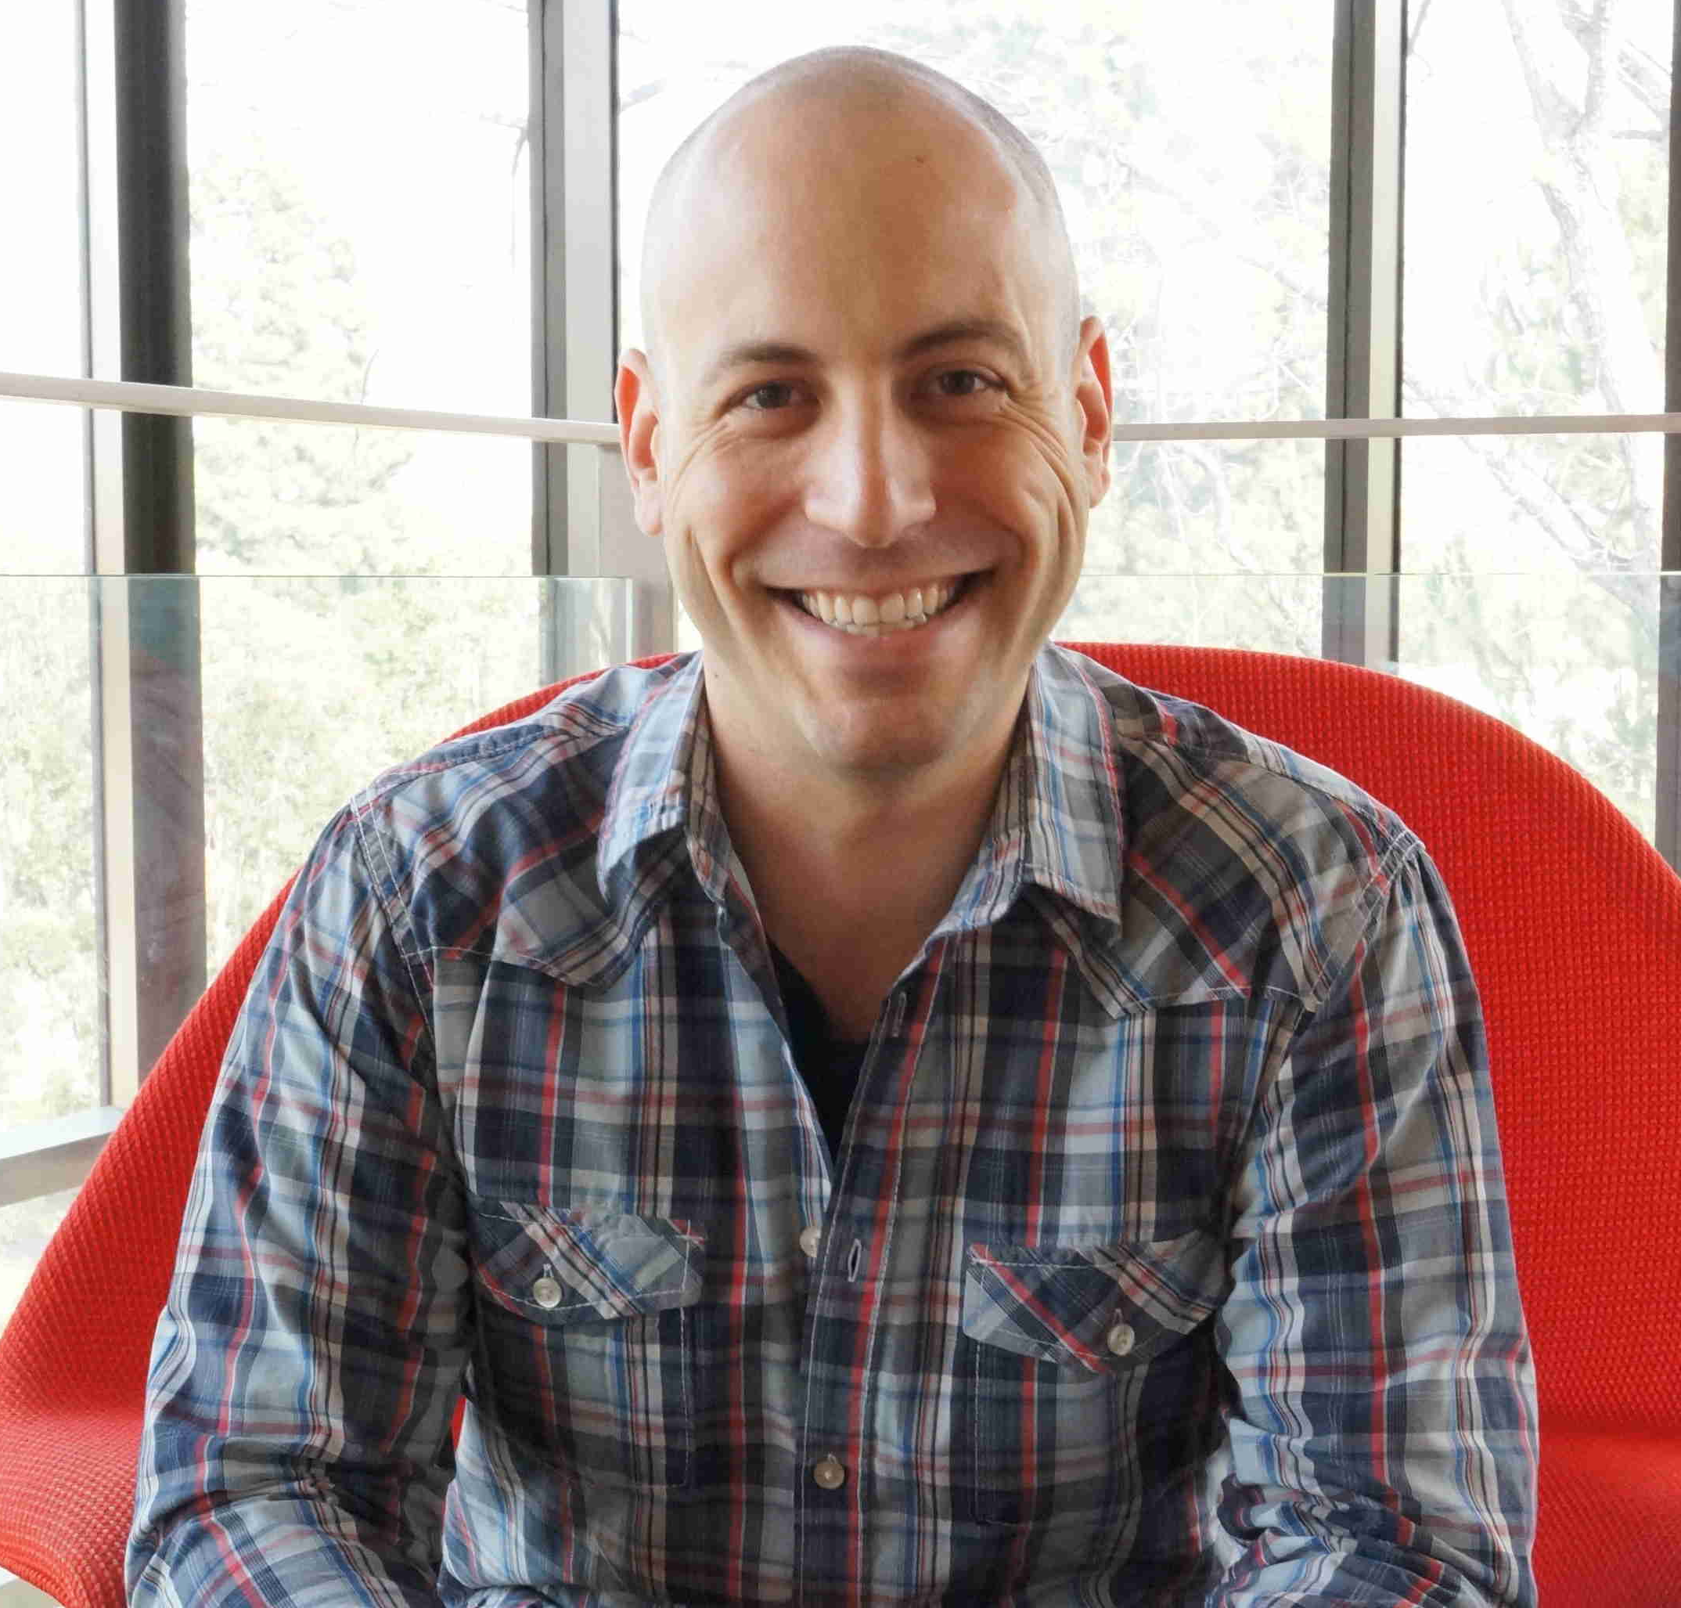
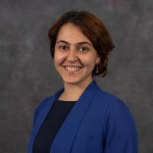

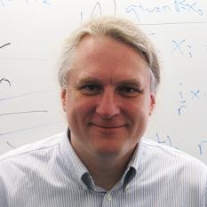

Acknowledgements
Co-authors
David Doty
Mahsa Eftekhari
Talley Amir
James Aspnes
Funding from NSF Grants

Slide 3














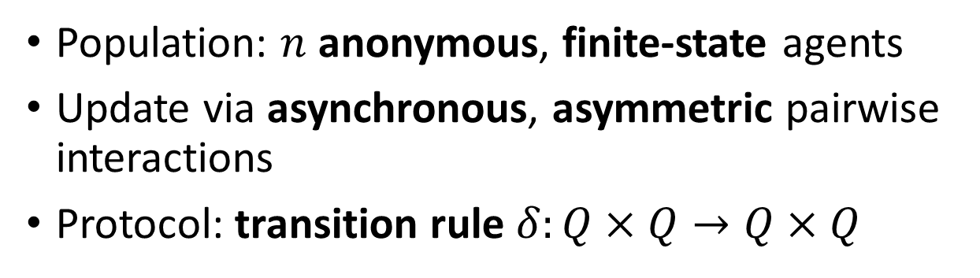



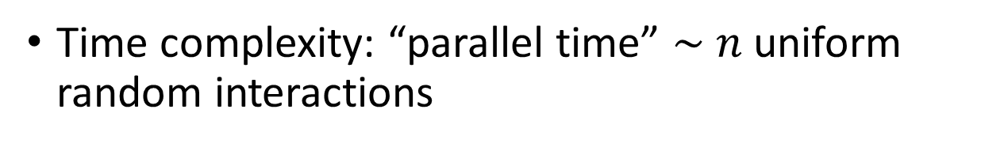


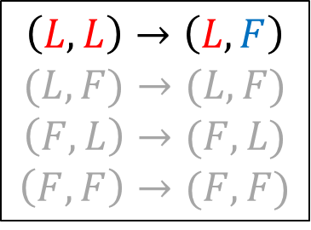

Original Population Protocols Model
[Dana Angluin, James Aspnes, Zoe Diamadi, Michael J. Fischer, and René Peralta. Computation in networks of passively mobile finite-state sensors. Distributed Computing, 2006.]
Population: $n$ anonymous, finite-state agents
Update via asynchronous, asymmetric pairwise interactions
Protocol: transition rule $δ:Q×Q→Q×Q$
$$Q=\{L,F\}$$
$$F$$
$O(n)$ time
$$L$$
$$F$$
$$L$$
$$L$$
$$L$$
$$F$$
$$L$$
$$F$$
$$F$$
$$L$$
$$L$$
$$F$$
$$F$$
Time complexity: “parallel time” $\sim n$ uniform random interactions
$$L$$
$$F$$
$$L$$
$$\left(L,L\right)→\left(L,F\right)$$
$$(L,F)→(L,F)$$
$$\left(F,L\right)→(F,L)$$
$$\left(F,F\right)→(F,F)$$
$$δ=$$

Slide 4
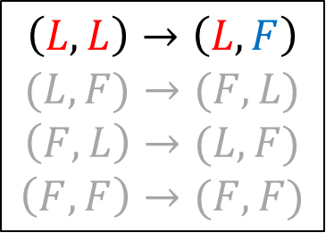


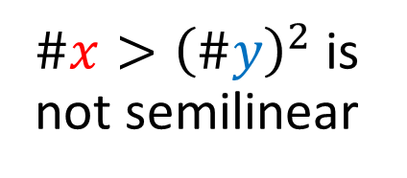
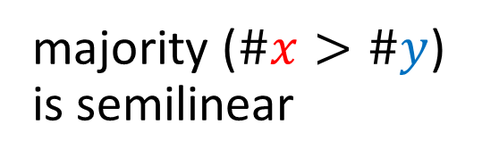
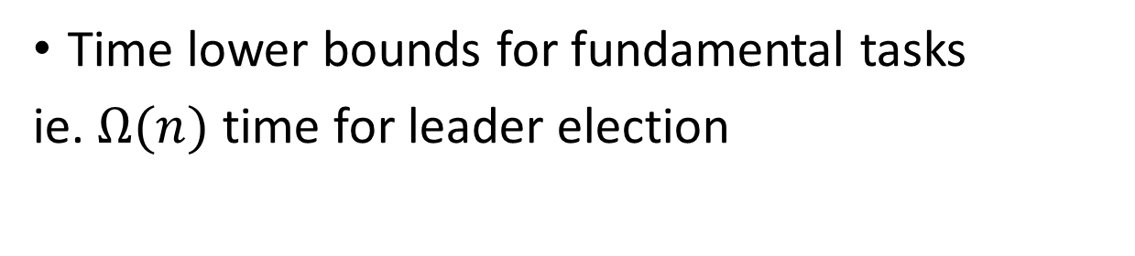



Original Model Limitations
Time lower bounds for fundamental tasks
ie. $Ω(n)$ time for leader election
$$Q=\{L,F\}$$
$$F$$
$O(n)$ time
$$F$$
[David Doty and David Soloveichik. Stable leader election in population protocols requires linear time. Distributed Computing, 2018.]
$$L$$
$$F$$
$$L$$
$$F$$
$$F$$
Can only compute semilinear predicates
$$F$$
$$F$$
[Dana Angluin, James Aspnes, and David Eisenstat. Stably computable predicates are semilinear. PODC, 2006]
$$F$$
$$L$$
majority ($\#x>\#y$) is semilinear
$\#x>{\left(\#y\right)}^{2}$ is not semilinear
$$\left(L,L\right)→\left(L,F\right)$$
$$(L,F)→(F,L)$$
$$\left(F,L\right)→(L,F)$$
$$\left(F,F\right)→(F,F)$$
$$δ=$$
$$y$$
$$y$$
$$x$$
$$x$$

Slide 5
Recent Protocols Using More States
Faster Leader Election Protocols
Faster Majority Protocols
[Alistarh, Gelashvili. ICALP, 2015.]
[Alistarh, Gelashvili, Vojnovic. PODC, 2015.]
[Alistarh, Aspnes, Eisenstat, Gelashvili, Rivest. SODA, 2017]
[Alistarh, Aspnes, Eisenstat, Gelashvili, Rivest. SODA, 2017]
[Bilke, Cooper, Elsässer, Radzik. PODC, 2017.]
[Bilke, Cooper, Elsässer, Radzik. PODC, 2017.]
[Gąsieniec, Stachowiak. SODA, 2018.]
[Alistarh, Aspnes, Gelashvili. SODA, 2018.]
[Berenbrink, Kaaser, Kling, Otterbach. SOSA, 2018.]
[Berenbrink, Elsässer, Friedetzky, Kaaser, Kling, Radzik. DISC, 2018.]
[Gąsieniec, Stachowiak, Uznanski. SPAA, 2019.]
[Ben-Nun, Kopelowitz, Kraus, Porat. PODC, 2020.]
[Sudo, Ooshita, Izumi, Kakugawa, Mauzawa. PODC, 2019.]
[Berenbrink, Elsässer, Friedetzky, Kaaser, Kling, Radzik. Distributed Computing, 2020.]
[Berenbrink, Giakkoupis, Kling. STOC, 2020.]
Population Size Counting / Estimation Protocols
[Beauquier, Burman, Claviere, Sohier. DISC, 2015.]
[Aspnes, Beauquier, Burman, Sohier. OPODIS, 2016.]
[Doty, Eftekhari, Michail, Spirakis. DISC, 2018.]
[Berenbrink, Kaaser, Radzik. PODC, 2019.]
[Doty, Eftekhari. PODC, 2019.]
Notes:
Size counting only makes sense with larger states

Slide 6
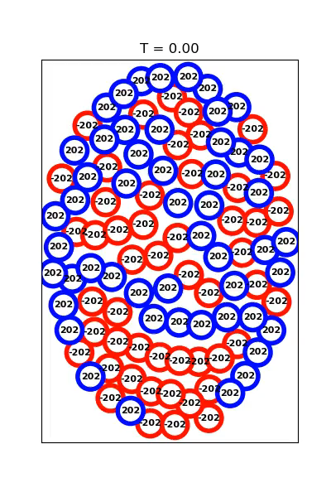


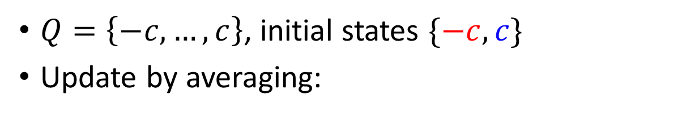





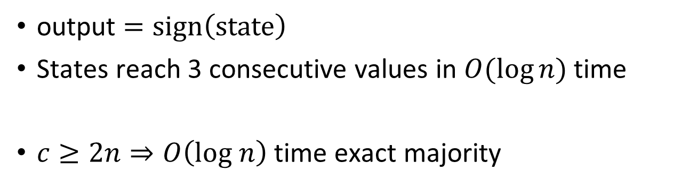
Simple Large State Majority Protocol
$$\# red=50$$
$$\# blue=51$$
$$c=202$$
$Q=\left\{−c,…, c\right\}$, initial states $\{−c, c\}$
Update by averaging:
$$\left(−3,6\right)→(1,2)$$
$$1$$
$$−3$$
$$6$$
$$2$$
$$δ\left(a,b\right)=\left( \left\lfloor \frac{a+b}{2}\right\rfloor ,\left\lceil \frac{a+b}{2}\right\rceil \right)$$
output $=sign\left(state\right)$
States reach 3 consecutive values in $O(\log{n)}$ time
$c≥2n⇒O\left(log n\right)$ time exact majority
[Petra Berenbrink, Tom Friedetzky, Dominik Kaaser, and Peter Kling. Tight & simple load balancing. IPDPS, 2019.]
Notes:
Visual for updating rule

Slide 7



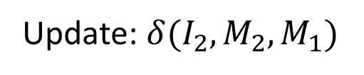
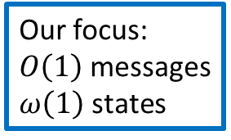
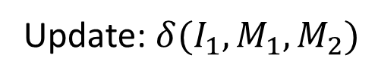

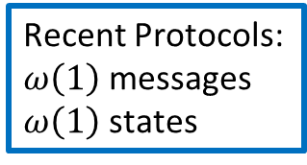

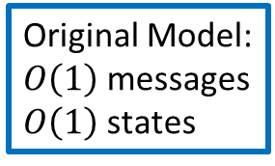
Our Work: Message Complexity
More states increases the communication cost
Refined model: distinguish interaction communication complexity from local space complexity
Original Model:
$O\left(1\right)$ messages
$O\left(1\right)$ states
Our focus:
$O\left(1\right)$ messages
$ω\left(1\right)$ states
Recent Protocols:
$ω\left(1\right)$ messages
$ω\left(1\right)$ states
$$Q=M×I$$
$$I_{1}$$
$$I_{2}$$
$$01010100$$
$$10100101$$
$$01000001$$
$$11010001$$
$$01010101$$
$$M_{1}$$
$$M_{2}$$
$$10100101$$
$$01011101$$
$$01010101$$
$$11010001$$
$$11010101$$
Update: $δ(I_{2},M_{2},M_{1})$
Update: $δ(I_{1},M_{1},M_{2})$

Slide 8
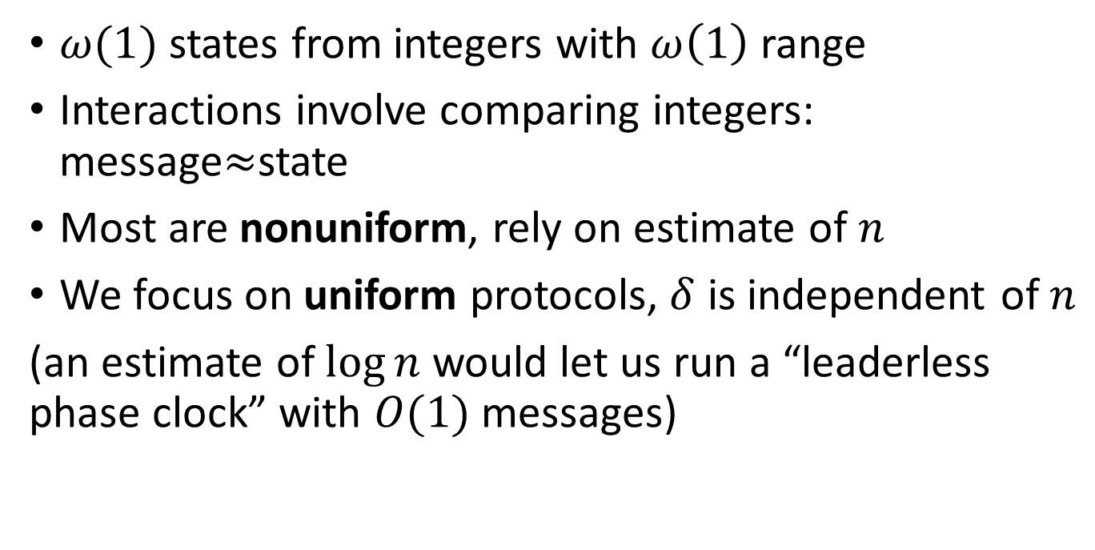




Existing Protocols: Large states and large messages
$ω(1)$ states from integers with $ω\left(1\right)$ range
Interactions involve comparing integers: message$≈$state
Most are nonuniform, rely on estimate of $n$
We focus on uniform protocols, $δ$ is independent of $n$
(an estimate of $\log{n}$ would let us run a “leaderless phase clock” with $O(1)$ messages)
$$Q=\left\{−c,…, c\right\}$$
$$c≥2n$$
$$−3$$
$$6$$
Notes:
Replace with animation from majority example slide

Slide 9










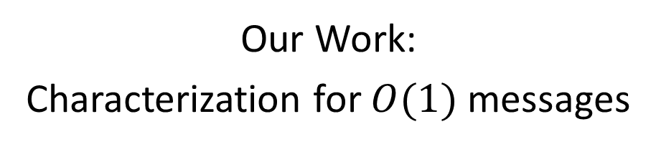
Computability with $O(1)$ messages
[Ioannis Chatzigiannakis, Othon Michail, Stavros Nikolaou, Andreas Pavlogiannis, and Paul G.Spirakis. Passively mobile communicating machines that use restricted space. FOMC , 2011.]
Our Work:
Characterization for $O(1)$ messages
Formal model of $ω\left(1\right)$ state uniform protocols
NSPACE$(n⋅log \left|Q\right|)$
NSPACE$(n⋅log \left|Q\right|)$
$$Ω(poly n)$$
$$Ω(poly n)$$
$$o(n)$$
$$o(\log{n)}$$
Only semilinear predicates
$$|Q|$$
Only semilinear predicates
$$|Q|$$
Notes:
Computability means no time constraints

Slide 10







Slow simulation of large messages
Two marked agents, simulate one interaction at a time
$$01$$
$$10$$
$$1 0$$
$$1 0$$
$$10$$
_ _ _ _
$$0 1$$
$$1 0$$
$$10$$
_ _ _ _
NSPACE$(n⋅log \left|Q\right|)$
$$Ω(poly n)$$
Composed with leader election
Leader uses self-stabilizing population counting to reset population
Only semilinear predicates
[James Aspnes, Joffroy Beauquier, Janna Burman, and Devan Sohier. Time and Space Optimal Counting in Population Protocols. OPODIS, 2016.]
$$|Q|$$

Slide 11


Computability with $O(1)$ messages
[Ioannis Chatzigiannakis, Othon Michail, Stavros Nikolaou, Andreas Pavlogiannis, and Paul G.Spirakis. Passively mobile communicating machines that use restricted space. FOMC , 2011.]
Our Work:
Characterization for $O(1)$ messages
Formal model of $ω\left(1\right)$ state uniform protocols
NSPACE$(n⋅log \left|Q\right|)$
NSPACE$(n⋅log \left|Q\right|)$
$$Ω(poly n)$$
$$Ω(poly n)$$
$$o(n)$$
$$o(\log{n)}$$
Only semilinear predicates
$$|Q|$$
Only semilinear predicates
$$|Q|$$

Slide 12
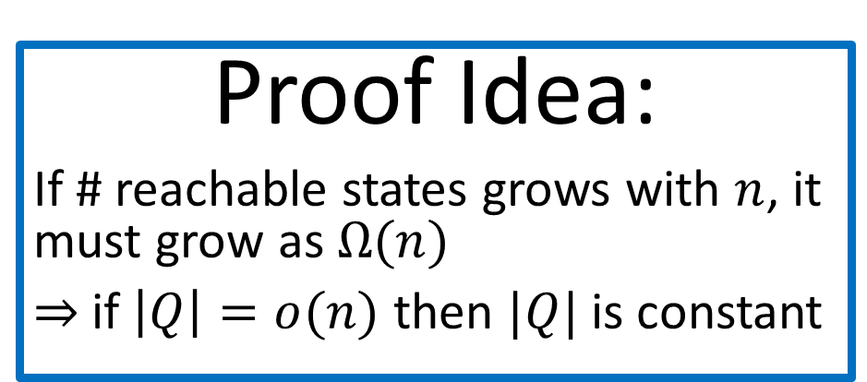
Proof Idea:
If # reachable states grows with $n$, it must grow as $Ω(n)$
$⇒$if $\left|Q\right|=o(n)$ then $|Q|$ is constant
Turing Machine simulation
$$o(n)$$
Only semilinear predicates
$$|Q|$$

Slide 13


Fast Protocols with $O(1)$ Messages
Population Size Counting
Minimally powerful model that can solve this problem
Simple slow algorithm – pass tokens, learn $n$ by collecting all $n$ tokens

Slide 14


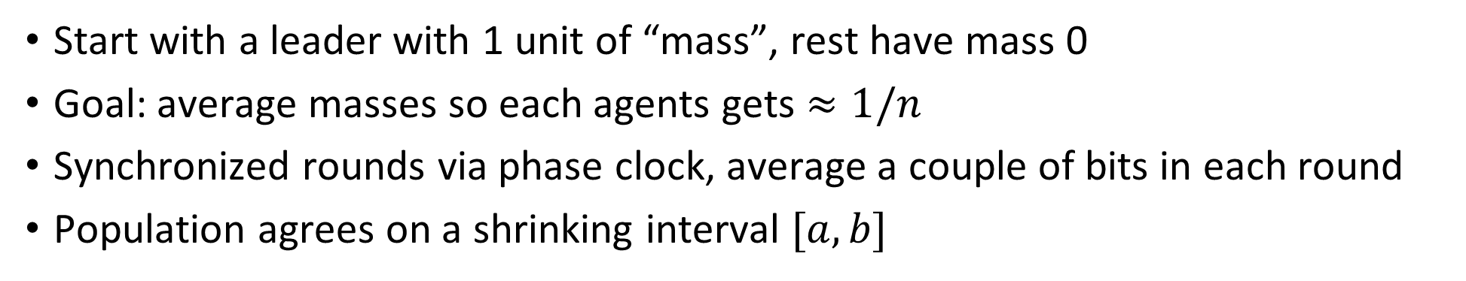


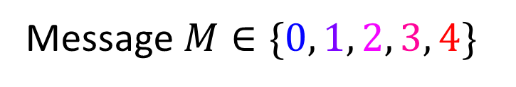








Exact Size Counting with Leader
Start with a leader with 1 unit of “mass”, rest have mass 0
Goal: average masses so each agents gets $≈1/n$
Synchronized rounds via phase clock, average a couple of bits in each round
Population agrees on a shrinking interval $[a,b]$
Message $M∈\{0, 1, 2, 3, 4\}$
units of “weight”
$$0$$
$$1$$
$$2$$
$$3$$
$$4$$
$$a+\frac{0}{4}$$
$$a+\frac{1}{4}$$
$$a+\frac{2}{4}$$
$$a+\frac{3}{4}$$
$$a+\frac{4}{4}$$
$$a=0$$
$$b=1$$

Slide 15
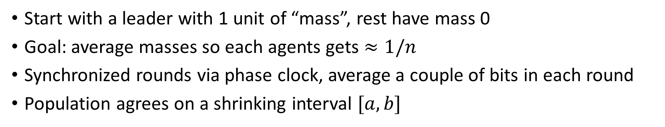

Exact Size Counting with Leader
Start with a leader with 1 unit of “mass”, rest have mass 0
Goal: average masses so each agents gets $≈1/n$
Synchronized rounds via phase clock, average a couple of bits in each round
Population agrees on a shrinking interval $[a,b]$
Message $M∈\{0, 1, 2, 3, 4\}$
units of “weight”
$$0$$
$$1$$
$$2$$
$$3$$
$$4$$
$$a+\frac{0}{4}$$
$$a+\frac{1}{4}$$
$$a+\frac{2}{4}$$
$$a+\frac{3}{4}$$
$$a+\frac{4}{4}$$
$$a=0$$
$$b=1$$
Round 1: Averaging Weights

Slide 16


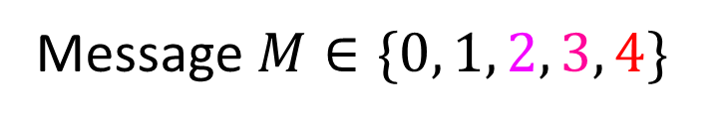


Exact Size Counting with Leader
Start with a leader with 1 unit of “mass”, rest have mass 0
Goal: average masses so each agents gets $≈1/n$
Synchronized rounds via phase clock, average a couple of bits in each round
Population agrees on a shrinking interval $[a,b]$
Message $M∈\{0, 1, 2, 3, 4\}$
units of “weight”
$$0$$
$$1$$
$$2$$
$$a+\frac{0}{4}$$
$$a+\frac{1}{4}$$
$$a+\frac{2}{4}$$
$$a=0$$
Round 1: Update Interval

Slide 17




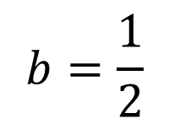


Exact Size Counting with Leader
Start with a leader with 1 unit of “mass”, rest have mass 0
Goal: average masses so each agents gets $≈1/n$
Synchronized rounds via phase clock, average a couple of bits in each round
Population agrees on a shrinking interval $[a,b]$
Message $M∈\{0, 1, 2, 3, 4\}$
units of “weight”
$$0$$
$$1$$
$$2$$
$$3$$
$$4$$
$$a+\frac{0}{8}$$
$$a+\frac{1}{8}$$
$$a+\frac{2}{8}$$
$$a+\frac{3}{8}$$
$$a+\frac{4}{8}$$
$$a=0$$
$$b=\frac{1}{2}$$
Round 1: Redefine Weights

Slide 18
Exact Size Counting with Leader
Start with a leader with 1 unit of “mass”, rest have mass 0
Goal: average masses so each agents gets $≈1/n$
Synchronized rounds via phase clock, average a couple of bits in each round
Population agrees on a shrinking interval $[a,b]$
Message $M∈\{0, 1, 2, 3, 4\}$
units of “weight”
$$0$$
$$1$$
$$2$$
$$3$$
$$4$$
$$a+\frac{0}{8}$$
$$a+\frac{1}{8}$$
$$a+\frac{2}{8}$$
$$a+\frac{3}{8}$$
$$a+\frac{4}{8}$$
$$a=0$$
$$b=\frac{1}{2}$$
Round 2: Averaging Weights

Slide 19
Exact Size Counting with Leader
Start with a leader with 1 unit of “mass”, rest have mass 0
Goal: average masses so each agents gets $≈1/n$
Synchronized rounds via phase clock, average a couple of bits in each round
Population agrees on a shrinking interval $[a,b]$
Message $M∈\{0, 1, 2, 3, 4\}$
units of “weight”
$$0$$
$$1$$
$$2$$
$$3$$
$$4$$
$$a+\frac{0}{8}$$
$$a+\frac{1}{8}$$
$$a+\frac{2}{8}$$
$$a+\frac{3}{8}$$
$$a+\frac{4}{8}$$
$$a=0$$
$$b=\frac{1}{2}$$
Round 2: Averaging Weights

Slide 20



Exact Size Counting with Leader
Start with a leader with 1 unit of “mass”, rest have mass 0
Goal: average masses so each agents gets $≈1/n$
Synchronized rounds via phase clock, average a couple of bits in each round
Population agrees on a shrinking interval $[a,b]$
Message $M∈\{0, 1, 2, 3, 4\}$
units of “weight”
$$0$$
$$1$$
$$2$$
$$a+\frac{0}{8}$$
$$a+\frac{1}{8}$$
$$a+\frac{2}{8}$$
$$a=0$$
Round 2: Update Interval

Slide 21



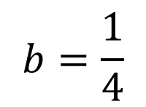


Exact Size Counting with Leader
Start with a leader with 1 unit of “mass”, rest have mass 0
Goal: average masses so each agents gets $≈1/n$
Synchronized rounds via phase clock, average a couple of bits in each round
Population agrees on a shrinking interval $[a,b]$
Message $M∈\{0, 1, 2, 3, 4\}$
units of “weight”
$$0$$
$$1$$
$$2$$
$$3$$
$$4$$
$$a+\frac{0}{16}$$
$$a+\frac{1}{16}$$
$$a+\frac{2}{16}$$
$$a+\frac{3}{16}$$
$$a+\frac{4}{16}$$
$$a=0$$
$$b=\frac{1}{4}$$
Round 2: Redefine Weights

Slide 22
Exact Size Counting with Leader
Start with a leader with 1 unit of “mass”, rest have mass 0
Goal: average masses so each agents gets $≈1/n$
Synchronized rounds via phase clock, average a couple of bits in each round
Population agrees on a shrinking interval $[a,b]$
Message $M∈\{0, 1, 2, 3, 4\}$
units of “weight”
$$0$$
$$1$$
$$2$$
$$3$$
$$4$$
$$a+\frac{0}{16}$$
$$a+\frac{1}{16}$$
$$a+\frac{2}{16}$$
$$a+\frac{3}{16}$$
$$a+\frac{4}{16}$$
$$a=0$$
$$b=\frac{1}{4}$$
Round 3: Averaging Weights

Slide 23
Exact Size Counting with Leader
Start with a leader with 1 unit of “mass”, rest have mass 0
Goal: average masses so each agents gets $≈1/n$
Synchronized rounds via phase clock, average a couple of bits in each round
Population agrees on a shrinking interval $[a,b]$
Message $M∈\{0, 1, 2, 3, 4\}$
units of “weight”
$$0$$
$$1$$
$$2$$
$$3$$
$$4$$
$$a+\frac{0}{16}$$
$$a+\frac{1}{16}$$
$$a+\frac{2}{16}$$
$$a+\frac{3}{16}$$
$$a+\frac{4}{16}$$
$$a=0$$
$$b=\frac{1}{4}$$
Round 3: Averaging Weights

Slide 24



Exact Size Counting with Leader
Start with a leader with 1 unit of “mass”, rest have mass 0
Goal: average masses so each agents gets $≈1/n$
Synchronized rounds via phase clock, average a couple of bits in each round
Population agrees on a shrinking interval $[a,b]$
Message $M∈\{0, 1, 2, 3, 4\}$
units of “weight”
$$1$$
$$2$$
$$3$$
$$a+\frac{1}{16}$$
$$a+\frac{2}{16}$$
$$a+\frac{3}{16}$$
Round 3: Update Interval

Slide 25



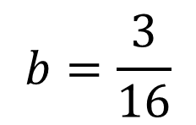

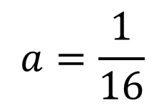

Exact Size Counting with Leader
Start with a leader with 1 unit of “mass”, rest have mass 0
Goal: average masses so each agents gets $≈1/n$
Synchronized rounds via phase clock, average a couple of bits in each round
Population agrees on a shrinking interval $[a,b]$
Message $M∈\{0, 1, 2, 3, 4\}$
units of “weight”
$$0$$
$$1$$
$$2$$
$$3$$
$$4$$
$$a+\frac{0}{32}$$
$$a+\frac{1}{32}$$
$$a+\frac{2}{32}$$
$$a+\frac{3}{32}$$
$$a+\frac{4}{32}$$
$$a=\frac{1}{16}$$
$$b=\frac{3}{16}$$
Round 3: Redefine Weights

Slide 26
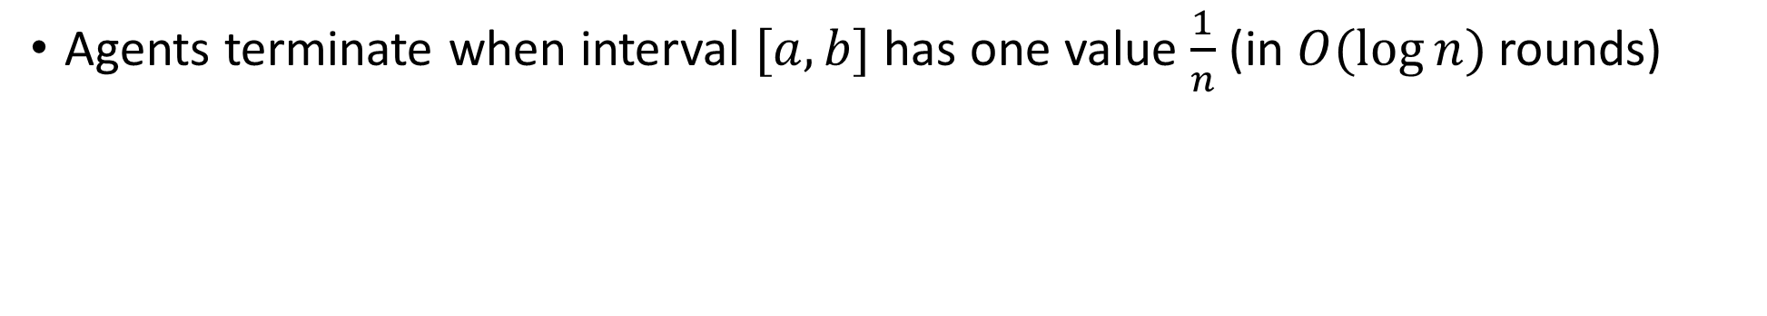
Exact Size Counting with Leader
Agents terminate when interval $[a,b]$ has one value $\frac{1}{n}$ (in $O(\log{n)}$ rounds)
$$0$$
$$1$$
$$2$$
$$3$$
$$4$$
$$a+\frac{0}{32}$$
$$a+\frac{1}{32}$$
$$a+\frac{2}{32}$$
$$a+\frac{3}{32}$$
$$a+\frac{4}{32}$$
$$a=\frac{1}{16}$$
$$b=\frac{3}{16}$$
End of Round 3

Slide 27



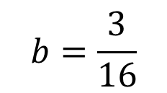
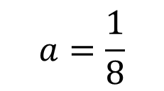

Exact Size Counting with Leader
Agents terminate when interval $[a,b]$ has one value $\frac{1}{n}$ (in $O(\log{n)}$ rounds)
$$0$$
$$1$$
$$2$$
$$3$$
$$4$$
$$a=\frac{1}{8}$$
$$b=\frac{3}{16}$$
End of Round 4

Slide 28



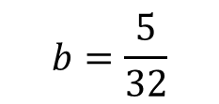
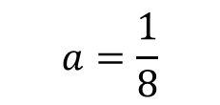

Exact Size Counting with Leader
Agents terminate when interval $[a,b]$ has one value $\frac{1}{n}$ (in $O(\log{n)}$ rounds)
$$0$$
$$1$$
$$2$$
$$3$$
$$4$$
$$a=\frac{1}{8}$$
$$b=\frac{5}{32}$$
End of Round 5

Slide 29


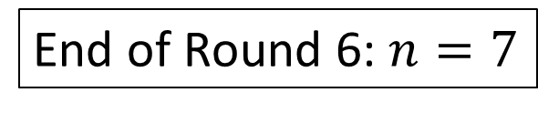






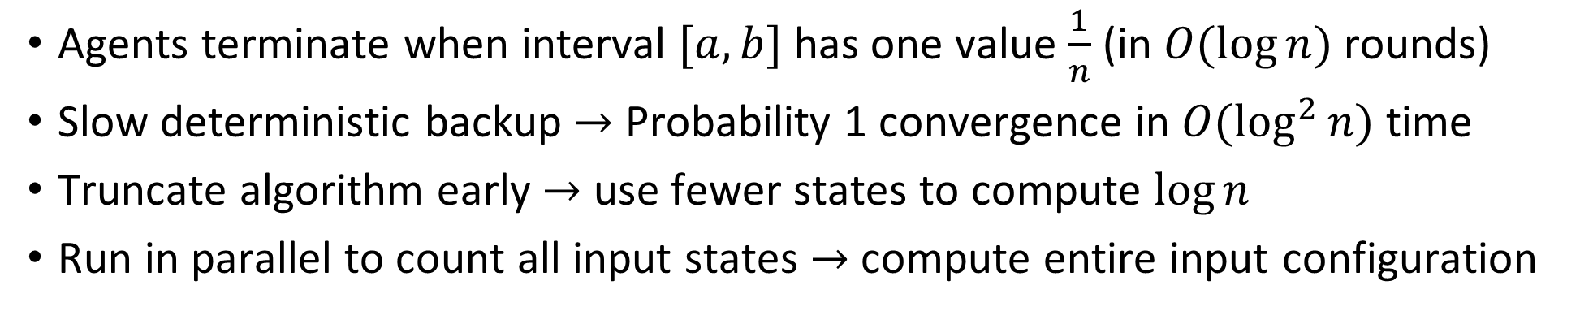


Exact Size Counting with Leader
Agents terminate when interval $[a,b]$ has one value $\frac{1}{n}$ (in $O(\log{n)}$ rounds)
Slow deterministic backup $→$ Probability 1 convergence in $O(\log^{2}{n)}$ time
Truncate algorithm early $→$ use fewer states to compute $\log{n}$
Run in parallel to count all input states $→$ compute entire input configuration
$$0$$
$$1$$
$$2$$
$$3$$
$$4$$
$$a=\frac{17}{128}$$
$$b=\frac{19}{128}$$
End of Round 6: $n=7$
End of Round 6
$$\frac{1}{8}$$
$$\frac{1}{7}$$
$$\frac{1}{6}$$

Slide 30
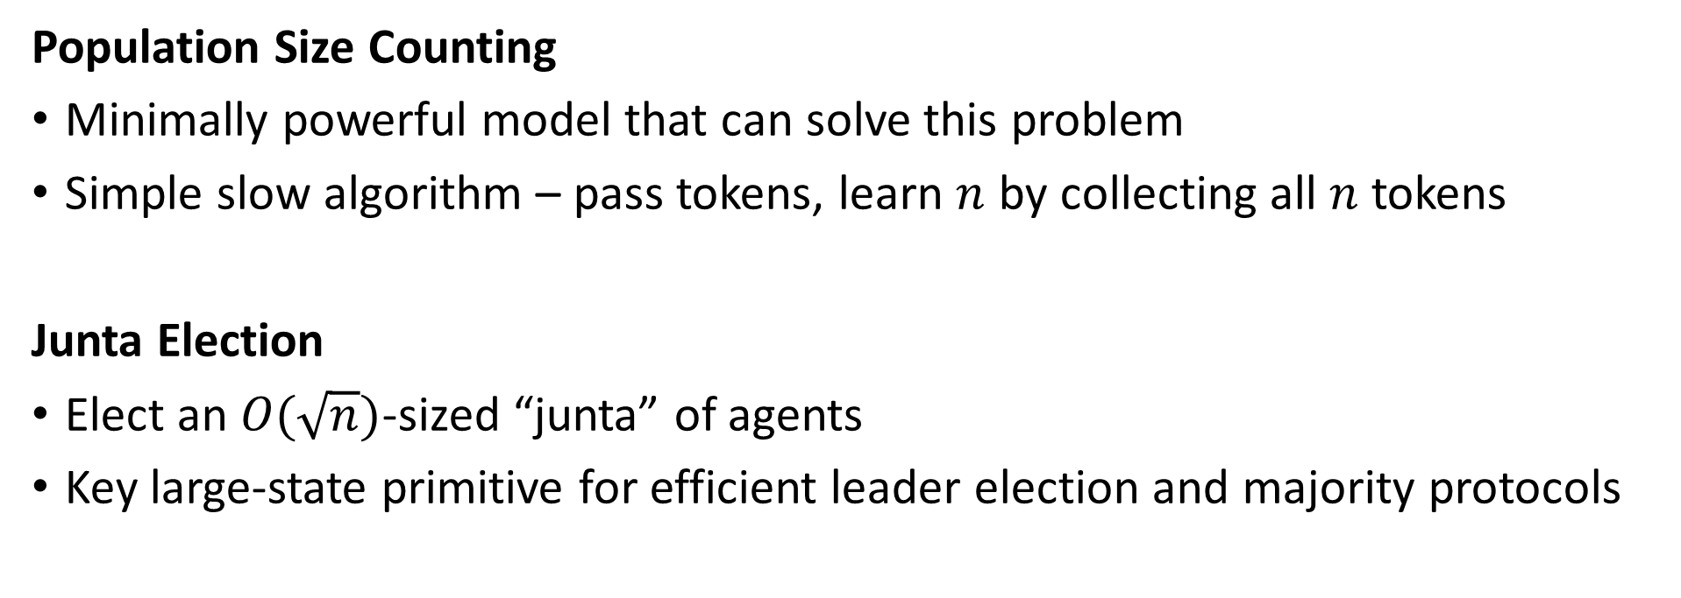

Fast Protocols with $O(1)$ Messages
Population Size Counting
Minimally powerful model that can solve this problem
Simple slow algorithm – pass tokens, learn $n$ by collecting all $n$ tokens
Junta Election
Elect an $O(\sqrt{n})$-sized “junta” of agents
Key large-state primitive for efficient leader election and majority protocols
[Gąsieniec, Stachowiak. SODA, 2018.]
[Gąsieniec, Stachowiak, Uznanski. SPAA, 2019.]
[Berenbrink, Giakkoupis, Kling. STOC, 2020.]
[Berenbrink, Elsässer, Friedetzky, Kaaser, Kling, Radzik. Distributed Computing, 2020.]

Slide 31

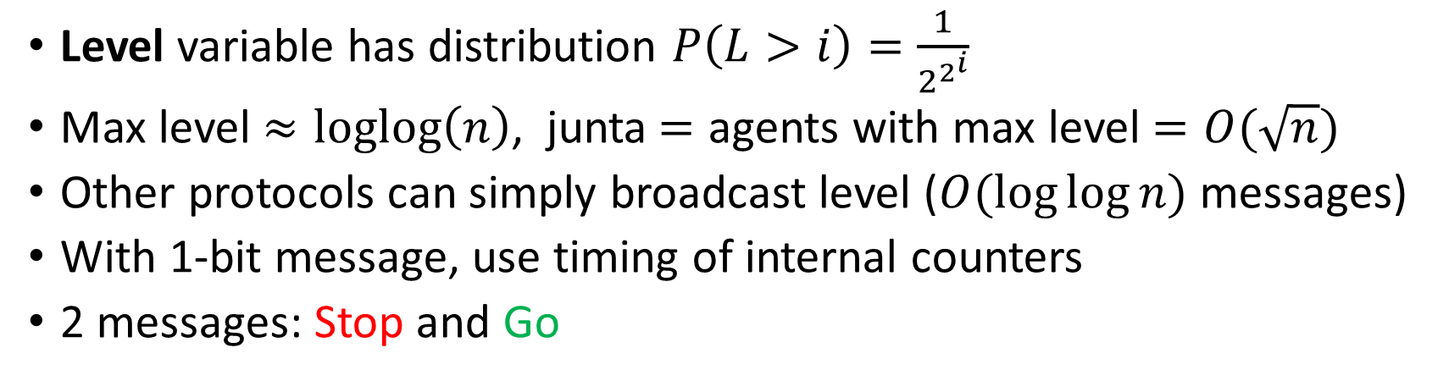








Junta Election with 1-bit messages
Level variable has distribution $P\left(L>i\right)=\frac{1}{2^{2^{i}}}$
Max level $≈loglog\left(n\right)$, junta$=$ agents with max level $=O(\sqrt{n})$
Other protocols can simply broadcast level ($O(\log{\log{n)}}$ messages)
With 1-bit message, use timing of internal counters
2 messages: Stop and Go
$$L:0$$
$$L:1$$
$$L:0$$
$$L:2$$
$$L:1$$
$$L:0$$
$M$=Go
$M$=Stop
$M$=Go
$M$=Stop
$M$=Go
$M$=Stop
$$d_{2}$$
$$d_{0}$$
$$d_{1}$$

Slide 32
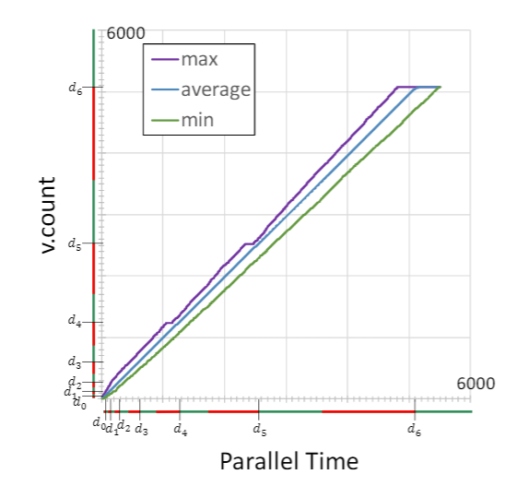
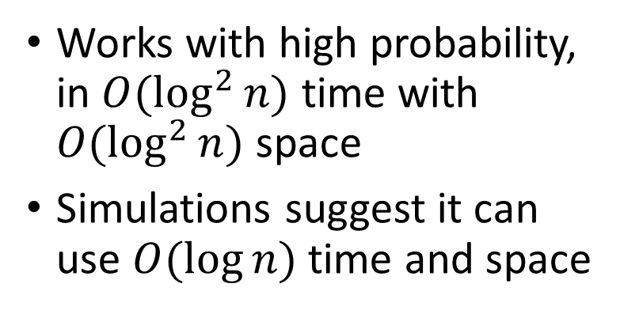
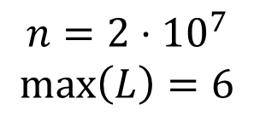
Junta Election with 1-bit messages
Works with high probability, in $O(\log^{2}{n)}$ time with $O(\log^{2}{n)}$ space
Simulations suggest it can use $O(\log{n)}$ time and space
$$n=2⋅{10}^{7}$$
$$\max\left(L\right)=6$$

Slide 33
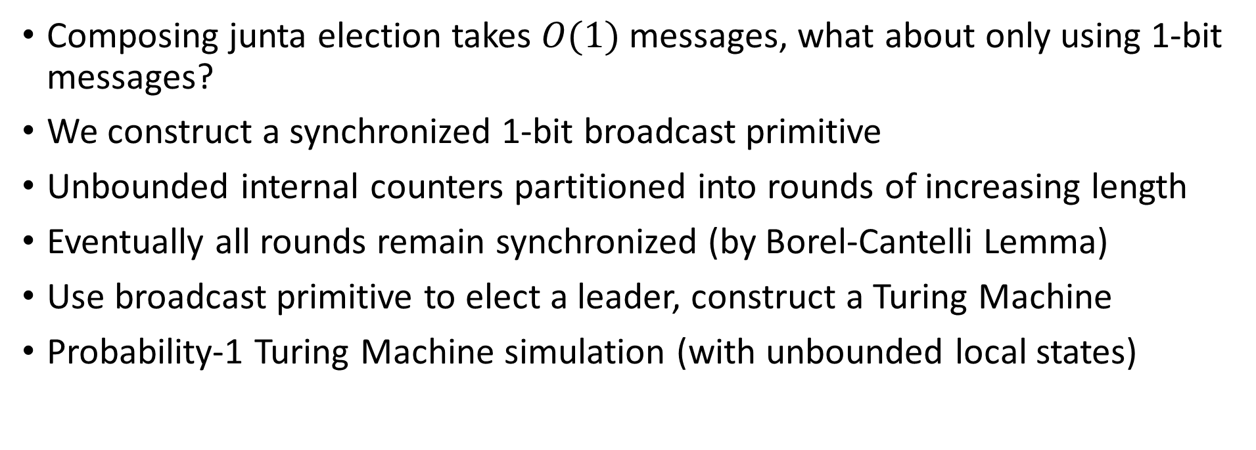
Computational Power of 1-bit Messages
Composing junta election takes $O(1)$ messages, what about only using 1-bit messages?
We construct a synchronized 1-bit broadcast primitive
Unbounded internal counters partitioned into rounds of increasing length
Eventually all rounds remain synchronized (by Borel-Cantelli Lemma)
Use broadcast primitive to elect a leader, construct a Turing Machine
Probability-1 Turing Machine simulation (with unbounded local states)

Slide 34
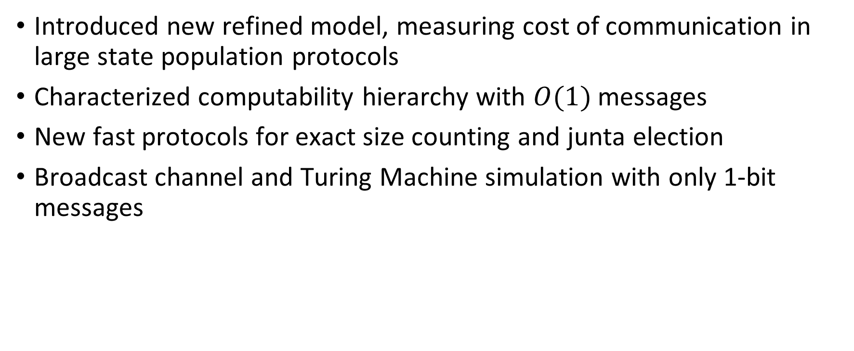
Summary
Introduced new refined model, measuring cost of communication in large state population protocols
Characterized computability hierarchy with $O(1)$ messages
New fast protocols for exact size counting and junta election
Broadcast channel and Turing Machine simulation with only 1-bit messages

Slide 35

Open Questions
Junta election protocol has positive probability of failure
Conjecture: Any protocol that solves leader election with probability 1 using $O\left(1\right)$ messages takes $Ω(n)$ time to stabilize
(same time lower bound as constant state model)
Proof idea: use “density lemma” that all messages appear as a constant fraction of the population in constant time

Slide 36
Thank you for your attention

