Slide 1
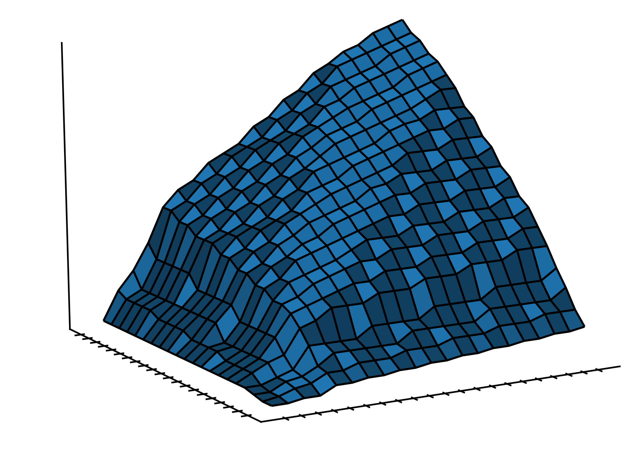
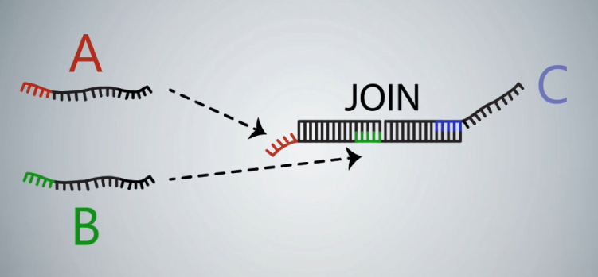



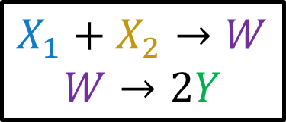


Composable Computation in Discrete Chemical Reaction Networks
$$X_{1}$$
min
$$W$$
2x
$$X_{2}$$
$$Y$$
$$X_{1}+X_{2}→W$$
$$W→2Y$$
Eric E. Severson
(joint work with David Haley and David Doty)
PODC: Principles of Distributed Computing
Toronto, ON, July 20, 2019
Notes:
Question: should I make Thm #s match the paper?

Slide 2
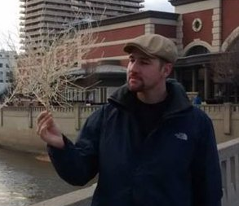



Acknowledgements
Co-authors
David Haley
David Doty
Special Thanks
Anne Condon, Cameron Chalk, Niels Kornerup, Wyatt Reeves, David Soloveichik

Slide 3







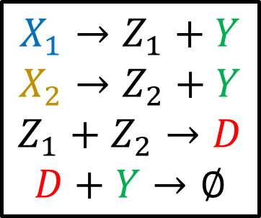









Discrete Chemical Reaction Network (CRN) Model
Finite set of species and finite set of reactions
Configuration: integer counts of species, changes by successive asynchronous reactions
Similar Models: Population Protocols, Petri Nets, Vector Addition Systems
$$X_{1}→Z_{1}+Y$$
$$X_{2}→Z_{2}+Y$$
$$Z_{1}+Z_{2}→D$$
$$D+Y→∅$$
CRN | Population Protocols
Molecule (anonymous) | Agent (anonymous)
Species | State
Reaction (asynchronous) | Transition Function (2 input, 2 output)
$$X_{1}$$
$$Y$$
$$Y$$
$$Y$$
$$Z_{2}$$
$$X_{2}$$
$$X_{2}$$
$$X_{1}$$
$$Z_{1}$$
$$D$$
$$Z_{2}$$
$$X_{1}$$
$$X_{2}$$
$$X_{2}$$
$$X_{1}$$
$$X_{1}$$

Slide 4
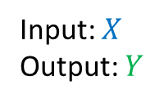





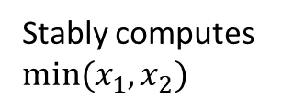




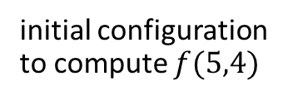







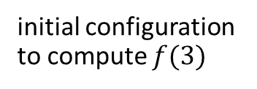





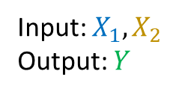

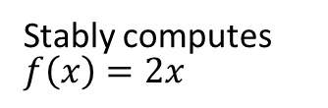





CRN Function Computation
Input: $X$
Output: $Y$
$$X→2Y$$
Stably computes $f\left(x\right)=2x$
Input: $X_{1},X_{2}$
Output: $Y$
$$X_{1}+X_{2}→Y$$
Stably computes $min⁡(x_{1},x_{2})$
$$X$$
$$⇒…⇒$$
$$Y$$
$$Y$$
$$Y$$
$$X_{1}$$
$$X$$
$$X$$
$$Y$$
$$Y$$
$$Y$$
$$X_{1}$$
$$X_{1}$$
$$X_{2}$$
$$X_{2}$$
$$Y$$
$$Y$$
$$⇒…⇒$$
$$X_{1}$$
$$X_{2}$$
$$X_{2}$$
$$Y$$
$$Y$$
initial configuration to compute $f(3)$
$$X_{1}$$
$$X_{1}$$
initial configuration to compute $f(5,4)$
Stable Computation: Intuitively, correct # output with probability 1

Slide 5




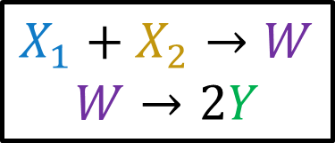











Goal: Function Composition
Rename intermediate species
Combine reactions
$$X_{1}$$
min
$$Y$$
$$X_{2}$$
$$W$$
$$X_{1}$$
min
$$W$$
2x
$$X_{2}$$
$$Y$$
$$X_{1}+X_{2}→W$$
$$X_{1}+X_{2}→Y$$
min
2x
2xmin
$$X_{1}+X_{2}→W$$
$$W→2Y$$
$$X$$
2x
$$Y$$
$$W$$
2xmin
$$X→2Y$$
$$W→2Y$$

Slide 6




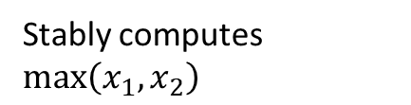


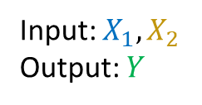
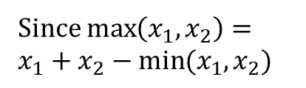
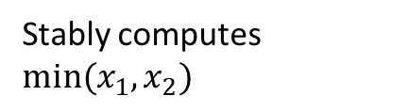
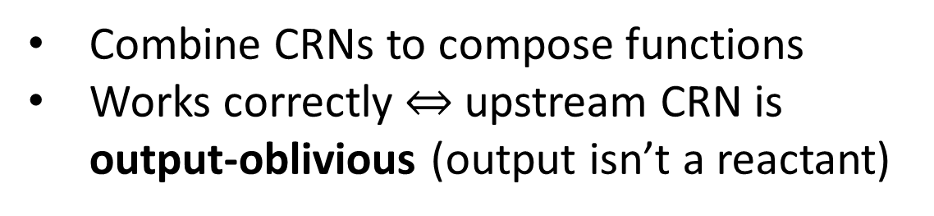











When Composition Works
$$2⋅(min\left(x_{1},x_{2}\right))$$
$$X_{1}$$
min
$$W$$
2x
$$X_{2}$$
$$Y$$
Input: $X_{1},X_{2}$
Output: $Y$
$$X_{1}+X_{2}→Y$$
Stably computes $min⁡(x_{1},x_{2})$
$$X_{1}+X_{2}→W$$
$$W→2Y$$
Output-oblivious
$$X_{1}→Z_{1}+Y$$
$$X_{2}→Z_{2}+Y$$
$$Z_{1}+Z_{2}→D$$
$$D+Y→∅$$
Stably computes $\max\left(x_{1},x_{2}\right)$
Input: $X_{1},X_{2}$
Output: $Y$
$$2⋅(max\left(x_{1},x_{2}\right))$$
Since $\max\left(x_{1},x_{2}\right)=x_{1}+x_{2}−min⁡(x_{1},x_{2})$
$$X_{1}$$
max
$$W$$
2x
$$X_{2}$$
$$Y$$
$$X_{1}→Z_{1}+W$$
$$X_{2}→Z_{2}+W$$
$$Z_{1}+Z_{2}→D$$
$$D+W→∅$$
$$W→2Y$$
NOT Output-oblivious
Combine CRNs to compose functions
Works correctly $⇔$ upstream CRN is output-oblivious (output isn’t a reactant)
reactions
compete

Slide 7

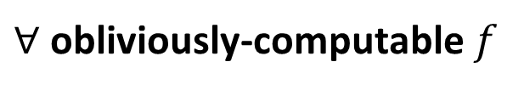

The Main Question
Classify the obliviously-computable $f:ℕ^{d}→ℕ$ that can be stably computed by some output-oblivious CRN (doesn’t consume its output)
$∀$ obliviously-computable$f$
Modular CRN Design
$∃$output-oblivious CRN
to compute $f$
Notes:
Show

Slide 8
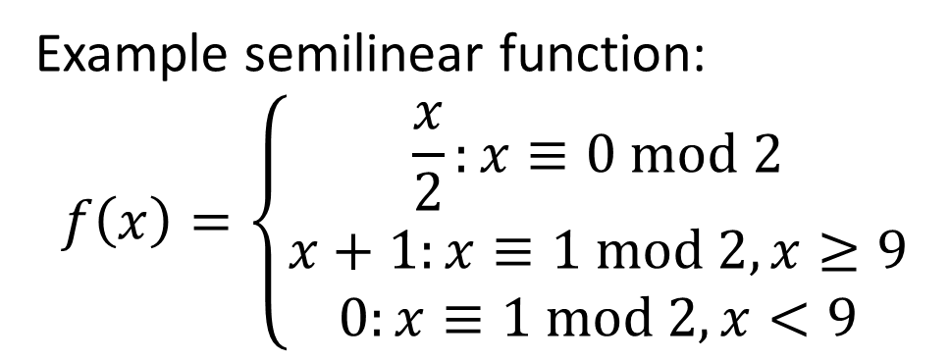


What functions can be stably computed?
Theorem: $f:$ $ℕ^{d}→ℕ$ is stably computable $⇔$ $f$ is semilinear
$$f\left(x\right)$$
Example semilinear function:
$$f\left(x\right)=\left\{\begin{aligned}\frac{x}{2}:x≡0 mod 2 \\ x+1:x≡1 mod 2, x≥9 \\ 0:x≡1 mod 2, x<9\end{aligned}\right.$$
Piecewise Affine
Domains are semilinear sets
(threshold / mod)
$$x$$
[Ho-Lin Chen, David Doty, and David Soloveichik. Deterministic function computation with chemical reaction networks. Natural Computing, 2014.]
[Dana Angluin, James Aspnes, and David Eisenstat. Stably computable predicates are semilinear. PODC, 2006.]

Slide 9






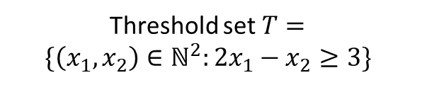

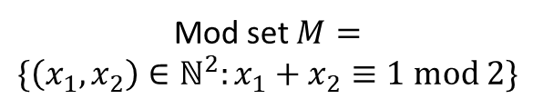

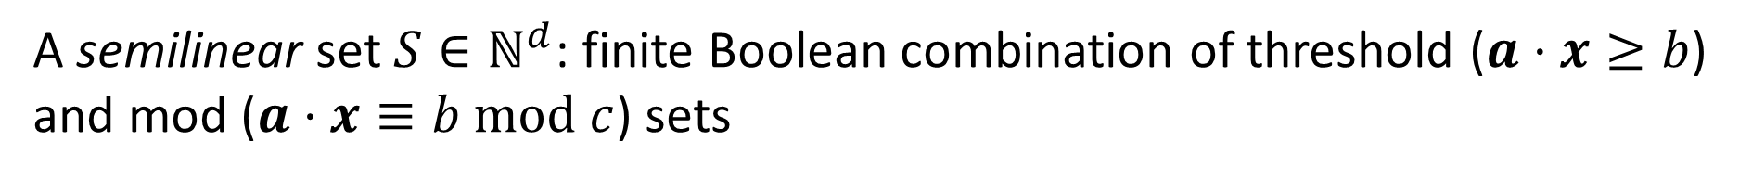


What functions can be stably computed?
Theorem: $f:$ $ℕ^{d}→ℕ$ is stably computable $⇔$ $f$ is semilinear
A semilinear set $S∈ℕ^{d}$: finite Boolean combination of threshold ($a⋅x≥b$) and mod ($a⋅x≡b mod c$) sets
$$x_{2}$$
$$x_{2}$$
$$x_{2}$$
$$x_{2}$$
$$x_{1}$$
$$x_{1}$$
$$x_{1}$$
$$x_{1}$$
Threshold set $T=$
$$\{\left(x_{1},x_{2}\right)∈ℕ^{2}:2x_{1}−x_{2}≥3\}$$
Mod set $M=$
$$\{\left(x_{1},x_{2}\right)∈ℕ^{2}:x_{1}+x_{2}≡1 mod 2\}$$
$T∩M$ is semilinear
$T∪M$ is semilinear
[Ho-Lin Chen, David Doty, and David Soloveichik. Deterministic function computation with chemical reaction networks. Natural Computing, 2014.]

Slide 10





















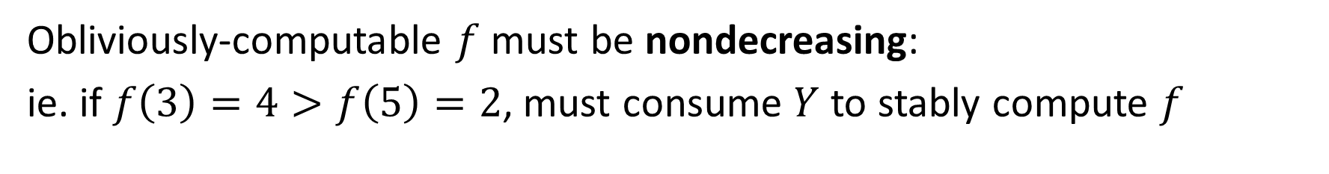





New Constraint for Oblivious Computation
Obliviously-computable $f$must be nondecreasing:
ie. if $f\left(3\right)=4>f\left(5\right)=2$, must consume $Y$ to stably compute $f$
$$⇒$$
$$X$$
$$+$$
Other species
$$X$$
$$Y$$
$$Y$$
To stably compute $f\left(3\right)=4$
$$X$$
$$Y$$
$$Y$$
$$⇒$$
Other species
$$X$$
$$+$$
$$X$$
$$Y$$
$$Y$$
$$+$$
$$+$$
$$X$$
$$X$$
Same reactions overproduce $Y$ when computing $f\left(5\right)=2$
$$X$$
$$X$$
$$Y$$
$$Y$$
$$X$$

Slide 11




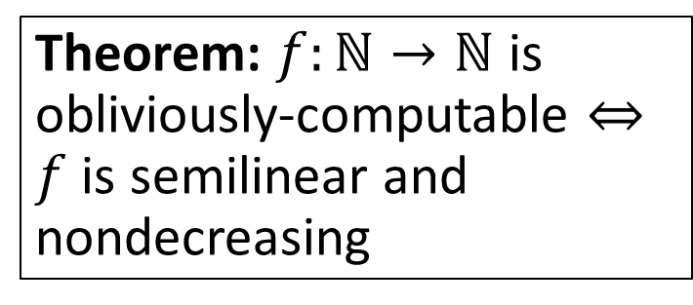
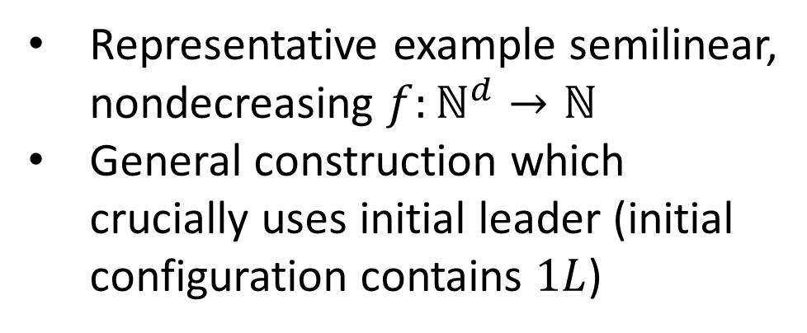
1D Case: Exact Characterization
$$f(x)$$
Theorem: $f:ℕ→ℕ$ is obliviously-computable $⇔f$ is semilinear and nondecreasing
Representative example semilinear, nondecreasing $f:ℕ^{d}→ℕ$
General construction which crucially uses initial leader (initial configuration contains $1L$)
$$p$$
$$n$$
$$x$$

Slide 12
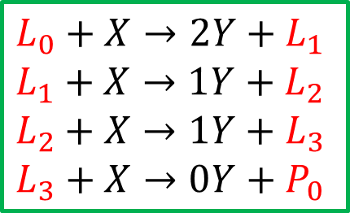

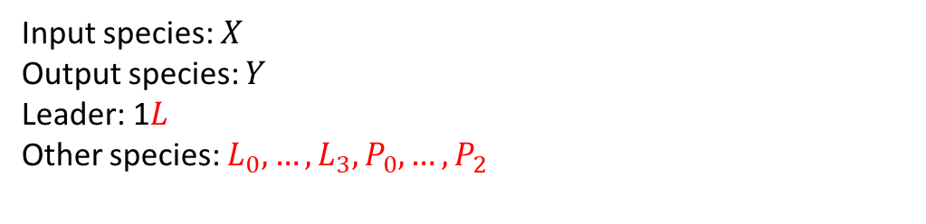
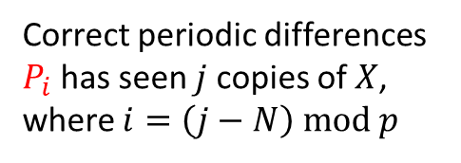
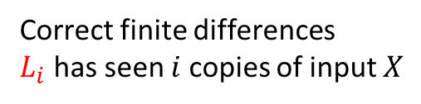
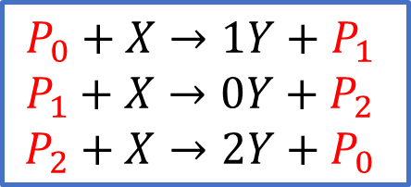
CRN Construction
Input species: $X_{}$
Output species: $Y$
Leader: 1$L$
Other species: $L_{0},…,L_{3},P_{0},…,P_{2}$
Invariant: exactly 1 copy of red species in every reachable configuration
$$f(x)$$
$$f(x)$$
$$L→1Y+L_{0}$$
Correct starting value
$$L_{0}+X→2Y+L_{1}$$
$$L_{1}+X→1Y+L_{2}$$
$$L_{2}+X→1Y+L_{3}$$
$$L_{3}+X→0Y+P_{0}$$
2
Correct finite differences
$L_{i}$ has seen $i$ copies of input $X$
0
0
1
1
$$p$$
1
$$P_{0}+X→1Y+P_{1}$$
$$P_{1}+X→0Y+P_{2}$$
$$P_{2}+X→2Y+P_{0}$$
Correct periodic differences
$P_{i}$ has seen $j$copies of $X$, where $i=\left(j−N\right) mod p$
2
1
$$x$$
$$n$$
$$x$$

Slide 13
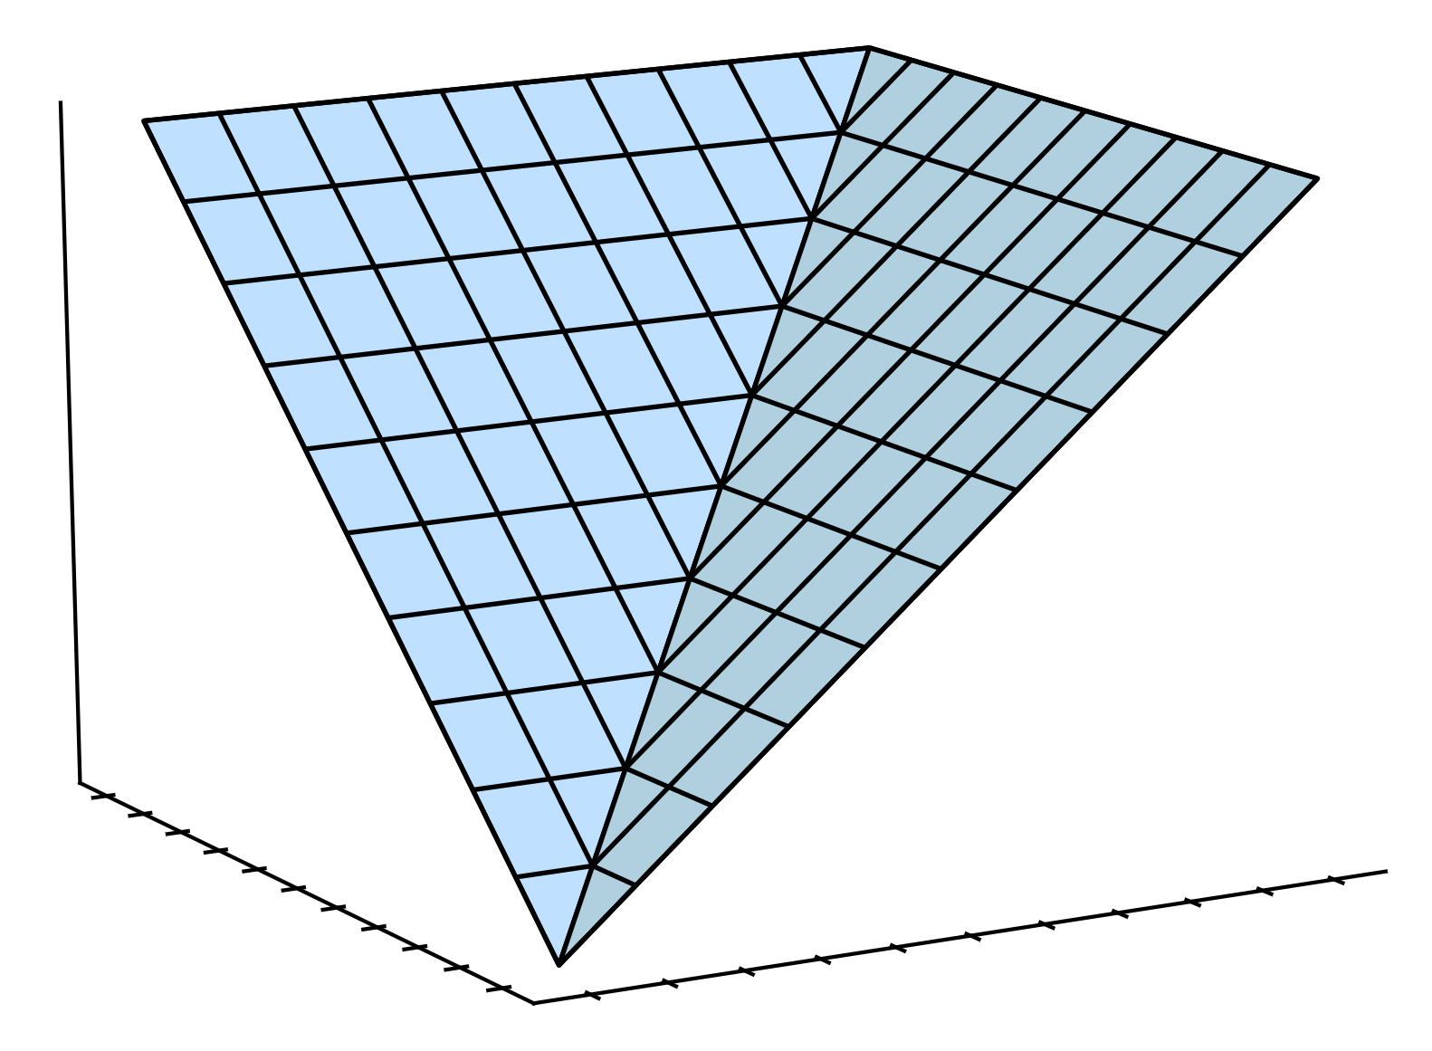
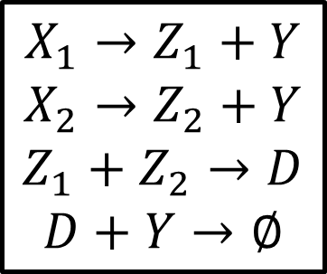

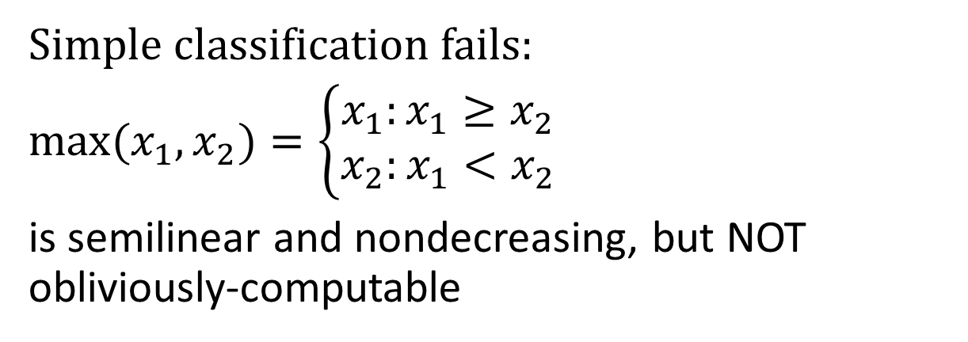



Dimension $d>1$
$$max$$
Simple classification fails:
$max(x_{1}, x_{2})=\left\{\begin{aligned}x_{1}:x_{1}≥x_{2} \\ x_{2}:x_{1}<x_{2}\end{aligned}\right.$
is semilinear and nondecreasing, but NOT obliviously-computable
$$x_{2}$$
$$x_{1}$$
$$X_{1}→Z_{1}+Y$$
$$X_{2}→Z_{2}+Y$$
$$Z_{1}+Z_{2}→D$$
$$D+Y→∅$$
No output-oblivious CRN (even with a leader) can compute max
NOT Output-oblivious

Slide 14





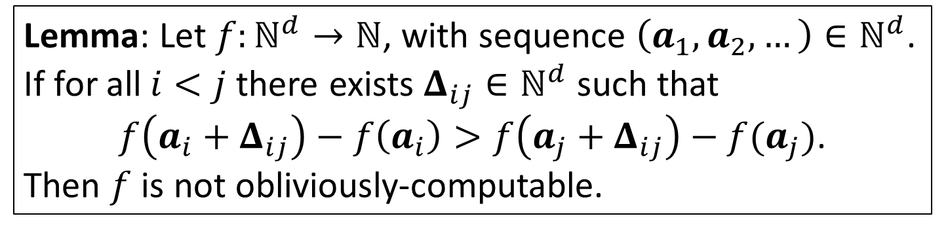






Max is not Obliviously-Computable
$$max$$
$$+(j−i)Y$$
$$+0Y$$
$$Δ_{ij}$$
Idea: Any CRN will overproduce $Y$
$$a_{j}=(j,0)$$
$$Δ_{ij}$$
$$a_{3}=(3,0)$$
$$a_{i}=(i,0)$$
$$a_{2}=(2,0)$$
$$x_{2}$$
$$a_{1}=(1,0)$$
$$x_{1}$$
General Impossibility Lemma:
$$Δ_{ij}=(0,j)$$
Lemma: Let $f:ℕ^{d}→ℕ$, with sequence $\left(a_{1},a_{2},…\right)∈ℕ^{d}$. If for all$i<j$there exists $Δ_{ij}∈ℕ^{d}$ such that
$f\left(a_{i}+Δ_{ij}\right)−f\left(a_{i}\right)>f\left(a_{j}+Δ_{ij}\right)−f(a_{j})$.
Then $f$ is not obliviously-computable.
Notes:
Hide lemma

Slide 15
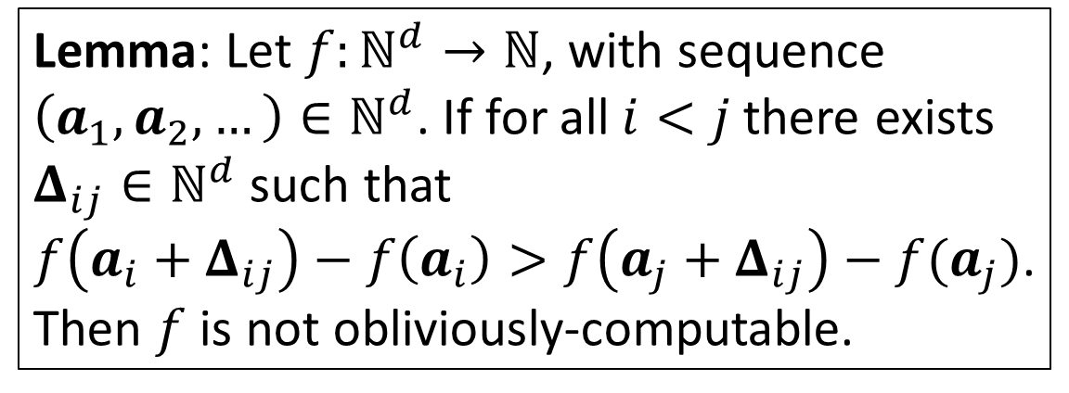
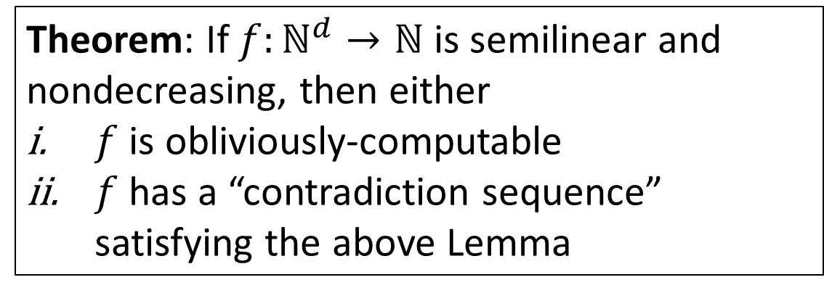
General Impossibility Result
$$max$$
Lemma: Let $f:ℕ^{d}→ℕ$, with sequence $\left(a_{1},a_{2},…\right)∈ℕ^{d}$. If for all$i<j$there exists $Δ_{ij}∈ℕ^{d}$ such that
$f\left(a_{i}+Δ_{ij}\right)−f\left(a_{i}\right)>f\left(a_{j}+Δ_{ij}\right)−f(a_{j})$.
Then $f$ is not obliviously-computable.
$$+0Y$$
$$+(j−i)Y$$
$$Δ_{ij}$$
$$a_{j}=(j,0)$$
$$Δ_{ij}$$
$$a_{i}=(i,0)$$
$$x_{2}$$
$$x_{1}$$
Theorem: If $f:ℕ^{d}→ℕ$ is semilinear and nondecreasing, then either
$f$ is obliviously-computable
$f$ has a “contradiction sequence” satisfying the above Lemma
But what do obliviously-computable functions look like?

Slide 16






Generalized Characterization
$$f(x)$$
$$f$$
$$x_{2}$$
$$x_{1}$$
Obliviously-computable $f:ℕ^{2}→ℕ$
$$x$$
Obliviously-computable $f:ℕ→ℕ$
16

Slide 17
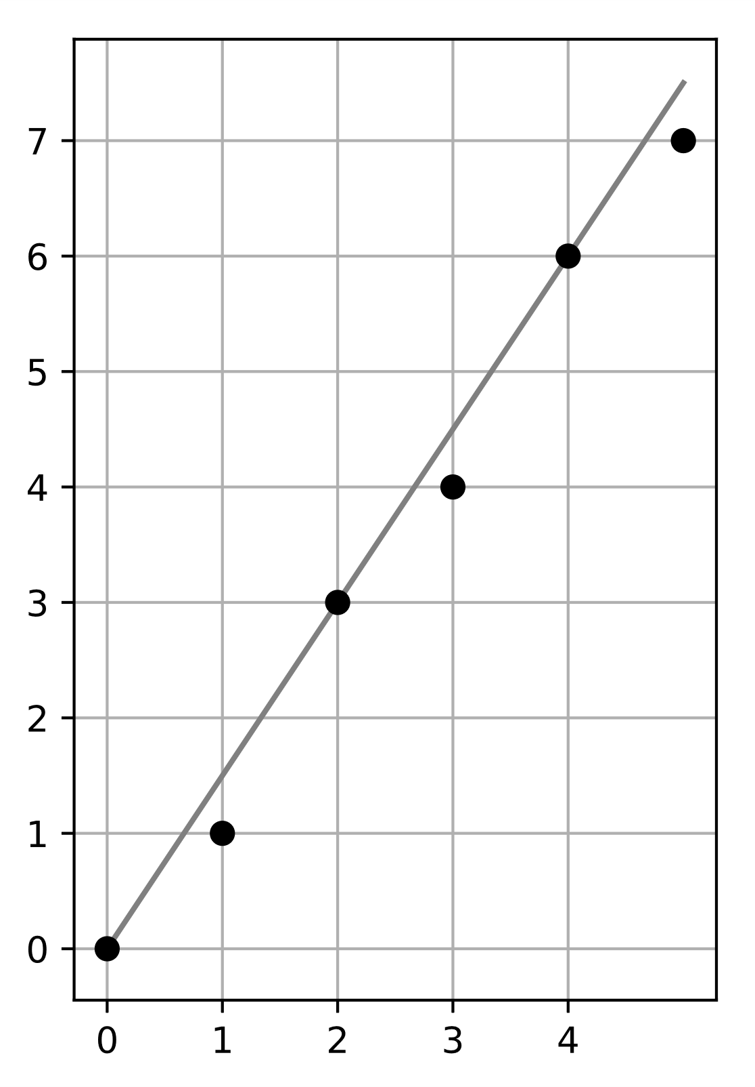
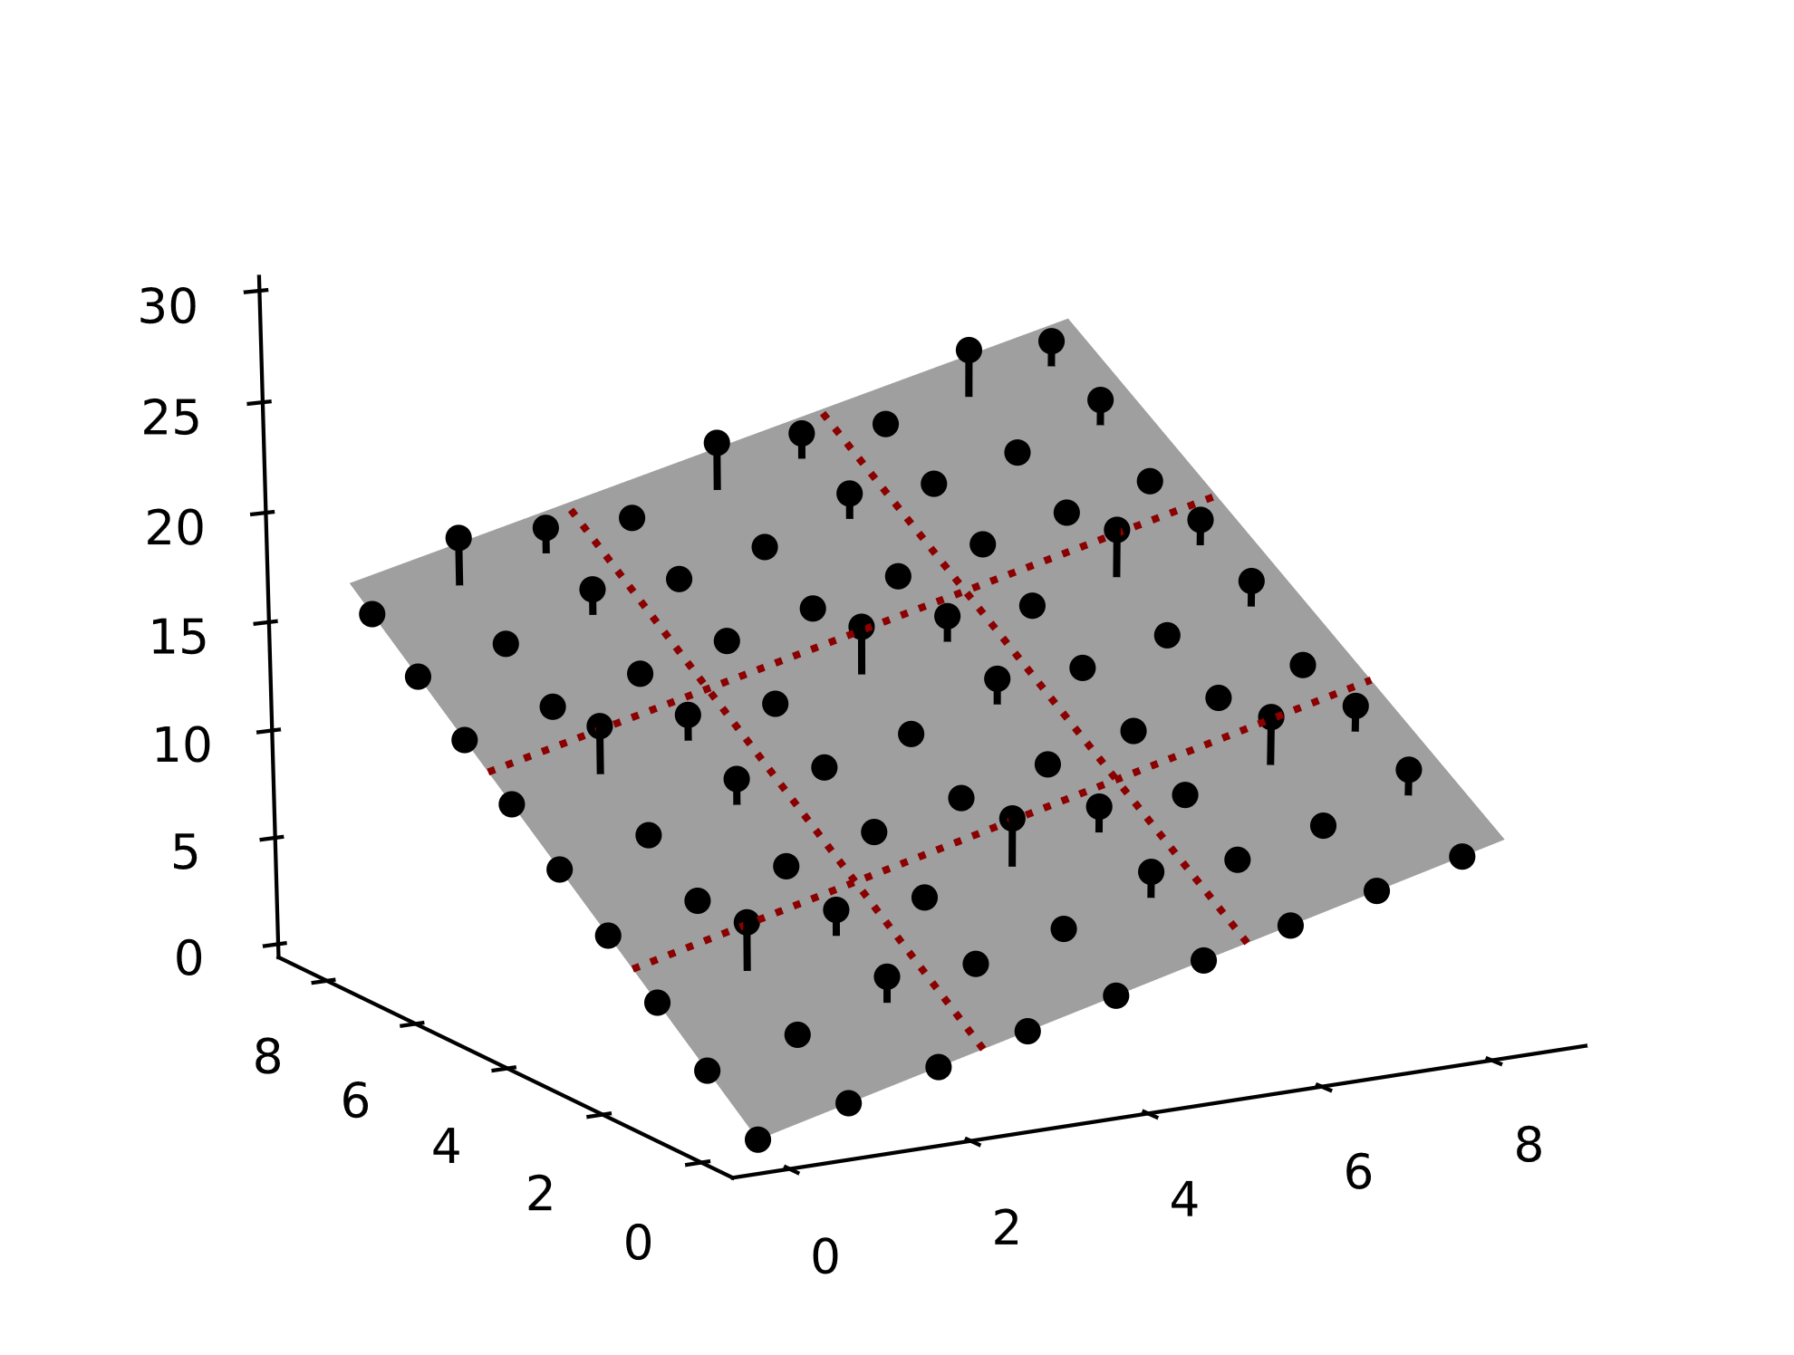




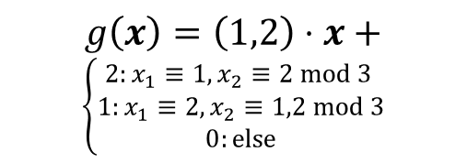
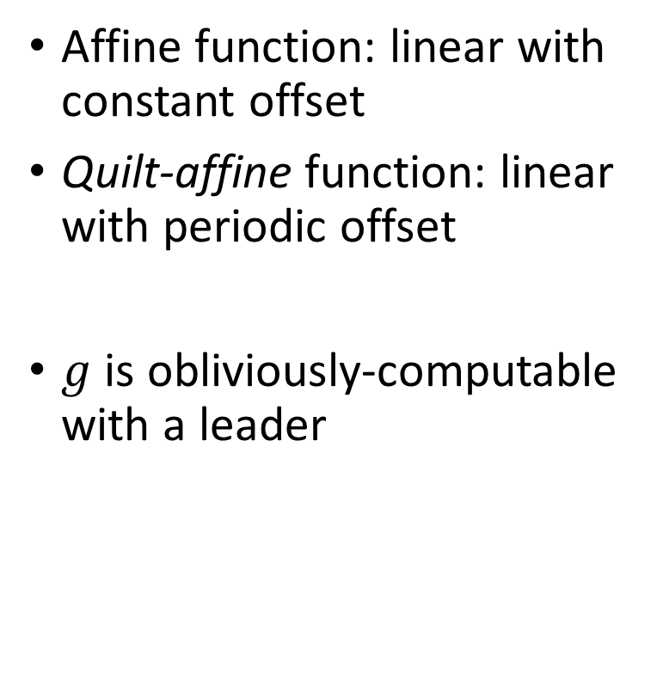

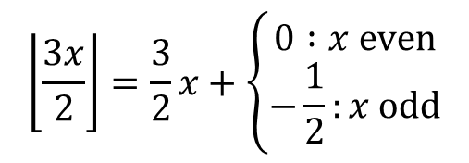
Quilt-Affine Functions
$$\left\lfloor \frac{3x}{2}\right\rfloor$$
Linear function
Affine function: linear with constant offset
Quilt-affine function: linear with periodic offset
$g$ is obliviously-computable with a leader
$$\left\lfloor \frac{3x}{2}\right\rfloor =\frac{3}{2}x+\left\{\begin{aligned}0 :x even \\ −\frac{1}{2}:x odd\end{aligned}\right.$$
Periodic offset
$$x$$
Linear function
$$g$$
$$g\left(x\right)=\left(1,2\right)⋅x+$$
$$\left\{\begin{aligned}2:x_{1}≡1,x_{2}≡2 mod 3 \\ 1:x_{1}≡2, x_{2}≡1,2 mod 3 \\ 0:else\end{aligned}\right.$$
Periodic offset
$$x_{2}$$
$$x_{1}$$
17

Slide 18
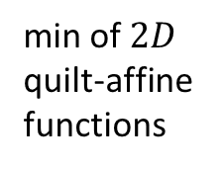



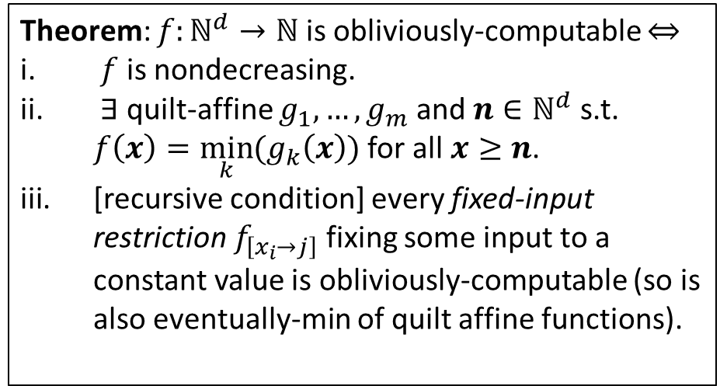

Main Result
min of $2D$
quilt-affine functions
$1D$
quilt-
affine functions
$$f$$
Theorem: $f:ℕ^{d}→ℕ$ is obliviously-computable $⇔$
$f$ is nondecreasing.
$∃$ quilt-affine $g_{1},…,g_{m}$ and $n∈ℕ^{d}$ s.t. $f\left(x\right)=\min_{k}{(g_{k}\left(x\right))}$ for all $x≥n$.
[recursive condition] every fixed-input restriction $f_{\left[x_{i}→j\right]}$ fixing some input to a constant value is obliviously-computable (so is also eventually-min of quilt affine functions).
$1D$
quilt-
affine
$$x_{2}$$
$$x_{1}$$
arbitrary finite behavior
$n=(4,4)$
Obliviously-computable $f:ℕ^{2}→ℕ$.
18

Slide 19







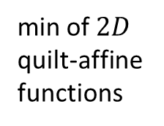








Continuous Limit
Agrees with the continuous output-oblivious CRN result [1]:
$f:ℝ_{≥0}^{d}→ℝ$ is positive-continuous, piecewise-linear, superadditive
min of $2D$
quilt-affine functions
$$f$$
min of linear functions when $x_{1},x_{2}>0$
$$f$$
$1D$
quilt-
affine functions
linear at $x_{2}=0$
$1D$
quilt-
affine
linear at $x_{1}=0$
$$x_{2}$$
$$x_{2}$$
$$x_{1}$$
$$x_{1}$$
arbitrary finite behavior
$n=(4,4)$
The scaling limit is obliviously-computable by a continuous CRN.
Obliviously-computable $f:ℕ^{2}→ℕ$.
[1] Cameron Chalk, Niels Kornerup, Wyatt Reeves, and David Soloveichik. Composable rate-independent computation in continuous chemical reaction networks. In Computational Methods in Systems Biology, 2018.
19

Slide 20




Open Question: Leaderless Output-Oblivious CRNs
Without a leader, obliviously-computable $f$ must be superadditive: $f\left(a\right)+f\left(b\right)≤f(a+b)$ for all inputs $a,b∈ℕ^{d}$
Dimension $d=1$ is classified:
Dimension $d>1$ is open:
Theorem: $f:ℕ→ℕ$ is leaderlessly obliviously-computable $⇔$ $f$ is semilinear, nondecreasing, and superadditive
Conjecture: $f:ℕ^{d}→ℕ$ is leaderlessly obliviously-computable $⇔$ $f$ is obliviously-computable and superadditive

Slide 21
Thank you for your attention.
Questions?

