Slide 1

Time-Optimal Self-Stabilizing Leader Election in Population Protocols
Eric Severson
UC Davis
PODC 2021

Slide 2




Joint Work
with
Janna Burman
David Doty
Ho-Lin Chen
Hsueh-Ping Chen
Chuan Xu
Thomas Nowak

Slide 3






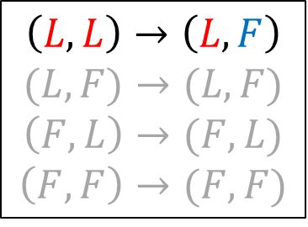










Population Protocols Model
[Dana Angluin, James Aspnes, Zoe Diamadi, Michael J. Fischer, and René Peralta. PODC, 2004. Distributed Computing, 2006.]
System of $n$ agents, each with state $s∈S$ (otherwise indistinguishable)
Configuration updates by successive random pairwise interactions
Apply transition rule $δ:S×S→S×S$
$n=13$ $S=\{L,F\}$
$$L$$
$$L$$
$$F$$
$$L$$
$$F$$
$$F$$
$$F$$
$$F$$
$$F$$
$$L$$
$$F$$
$$L$$
$$L$$
$$F$$
$$\left(L,L\right)→\left(L,F\right)$$
$$(L,F)→(L,F)$$
$$\left(F,L\right)→(F,L)$$
$$\left(F,F\right)→(F,F)$$

Slide 4
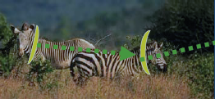
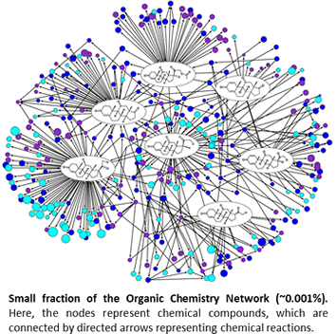
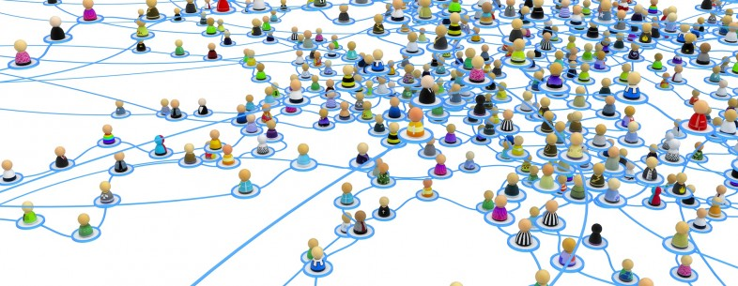
Population Protocols Motivation
Original motivation: mobile sensor networks
ZebraNet [ASPLOS’02] (wildlife tracking)
EMMA [WCMC’07] (pollution monitoring)
Recent motivation: chemical reaction networks dynamics of well mixed solutions [Gillespie 77], [Soloveichik, Cook, Winfree, Bruck NC’08], [Doty SODA’2014]
Social networks propagation of
trust [Diamadi, Fischer WU.J.Nat.Sci.01]
rumors [Daley, Kendall J.Inst.Math.Appl.65]
epidemics [Bailey,75] [Herbert et al, SIAM’00]

Slide 5










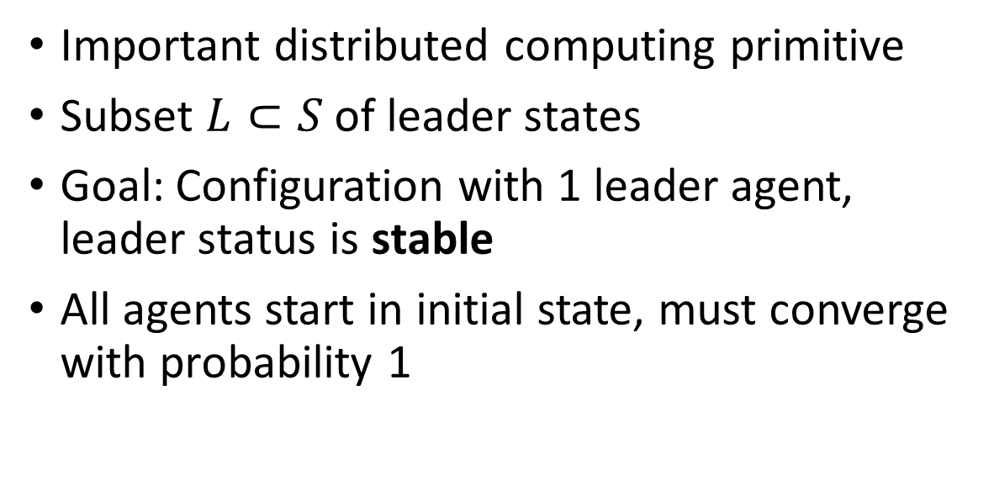












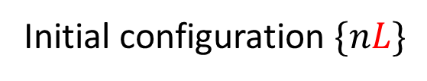




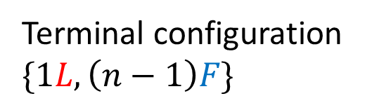
Leader Election Problem
Simple leader election protocol:
Important distributed computing primitive
Subset $L⊂S$ of leader states
Goal: Configuration with 1 leader agent, leader status is stable
All agents start in initial state, must converge with probability 1
$$\left(L,L\right)→\left(L,F\right)$$
Initial configuration $\{nL\}$
$$F$$
$$F$$
$$L$$
$$L$$
$$F$$
$$L$$
$$L$$
$$F$$
$$L$$
$$F$$
$$L$$
$$L$$
$$L$$
$$F$$
$$F$$
$$F$$
$$L$$
$$L$$
$$F$$
$$F$$
$$L$$
$$L$$
$$F$$
$$F$$
$$L$$
Terminal configuration $\{1L,\left(n−1\right)F\}$

Slide 6

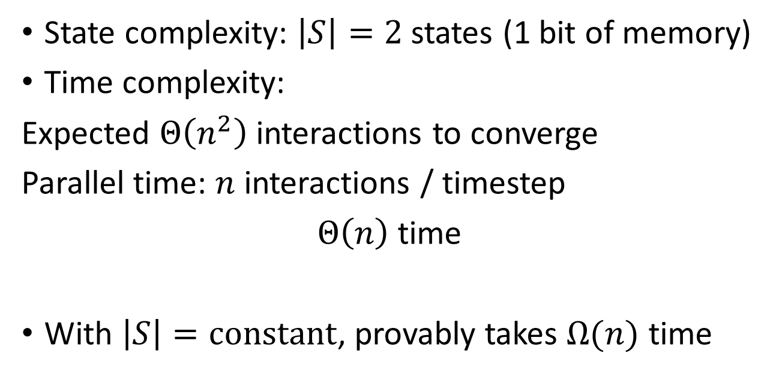
Protocol Complexity
Simple leader election protocol:
State complexity: $\left|S\right|=2$ states (1 bit of memory)
Time complexity:
Expected $Θ\left(n^{2}\right)$ interactions to converge
Parallel time: $n$ interactions / timestep
$Θ\left(n\right)$ time
With $\left|S\right|=constant$, provably takes $Ω(n)$ time
$$\left(L,L\right)→\left(L,F\right)$$
Final transition:
$$F$$
$$F$$
$$L$$
$$F$$
$$F$$
$$F$$
$$F$$
$$F$$
$$F$$
$$F$$
$$F$$
$$F$$
$$L$$
[David Doty and David Soloveichik. DISC, 2015. Distributed Computing, 2018.]
probability $1/\left({n \atop 2}\right)$

Slide 7
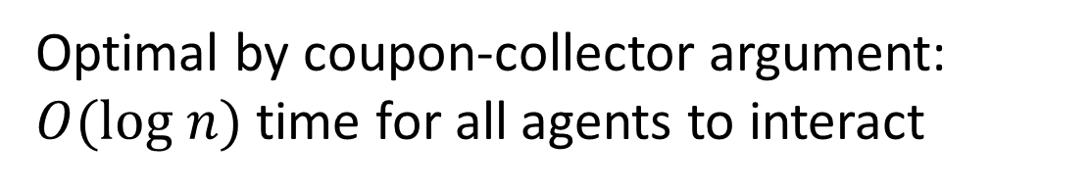
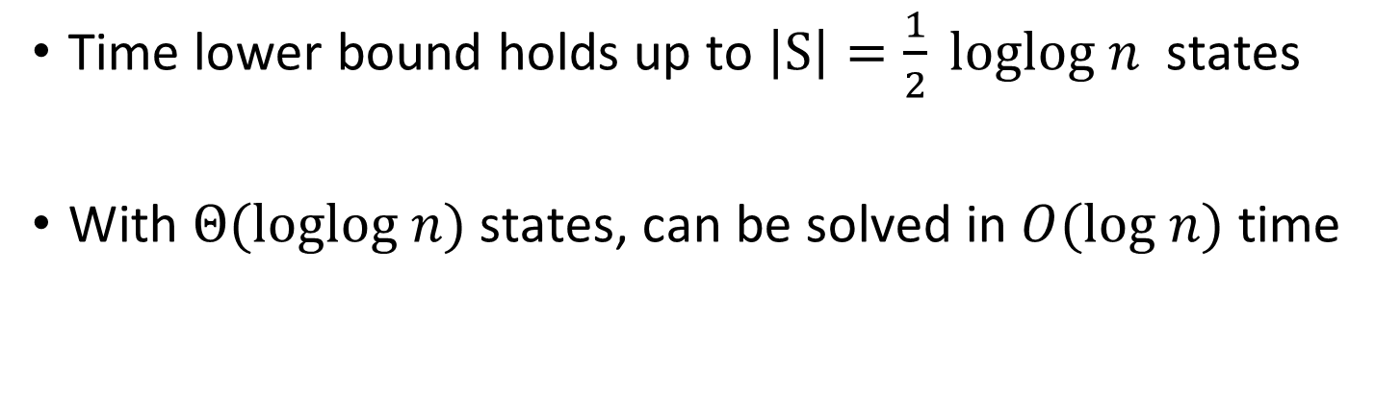
Uniformly initialized Leader Election
Time lower bound holds up to $\left|S\right|=\frac{1}{2} loglog n$ states
With $Θ(loglog n)$ states, can be solved in $O(log n)$ time
[Dan Alistarh, James Aspnes, David Eisenstat, Rati Gelashvili, Ronald L Rivest. SODA, 2017.]
[Leszek Gasieniec, Grzegorz Stachowiak. SODA, 2018. JACM, 2020.]
[Petra Berenbrink, George Giakkoupis, Peter Kling. STOC, 2020.]
Optimal by coupon-collector argument:
$O(log n)$ time for all agents to interact

Slide 8


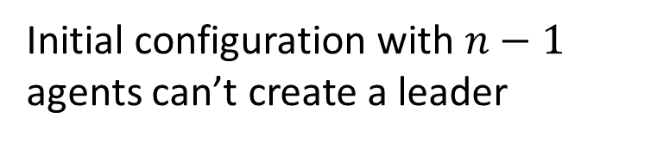



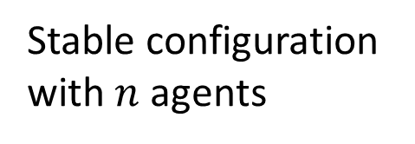





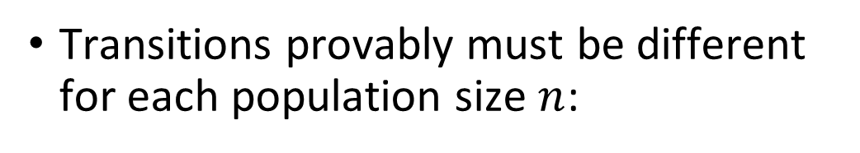




Self-Stabilizing Leader Election
Protocol starts from arbitrary initial configuration
Simple protocol fails:
Transitions provably must be different for each population size $n$:
$$\left(L,L\right)→\left(L,F\right)$$
$$F$$
$$F$$
volatile
memory
corruption
$$F$$
Stable configuration with $n$ agents
$$F$$
$$F$$
$$L$$
$$F$$
$$F$$
$$F$$
$$F$$
$$F$$
$$F$$
$$F$$
Initial configuration with $n−1$ agents can’t create a leader

Slide 9


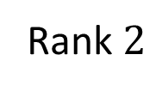
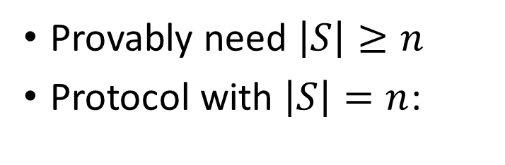


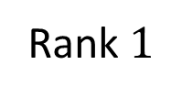

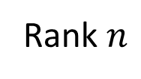





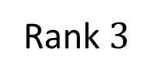



Simple Self-Stabilizing Leader Election Protocol
[S. Cai, T. Izumi, and K. Wada. Theory of Computing Systems, 2012.]
Provably need $\left|S\right|≥n$
Protocol with $\left|S\right|=n$:
$S=\{0,1,…,n−1\}$ $L=\{0\}$
$$\left(i,i\right)→(i,i+1 mod n)$$
$$3$$
Arbitrary initial configuration
Unique terminal configuration
$$1$$
$$3$$
$$5$$
$$0$$
$$1$$
$$2$$
$$3$$
$$4$$
$$5$$
$$6$$
…
Rank $1$
Rank $2$
Rank $3$
Rank $n$
Solves strictly harder ranking problem
Protocol is silent (only null transitions in terminal configuration)
Notes:
Say there are 7 states, 0-6 shown here in these bins

Slide 10






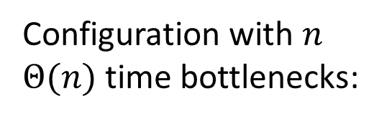




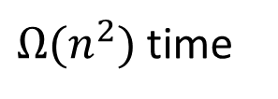

Time Analysis
$S=\{0,1,…,n−1\}$ $L=\{0\}$
$$\left(i,i\right)→(i,i+1 mod n)$$
Configuration with $n$ $Θ(n)$ time bottlenecks:
$Θ(n)$ time
$Θ(n)$ time
$Θ(n)$ time
$Θ(n)$ time
$Θ(n)$ time
$$1$$
$$2$$
$$3$$
$$4$$
$$5$$
$$6$$
$Ω(n^{2})$ time
$$0$$
$$1$$
$$2$$
$$3$$
$$4$$
$$5$$
$$6$$
…
Rank $1$
Rank $2$
Rank $3$
Rank $n$

Slide 11


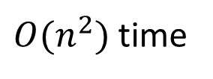



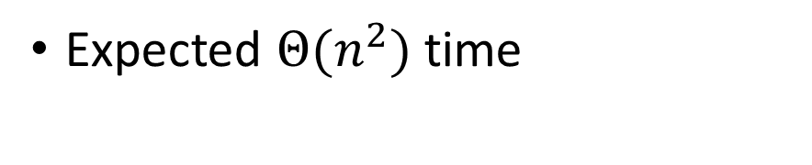


Time Analysis
Expected $Θ(n^{2})$ time
$S=\{0,1,…,n−1\}$ $L=\{0\}$
$$\left(i,i\right)→(i,i+1 mod n)$$
Worst case initial configuration:
$$1$$
$$1$$
$$1$$
$$1$$
$$1$$
$O(n^{2})$ time
$$1$$
$$1$$
…
Rank $1$
Rank $2$
Rank $3$
Rank $n$

Slide 12
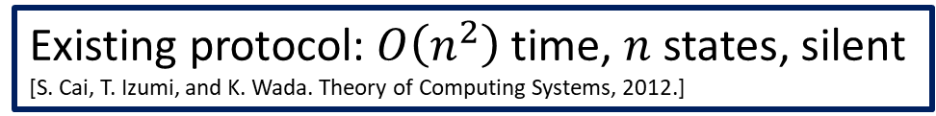
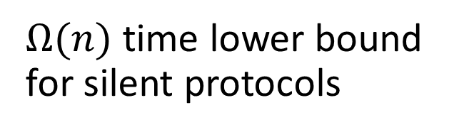
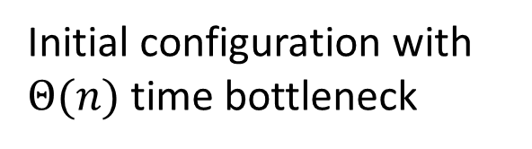
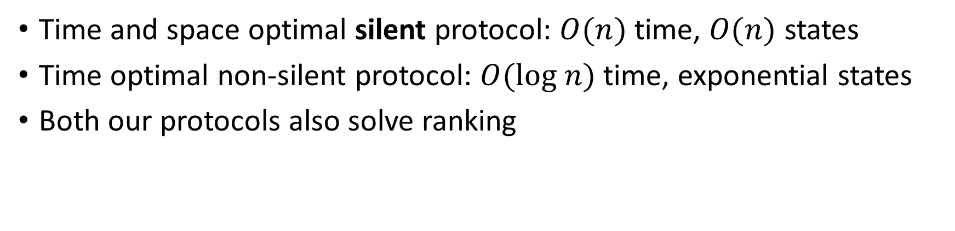



Our Work: Time / Space Tradeoffs for Self-Stabilizing Leader Election
Existing protocol: $O\left(n^{2}\right)$ time, $n$ states, silent
[S. Cai, T. Izumi, and K. Wada. Theory of Computing Systems, 2012.]
Time and space optimal silent protocol: $O(n)$ time, $O(n)$ states
Time optimal non-silent protocol: $O(log n)$ time, exponential states
Both our protocols also solve ranking
$$L$$
$Ω(n)$ time lower bound for silent protocols
$$L$$
$$L$$
Silent configuration
Initial configuration with $Θ(n)$ time bottleneck

Slide 13
Optimal silent protocol
Each agent has a role ∈ {Settled, Unsettled, Resetting}
Settled agent has a rank ∈ {1, …, n}
Unsettled agent waits to get its rank from a Settled agent (and counts Θ(n) interactions)
In a silent stable configuration every agent is Settled to a unique rank ∈ {1, …, n}
Otherwise, trigger Reset if
two Settled agents with an identical rank interact
agent stays Unsettled after Θ(n) interactions
➔ agents move to Resetting
4
2
1
4
5
3
4
4
error counter: Θ(n) interactions

Slide 14













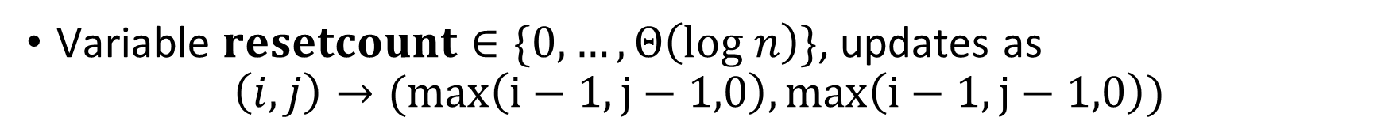
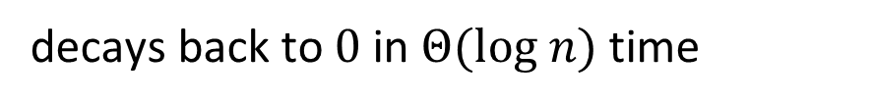












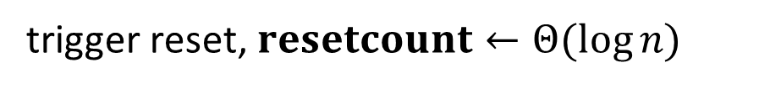
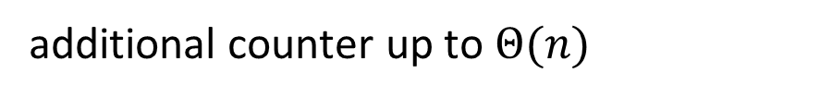

Reset Subroutine
Variable $resetcount∈\{0,…, Θ\left(log n\right)\}$, updates as
$$\left(i,j\right)→(max\left(i−1,j−1,0\right),max\left(i−1,j−1,0\right))$$
$$0$$
trigger reset, $resetcount←Θ(\log{n)}$
$$5$$
$$9$$
$$0$$
$$6$$
$$10$$
$$0$$
$$1$$
positive signal spreads in $Θ(log n)$ time
$$9$$
$$8$$
$$8$$
$$0$$
$$4$$
$$0$$
$$6$$
additional counter up to $Θ(n)$
$$0$$
decays back to $0$ in $Θ(log n)$ time
$$2$$
$$0$$
$$5$$
$$0$$
$$3$$
[Dan Alistarh, Bartlomiej Dudek, Adrian Kosowski, David Soloveichik, Przemyslaw Uznanski. DNA, 2017.]
Wait an additional $O(n)$ time, do initialized 2-state leader election
$$\left(L,L\right)→\left(L,F\right)$$
$$F$$
Unsettled
$$F$$
$$F$$
$$F$$
$$F$$
$$F$$
$$F$$
$$L$$
1
Settled, rank = 1

Slide 15
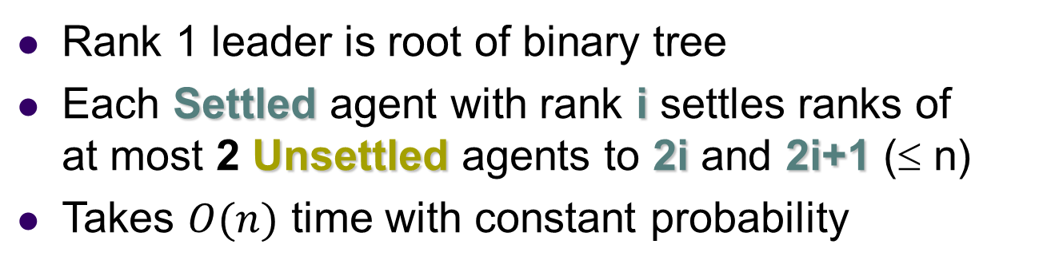
Post reset: Binary tree ranking
Rank 1 leader is root of binary tree
Each Settled agent with rank i settles ranks of at most 2 Unsettled agents to 2i and 2i+1 (≤ n)
Takes $O(n)$ time with constant probability
Settled agents with ranks
Unsettled
1
n = 12
2
3
3
4
5
6
7
8
12

Slide 16

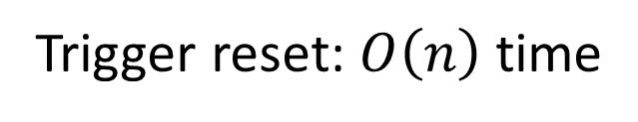



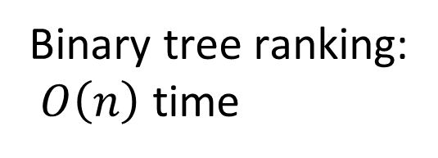
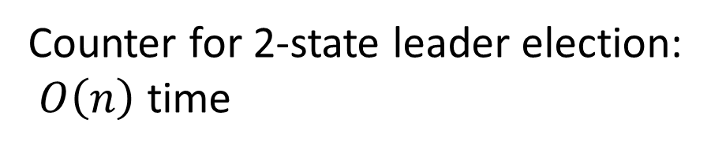
Silent protocol: $O(n)$ time, $O(n)$ states
Trigger reset: $O\left(n\right)$ time
Settled agents: $O\left(n\right)$ states
+
+
Counter for 2-state leader election:
$O\left(n\right)$ time
Unsettled agents: $O\left(n\right)$ states
+
+
Binary tree ranking:
$O\left(n\right)$ time
Resetting agents: $O\left(n\right)$ states

Slide 17
Time-optimal non-silent protocol
An agent is either Collecting or Resetting.
When Collecting, it has a name ∈ {1, …, n³} and a roster array to collect names
agents merge their rosters during an interaction
All rosters are complete in O(log n) time
When |roster| = n, agent’s rank is its name’s order in the roster
Roster = {2, 4, 10}
2
{2, 4, 5, 10, 21}
{4, 5, 10}
or
{4}
{5, 10, 21}
10
4
5
21
{4, 5, 10}
{5, 10}
{2, 4, 10, 21}
{2, 4, 5, 10, 21}
rank = 2
Roster = {2, 4, 5, 10, 21}
4
Stable config: unique names, correct rosters

Slide 18

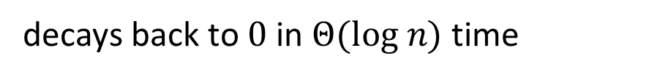

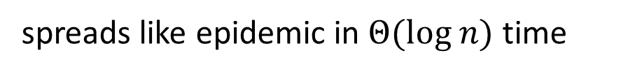
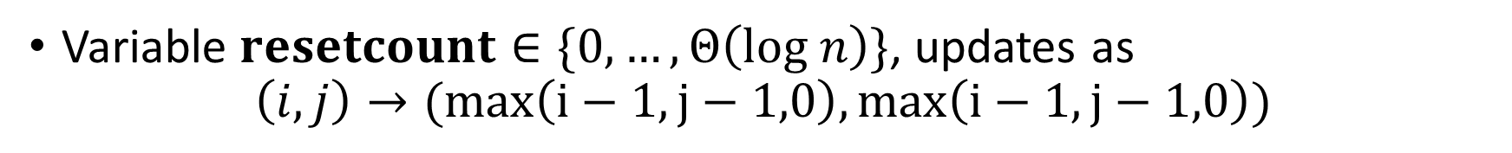

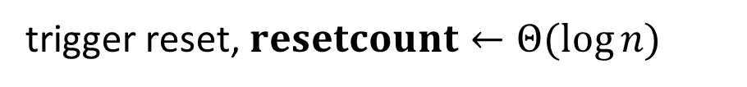

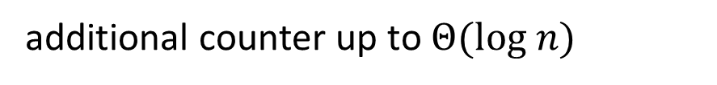

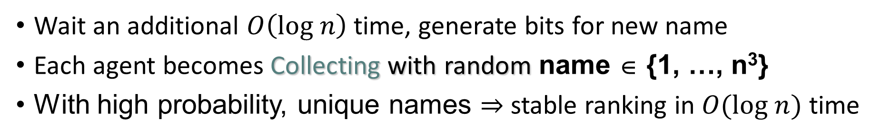
Similar Reset Rule
Variable $resetcount∈\{0,…, Θ\left(log n\right)\}$, updates as
$$\left(i,j\right)→(max\left(i−1,j−1,0\right),max\left(i−1,j−1,0\right))$$
$$0$$
trigger reset, $resetcount←Θ(\log{n)}$
$$5$$
$$9$$
$$0$$
$$6$$
$$10$$
$$0$$
$$1$$
spreads like epidemic in $Θ(log n)$ time
$$9$$
additional counter up to $Θ(log n)$
$$8$$
$$8$$
$$0$$
$$4$$
$$0$$
$$6$$
decays back to $0$ in $Θ(log n)$ time
$$0$$
$$2$$
$$0$$
$$5$$
$$0$$
$$3$$
Wait an additional $O\left(log n\right)$ time, generate bits for new name
Each agent becomes Collecting with random name ∈ {1, …, n³}
With high probability, unique names $⇒$ stable ranking in $O(log n)$ time

Slide 19
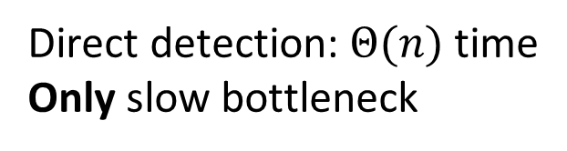

Detecting Errors from any initial configuration
Reset is triggered if an agent detects:
“Ghost name” error a name in a roster belonging to no agent.
Unique names $⇒$detected whenever |roster| > n (in O(log n) time)
Name collision error
{2, 4, 11}
2
{2, 4, 5, 11, 21}
{2, 4, 5, 10, 11, 21}
{2, 4, 5, 10, 11, 21}
10
4
{5, 10, 21}
5
21
{4, 5, 11}
{2, 4, 5, 11, 21}
Direct detection: $Θ(n)$ time
Only slow bottleneck
4
4

Slide 20
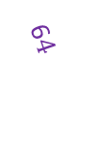

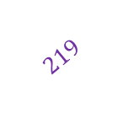
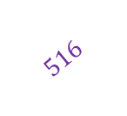
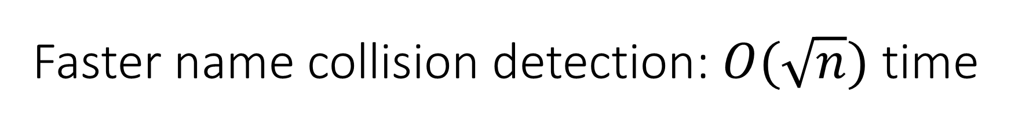

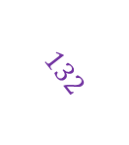
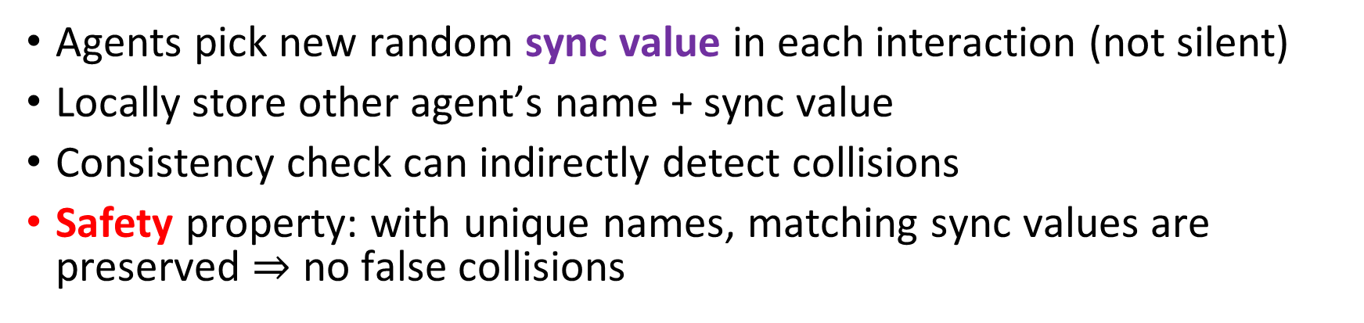


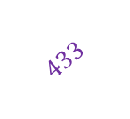
Faster name collision detection: $O(\sqrt{n})$ time
Direct interaction: $Θ(n)$ time
Length-2 path: $Θ(\sqrt{n})$ time
4
4
4
7
4
$$132$$
4
7
$$516$$
4
$$132$$
$$433$$
$$132$$
$$219$$
7
trigger reset
8
8
1
4
6$4$
3
Agents pick new random sync value in each interaction (not silent)
Locally store other agent’s name + sync value
Consistency check can indirectly detect collisions
Safety property: with unique names, matching sync values are preserved $⇒$ no false collisions

Slide 21












Fast name collision detection: $O(log n)$ time
. . . . . . . . . . . . .
4
7
2
6
4
$$132$$
$$99$$
4
$$132$$
7
2
$$132$$
$$516$$
$$54$$
7
$$99$$
$$99$$
4
3
8
2
7
$$516$$
$$54$$
$$132$$
3
8
4
Store sync value history in depth $H$ tree

Slide 22






Fast name collision detection: $O(log n)$ time
Epidemic from 4$→$4 gives length-$Θ(log n)$ causal path in $Θ(log n)$ time
no matching sync values
. . . . . . . . . . . . .
4
7
2
6
4
$$132$$
$$99$$
6
4
$$132$$
7
2
. . .
$$132$$
$$516$$
$$54$$
7
$$99$$
$$99$$
4
3
8
2
7
$$516$$
$$54$$
$$132$$
8
4
$$H=Θ(log n)$$
3
$$516$$
2
$$54$$
$$99$$
3
8
7
Store sync value history in depth $H$ tree
Check consistency of causal paths of length $≤H$
Still maintains safety: unique names $⇒$ no false collisions
$$132$$
4

Slide 23







Fast name collision detection: $O(log n)$ time
new sync value
Some interaction appears in both causal histories
4
7
2
6
4
$$818$$
6
4
$$818$$
7
2
. . .
$$132$$
$$516$$
$$54$$
$$132$$
7
$$99$$
$$818$$
$$99$$
$$99$$
7
4
3
8
4
2
7
$$516$$
2
$$54$$
$$516$$
$$54$$
$$132$$
3
8
4
matching sync value
3
8
$$516$$
2
$$54$$
$$99$$
3
8
7
Store sync value history in depth $H$ tree
Check consistency of causal paths of length $≤H$
Still maintains safety: unique names $⇒$ no false collisions
$$132$$
4

Slide 24

Summary
Time and space optimal silent protocol: $O(n)$ time, $O(n)$ space
Time optimal non-silent protocol: $O(log n)$ time, exponential space
Open Questions
for roster and
for sync value tree
Sublinear time self-stabilizing leader election with sub-exponential space ??
Solving the ranking problem in the initialized setting, with sub-exponential space

Slide 25
Thank you for your attention Please see the full paper for details

