Slide 1

How to Stably Elect a Leader from a Corrupted Population
Efficient Self-Stabilizing Leader Election in Population Protocols
Eric E. Severson
UC Davis
UBC Algorithms Seminar
Sept. 16, 2019

Slide 2




Acknowledgements
Co-authors
David Doty
Janna Burman
Chuan Xu
Thomas Nowak
Funding from NSF Grants

Slide 3






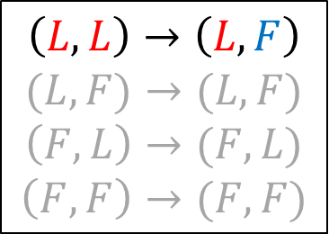
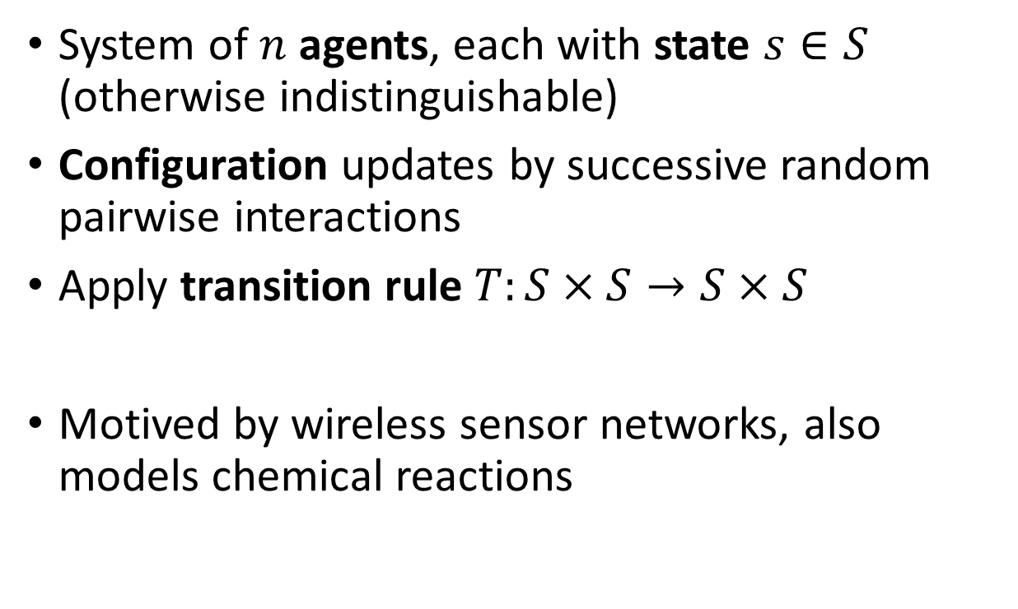









Population Protocols Model
[Dana Angluin, James Aspnes, Zoe Diamadi, Michael J. Fischer, and René Peralta. Computation in networks of passively mobile finite-state sensors. Distributed Computing, 2006.]
System of $n$ agents, each with state $s∈S$ (otherwise indistinguishable)
Configuration updates by successive random pairwise interactions
Apply transition rule $T:S×S→S×S$
Motived by wireless sensor networks, also models chemical reactions
$n=13$ $S=\{L,F\}$
$$L$$
$$L$$
$$F$$
$$L$$
$$F$$
$$F$$
$$F$$
$$F$$
$$F$$
$$L$$
$$F$$
$$L$$
$$L$$
$$F$$
$$\left(L,L\right)→\left(L,F\right)$$
$$(L,F)→(L,F)$$
$$\left(F,L\right)→(F,L)$$
$$\left(F,F\right)→(F,F)$$

Slide 4










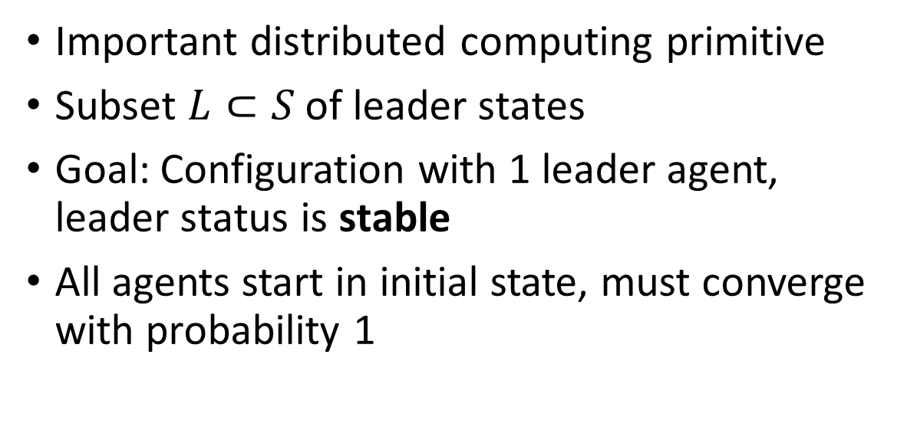












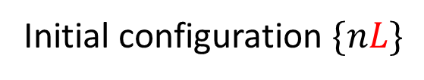




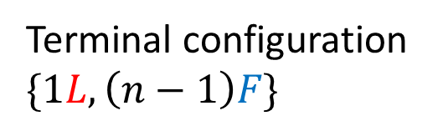
Leader Election Problem
Simple leader election protocol:
Important distributed computing primitive
Subset $L⊂S$ of leader states
Goal: Configuration with 1 leader agent, leader status is stable
All agents start in initial state, must converge with probability 1
$$\left(L,L\right)→\left(L,F\right)$$
Initial configuration $\{nL\}$
$$F$$
$$F$$
$$L$$
$$L$$
$$F$$
$$L$$
$$L$$
$$F$$
$$L$$
$$F$$
$$L$$
$$L$$
$$L$$
$$F$$
$$F$$
$$F$$
$$L$$
$$L$$
$$F$$
$$F$$
$$L$$
$$L$$
$$F$$
$$F$$
$$L$$
Terminal configuration $\{1L,\left(n−1\right)F\}$

Slide 5

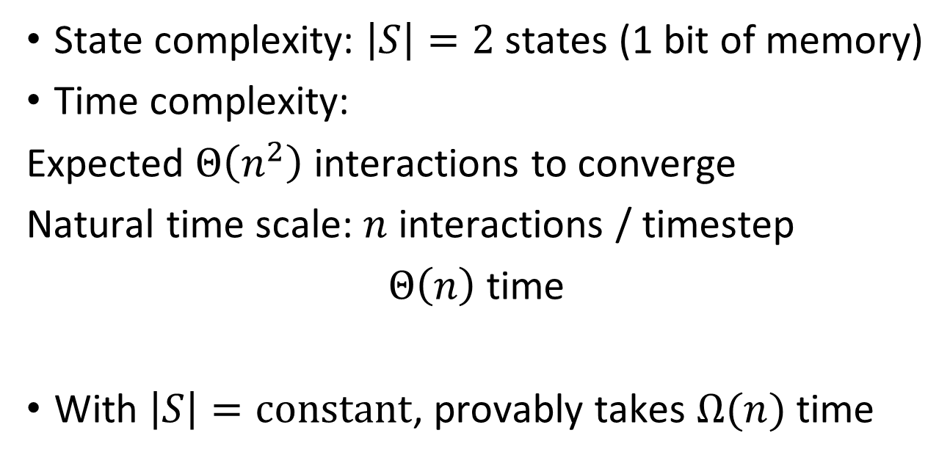
Protocol Complexity
Simple leader election protocol:
State complexity: $\left|S\right|=2$ states (1 bit of memory)
Time complexity:
Expected $Θ\left(n^{2}\right)$ interactions to converge
Natural time scale: $n$ interactions / timestep
$Θ\left(n\right)$ time
With $\left|S\right|=constant$, provably takes $Ω(n)$ time
$$\left(L,L\right)→\left(L,F\right)$$
Final transition:
$$F$$
$$F$$
$$L$$
$$F$$
$$F$$
$$F$$
$$F$$
$$F$$
$$F$$
$$F$$
$$F$$
$$F$$
$$L$$
[David Doty and David Soloveichik. Stable leader election in population protocols requires linear time. Distributed Computing, 2018.]
$$P=1/\left({n \atop 2}\right)$$

Slide 6












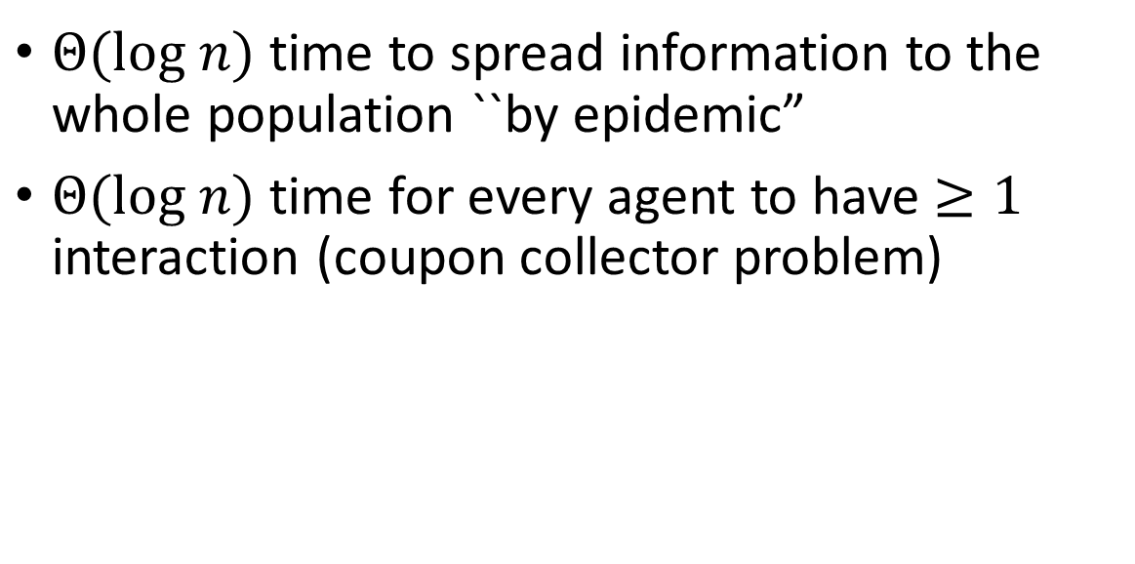
Efficient Algorithms: $O(log n)$ time
Epidemic Process
$Θ(log n)$ time to spread information to the whole population ``by epidemic”
$Θ(log n)$ time for every agent to have $≥1$ interaction (coupon collector problem)
$$I+S→I+I$$
Initial population: $\left\{1I, n−1 S\right\}$
$$I$$
$$I$$
$$S$$
$$I$$
$$S$$
$$I$$
$$S$$
$$I$$
$$S$$

Slide 7
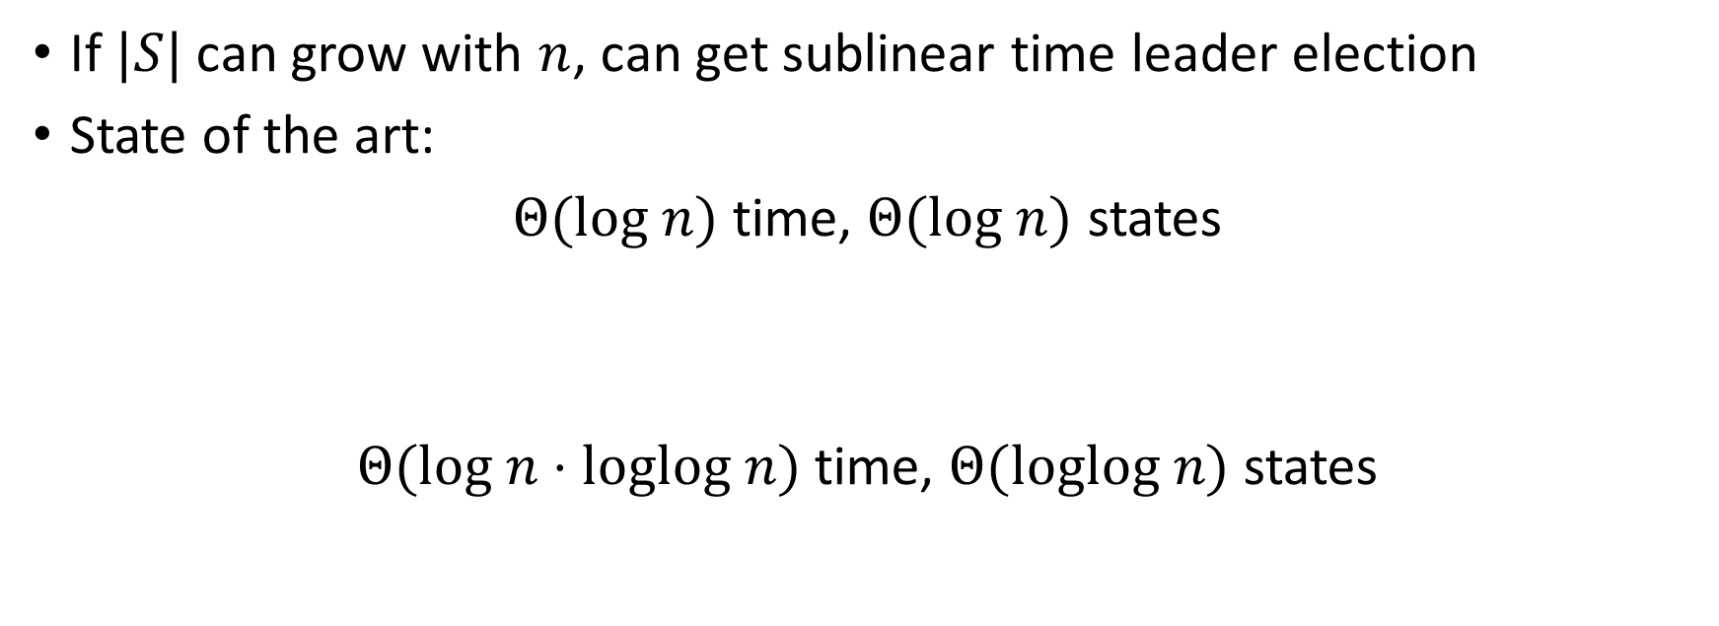
Time / Space Tradeoffs
[Dan Alistarh, James Aspnes, David Eisenstat, Rati Gelashvili, and Ronald L Rivest. Time-space tradeoffs in population protocols. SODA, 2017]
If $|S|$ can grow with $n$, can get sublinear time leader election
State of the art:
$Θ(log n)$ time, $Θ(log n)$ states
$Θ(log n⋅loglog n)$ time, $Θ(loglog n)$ states
[Yuichi Sudo, Fukuhito Ooshita, Taisuke Izumi, Hirotsugu Kakugawa, and Toshitmitsu Mauzawa. Brief announcement: Logarithmic expected-time leader election in population protocol model. PODC, 2019.]
[Leszek Gąsieniec, Grzegorz Stachowiak, and Przemyslaw Uznanski. Almost Logarithmic-Time Space Optimal Leader Election in Population Protocols. In The 31st ACM Symposium on Parallelism in Algorithms and Architectures (SPAA '19).]

Slide 8


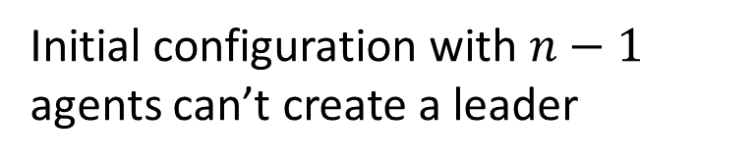



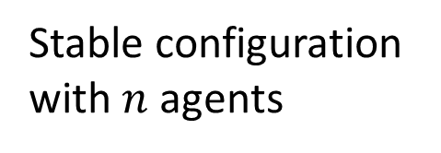





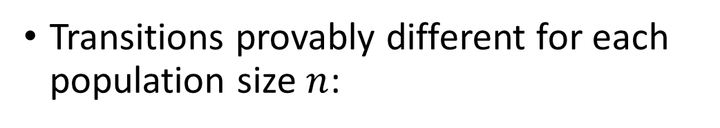




Self-Stabilizing Leader Election
Protocol now starts from an arbitrary initial configuration
Simple protocol fails:
Transitions provably different for each population size $n$:
$$\left(L,L\right)→\left(L,F\right)$$
$$F$$
$$F$$
$$F$$
Stable configuration with $n$ agents
$$F$$
$$F$$
$$L$$
$$F$$
$$F$$
$$F$$
$$F$$
$$F$$
$$F$$
$$F$$
Initial configuration with $n−1$ agents can’t create a leader

Slide 9


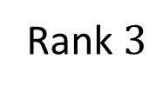



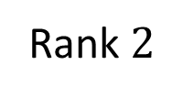
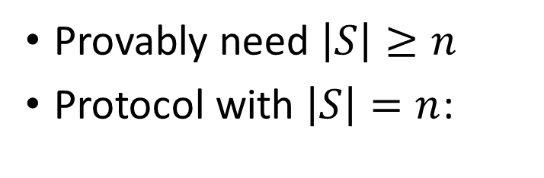
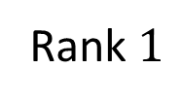





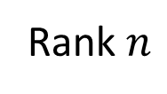



Simple Self-Stabilizing Leader Election Protocol
[S. Cai, T. Izumi, and K. Wada. How to prove impossibility under global fairness: On space complexity of self-stabilizing leader election on a population protocol model. Theory of Computing Systems, 2012.]
Provably need $\left|S\right|≥n$
Protocol with $\left|S\right|=n$:
$S=\{0,1,…,n−1\}$ $L=\{0\}$
$$\left(i,i\right)→(i,i+1 mod n)$$
$$3$$
Arbitrary initial configuration
Unique terminal configuration
$$1$$
$$3$$
$$5$$
$$0$$
$$1$$
$$2$$
$$3$$
$$4$$
$$5$$
$$6$$
…
Rank $1$
Rank $2$
Rank $3$
Rank $n$
Solves strictly harder ranking problem

Slide 10






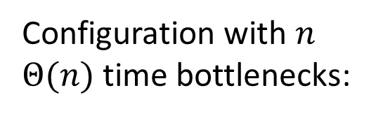




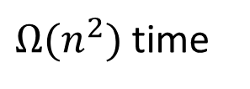

Time Analysis
$S=\{0,1,…,n−1\}$ $L=\{0\}$
$$\left(i,i\right)→(i,i+1 mod n)$$
Configuration with $n$ $Θ(n)$ time bottlenecks:
$Θ(n)$ time
$Θ(n)$ time
$Θ(n)$ time
$Θ(n)$ time
$Θ(n)$ time
$$1$$
$$2$$
$$3$$
$$4$$
$$5$$
$$6$$
$Ω(n^{2})$ time
$$0$$
$$1$$
$$2$$
$$3$$
$$4$$
$$5$$
$$6$$
…
Rank $1$
Rank $2$
Rank $3$
Rank $n$

Slide 11


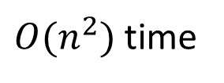



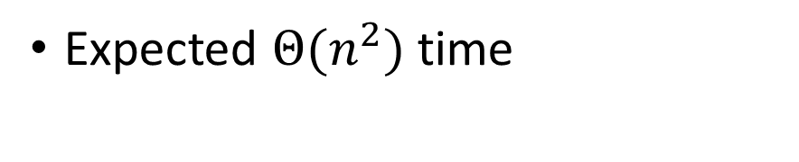


Time Analysis
Expected $Θ(n^{2})$ time
$S=\{0,1,…,n−1\}$ $L=\{0\}$
$$\left(i,i\right)→(i,i+1 mod n)$$
Worst case initial configuration:
$$1$$
$$1$$
$$1$$
$$1$$
$$1$$
$O(n^{2})$ time
$$1$$
$$1$$
…
Rank $1$
Rank $2$
Rank $3$
Rank $n$

Slide 12
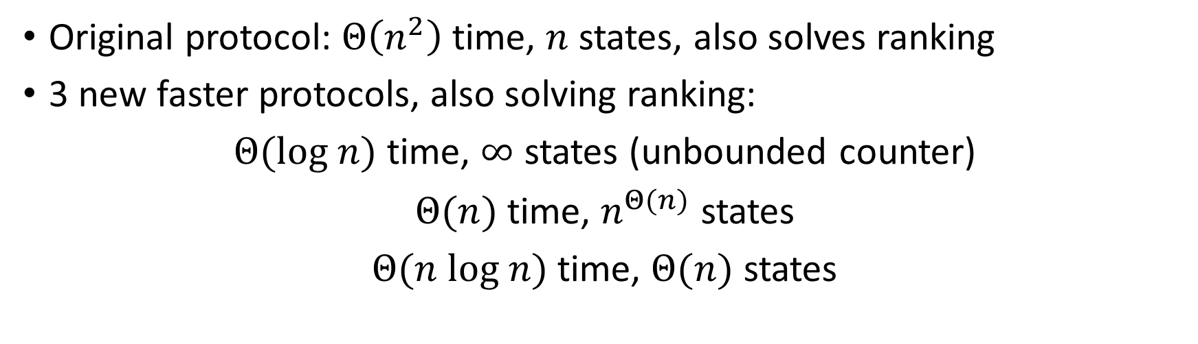
Our Work: Time / Space Tradeoffs for Self-Stabilizing Leader Election
Original protocol: $Θ\left(n^{2}\right)$ time, $n$ states, also solves ranking
3 new faster protocols, also solving ranking:
$Θ(log n)$ time, $∞$ states (unbounded counter)
$Θ(n)$ time, $n^{Θ(n)}$ states
$Θ(n log n)$ time, $Θ(n)$ states

Slide 13


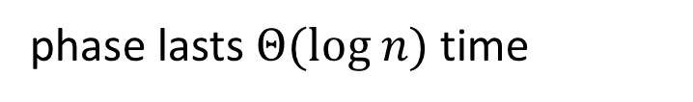
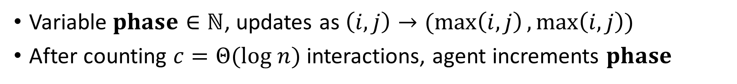



















$Θ(log n)$ time, $∞$ state protocol
Phase Clock Subroutine:
Variable $phase∈ℕ$, updates as $\left(i,j\right)→(\max\left(i,j\right),\max\left(i,j\right))$
After counting $c=Θ(log n)$ interactions, agent increments $phase$
$$1$$
$$7$$
$$8$$
$$4$$
$$7$$
$$8$$
$$2$$
$$7$$
$$8$$
max phase spreads by epidemic
$$2$$
$$7$$
$$8$$
$$8$$
phase lasts $Θ(log n)$ time
$$1$$
$$7$$
$$8$$
$$3$$
$$7$$
$$7$$
$$8$$
Each phase reaches whole population with high probability

Slide 14
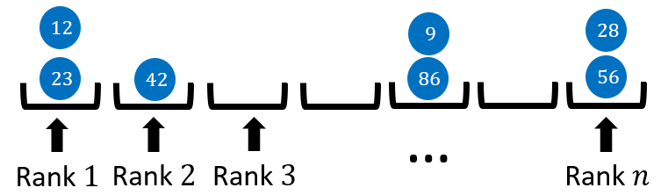
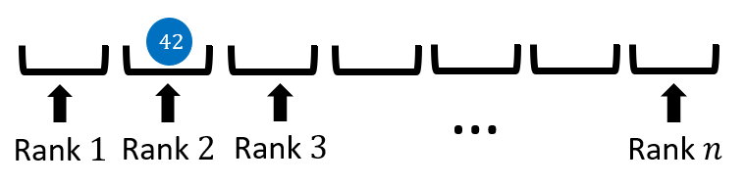







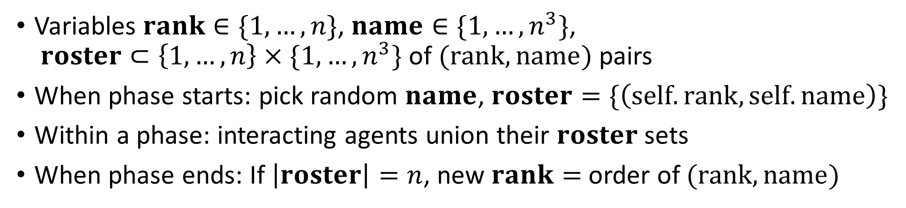

$Θ(log n)$ time, $∞$ state protocol
Ranking Subroutine:
Variables $rank∈\{1,…,n\}$, $name∈\{1,…, n^{3}\}$, $roster⊂\left\{1,…,n\right\}×\{1,…,n^{3}\}$ of $(rank,name)$ pairs
When phase starts: pick random $name$, $roster=\{\left(self.rank,self.name\right)\}$
Within a phase: interacting agents union their $roster$ sets
When phase ends: If $\left|roster\right|=n$, new $rank=$ order of $(rank,name)$
$$12$$
$$9$$
$$28$$
unique names with high probability
$$23$$
$$42$$
$$86$$
$$56$$
…
Rank $1$
Rank $2$
Rank $3$
Rank $n$

Slide 15


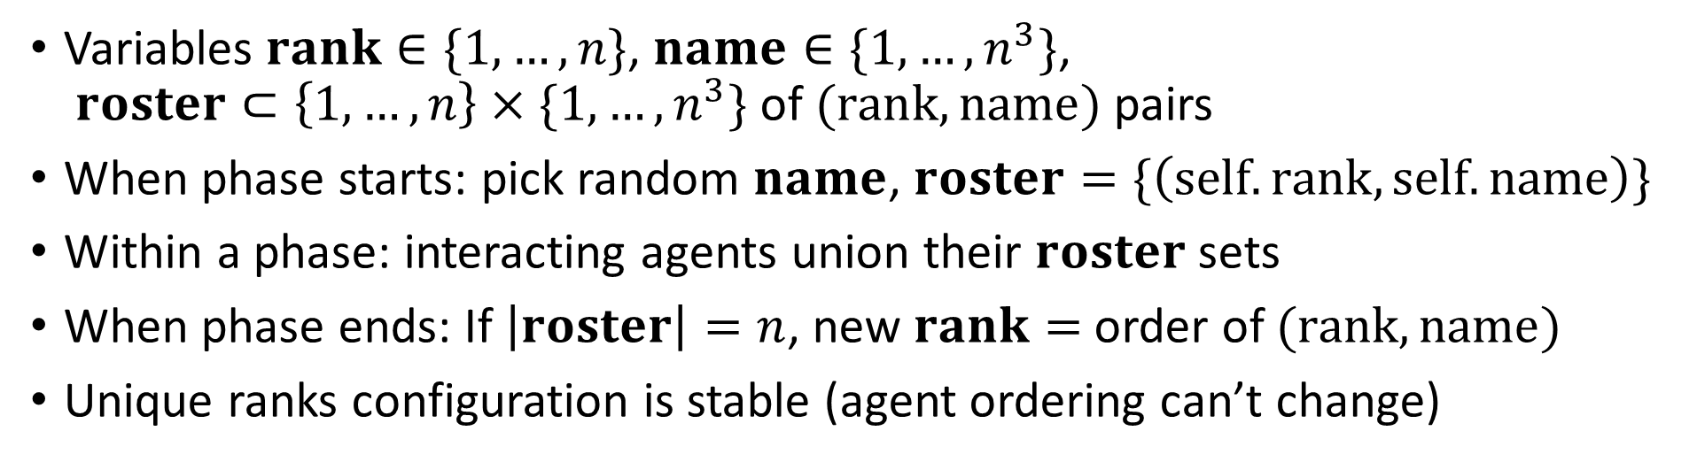











$Θ(log n)$ time, $∞$ state protocol
Ranking Subroutine:
Variables $rank∈\{1,…,n\}$, $name∈\{1,…, n^{3}\}$, $roster⊂\left\{1,…,n\right\}×\{1,…,n^{3}\}$ of $(rank,name)$ pairs
When phase starts: pick random $name$, $roster=\{\left(self.rank,self.name\right)\}$
Within a phase: interacting agents union their $roster$ sets
When phase ends: If $\left|roster\right|=n$, new $rank=$ order of $(rank,name)$
Unique ranks configuration is stable (agent ordering can’t change)
$$56$$
$$12$$
$$11$$
$$43$$
$$86$$
$$20$$
$$28$$
$$23$$
$$42$$
$$49$$
$$50$$
$$4$$
$$9$$
$$78$$
…
Rank $1$
Rank $2$
Rank $3$
Rank $n$

Slide 16
















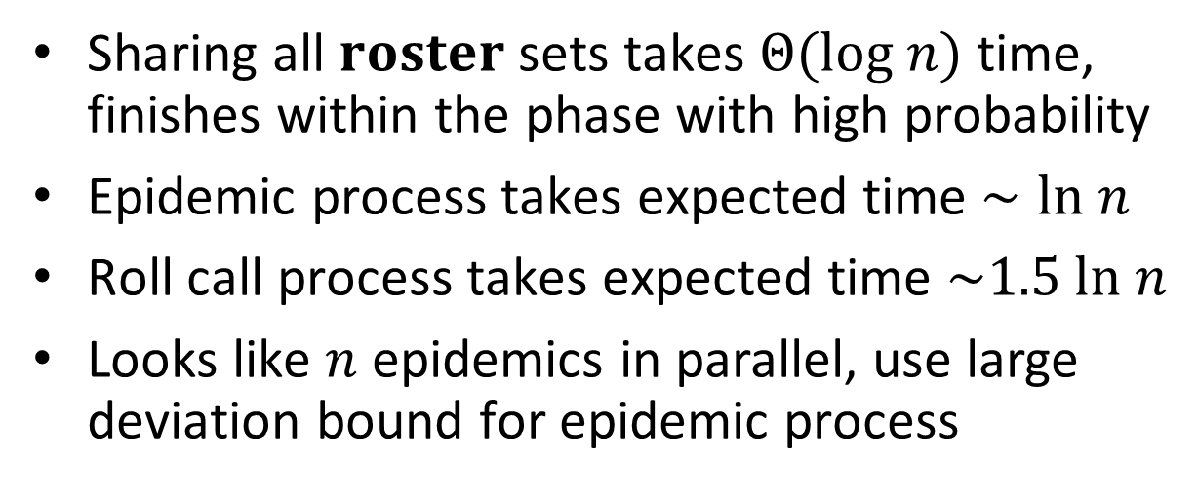



Time Analysis: $Θ(log n)$ time
Sharing all $roster$ sets takes $Θ(log n)$ time, finishes within the phase with high probability
Epidemic process takes expected time $∼ln n$
Roll call process takes expected time $\sim 1.5 ln n$
Looks like $n$ epidemics in parallel, use large deviation bound for epidemic process
Roll call process:
$$\{A\}$$
$$\{A,B,C,D,E\}$$
$$\{A,C,E\}$$
$$\{A,C\}$$
$$\{B\}$$
$$\{A,B,C,D,E\}$$
$$\{E\}$$
$$\{B,D\}$$
$$\{A,C,E\}$$
[Y. Mocquard, B. Sericola, S. Robert, and E. Anceaume. Analysis of the propagation time of a rumour in large-scale distributed systems. In 2016 IEEE 15th International Symposium on Network Computing and Applications (NCA), 2016.]
$$\{A,B,C,D,E\}$$
$$\{A,B,C,D\}$$
$$\{A,C\}$$
$$\{C\}$$
$$\{A,B,C,D,E\}$$
$$\{A,B,C,D,E\}$$
$$\{B,D\}$$
$$\{D\}$$
$$\{A,B,C,D\}$$
Notes:
P(T_n>(1+d)ET_n)\leq\approx. 2(1+d)n^(-2d)

Slide 17

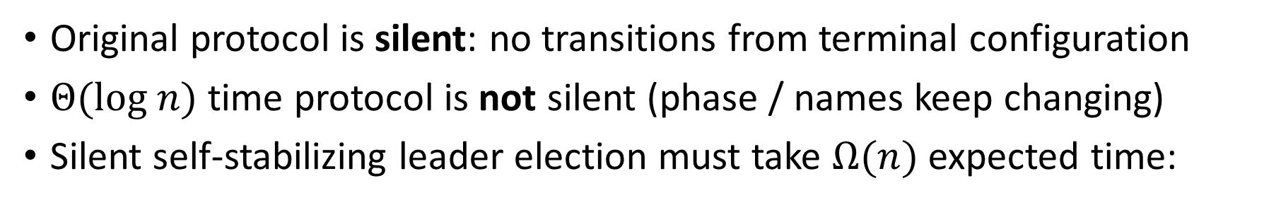
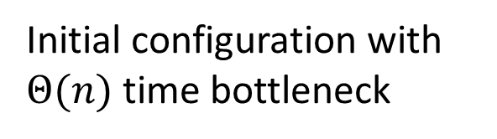


Lower Bound for Silent Protocols
Original protocol is silent: no transitions from terminal configuration
$Θ(log n)$ time protocol is not silent (phase / names keep changing)
Silent self-stabilizing leader election must take $Ω(n)$ expected time:
$$L$$
$$L$$
$$L$$
Silent configuration
Initial configuration with $Θ(n)$ time bottleneck

Slide 18
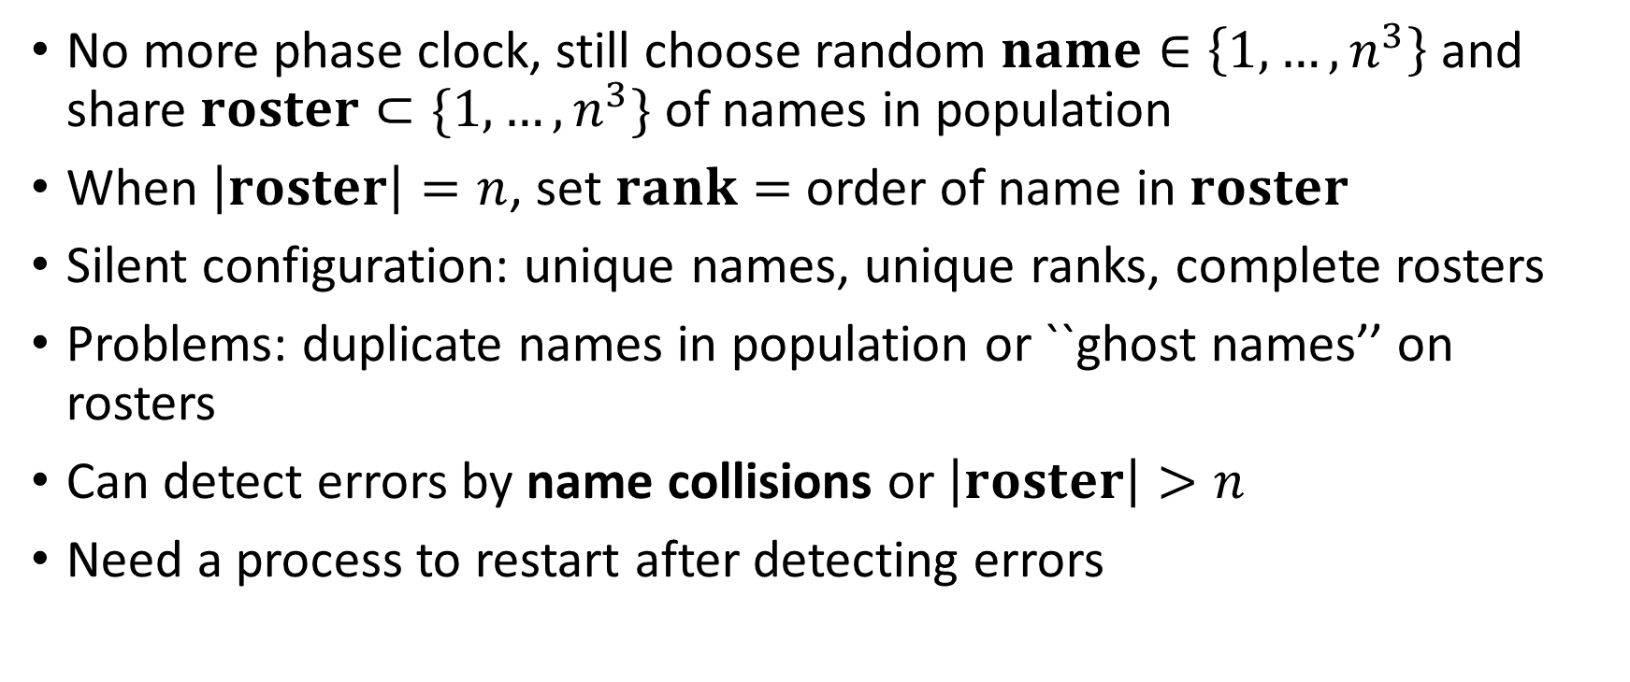
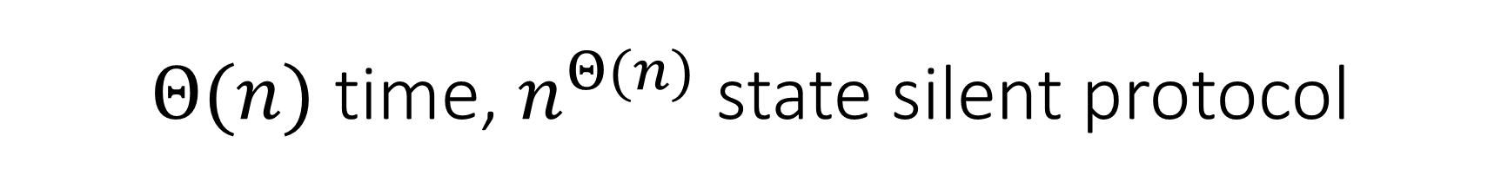
$Θ(n)$ time, $n^{Θ(n)}$ state silent protocol
No more phase clock, still choose random $name∈\left\{1,…,n^{3}\right\}$ and share $roster⊂\{1,…, n^{3}\}$ of names in population
When $\left|roster\right|=n$, set $rank=$ order of name in $roster$
Silent configuration: unique names, unique ranks, complete rosters
Problems: duplicate names in population or ``ghost names’’ on rosters
Can detect errors by name collisions or $\left|roster\right|>n$
Need a process to restart after detecting errors

Slide 19



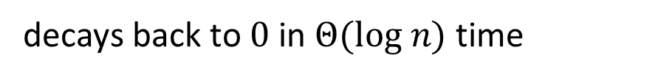





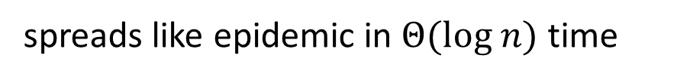
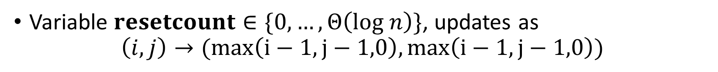




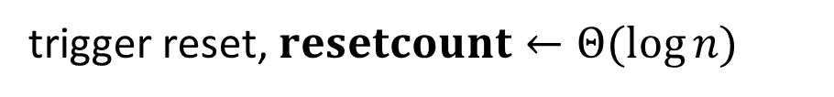









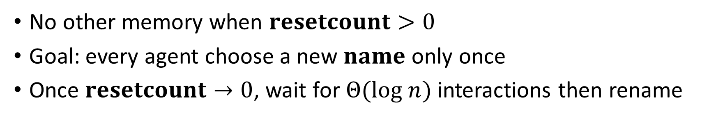
Reset Subroutine
Variable $resetcount∈\{0,…, Θ\left(log n\right)\}$, updates as
$$\left(i,j\right)→(max\left(i−1,j−1,0\right),max\left(i−1,j−1,0\right))$$
$$0$$
trigger reset, $resetcount←Θ(\log{n)}$
$$5$$
$$9$$
$$0$$
$$10$$
$$6$$
$$0$$
$$1$$
spreads like epidemic in $Θ(log n)$ time
$$9$$
$$8$$
$$8$$
$$0$$
$$4$$
$$0$$
$$6$$
decays back to $0$ in $Θ(log n)$ time
$$0$$
$$2$$
$$0$$
$$5$$
$$0$$
$$3$$
No other memory when $resetcount>0$
Goal: every agent choose a new $name$ only once
Once $resetcount→0$, wait for $Θ(log n)$ interactions then rename

Slide 20
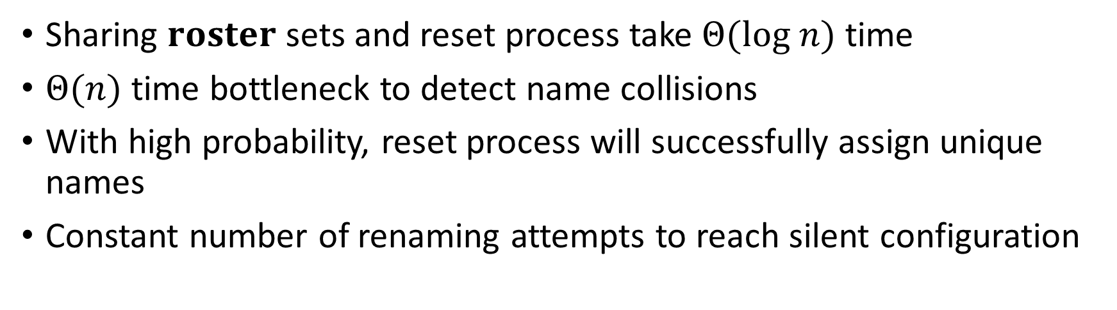

Time Analysis: $Θ(n)$ time
Sharing $roster$ sets and reset process take $Θ(log n)$ time
$Θ(n)$ time bottleneck to detect name collisions
With high probability, reset process will successfully assign unique names
Constant number of renaming attempts to reach silent configuration

Slide 21
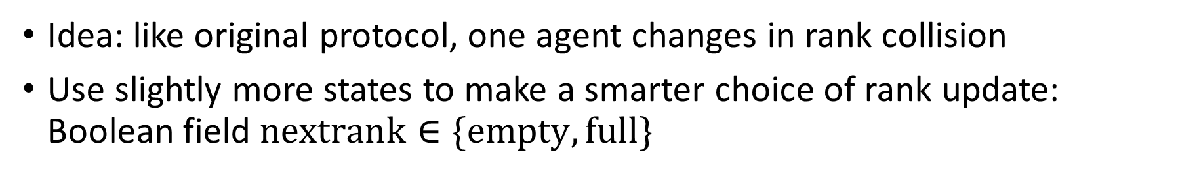
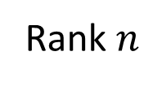
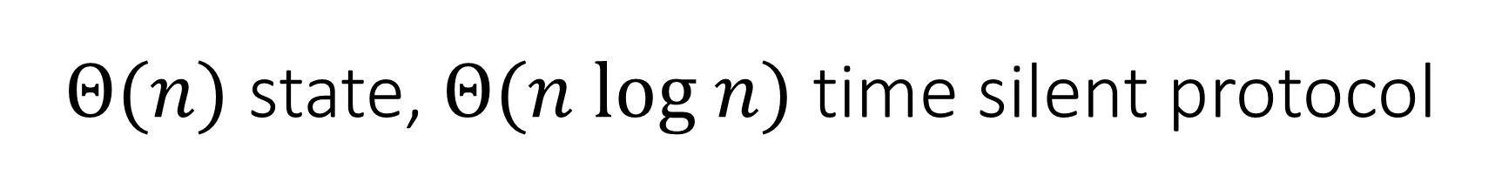
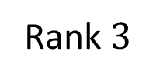
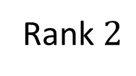
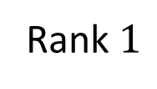
$Θ(n)$ state, $Θ(n log n)$ time silent protocol
Idea: like original protocol, one agent changes in rank collision
Use slightly more states to make a smarter choice of rank update: Boolean field $nextrank∈\{empty,full\}$
Unsettled agent
full
full
full
empty
full
full
full
…
Rank $1$
Rank $2$
Rank $3$
Rank $n$

Slide 22
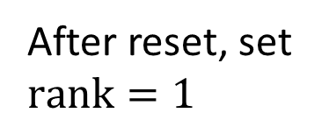
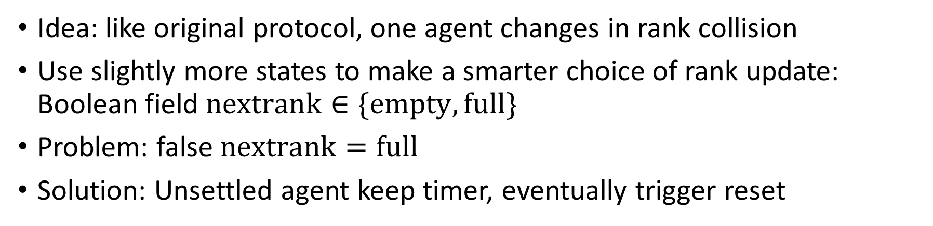
$Θ(n)$ state, $Θ(n log n)$ time silent protocol
Idea: like original protocol, one agent changes in rank collision
Use slightly more states to make a smarter choice of rank update: Boolean field $nextrank∈\{empty,full\}$
Problem: false $nextrank=full$
Solution: Unsettled agent keep timer, eventually trigger reset
Unsettled agent
Resetting agents
After reset, set $rank=1$
full
full
full
full
full
…
Rank $1$
Rank $2$
Rank $3$
Rank $n$

Slide 23

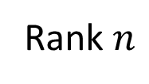
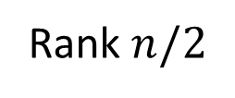
Time Analysis: $Θ(n log n)$ time
Configuration with an $Ω(n log n)$ time bottleneck:
…
…
Rank $1$
Rank $n/2$
Rank $n$
$Ω(n log n)$ time to wait for all $n/2$ rank collisions

Slide 24
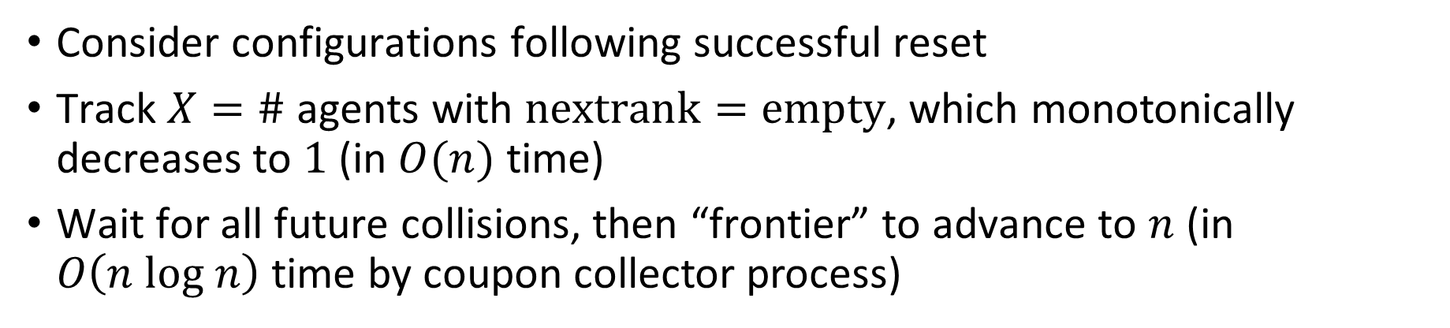
Time Analysis: $Θ(n log n)$ time
Consider configurations following successful reset
Track $X=\#$ agents with $nextrank=empty$, which monotonically decreases to $1$ (in $O(n)$ time)
Wait for all future collisions, then “frontier” to advance to $n$ (in $O\left(n log n\right)$ time by coupon collector process)
empty
empty
full
full
empty
empty
empty
empty
full
full
full
…
Rank $1$
Rank $2$
Rank $3$
Rank $n$

Slide 25
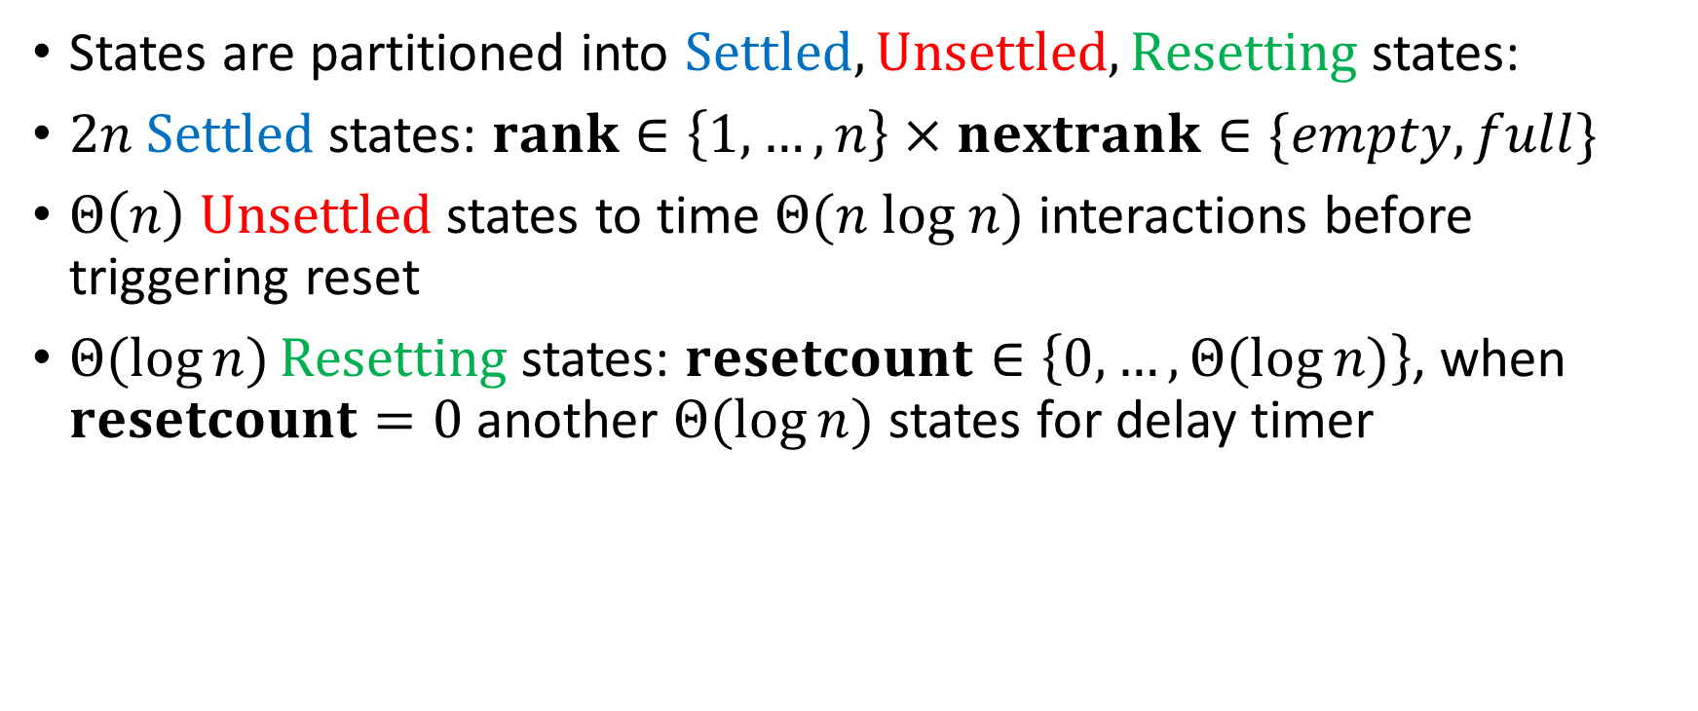

Space Analysis: $Θ(n)$ states
States are partitioned into $Settled, Unsettled, Resetting$ states:
$2n Settled$ states: $rank∈\left\{1,…, n\right\}×nextrank∈\{empty,full\}$
$Θ\left(n\right) Unsettled$ states to time $Θ(n log n)$ interactions before triggering reset
$Θ(\log{n)}Resetting$ states: $resetcount∈\left\{0,…,Θ(\log{n)}\right\}$, when $resetcount=0$ another $Θ(\log{n)}$ states for delay timer

Slide 26


Slide 27


$Θ(n)$ states
$Θ(n)$ Settled States, $Θ\left(n\right)$ Unsettled States, $Θ(log n)$ Resetting States

Slide 28

Open Questions
Are there better protocols to solve self-stabilizing leader election that don’t also solve ranking?
Conjecture: Any sublinear-time self-stabilizing leader election protocol must use $∞$ states

Slide 29
Thank you for your attention Questions?

