Slide 1
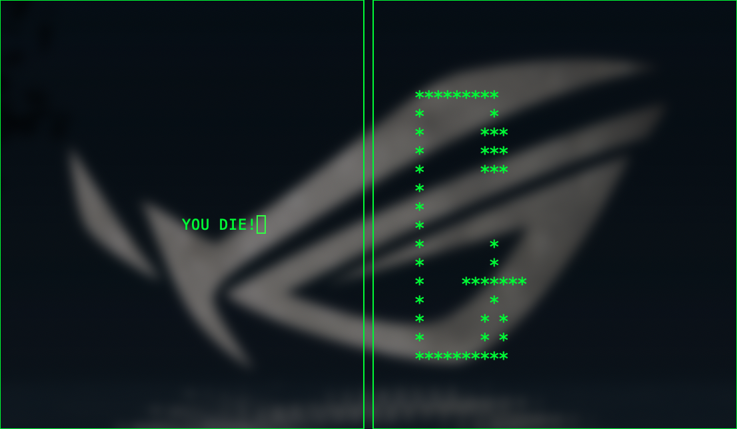
Hanged Man Game
DP1-1 Rifile, Eric, Noel, Leo

Slide 2
Structure

Slide 3
Flowchart

Slide 4
Pseudocode

Slide 5
C++ program implementation
Readme
# Hanged Man Game
## Running environmemnt UNIX / LINUX
## Compile environment
g++, with curses lib installed
## How to compile
```
cd [folder_path]
make
```
## How to play
- Run hanged_man.out
Player 1:
- Use `Tab` to shift the tabs
- For hardness: `1`: simple, `2`: middle, `3`: hard
- Word and hint only support small case character, word support 20 character MAX, hint support 100 char MAX
- After fill the question, shift to tab “Finish” and press `return`
Player 2:
- Press A...Z keys. If the char you pressed is in the word, all the chars in the word will appear; If the char you pressed is NOT in the word, one more stroke will be drawn on the man.
- If all charts filled, you win; If all strokes of the man drawn, you DIE.

Slide 6
Live Test

