Slide 1
Phase 3 Presentation
By: Eric Falkenberg, Dave Studin,
and Harry Longwell

Slide 2
The Domain
The World of Warcraft

Slide 3
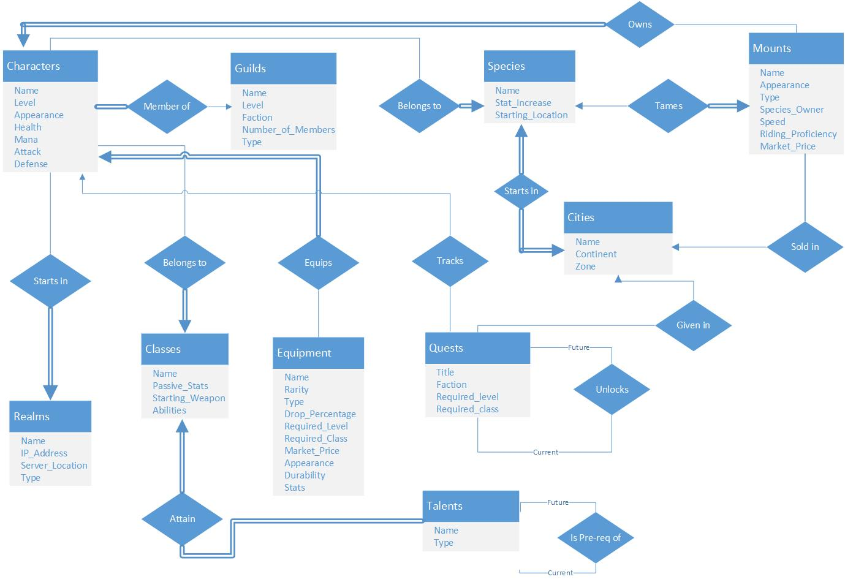
Data Modeling: Conceptual Model (ER)

Slide 4
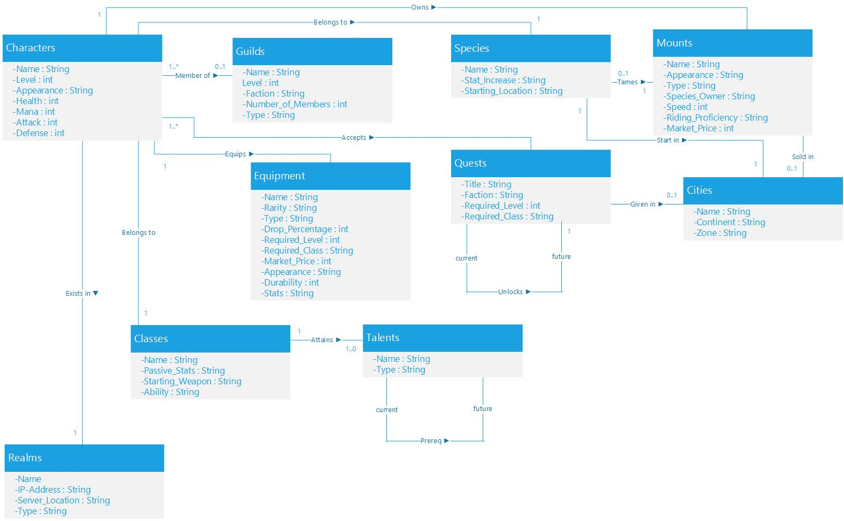
Data Modeling: Conceptual Model (UML)

Slide 5
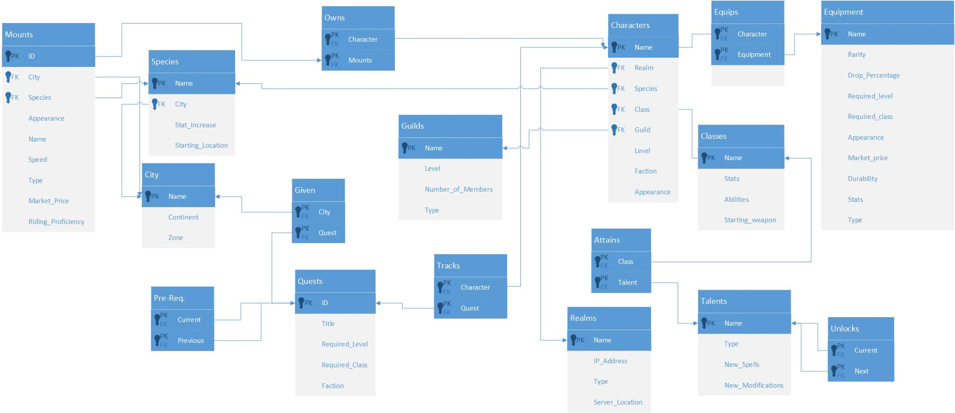
Data Modeling: Logical Model

Slide 6
Data Querying
QUERY 7: SELECT name, level FROM ((Characters AS c) JOIN Tracks ON name=character) JOIN (Quests AS q) ON id=quest WHERE c.level < q.required_level GROUP BY q.title
QUERY 8: SELECT name FROM (Classes JOIN Attains ON name=class) JOIN (Talents AS t) ON talent= t.name WHERE x.name=‘Warrior’ AND t.new_spells IS NOT NULL

Slide 7
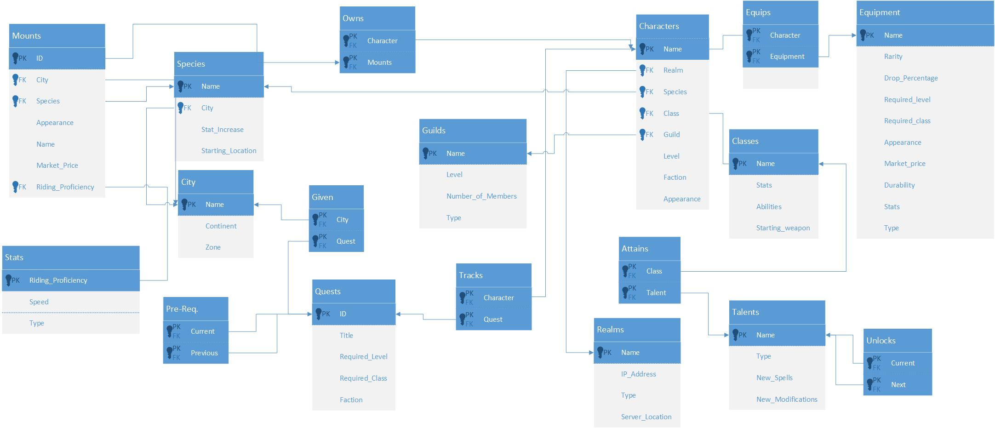
Normalization: 3NF

Slide 8
Normalization: BCNF

Slide 9
Optimizing Our Queries
Indexing over name in Characters and Guilds
BEFORE: Query 7 Duration: 15 Milliseconds Query 8 Duration: 7 Milliseconds AFTER: Query 7 Duration: 1 Milliseconds Query 8 Duration: 31 Milliseconds

Slide 10
Relational Drawbacks
Joins
Scalability

Slide 11
Conclusions
What we learned
Challenges

Slide 12
The End

