Slide 1
Clustering of KV Cache
Zehao Fan
Electrical, Computer, and Systems Engineering
Rensselaer Polytechnic Institute

Slide 2
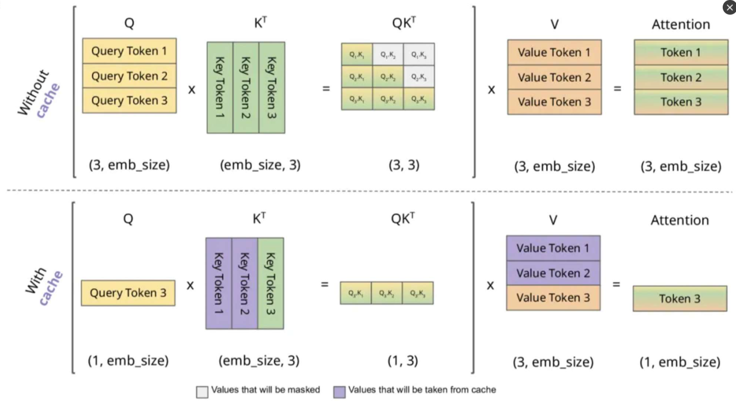
Background and Prior Work
Notes:
To reduce redundant computations during the generation process of LLMs, I introduced the KV cache in my research presentation, which stores the previously generated keys and values. However, it is also evident that if the context becomes very long, as nowadays ChatGPT, the KV that needs to be stored will also become huge.

Slide 3


Background and Prior Work
Notes:
2 refers to the K and V matrices.
precision indicates the number of bytes for each K & V, such as 2 bytes for float16 precision.
n_layer and d_model refer to the number of decoder layers and the embedding dimension size in the model.
seq_len and batch_size represent the maximum sequence length and the global batch size.

Slide 4
Background and Prior Work
The size of the KV cache grows linearly with the input sequence length.
Notes:
Due to the auto-regressive nature of LLMs, generating a single token requires accessing the entire KV cache. Consequently, processing long-context requests becomes highly challenging, significantly slowing down inference speed and imposing substantial memory pressure.

Slide 5
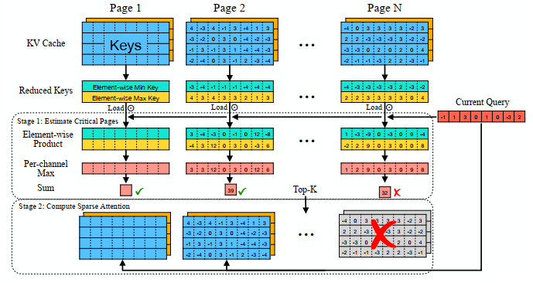
Background and Prior Work
Quest: Query-Aware Sparsity for Efficient Long-Context LLM Inference
Quest tracks the minimal and maximal keys of KV cache pages and estimates the importance of these pages using the query vector.
Only loads the most critical KV cache pages.
Notes:
Background: Now it is clear that one of the most significant problems of LLM inference is the KV Cache.
Let’s start by reviewing the starting point of this project—The paper Quest...
Motivation A small portion of critical tokens will dominate the attention outcomes. However, the criticality of a token highly depends on the query.
The algorithm of Quest is here
Quest tracks the minimal and maximal keys of KV cache pages and estimates the importance of these pages using the query vector. Quest only loads the most critical KV cache pages, significantly speeding up self-attention while maintaining accuracy.

Slide 6
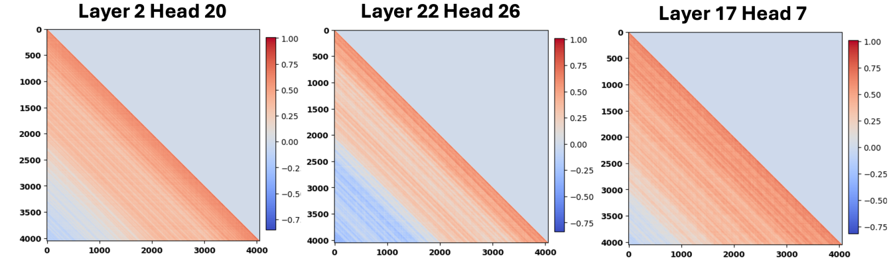
Key Points of Quest
Quest's paging mechanism achieves Query-Aware Sparsity.
The pages are created simply in sequential order.
Although adjacent keys exhibit high similarity, there are still many non-adjacent keys that also have high similarity.
Notes:
The key point of Quest is the paging mechanism. However, we noticed that QUEST simply performs sequential paging. Although adjacent keys exhibit high similarity, there are still many non-adjacent keys that also have high similarity.
Moreover, Quest only tested page sizes ranging from 4 to 32, which is clearly insufficient to cover the majority of similar keys.
It suggests that we can further leverage the similarity of keys within each page.

Slide 7
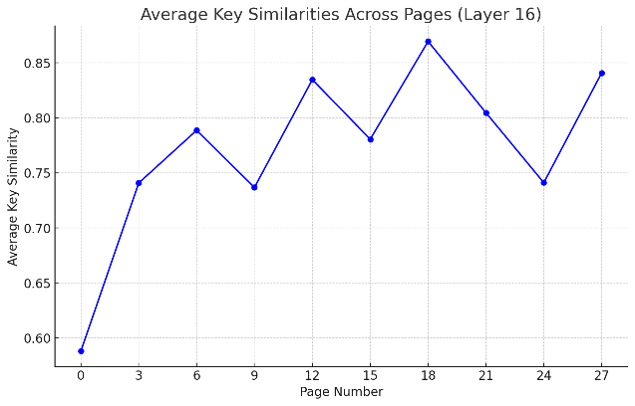
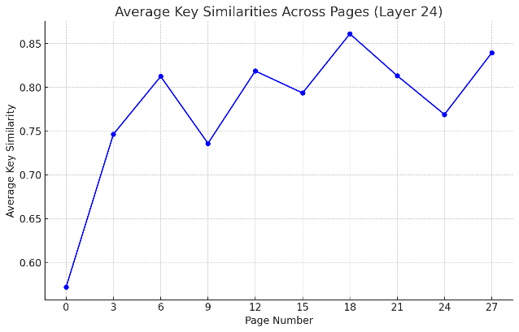
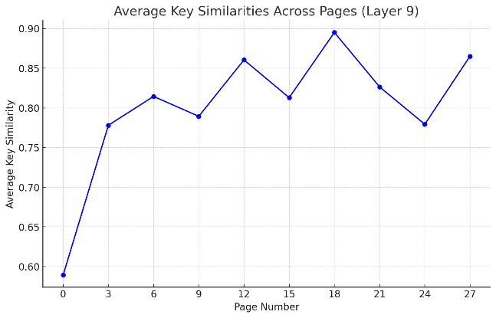
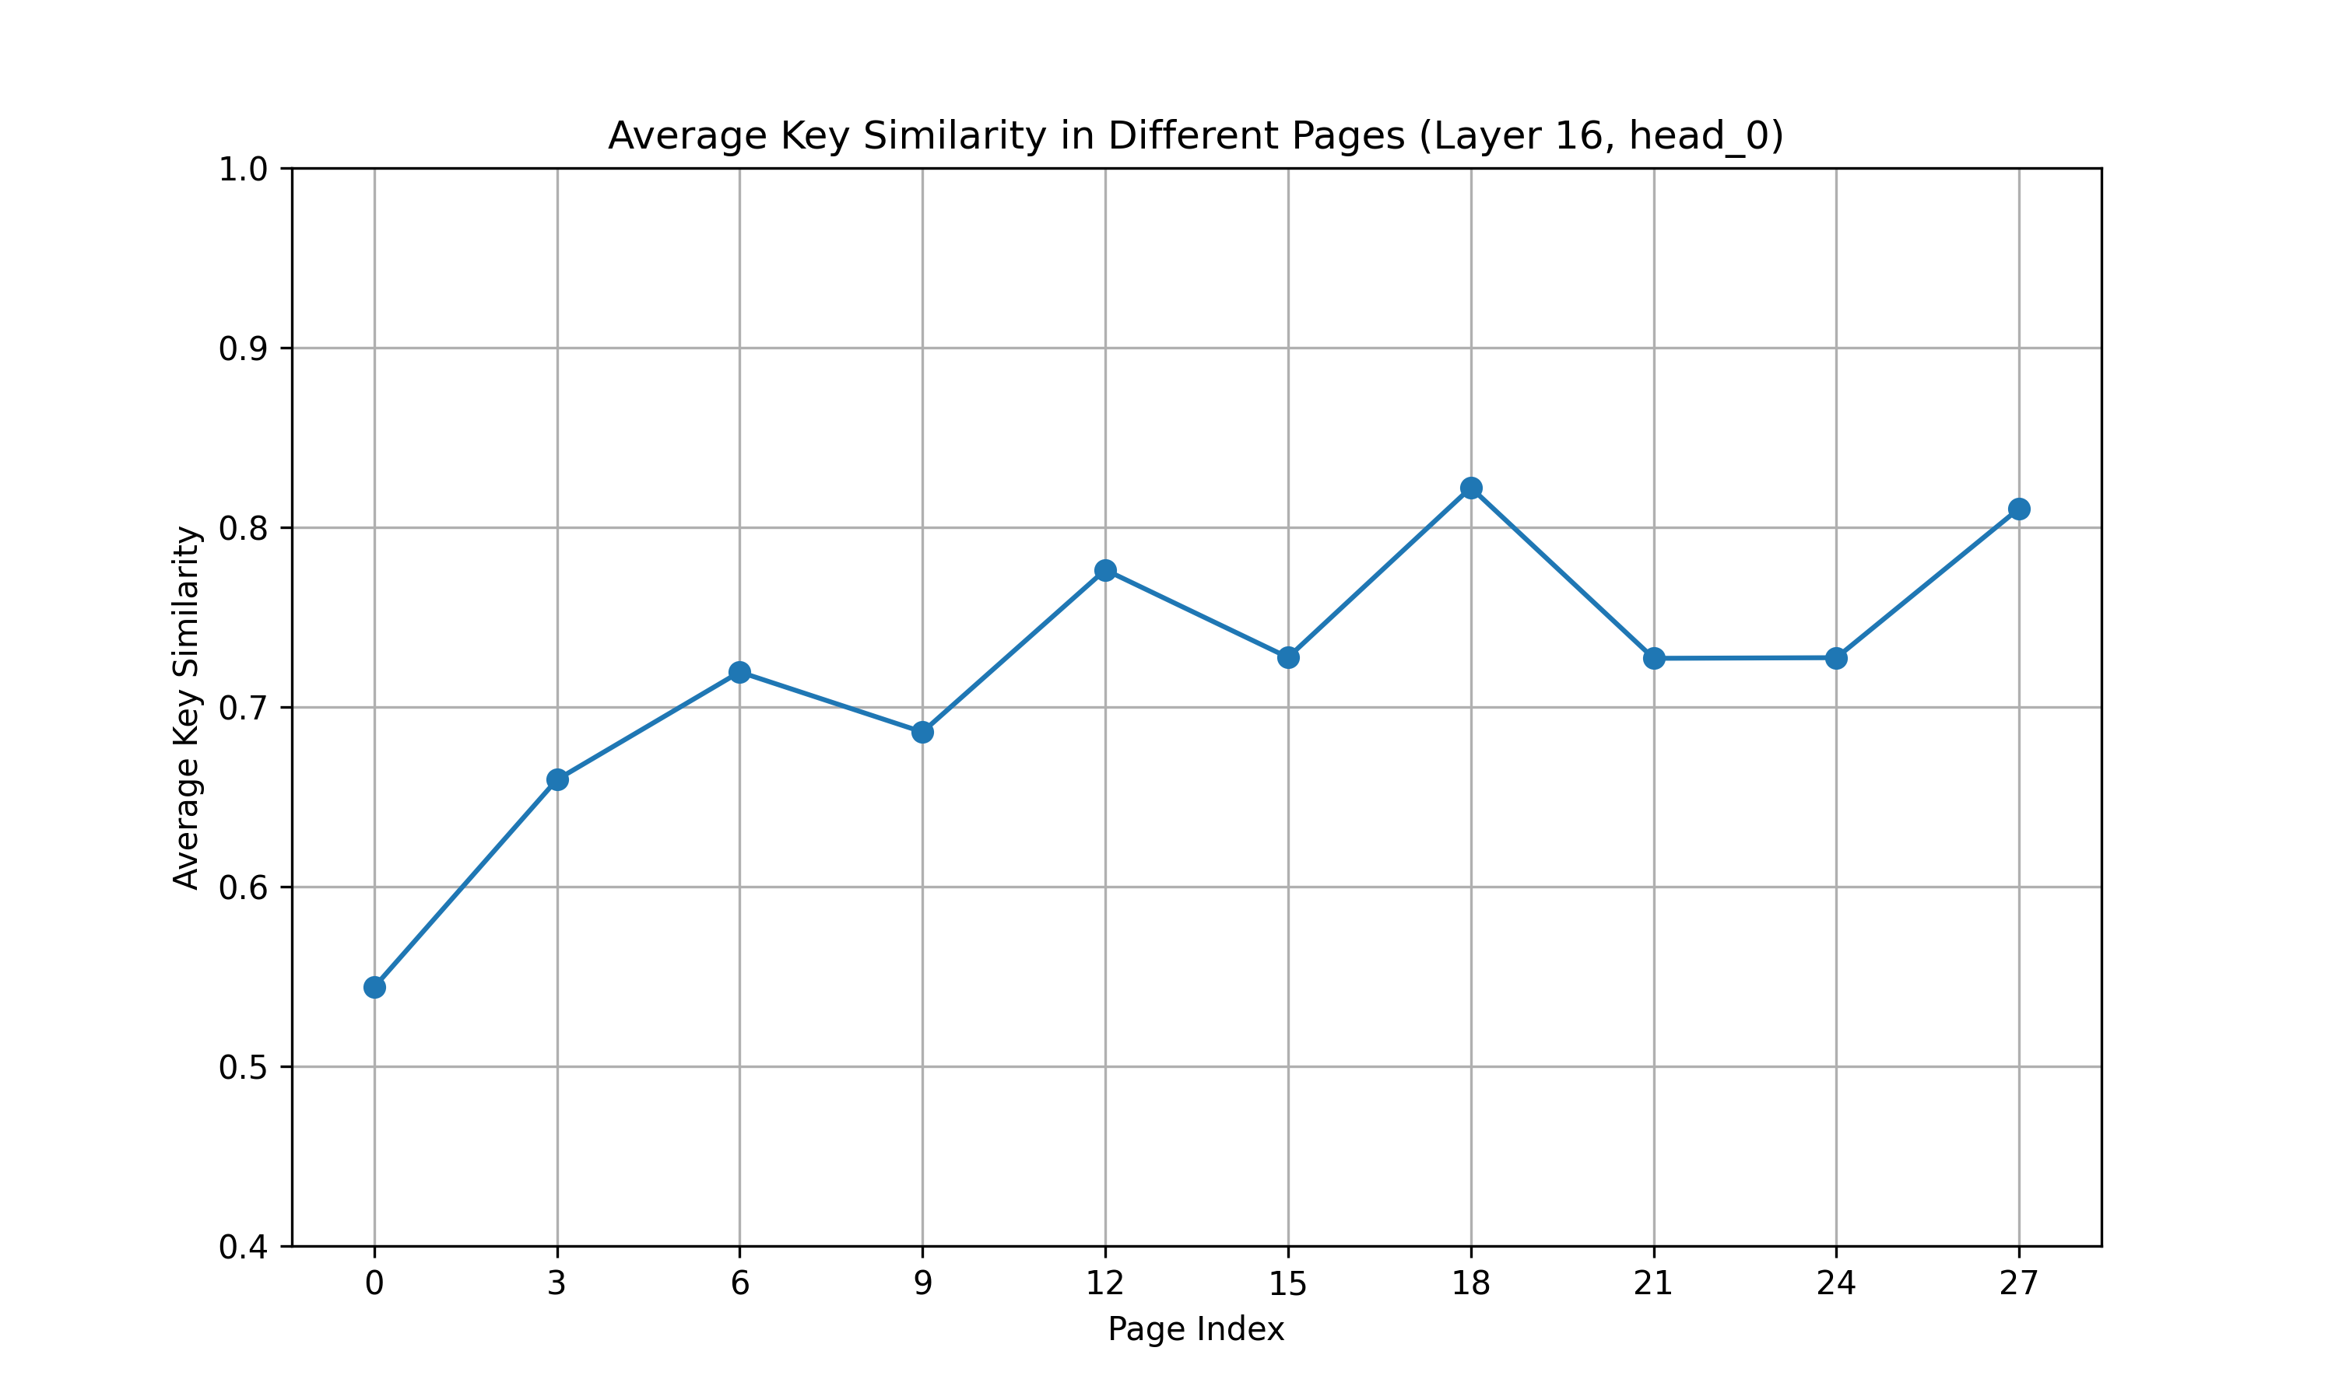
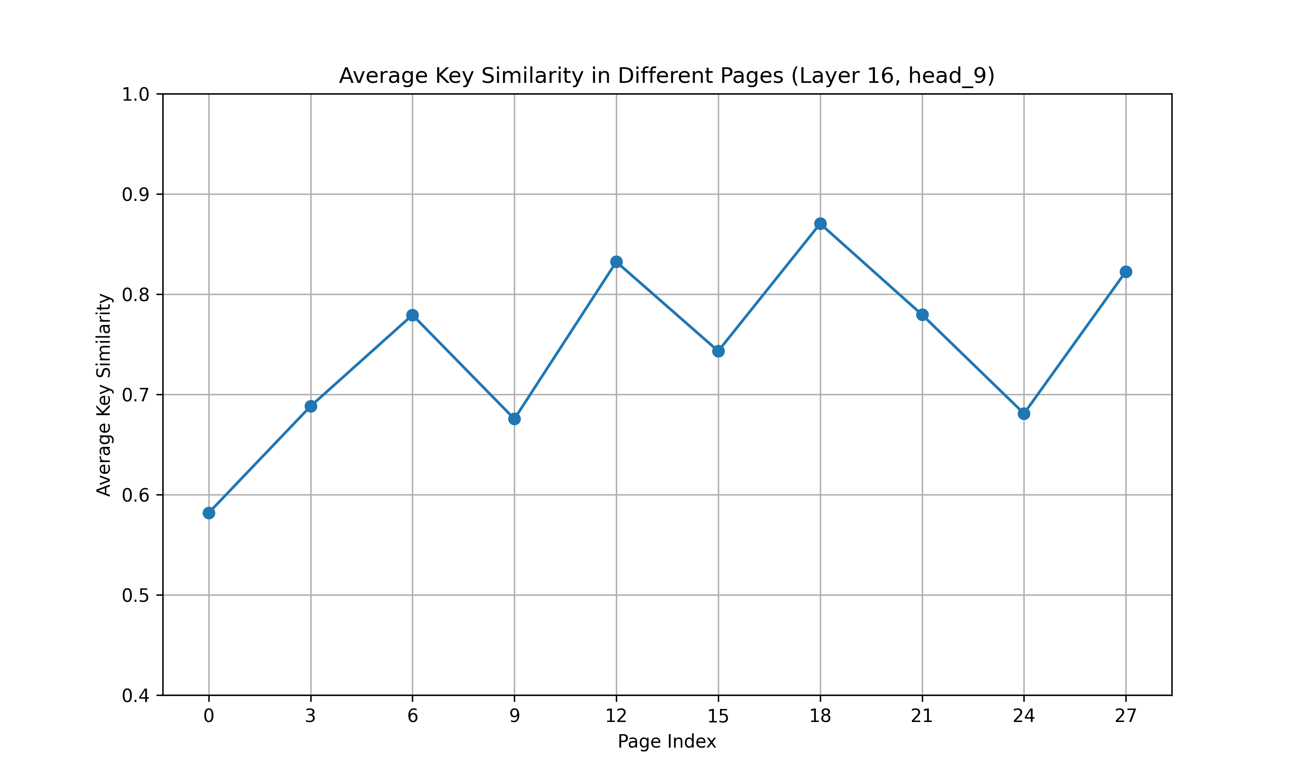
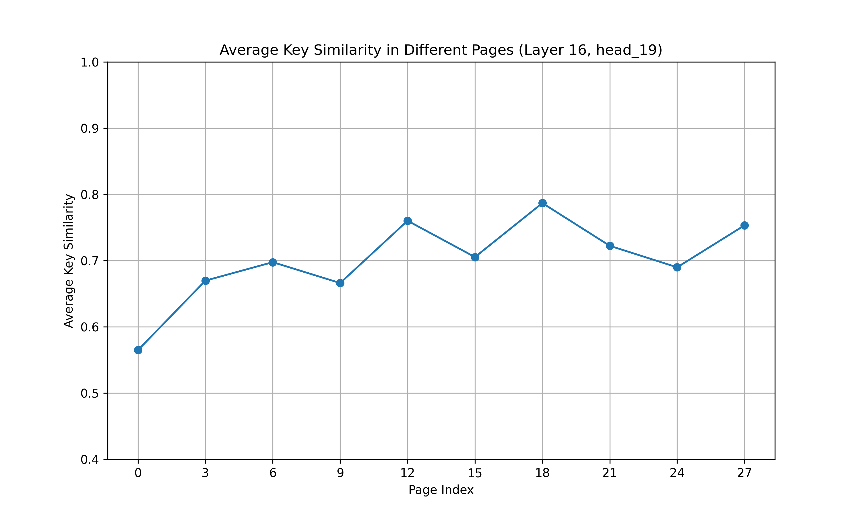
Motivation
From the analysis of in-page similarity in Quest, there is still space for improvement in the similarity of keys (based on the WikiText-2 dataset, with similar results observed in the PG-19 dataset):
Notes:
These are the test results of the LongChat model on Wikitext-2. The top three charts show the intra-page key similarity for different layers, while the bottom three charts display the intra-page key similarity for different heads.

Slide 8
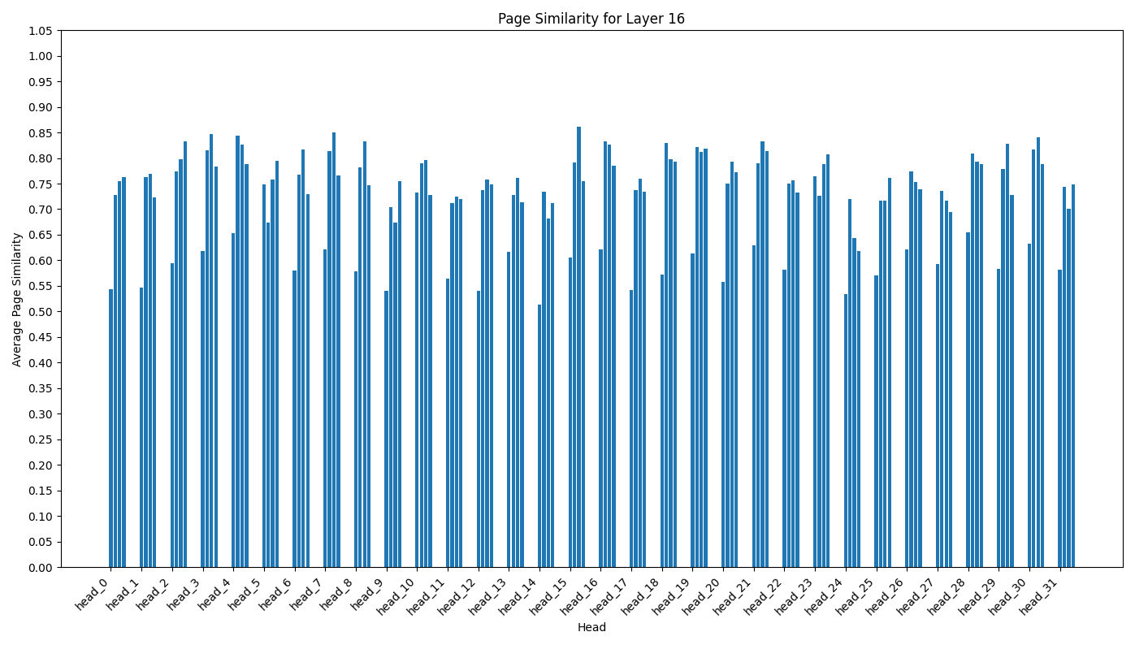
Motivation
The pages selected by Quest (budget = 64, 4 pages)
Notes:
As I said, Quest loads only the Top-k most critical KV cache pages. To explore potential improvements in compressibility, I calculated the key similarity within the KV pages selected by Quest. As shown in Figure, I examined a KV cache budget of 64 tokens and a page size of 16 tokens, displaying the intra-page key similarity of the four selected pages for each head in layer 16 of the LongChat-7b model. The results show that only a few pages exhibit high similarity. This means that the compression efficiency achievable by directly compressing these pages is limited by the level of key similarity within the pages. In other words, for pages with lower similarity, the compression effect may be suboptimal.

Slide 9
Motivation
For bandwidth/storage: Clustering facilitates greater compression compared to merely paging by input order, thereby allowing more KV pages to be loaded within the same bandwidth and reducing the storage space of the KV cache.
For performance: Clustering similar keys so that the keys within each page more effectively match the queries, thus improving model accuracy.
Notes:
For motivation, we can sum it up into two aspects.

Slide 10
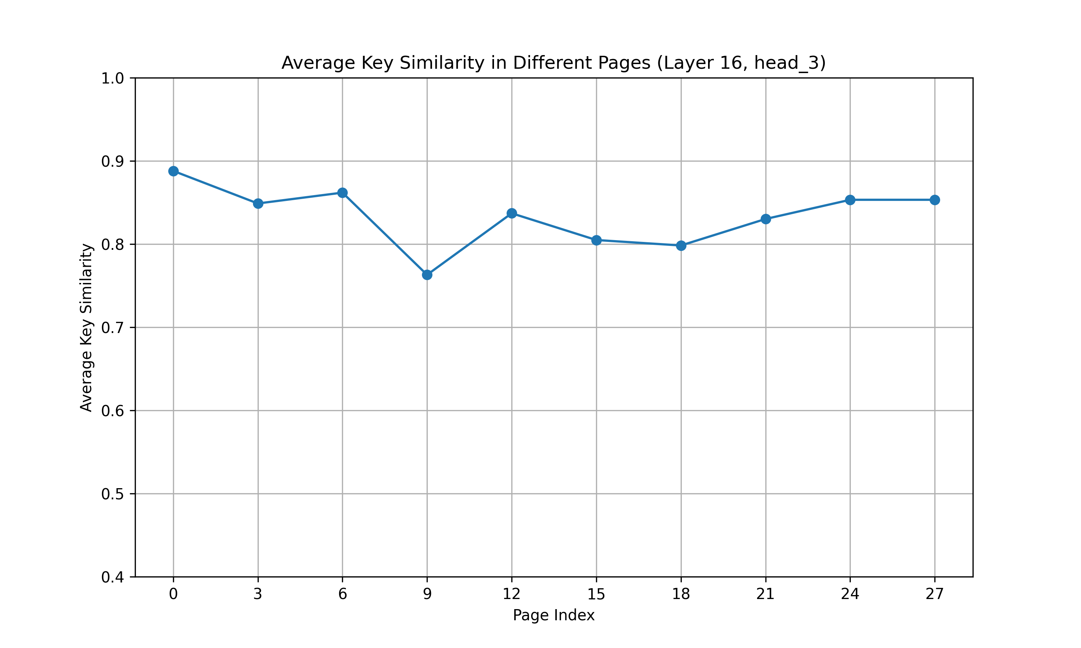
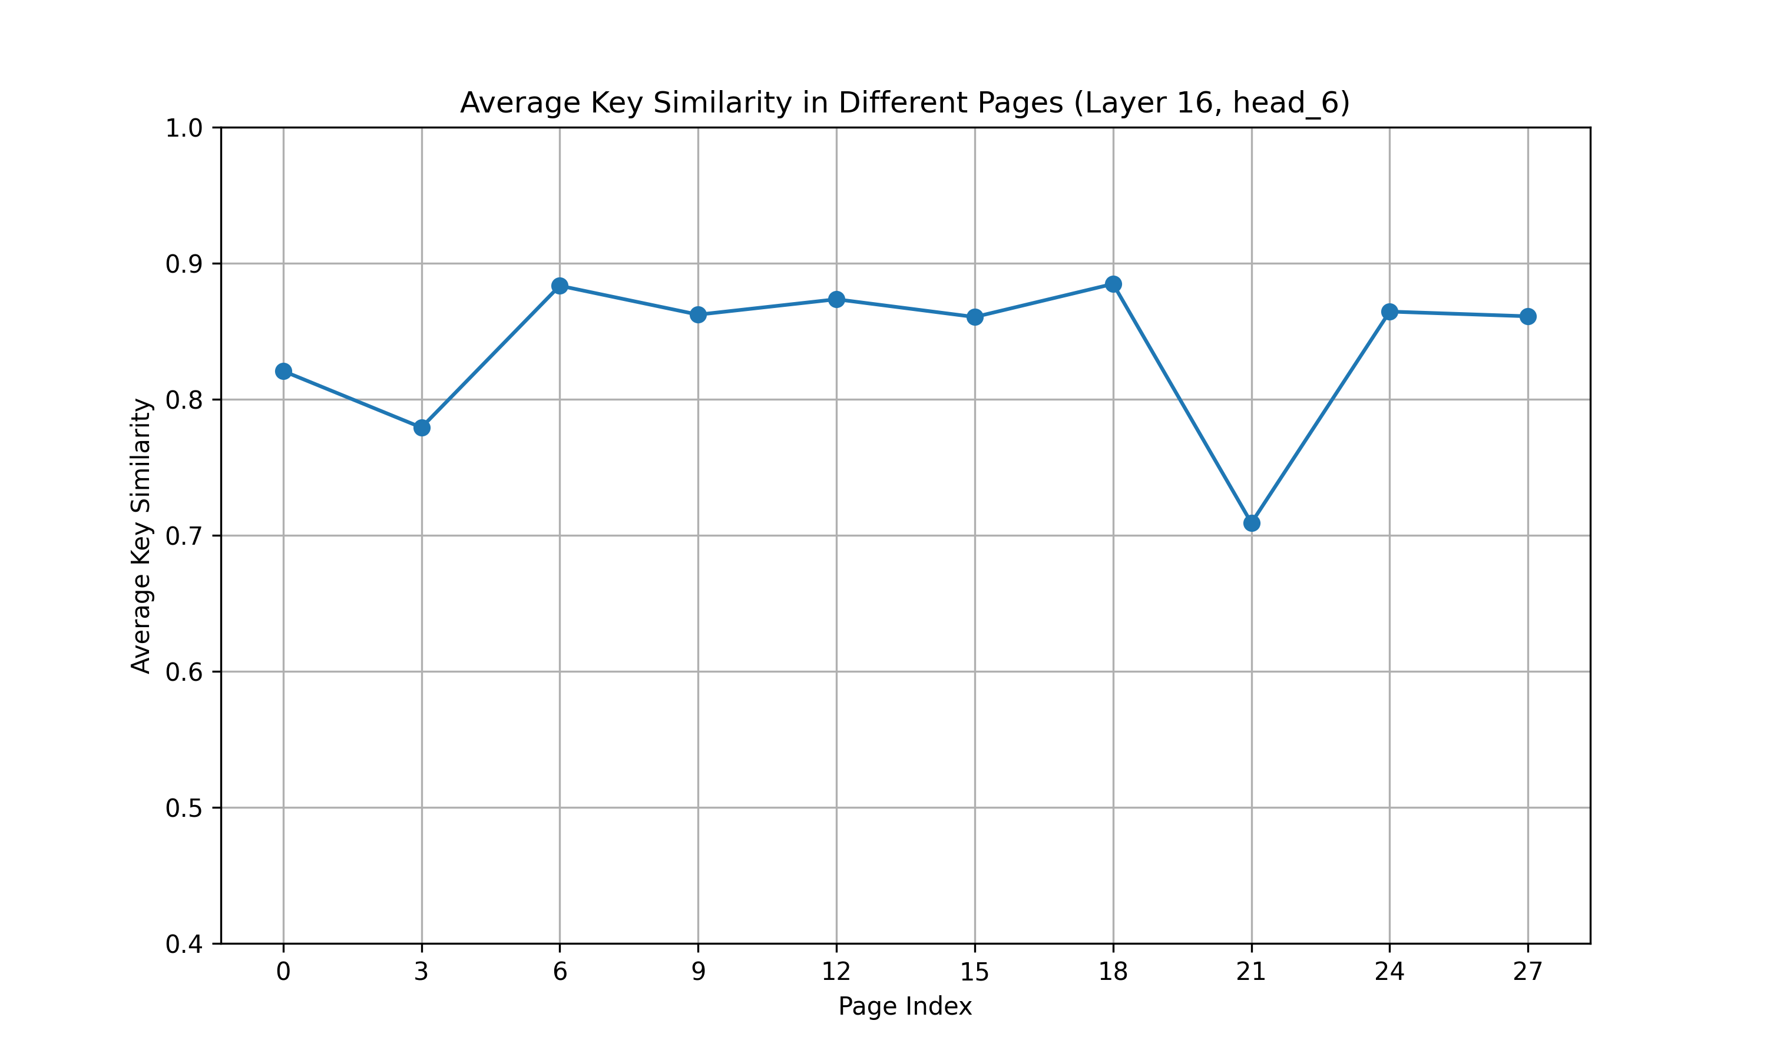
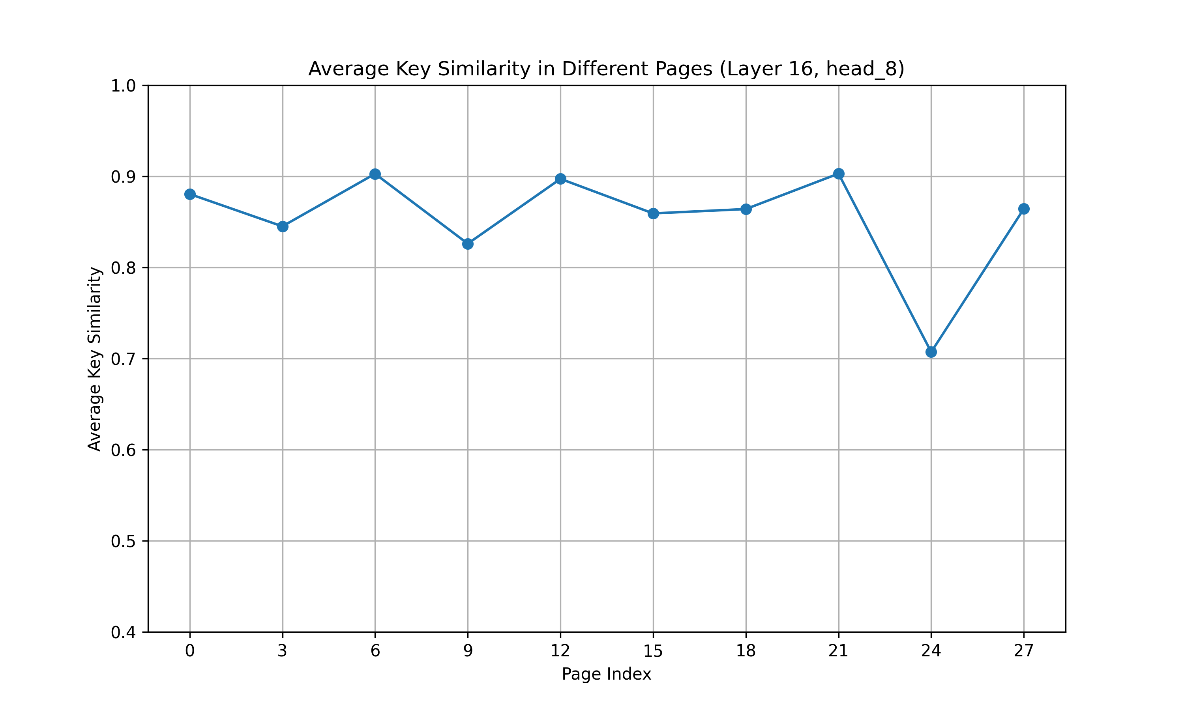
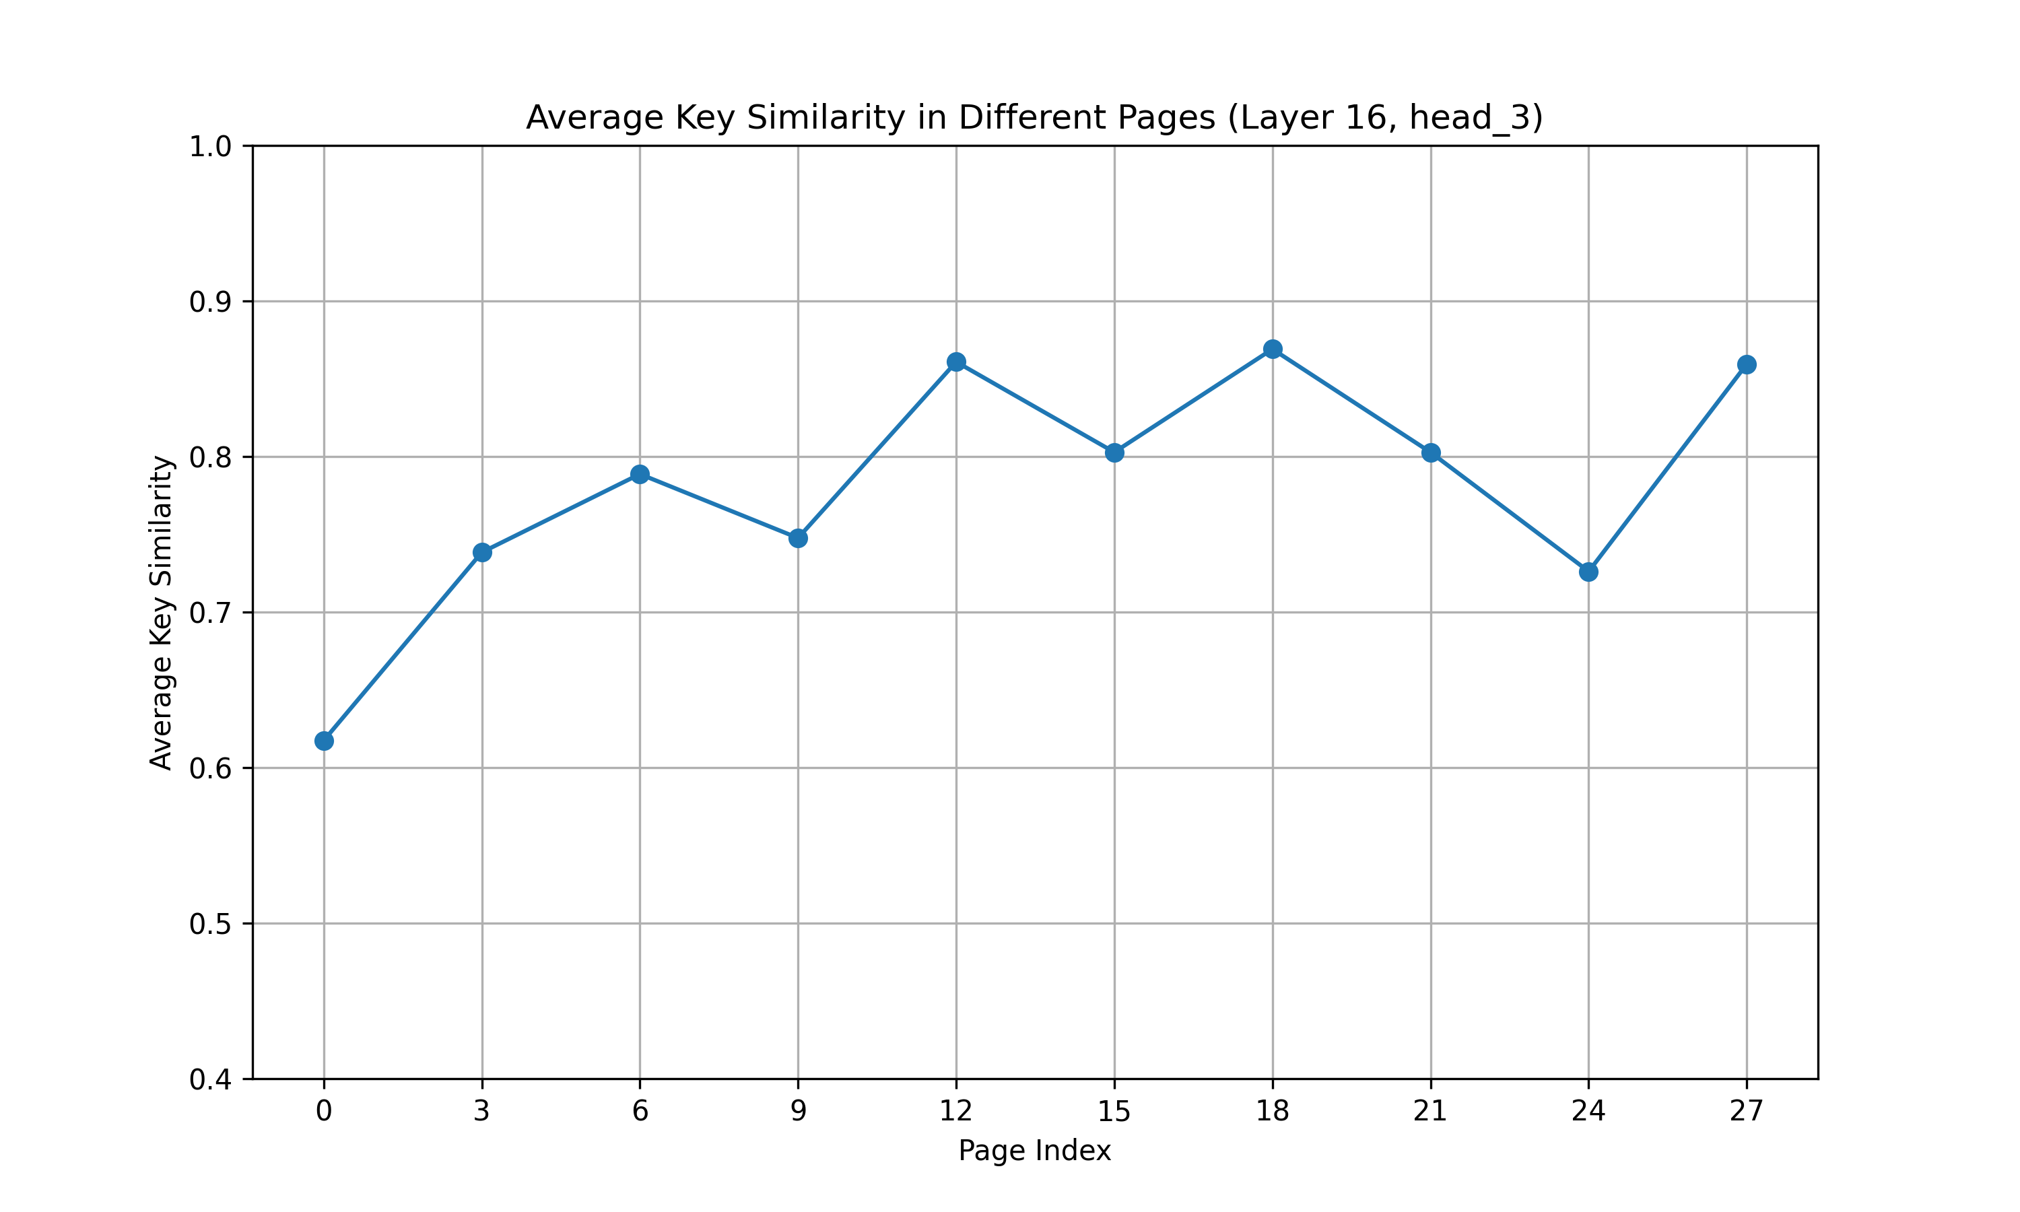
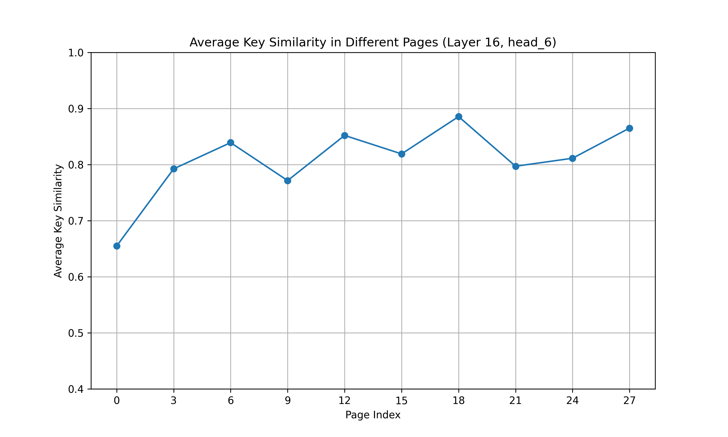
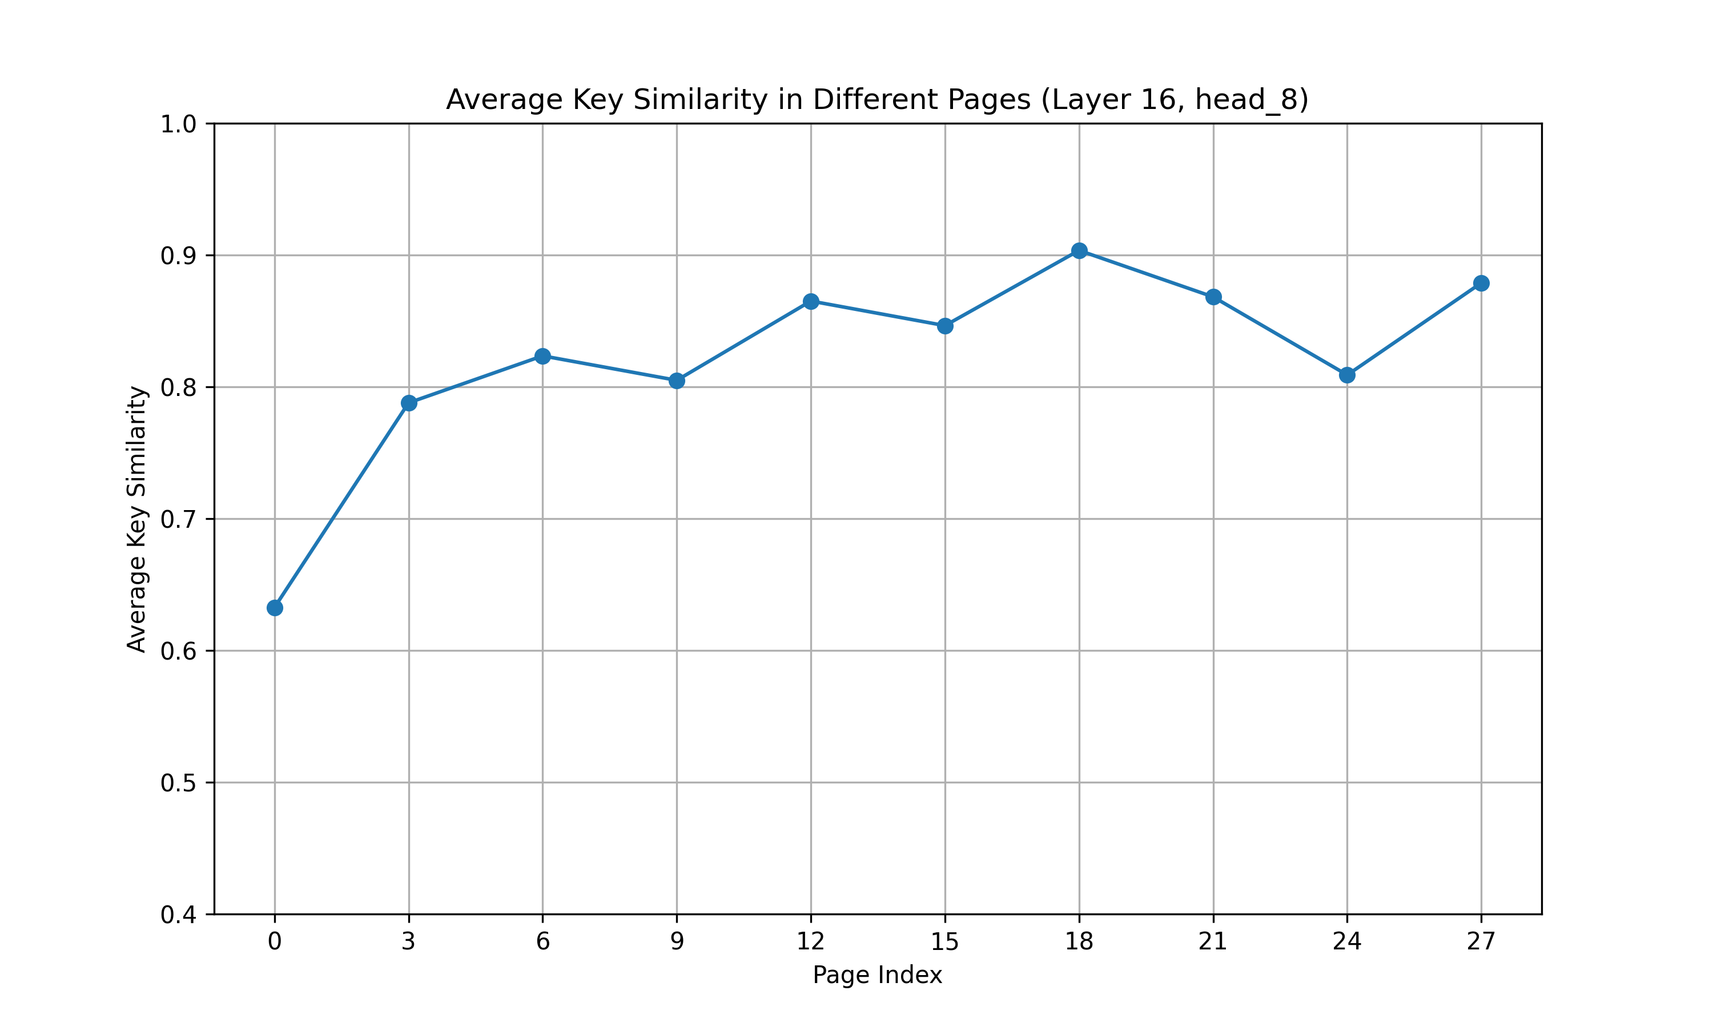
Clustering
Cos-similarity based balanced K-means
Notes:
To avoid additional memory access costs and fragmentation, I maintain a fixed page size while performing Balanced K-means clustering on KV pairs.
This approach aims to place KV pairs with high cosine similarity within the same page. And I use cosine similarity as Distance Metric, which better aligns with the application context.
The top three images display the results after clustering based on cosine similarity, showing higher intra-page key similarity compared to before clustering, as illustrated in the bottom three images.

Slide 11
Clustering
Initialization of clustering
Random initialization randomly chooses k observations from the data set and uses these as the initial centroids.
Density-based initialization linearly spaces the CDF of the keys in the y-axis, then finds the horizontal intersection with the CDF, and finally finds the vertical intersection on the x-axis, which becomes a centroid.
Linear initialization linearly spaces the centroids between the [min, max] of the keys. This initialization method is invariant to the distribution of the keys and is the most scattered compared with the former two methods.

Slide 12
Clustering
Initialization of clustering
Random initialization randomly chooses k observations from the data set and uses these as the initial centroids.
Density-based initialization linearly spaces the CDF of the keys in the y-axis, then finds the horizontal intersection with the CDF, and finally finds the vertical intersection on the x-axis, which becomes a centroid.
Linear initialization linearly spaces the centroids between the [min, max] of the keys. This initialization method is invariant to the distribution of the keys and is the most scattered compared with the former two methods.
Linear initialization works best
Keys with greater absolute value play a more important role, but there are fewer of these large keys. Thus for both random initialization and density-based initialization, very few centroids have large absolute value which results in poor representation of these few large keys. Linear initialization does not suffer from this problem.

Slide 13
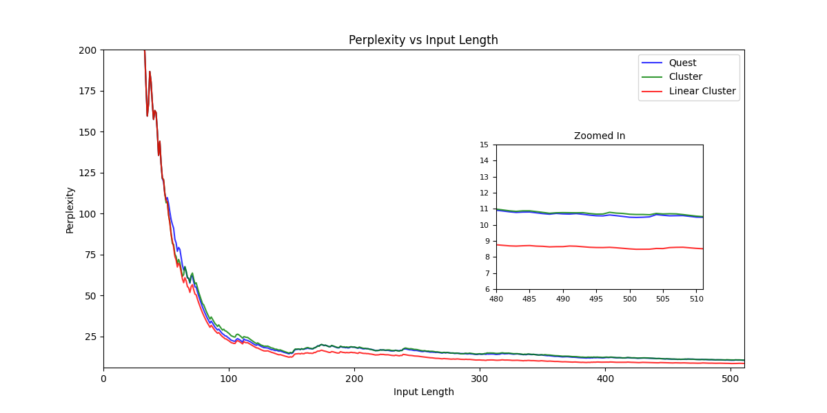
Clustering
Comparison of perplexity (based on the WikiText-2 dataset)
Notes:
These are the perplexity results of the model using different methods. I prompt the model with 0 to 512 tokens from the Wikitext-2 test set and measure the perplexity of the output tokens. Perplexity is a metric that reflects the accuracy of the model, with lower values indicating higher accuracy. The blue line represents the results of the original Quest method, while the green line shows the results of clustering with random initialization. It can be observed that the green line maintains the same model performance while improving the compressibility of KV pages. The red line corresponds to clustering with linear initialization, which shows a significant improvement in model performance.

Slide 14
Question

