Slide 1
STARC: Selective Token Access with Remapping and Clustering for Efficient LLM Decoding on PIM
Zehao Fan
Electrical, Computer, and Systems Engineering
Rensselaer Polytechnic Institute
Notes:
a sparsity-optimized data mapping scheme tailored specifically for efficient LLM decoding on PIM systems.

Slide 2
Outline
Background
Motivation
Key Idea
Results

Slide 3
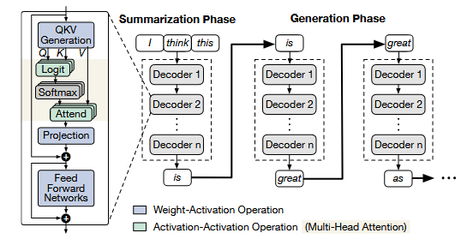
Background
Prefill
Decoding
LLM Inference
LLMs generate outputs in two phases: Prefill and Decoding
Notes:
Transformer-based LLMs typically perform inference in two stages:
Prefill: parallel processing of the input prompt Decoding: autoregressive token-by-token generation

Slide 4
Background
Prefill
Decoding
LLM Inference
LLMs generate outputs in two phases: Prefill and Decoding
During decoding, each step requires reading all past key/value vectors → Heavy Memory Access and Bandwidth Bottlenecks
Notes:
Transformer-based LLMs typically perform inference in two stages:
Prefill: parallel processing of the input prompt Decoding: autoregressive token-by-token generation

Slide 5
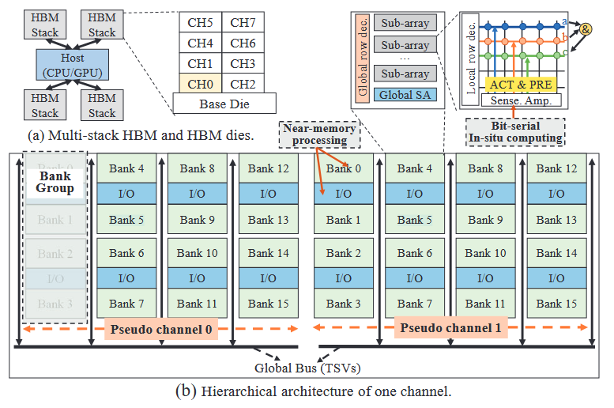
Background
Processing-in-memory (PIM)
Integrates computational units within memory systems, alleviating bandwidth constraints and enabling efficient in-memory computation
Notes:
PIM comes to the rescue:
We can start by looking at subfigure (a), which presents a relatively high-level structure.
[1] Multi-stack HBM organization
Each HBM stack consists of multiple channels connected to the host (CPU/GPU) via TSVs (Through-Silicon Vias). This high-bandwidth interconnect enables parallel access across memory dies.
[2] Channel
For each channel, it contains multiple Pseudo Channels further divided into Bank Groups.
[3] Near-Memory Processing
Lightweight processing units are placed close to memory banks, allowing basic computation (e.g., GEMV) to occur near data, reducing round-trip latency to the host.
[4] Sub-array Structure
Each bank is subdivided into smaller sub-arrays, enabling fine-grained access and facilitating internal data reuse.
Here, the
[5] Local Row Decoder
local row decoder activates the specific memory row required for read/write or compute operations.
[6] ACT & PRE (Activate and Precharge)
ACT: Activates a memory row and brings its data into the sense amplifier.
PRE: Prepares the bitline for the next access by recharging it to a known voltage. These are standard DRAM operations but reused here for PIM-friendly compute patterns.
[7] Sense Amplifier (SA)
The SA detects small voltage differences and amplifies them to full logic levels. In PIM, it also supports bit-serial in-situ operations, like dot products or logic gates, directly on stored data.
[8] Bit-Serial In-Situ Computing
Logic operations (e.g., AND, addition) are performed inside the memory using bit-serial arithmetic, where bits are processed sequentially to avoid moving data out.

Slide 6
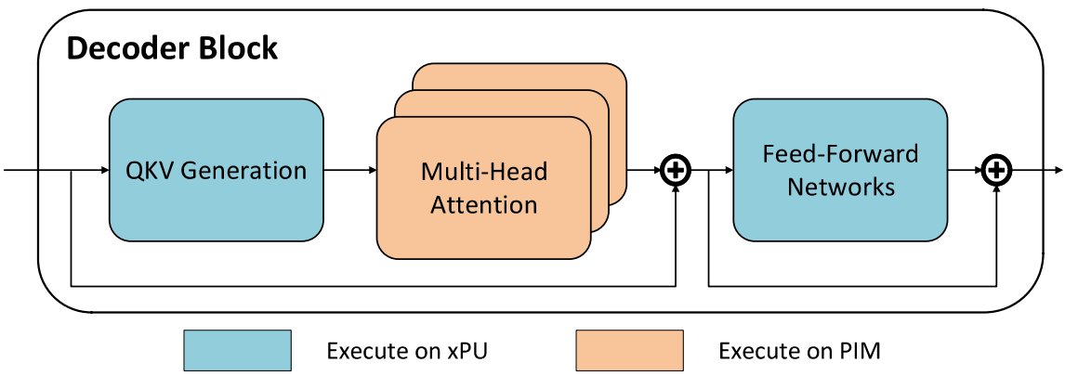
Background
PIM for LLM Attention
GPUs typically have mismatched memory bandwidth and compute capacity, and attention computation (GEMV) during decoding is typically memory-bound.
Notes:
After introducing PIM, let’s move back to LLM decoding. While modern GPUs excel in raw floating-point operations(FLOPS), attention computation during decoding is typically memory-bound, given its low arithmetic intensity and large-scale memory accesses to the KV cache.
This insight motivates us to use a heterogeneous system that combines a compute-centric GPU for GEMMs with memory-centric PIM accelerators for GEMVs.

Slide 7
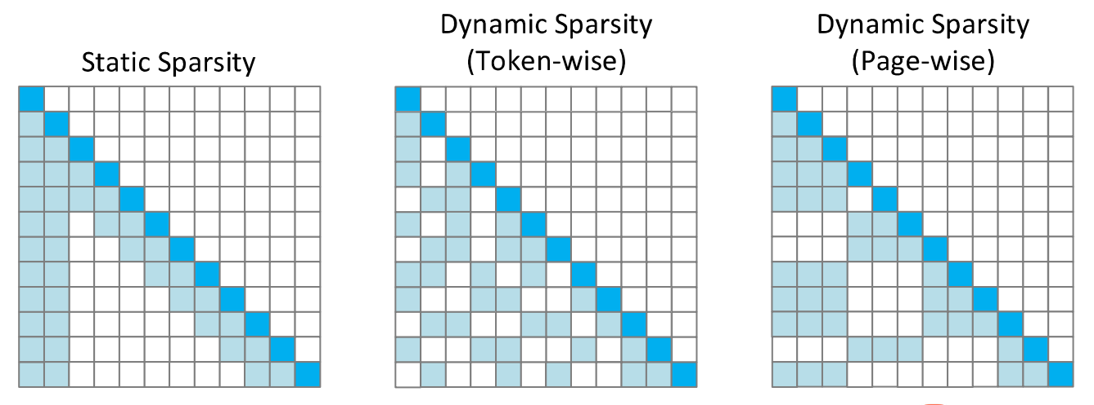
Background
KV Cache Sparsity
A small portion of critical tokens will dominate the attention outcomes.
Identify and retrieve a smaller subset of historically cached tokens that contribute most significantly to the attention output.
Notes:
However, the trend toward increasingly longer context lengths continues to impose substantial computation and memory costs, primarily due to the quadratic complexity inherent in attention computations. Recent works attempt to alleviate this burden through selective retrieval or compression of the KV cache, where only a subset of past tokens’ keys and values are selected to approximate full attention computation. In practice, sparse attention mechanisms can be broadly categorized into three classes, illustrated in Figure 2:
• Static sparsity restricts each query to attend only to a fixed-size window of past tokens, independent of content. This approach is hardware-friendly but fails to capture long-range dependencies.
• Dynamic sparsity (token-wise) selects the top most relevant tokens for each query dynamically based on similarity scores. It provides finer control over which tokens are attended but introduces irregular access patterns.
• Dynamic sparsity (page-wise) groups the context into fixed-size segments or “pages” and selects relevant pages rather than individual tokens. Compared to static sparsity, this method improves model accuracy by enabling dynamic retrieval, while still maintaining hardware-friendly access patterns.

Slide 8
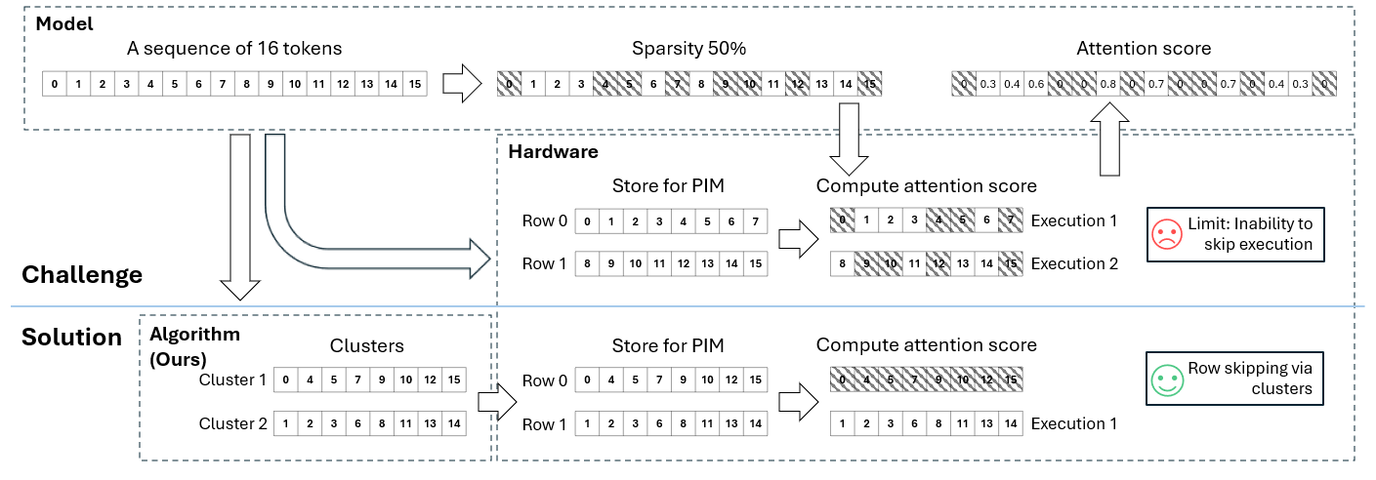
Motivation
Challenges of Sparse Attention for Existing PIM Architectures
Notes:
In a PIM system, each attention query must retrieve data from full memory rows, even if only a few tokens in those rows are actually needed.
Since PIM executes at row granularity, token-wise sparsity often leads to over-fetching and redundant computation.

Slide 9
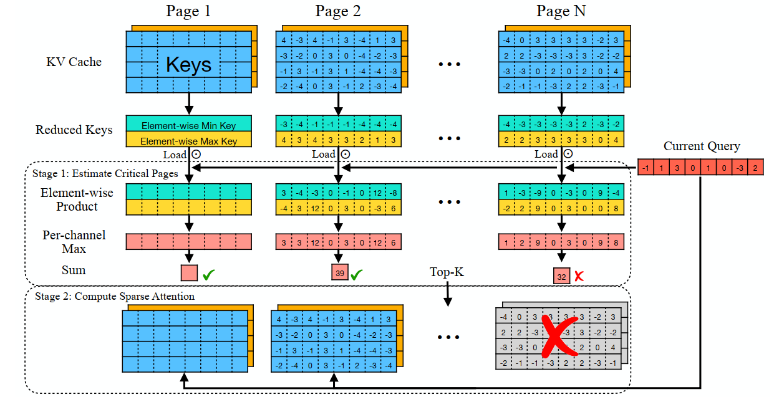
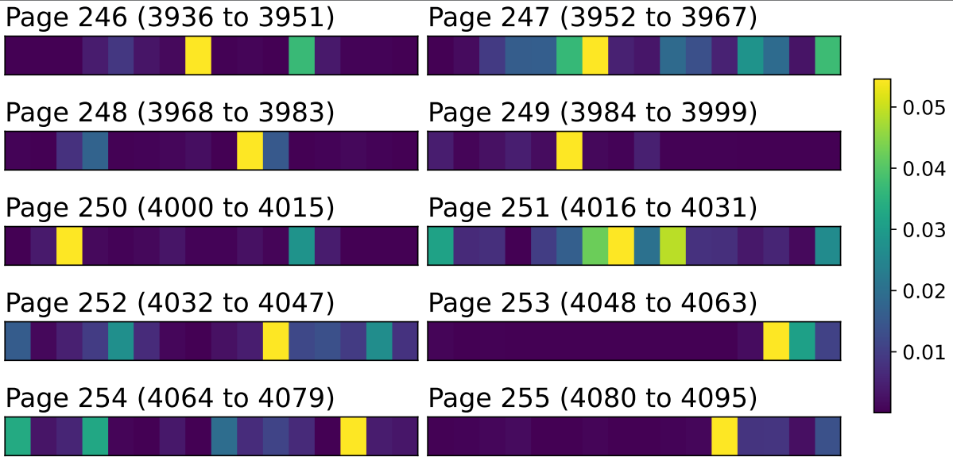
Motivation
The Tradeoff Between Hardware Efficiency and Attention Precision
Page-wise sparsity aligns well with PIM’s hardware constraints.
However, this coarse-grained selection can lead to a degradation in model accuracy.
Quest
Notes:
It‘s easy to think of during KV retrieval, when the page size matches the physical memory row size or is a multiple of it, PIM can fetch and process entire rows efficiently. This allows the system to fully utilize internal memory bandwidth and avoid partial-row access overhead.
The figure on the left is an algorithm illustration from a research paper which did this, their method named Quest.
Quest divides KV cache into fixed pages, tracks the minimal and maximal keys of KV cache pages and estimates the importance of these pages using the query vector. and only loads the most critical KV cache pages. Page boundaries are defined purely based on token position, not token importance. As a result, selected pages often include many unimportant tokens.

Slide 10
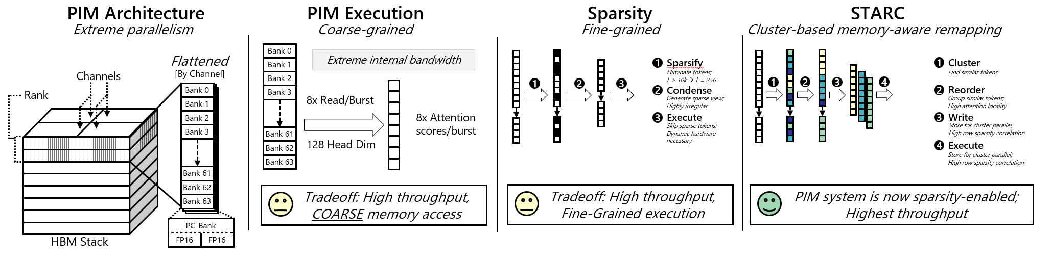
Key Idea
Managing KV Cache in PIM
Our Method
Our method enables fine-grained attention sparsity on PIM architectures by clustering and remapping tokens to maximize row-locality.
Notes:
I’ll walk you through it step by step.
1️⃣ Left: PIM Architecture
This is a typical HBM-PIM architecture, composed of multiple memory banks stacked vertically and accessed through high-bandwidth channels.
PIM provides extreme parallelism and high internal bandwidth, but each access operates at row granularity—you can’t just fetch individual tokens.
2️⃣ Mid-left: PIM Execution Bottleneck
Due to coarse-grained row access, even a single query triggers full-row activations.
This leads to over-fetching when attention only needs a few tokens.
So while throughput is high, it comes with a tradeoff: coarse and inefficient memory access when sparsity is applied naively.
3️⃣ Mid-right: Conventional Sparsity
Traditional sparsity methods eliminate unimportant tokens (Step 1), condense the remaining ones (Step 2), and execute attention (Step 3).
These methods rely on fine-grained, often scattered memory access, which is incompatible with PIM’s row-based logic.
So although they reduce computation on paper, they perform poorly in row-parallel execution environments like PIM.
4️⃣ Right: STARC: Our Solution
We addresses this gap by clustering similar tokens and reordering them so that each group is physically adjacent in memory.
During decoding, attention can operate at the cluster level, which aligns well with PIM’s row-based execution.
This transforms the sparsity pattern into something memory-friendly—relevant tokens are grouped, stored, and executed together.
The result is a PIM system that is truly sparsity-enabled.

Slide 11
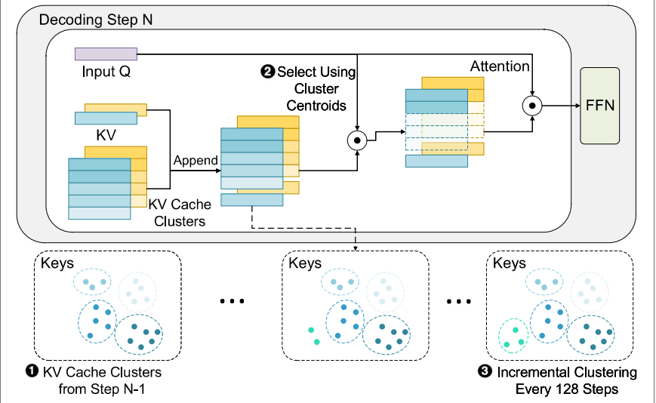
Key Idea
Semantic clustering
Perform clustering immediately after the prefill stage. To improve generation efficiency, perform clustering on the newly generated tokens every few decoding steps during the decoding stage.
At each decoding step, the query compares with each cluster centroid via dot product to select top clusters.
Notes:
Then I will introduce the clustering algorithm in detail.

Slide 12
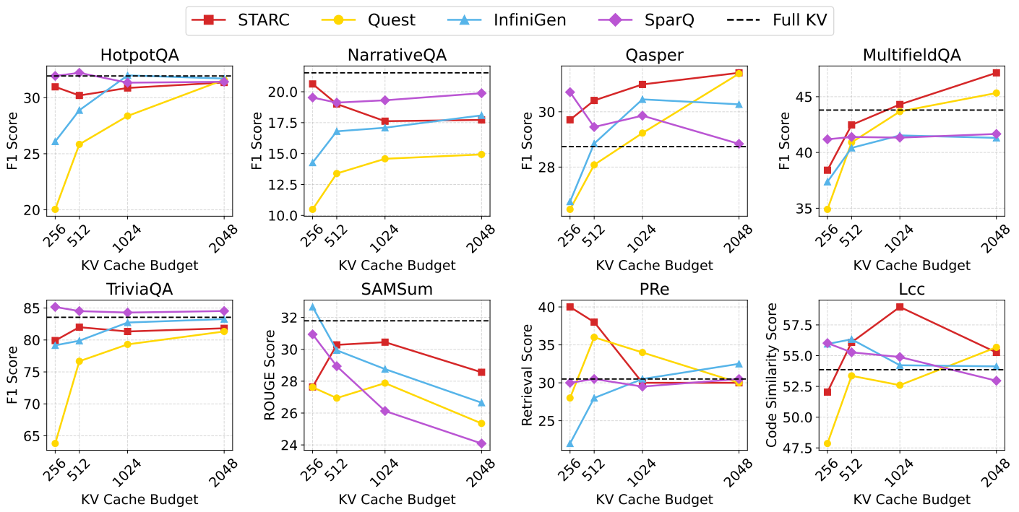
Results
Accuracy Evaluation
Notes:
This figure presents LongBench evaluation results across eight diverse datasets, reflecting the generation quality of the LLaMA3.1-8B-Instruct model — higher scores indicate better performance.
These datasets span a range of tasks, such as single- and multi-document QA, few-shot reasoning, and code completion.
We compare our proposed method against existing baselines such as Quest(page-wise) InfiniGen, SparQ(token-wise) and include a "Full KV" reference line representing that all key/value pairs are retained without any sparsity.
STARC consistently outperforms the page-wise sparsity method Quest. It also achieves comparable accuracy to the token-wise sparsity methods InfiniGen and SparQ
These results demonstrate that STARC maintains competitive accuracy compared to state-of-the-art sparsity methods, while offering better hardware alignment with PIM architectures.

Slide 13
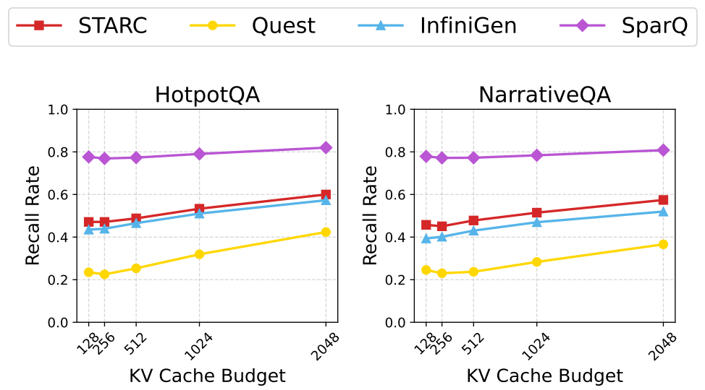
Results
Accuracy Evaluation
Notes:
We measure how well each method can keep the most important tokens during decoding. "Important tokens" the ones with the highest attention scores. During decoding, we check how many of these top important tokens are actually kept in the limited KV cache.
The higher the recall rate, the better the method is at keeping tokens that matter for attention. Although STARC is outperformed by SparQ, it achieves a higher recall rate than both Quest and InfiniGen. These results indicate that STARC’s clustering strategy effectively improves its ability to retrieve semantically important tokens.

Slide 14
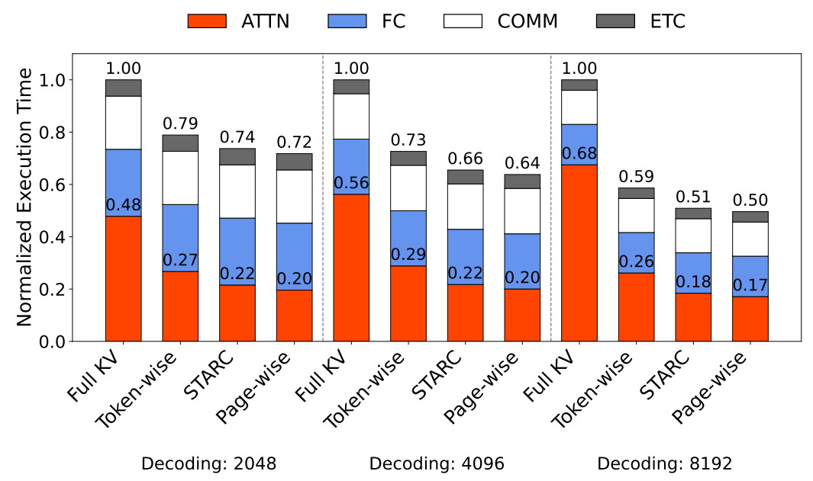
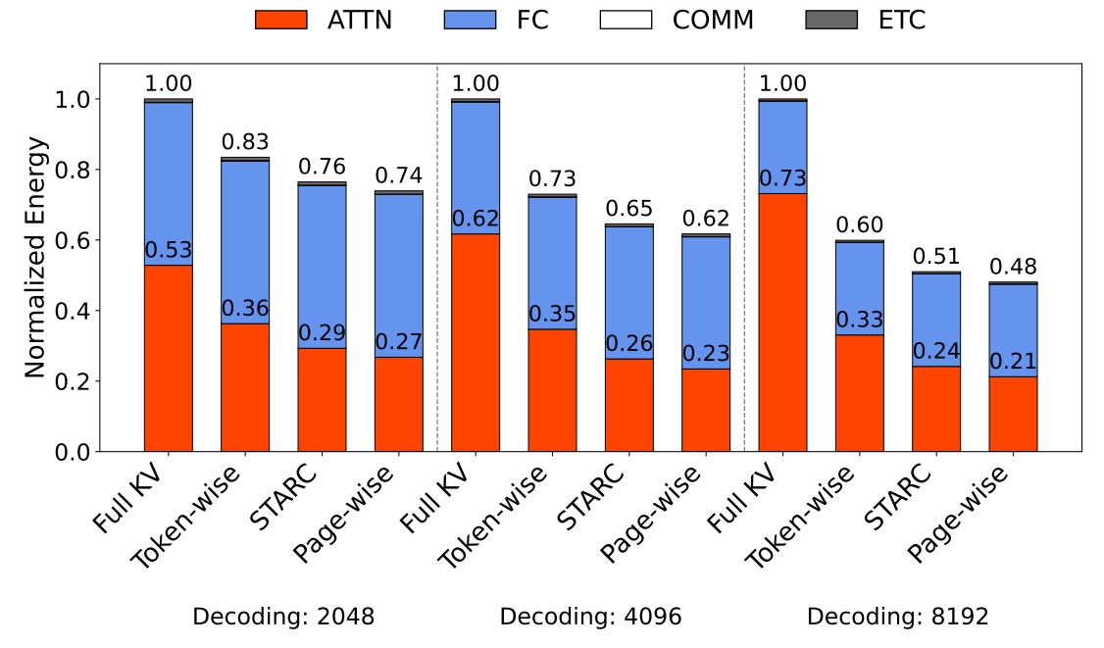
Results
Performance on PIM Systems
Notes:
We evaluate the impact of attention sparsity on the performance of PIM systems, focusing on end-to-end decoding latency and energy efficiency. We categorize sparsity strategies into two types: tokenwise sparsity(such as …) and page-wise sparsity.
As decoding length increases, the attention layer becomes the dominant contributor to system latency and energy. Notably, even token-wise sparsity yields notable improvements over the full KV baseline.
Fig. 11 shows the normalized execution time per token. Compared to token-wise sparsity methods, STARC reduces attention-layer latency by 19%–31%, and achieves up to 54%–74% latency reduction relative to full KV retrieval. These improvements translate to 6%–14% reduction in total token processing latency.
Fig. 12 reports the normalized energy consumption per output token. STARC further reduces attention-layer energy by 19%–27% compared to token-wise sparsity, and achieves up to 45%– 67% energy reduction compared to full KV retrieval. Overall, STARC reduces total per-token energy consumption by 8%–15%.
While page-wise sparsity exhibits ideal alignment with the memory layout of PIM systems and achieves the best latency and energy efficiency, this comes at the expense of significantly reduced model accuracy (as shown in previous pages). STARC offers a better tradeoff by reducing redundant computation while preserving high retrieval quality and model accuracy, demonstrating its practical advantage for deploying sparse attention on PIM architectures.

Slide 15
Thank You

