Slide 1

COMP9313: Big Data Management Lecturer: Xin Cao Course web site: http://www.cse.unsw.edu.au/~cs9313/

Slide 2
Set Similarity Join on Hadoop

Slide 3
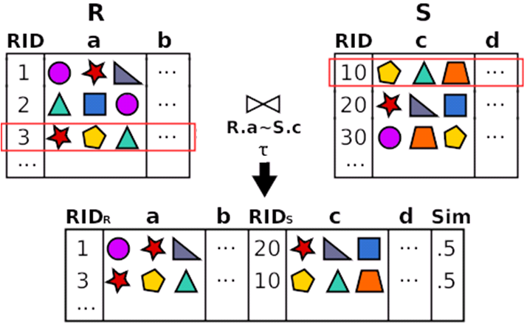
Set-Similarity Join
Finding pairs of records with a similarity on their join attributes > t

Slide 4
Application: Record linkage
Table R
Table S
Star
Keanu Reeves
Samuel Jackson
Schwarzenegger
…
Star
Keanu Reeves
Samuel L. Jackson
Schwarzenegger
…

Slide 5


Two-step Solution
Step 1:
Similarity Join
Table R
Table S
Star
…
Star
…
Step 2: Verification

Slide 6
Why Hadoop?
Large amounts of data
Data or processing does not fit in one machine
Assumptions:
Self join: R = S
Two similar sets share at least 1 token
Efficient Parallel Set-Similarity Joins Using Hadoop (SIGMOD’10)

Slide 7
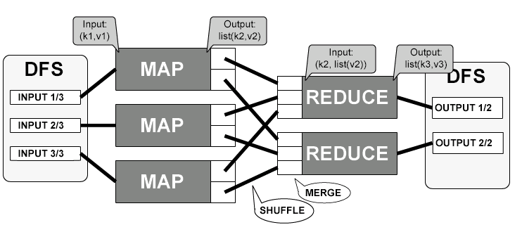
A naïve solution
Map: <23, (a,b,c)> → (a, 23), (b, 23), (c, 23)
Reduce:(a,23),(a,29),(a,50), …→ Verify each pair (23, 29), (23, 50), (29, 50) … …
Too much data to transfer ☹
Too many pairs to verify ☹.

Slide 8



Solving frequency skew: prefix filtering
Sort tokens by frequency (ascending)
Prefix of a set: least frequent tokens
r1
r2
Sorted by frequency
prefix
Prefixes of similar sets should share tokens
Chaudhuri, Ganti, Kaushik: A Primitive Operator for Similarity Joins in Data Cleaning. ICDE’06

Slide 9
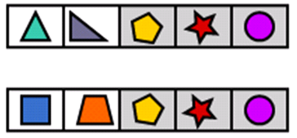
Prefix filtering: example
Record 1
Record 2
Each set has 5 tokens
“Similar”: they share at least 4 tokens
Prefix length: 2

Slide 10
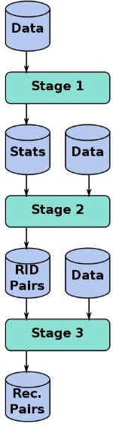
Hadoop Solution: Overview
Stage 1: Order tokens by frequency
(Already done in the given example data)
Stage 2: Finding “similar” id pairs (verification)
Stage 3: remove duplicates

Slide 11
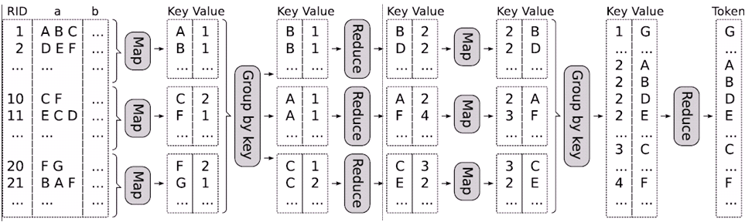
Stage 1: Sort tokens by frequency
Compute token frequencies
Sort them
MapReduce phase 1
MapReduce phase 2

Slide 12
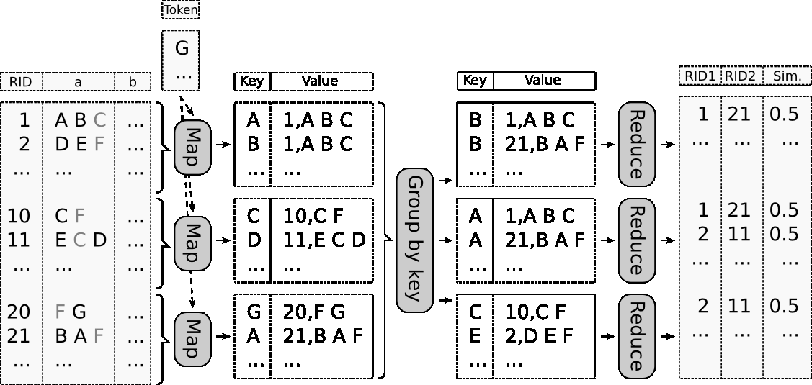
Stage 2: Find “similar” id pairs
Partition using prefixes
Verify similarity

Slide 13
Compute the Length of Shared Tokens
Jaccard Similarity: sim(r, s) = |r∩s|/|r∪s|
If sim(r, s) >= τ, l = |r∩s| >= |r∪s| * τ >= max(|r|, |s|) * τ
Given a record r, you can compute the prefix length as p = |r| - l + 1
r and s is a candidate pair, they must share at least one token in the first (|r| - l + 1) tokens
Given a record r = (A, B, C, D) and p = 2, the mapper emits (A, r) and (B, r)
Notes:
Because s is unknown, we can just use |r| * τ

Slide 14
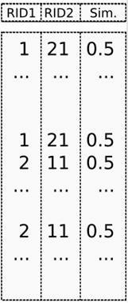
Stage 3: Remove Duplicates

Slide 15
More Optimization Strategies
It is your job!!!
The faster the better

