Slide 1

Predicting Home Prices
How can understanding the predictions help you increase the value of your home?

Slide 2

Agenda
What data are we looking at?
What do we see in the data?
How does the model work?
How can you use these insights to increase the value of your home?

Slide 3

Data Summary

Slide 4

What’s inside the data set?
What data are we looking at?
Houses Sold in Ames, IA from 2006-2010
2930 homes, 82 variables
Objective quantitative data
  Square footage
  Lot area
Subjective qualitative data
  Exterior quality
  Kitchen quality
  Overall quality/condition
Any issues with the data?
For subjective home features like exterior quality, we don’t know how the rating was derived.
A few outliers with large square footage and partial sales, also a garage that was built in 2077!
A lot of ‘missing’ data that implied that the homes didn’t have those features. E.g. Pools

Slide 5

Let’s look at some visualizations!

Slide 6
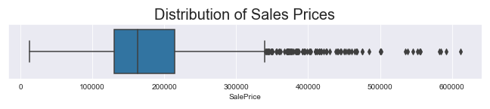
Notes:
Half of the houses in our dataset had a sale price between 129825 - 214000, so that's a very small range with a lot of data. We’ll have some trouble predicting the prices above 220k since there is just less data available there, but our model should be very good at predicting values within the range of 130k-214k

Slide 7
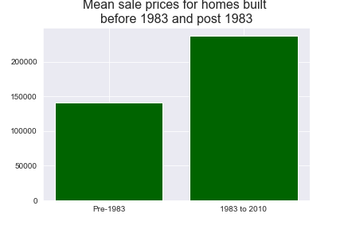
Age of Home and Sale Price
Homes prices in Ames, IA jump dramatically when the home has been built after 1983.

Slide 8
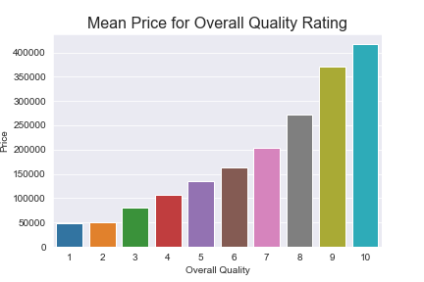
Overall Quality
Though Overall Quality is a subjective measure, it seems to be a very strong indicator for house price.

Slide 9
About the models

Slide 10




What was the process?
We fed all the housing data into our models and let the computer crunch the numbers
And now we get to share those results with you!
We chose a few different models for our purposes–some are more interpretable than others
Our models found features of homes that are strongly correlated with home price

Slide 11
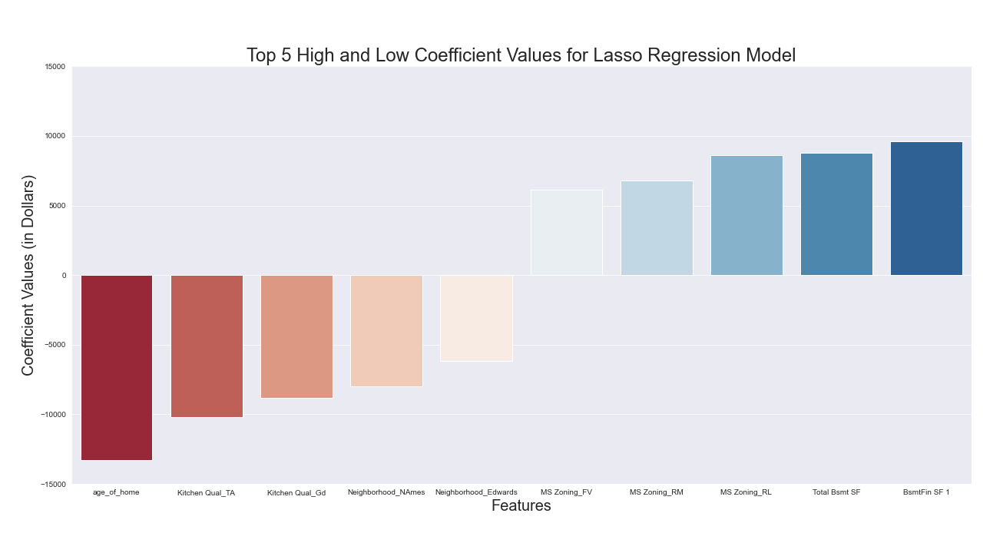
Notes:
We’re going to look at two of our models and focus on the features of a home that we can all control, since we’d like to improve the values of our homes without physically moving the home into a new neighborhood or getting the Zoning laws changed. In this chart, the things we can control are the finished basement here and the Kitchen Quality. Exter Qual_TA means an average quality exterior. It is linked to some other values behind the scenes, so we don’t necessarily want to include that one in our thinking here. Remember when I said some models are less interpretable than others?

Slide 12
Controllable features of a home that impact your sale price most dramatically
Feature Name | Coefficient (in dollars)
Kitchen Qual_TA | -17353.52449
Kitchen Qual_Gd | -16072.64169
Bsmt Qual_Gd | -11528.71693
Total Bsmt SF | 19.312078
BsmtFin SF 1 | 21.700437
Notes:
These are the results from the model that is more interpretable. Some of these are out of our control (Sale Type, Zoning, Age, and Neighborhood, so we’ll focus on the ones we can control: Kitchen Qual and BsmtFin SF.

Slide 13


What did we discover?
Finish your basement!
Remodel your kitchen!
~$16,000
~$21 per sf
Notes:
After running all the tests on the data, I've come to the following conclusions about the best ways to improve a home's value:
Remodel your kitchen! When compared to a kitchen of Excellent quality, a good to poor kitchen may negatively impact your house value by 8,000-10,000 dollars when all other variables are equal.
Remodel your basement! When compared to basements of Excellent quality, a Good to poor basement may negatively impact your house value by around $21 per sf when all other variables are held constant

Slide 14
Thank you!

