Slide 1
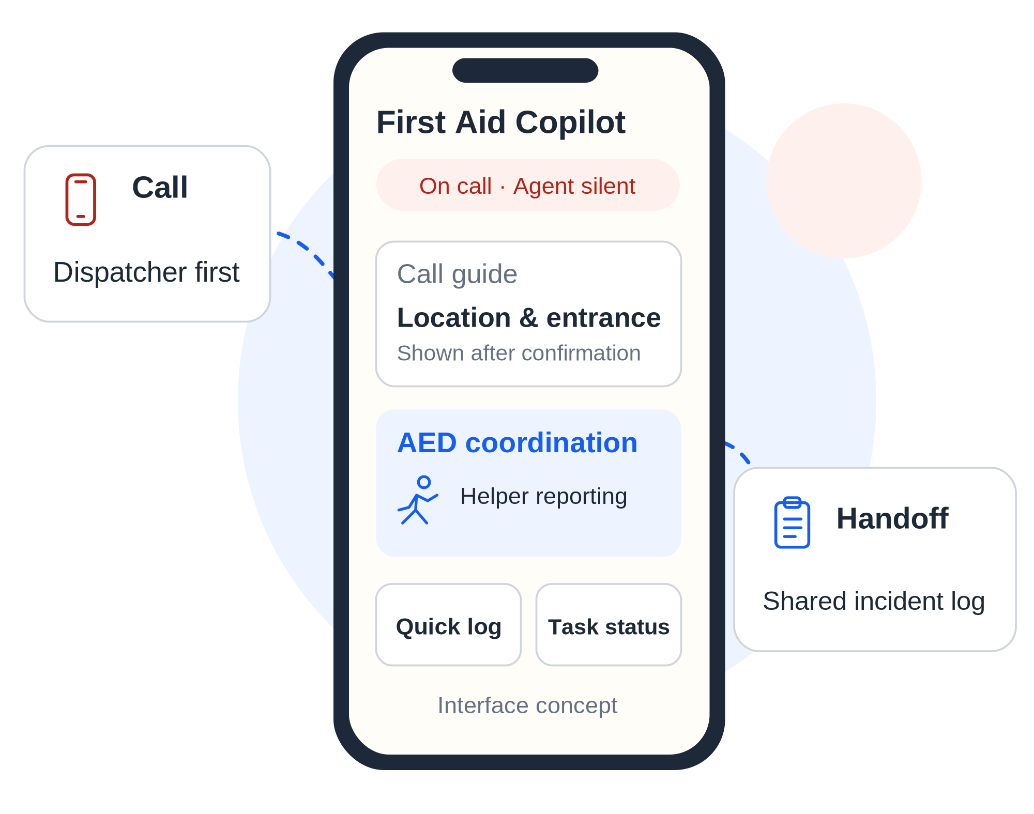
MEICHU HACKATHON · GOOGLE AI AGENTS
01 / 12
First Aid
Copilot
The dispatcher leads.
The Agent assists.
Connect emergency calls, AED tasks,
and handoff in one on-scene workflow.
Prototype proposal | The dispatcher leads; the Agent assists.
Sources: project README; Google challenge brief, p. 1
FIRST AID COPILOT
Notes:
第 1 頁｜急救副駕 / Slide 1: First Aid Copilot
建議單語講述時間：15 秒 / Suggested time in one language: 15 seconds.
中文與英文擇一朗讀；方括號提示及參考資料不朗讀。 / Read one language. Do not read cues or reference material aloud.
【中文逐字稿｜繁體中文】
各位評審好，我們的作品是急救副駕。派遣員指揮，Agent 輔助。我們希望把報案資訊、AED 協作與交接紀錄接起來，讓現場每個幫忙的人，都知道下一步。
【English Verbatim Script】
This is First Aid Copilot. The dispatcher leads; the Agent assists. Our goal is to connect emergency-call information, AED coordination, and handoff records, so everyone knows their next step.
【操作提示｜Stage Cues — 不朗讀 / Do Not Read Aloud】
先看標題，再指向右側介面概念圖；封面不展開技術細節。／Introduce the title, then point to the interface concept on the right. Save technical details for later.
中文與英文是兩套替代講稿，擇一朗讀，不連續念兩遍。／Choose one language; do not read both versions consecutively.
主簡報為第 1–9 頁，按約 6 分鐘規劃，含第 4 頁 90 秒情境展示；第 10–12 頁為問答備用。／Slides 1–9 follow an approximately six-minute plan, including the 90-second storyboard on slide 4. Slides 10–12 are for questions.
實作狀態與測試數字沿用原簡報及其來源；本次僅編修講者備註，未重新執行專案測試。／Implementation status and test figures are carried over from the supplied deck and its sources. This revision adds speaker notes; it does not rerun project tests.
【實作與證據邊界｜Reference Only — 沿用原簡報】
專案仍在原型實作階段。產品目標與目前完成範圍須依後續頁面區分，不能把封面的介面示意當成已上線功能。
【評分／題目對應｜Reference Only】
建立作品定位；接續 P2 的問題定義、P3 的創新與 P8 的影響力。
【來源｜Sources — 不朗讀 / Do Not Read Aloud】
S1: Google 題目.pdf，第 1 頁目標與指定模型。
S2: mchackathon-develop/README.md，產品介紹、AI 與規則的界線。

Slide 2
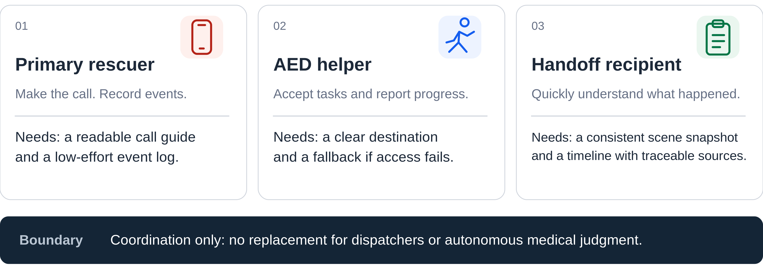
PROBLEM / USER NEEDS
02 / 12
People are helping. Their information is disconnected.
Needs hypothesis: calling, AED retrieval, and handoff are split across different people.
Criteria: insight into user needs | clarity of problem definition
Sources: README, problem statement; docs/sdd.md, Sections 1 and 4
FIRST AID COPILOT
Notes:
第 2 頁｜使用者需求與問題 / Slide 2: User Needs and Problem Definition
建議單語講述時間：35 秒 / Suggested time in one language: 35 seconds.
中文與英文擇一朗讀；方括號提示及參考資料不朗讀。 / Read one language. Do not read cues or reference material aloud.
【中文逐字稿｜繁體中文】
我們先把現場分成三個角色。救援者要報案，也要留下事件紀錄；AED 協助者需要明確目的地，還要能回報設備拿不到的情況；交接接收者則需要快速理解剛才發生的事。
我們要處理的是這三個角色之間的資訊與任務斷點，而不是取代派遣員，或自行做醫療判斷。這些目前仍是需求假設，需要透過演練驗證。
【English Verbatim Script】
We focus on three roles. The primary rescuer needs to make the emergency call and record events. The AED helper needs a clear destination and a way to report an inaccessible device. The handoff recipient needs to understand what has happened.
Our problem is the information gap between these roles. Our scope is coordination, not medical judgment or replacing the dispatcher. These needs are still hypotheses to validate through drills.
【操作提示｜Stage Cues — 不朗讀 / Do Not Read Aloud】
依左、中、右的順序指向三個角色，最後指向下方設計邊界。／Point to the three roles from left to right, then to the design boundary below.
不要把需求假設說成訪談結論或現場事故統計。／Do not present these hypotheses as interview findings or incident statistics.
【實作與證據邊界｜Reference Only — 沿用原簡報】
需求來自專案 README 與 SDD 的產品定義，沒有使用者訪談樣本或現場實證資料。
【評分／題目對應｜Reference Only】
Problem Definition & PoC：使用者需求洞察、問題定義清晰度。
【來源｜Sources — 不朗讀 / Do Not Read Aloud】
S2: README.md「我們想解決的問題」。
S3: docs/sdd.md §1 Product Definition and Scope；§4 Routes and User Experience。

Slide 3
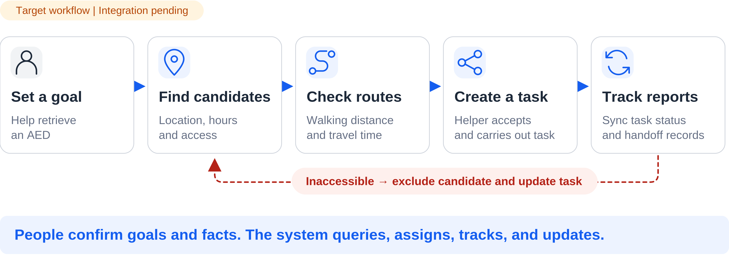
AUTONOMY / GOAL-DRIVEN TASKS
03 / 12
One coordination goal. Multiple connected steps.
Users should not have to command every search, route query, assignment, and record update.
Criteria: novelty | uniqueness | ease of use Challenge: proactive tasks and feedback-driven adaptation
Sources: README, AED coordination; docs/sdd.md, Section 8; agent/INTEGRATION.md
FIRST AID COPILOT
Notes:
第 3 頁｜主動完成任務的目標流程 / Slide 3: A Goal-Driven Task Workflow
建議單語講述時間：35 秒 / Suggested time in one language: 35 seconds.
中文與英文擇一朗讀；方括號提示及參考資料不朗讀。 / Read one language. Do not read cues or reference material aloud.
【中文逐字稿｜繁體中文】
我們的設計不是要使用者逐步下指令，而是從一個目標開始：協助取得 AED。系統的目標流程是接續找候選、查路線、建立任務，再追蹤回報。設備拿不到時，就排除原候選並更新任務。
人仍然確認目標、接受任務，並回報現場事實。主動執行不代表跳過人的確認。這張是整合目標，目前部分環節仍待接通。
【English Verbatim Script】
Instead of asking the user to command every step, our target workflow starts with one goal: help retrieve an AED. The system would find candidates, check routes, create a task, and track reports. If the device is inaccessible, it would exclude that candidate and update the task.
People still confirm the goal, accept assignments, and report what happened. This is the intended workflow; some parts still need integration.
【操作提示｜Stage Cues — 不朗讀 / Do Not Read Aloud】
沿藍色箭頭由左向右，接著指向紅色回饋路徑。／Follow the blue arrows from left to right, then point to the red feedback path.
這是系統的目標流程；不要說成 Gemini 已經自主呼叫工具完成全部步驟。／This is the target system workflow, not evidence that Gemini already calls tools to complete every step.
【實作與證據邊界｜Reference Only — 沿用原簡報】
agent/app/services/aed/assignment.py 有 assign 與 report_unavailable 等邏輯；目前 helper update API 保存回報，尚未串入重新指派。當前 Gemini Agent 未註冊工具。
【評分／題目對應｜Reference Only】
Innovation & Impact：新穎性、獨特性。Implementation & Usability：易用性。題目：主動完成任務、依環境反饋調整策略。
【來源｜Sources — 不朗讀 / Do Not Read Aloud】
S2: README.md「AED 自動改派」與協作流程。
S3: docs/sdd.md §8 AED Data and Coordination。
S4: agent/INTEGRATION.md「Implemented HTTP routes」「Helpers, sharing, and handoff」。
S6: agent/app/services/aed/assignment.py。

Slide 4
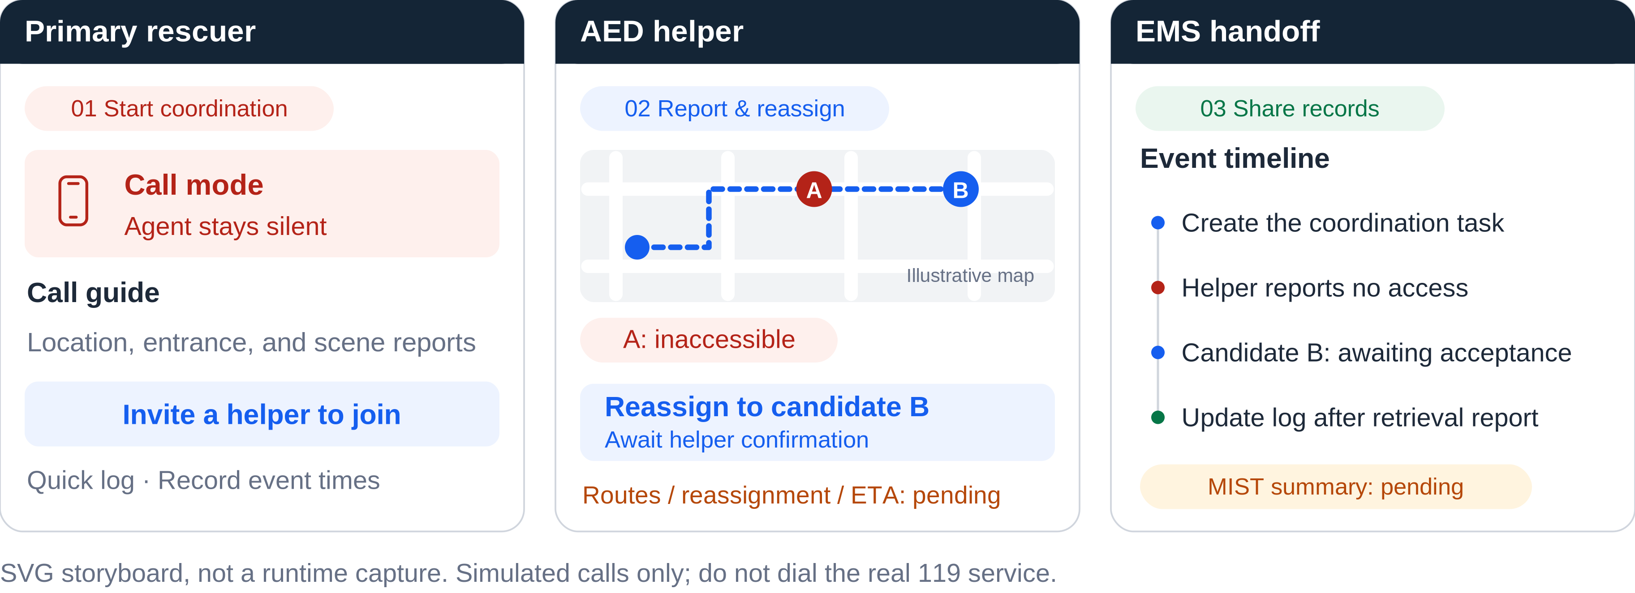
DEMO / 90-SECOND STORYBOARD
04 / 12
An inaccessible AED does not end the task.
90-second target sequence: start coordination → report no access → reassign → share records.
Criteria: completeness | smooth user experience | ease of use Storyboard, not an end-to-end result
Sources: README, workflow; agent/INTEGRATION.md; original SVG storyboard
FIRST AID COPILOT
Notes:
第 4 頁｜AED 無法取得後的接續流程 / Slide 4: Continuing After an AED Is Inaccessible
建議單語講述時間：90 秒 / Suggested time in one language: 90 seconds.
中文與英文擇一朗讀；方括號提示及參考資料不朗讀。 / Read one language. Do not read cues or reference material aloud.
【中文逐字稿｜繁體中文】
[00–20 秒｜左側：救援者／Left: primary rescuer]
這一頁用情境示意說明整合目標，不是已跑通的現場展示。先看左側。在模擬通話模式下，Agent 保持靜音；救援者可以參考報案小抄、記錄事件，並邀請協助者。
[20–40 秒｜中間：協助者回報／Center: helper report]
接著看中間。協助者加入後，接受取得 AED 的任務。假設候選 A 無法取得，協助者就回報這個結果，不讓任務停在沒有後續的狀態。這個回報，是啟動下一步協作的依據。
[40–70 秒｜中間：改派目標／Center: proposed reassignment]
在目標流程裡，系統會排除候選 A，尋找其他候選、重新查詢路線，再更新任務。圖中的候選 B 是改派目標，但仍要由協助者確認新目的地。這裡的地圖只是示意；路線、改派和預估時間，仍然待整合。
[70–90 秒｜右側：交接時間軸／Right: handoff timeline]
最後看右側。回報會延續到交接時間軸。現在已有分享、回報與時間軸的基礎，但改派流程和 MIST 摘要還沒完整接通。發出任務不等於任務完成；是否取得設備，仍要依協助者回報。
【English Verbatim Script】
[00–20 秒｜左側：救援者／Left: primary rescuer]
This is a storyboard of the intended workflow, not a completed live demo. First, look at the rescuer. In simulated call mode, the Agent stays silent, while the rescuer uses the call guide, records events, and invites a helper.
[20–40 秒｜中間：協助者回報／Center: helper report]
Next, the helper joins and accepts the retrieval task. Suppose candidate A is inaccessible. The helper reports that result instead of leaving the task unresolved. That report is intended to trigger the next coordination step.
[40–70 秒｜中間：改派目標／Center: proposed reassignment]
In the target workflow, the system would exclude candidate A, look for another candidate, query a new route, and update the task. Here, candidate B is the proposed replacement, but the helper still needs to confirm the new destination. The map is illustrative; routing, reassignment, and travel-time estimates are still awaiting integration.
[70–90 秒｜右側：交接時間軸／Right: handoff timeline]
Finally, the reports would feed into a shared timeline for handoff. The sharing, reporting, and timeline foundation exists, but reassignment and the MIST summary are not fully connected. Sending a task is not completing it; retrieval still needs a helper's report.
【操作提示｜Stage Cues — 不朗讀 / Do Not Read Aloud】
本頁保留 90 秒，含指向圖面、切換與短暫停頓；段落前的時間標記不朗讀。／Allow 90 seconds for narration, pointing, transitions, and brief pauses. Do not read the timing labels aloud.
目前使用本頁 SVG 情境示意；未串通的環節不要以點擊或手動改狀態冒充成功操作。／Use the SVG storyboard for unconnected steps. Do not present clicks or manually changed states as a successful live workflow.
所有 A／B 位置皆為合成示意；只做模擬通話，不實際撥打 119。／Locations A and B are synthetic. Simulate the call; do not dial the real 119 service.
圖上的 MIST 保留待整合標示，不當作已完成的自動交接摘要。／Keep MIST labeled as pending integration, not as a completed automatic handoff summary.
【實作與證據邊界｜Reference Only — 沿用原簡報】
目前 /aeds 回傳空候選，helper update 不產生新 AED 或 ETA，MIST 尚未由現行 API 輸出。圖中未提供假造的 API 回傳、實測時間或真實路線。
【評分／題目對應｜Reference Only】
Implementation & Usability：產品完整性、體驗流暢度與易用性。支援 PoC。題目：主動執行、外部服務連動、回饋後調整。
【來源｜Sources — 不朗讀 / Do Not Read Aloud】
S2: README.md 使用流程與 AED 協作。
S4: agent/INTEGRATION.md「Implemented HTTP routes」「Helpers, sharing, and handoff」。
S8: web/src/features/helpers/HelperTaskPage.tsx；web/src/features/handoff/HandoffPage.tsx。

Slide 5
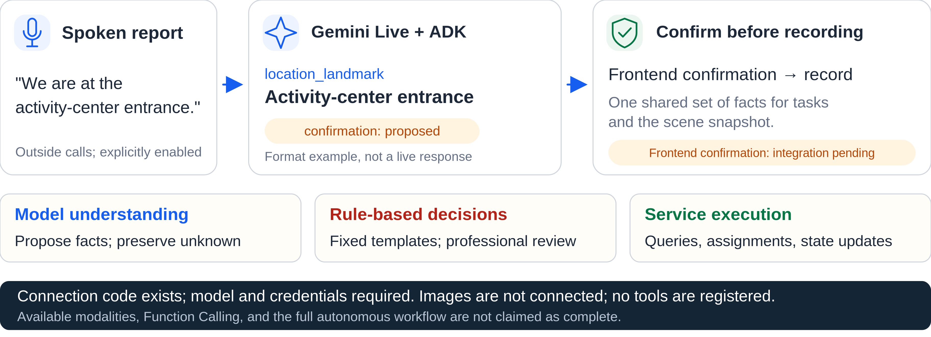
GEMINI / MODEL, RULES, AND SERVICES
05 / 12
Gemini interprets; rules and services execute.
Existing code path: audio → Google ADK / Gemini Live → unconfirmed structured observations.
Criteria: technical basis for novelty | PoC completeness Challenge: Gemini, multimodal and Agent capabilities
Sources: agent/app/agent/live_provider.py; agent/INTEGRATION.md, Live WebSocket
FIRST AID COPILOT
Notes:
第 5 頁｜Gemini 的實際角色 / Slide 5: Gemini's Actual Role
建議單語講述時間：45 秒 / Suggested time in one language: 45 seconds.
中文與英文擇一朗讀；方括號提示及參考資料不朗讀。 / Read one language. Do not read cues or reference material aloud.
【中文逐字稿｜繁體中文】
在非通話模式下，Gemini 的角色是把明確回報的語音整理成結構化觀察。以圖中例子來說，「我們在活動中心入口」會成為位置地標的提議，標成 proposed，還不是已確認事實。這是輸出格式示意，不是實測模型回應。
規則定義可審閱的流程，服務負責查詢與任務更新。ADK Live 的接入程式已存在，但真實呼叫與前端確認仍待驗證。影像未接通，Agent 也沒有註冊工具，所以目前不宣稱 Function Calling 已完成。
【English Verbatim Script】
Outside call mode, Gemini is intended to turn a spoken report into structured observations. Here, 'We are at the activity-center entrance' becomes a location proposal marked 'proposed,' not a confirmed fact. This is a format example, not a captured model response.
Rules define reviewable workflows; services handle queries and task updates. The ADK Live code exists, but real calls and frontend confirmation need validation. Images are not connected, and no tools are registered, so Function Calling is not complete.
【操作提示｜Stage Cues — 不朗讀 / Do Not Read Aloud】
依序指向語音、location_landmark、confirmation: proposed，最後指向三層分工。／Point to the spoken input, location_landmark, confirmation: proposed, and then the three-way division of responsibilities.
技術名稱按原名朗讀；不要補上未被驗證的 Gemini 型號。／Read the technical names as written. Do not add an unverified Gemini model version.
模型輸出與規則內容都不應包裝成醫療判斷；固定內容仍需專業審閱。／Do not present model output or rule content as a medical judgment. Fixed guidance still requires professional review.
【實作與證據邊界｜Reference Only — 沿用原簡報】
live_provider.py 的 Agent 模型由 GEMINI_MODEL 設定；未配置時使用 UnavailableProvider。可接受的觀察鍵為 patient_responsive、breathing_reported、location_landmark。程式未註冊 tools。Live gateway 對 image/jpeg 回 unavailable。目前資料不能確認實際使用的 Gemini 版本。
【評分／題目對應｜Reference Only】
題目指定 Gemini 多模態能力，鼓勵 Function Calling、Multimodal Reasoning、Autonomy；本頁說明採用方式與未完成範圍，不以模態數量取代實作證據。
【來源｜Sources — 不朗讀 / Do Not Read Aloud】
S1: Google 題目.pdf p.1。
S5: agent/app/agent/live_provider.py，AdkObservationProvider._session、_accept_text、default_provider。
S4: agent/INTEGRATION.md「Live WebSocket and call-mode policy」。
S8: web/src/lib/connection/incidentRuntime.ts，#receiveLive。

Slide 6
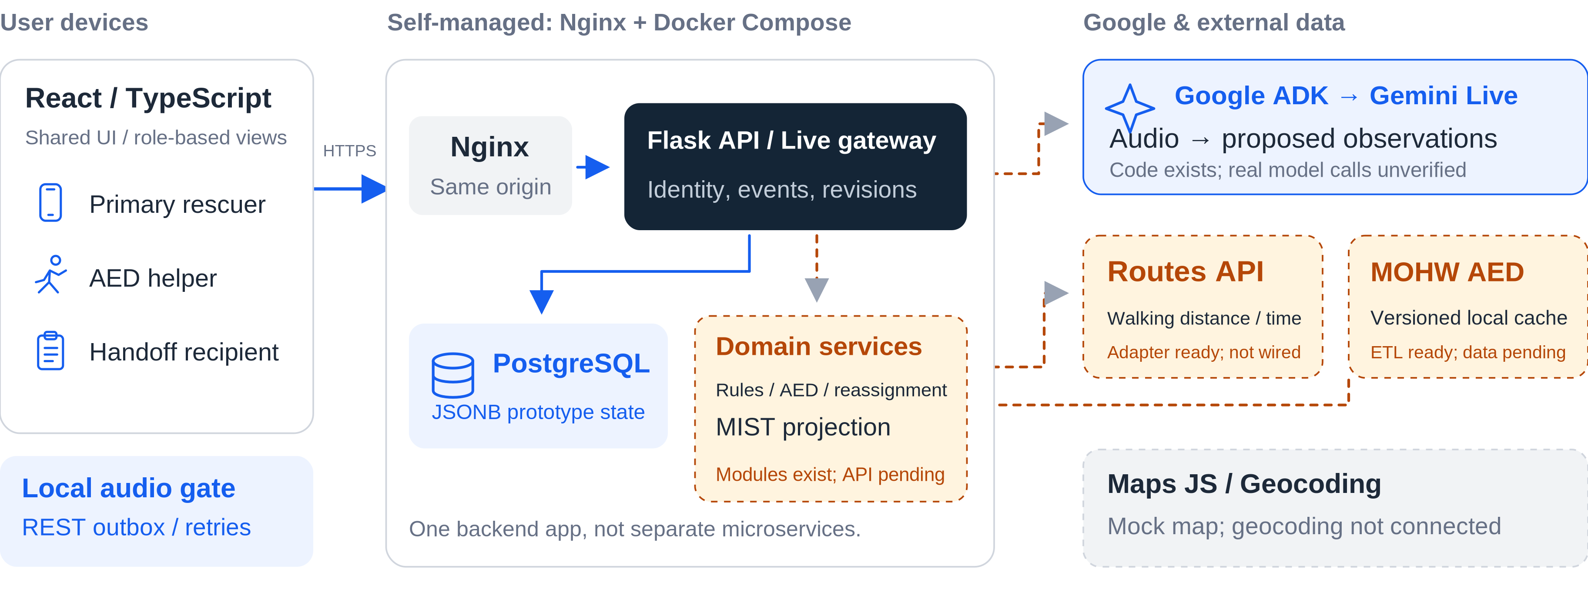
ARCHITECTURE / SYSTEM AND EXTERNAL SERVICES
06 / 12
System architecture: from input to shared state
Solid: existing interfaces. Dashed: modules or designs awaiting integration and verification.
Criteria: PoC technical completeness Challenge: third-party service integration
Sources: docs/sdd.md, Sections 2-3; agent/INTEGRATION.md; Live / AED / Routes code
FIRST AID COPILOT
Notes:
第 6 頁｜系統架構與服務串接 / Slide 6: System Architecture and External Services
建議單語講述時間：45 秒 / Suggested time in one language: 45 seconds.
中文與英文擇一朗讀；方括號提示及參考資料不朗讀。 / Read one language. Do not read cues or reference material aloud.
【中文逐字稿｜繁體中文】
三種角色共用 React 前端，請求經過同源 Nginx 進入 Flask，事件、觀察與權限資料存放在 PostgreSQL。音訊另走 Live gateway、ADK 和 Gemini。
右側是外部服務與資料。在整合目標裡，Routes 提供步行距離與時間，衛福部資料提供 AED 候選，Maps 和 Geocoding 則負責地圖與地址。虛線代表仍待串接的路徑。第三方連動的重點，是服務結果真的參與任務更新，不只是放上服務 Logo。
【English Verbatim Script】
The three roles share a React frontend. Requests pass through the same-origin Nginx entry to Flask, with events, observations, and access data stored in PostgreSQL. Audio takes a separate path through the Live gateway, ADK, and Gemini.
On the right, Routes would supply walking distance and time; health-ministry data would provide AED candidates. Maps and Geocoding are for map display and addresses. Dashed paths still need integration. The key is that external service results should drive task updates, rather than simply appearing as logos.
【操作提示｜Stage Cues — 不朗讀 / Do Not Read Aloud】
從左到右解釋資料流，再指向虛線的領域服務與 Routes 接點。／Explain the flow from left to right, then point to the dashed domain-service and Routes connections.
後端是一個應用，不是各領域獨立部署的微服務；資料庫是 PostgreSQL。／This is one backend application, not separately deployed domain microservices. The database is PostgreSQL.
實線表示文件與程式已有接點，不代表本次做過真實部署端到端驗證。／Solid lines indicate existing code or documented interfaces, not proof of a live end-to-end deployment test.
【實作與證據邊界｜Reference Only — 沿用原簡報】
實線代表文件與程式中已有接點，不表示本次已進行部署端到端測試。現行資料以 locked JSONB row 保存原型狀態；normalized repositories 等已有模組，仍待整合。Maps JS 示意、Geocoding 503、AED 空候選。
【評分／題目對應｜Reference Only】
Problem Definition & PoC：概念驗證技術完整性。題目：第三方服務連動；不能以架構圖取代外部 API 實際呼叫證據。
【來源｜Sources — 不朗讀 / Do Not Read Aloud】
S3: docs/sdd.md §2 System Architecture、§3 Technology and Frameworks。
S4: agent/INTEGRATION.md 部署、HTTP 路由、Workstream handoff。
S5: agent/app/agent/live_provider.py。
S6: agent/app/services/aed/routing.py，GoogleRoutesProvider。
S7: data/aed/README.md。

Slide 7
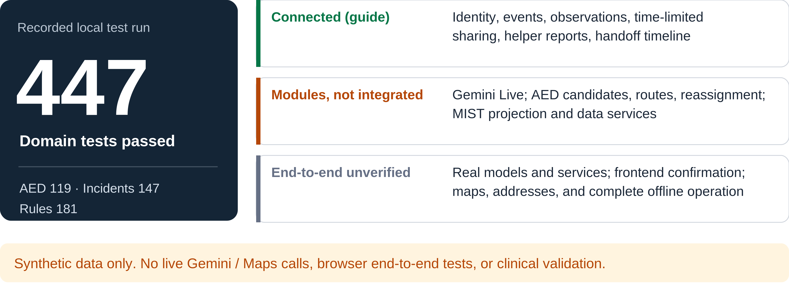
EVIDENCE / IMPLEMENTATION MATURITY
07 / 12
447 domain tests passed; end-to-end is separate
Separate connected routes, existing modules, and unverified steps. Architecture is not proof of completion.
Criteria: technical maturity | product completeness | PoC evidence
Sources: recorded pytest results (2026-09-19); agent/INTEGRATION.md
FIRST AID COPILOT
Notes:
第 7 頁｜實作與驗證證據 / Slide 7: Implementation and Verification Evidence
建議單語講述時間：45 秒 / Suggested time in one language: 45 seconds.
中文與英文擇一朗讀；方括號提示及參考資料不朗讀。 / Read one language. Do not read cues or reference material aloud.
【中文逐字稿｜繁體中文】
這份簡報附的測試紀錄顯示，四百四十七項領域測試全數通過，涵蓋 AED、事件與規則。這是限定範圍的結果，不是整個專案的全套測試。
整合狀態則另外看。接入文件記載身分、事件、分享、回報與時間軸已接通；Gemini Live、AED 搜尋與改派、MIST 雖然已有模組，部分仍待整合。測試使用合成資料與替身，不包含真實 Gemini 或 Maps 呼叫、完整瀏覽器流程，也不代表臨床效果已獲驗證。
【English Verbatim Script】
The supplied test log records four hundred and forty-seven passing domain tests across AED, incident, and rule logic. This is a scoped result, not the entire project test suite.
Separately, the integration guide documents connected identity, event, sharing, reporting, and timeline routes. Gemini Live, AED search and reassignment, and MIST have modules, but parts still need integration. These tests use synthetic data and test doubles. They do not verify real Gemini or Maps calls, a complete browser workflow, or clinical outcomes.
【操作提示｜Stage Cues — 不朗讀 / Do Not Read Aloud】
先指向 447 與測試範圍，再由上到下說明三個成熟度區段。／Point to 447 and its test scope first, then explain the three maturity categories from top to bottom.
447 沿用原簡報所附測試紀錄；本次只更新講稿，沒有重新執行測試。／The figure 447 comes from the original deck's test record. This notes-only update did not rerun the tests.
需要細分時使用第 12 頁：AED 119、事件 147、規則 181。／Use slide 12 for the breakdown: 119 AED tests, 147 incident tests, and 181 rule tests.
【實作與證據邊界｜Reference Only — 沿用原簡報】
本次命令在提供 ZIP 的解壓副本執行，原始碼未修改。119 項 AED、147 項 incident、181 項 rules，合計 447，pytest 回報 447 passed。排除 HTTP、Live、PostgreSQL、前端與實體瀏覽器測試。測試皆合成資料／替身，不呼叫外部模型與地圖服務。
【評分／題目對應｜Reference Only】
Implementation & Usability：技術實現成熟度與產品完整性。Problem Definition & PoC：提供可重現的部分技術證據。
【來源｜Sources — 不朗讀 / Do Not Read Aloud】
S9: evidence/domain-tests.log；evidence/domain-tests.xml。
重現：在 ZIP 專案根目錄執行 PYTHONPATH="$PWD/agent:$PWD" python -m pytest agent/tests/aed agent/tests/incident agent/tests/rules -q。
S4: agent/INTEGRATION.md「Implemented HTTP routes」「Workstream handoff」。

Slide 8
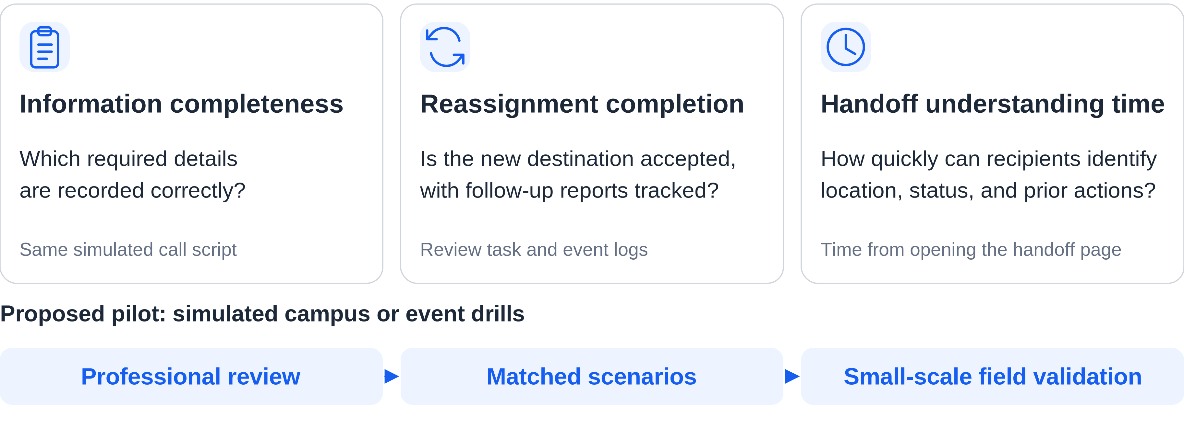
IMPACT / POTENTIAL VALUE AND NEXT STEPS
08 / 12
Measure coordination value in drills first
Proposed validation plan—not evidence of partnerships, user outcomes, or medical benefit.
Criterion: transformative potential for societal problems and efficiency
Sources: docs/sdd.md, Section 12; pilot sequence proposed in this deck
FIRST AID COPILOT
Notes:
第 8 頁｜影響力與驗證計畫 / Slide 8: Potential Impact and Validation Plan
建議單語講述時間：30 秒 / Suggested time in one language: 30 seconds.
中文與英文擇一朗讀；方括號提示及參考資料不朗讀。 / Read one language. Do not read cues or reference material aloud.
【中文逐字稿｜繁體中文】
我們提出三個量測方向：報案資訊的完整度、改派後任務有沒有持續到確認與回報，以及交接者理解關鍵資訊所需的時間。
驗證計畫從專業審閱開始，再做同情境模擬比較，最後進行校園或活動場域的小規模演練。這些是待執行的計畫；目前沒有量測成果、已確認的場域合作，或醫療效益的證據。
【English Verbatim Script】
We propose three measures: completeness of call information, follow-through after reassignment, and time to understand the handoff.
The plan starts with professional review, followed by matched simulated scenarios and small-scale campus or event drills. These are proposed tests. We do not yet have measured results, confirmed venue partnerships, or evidence of medical benefit.
【操作提示｜Stage Cues — 不朗讀 / Do Not Read Aloud】
先指三個量測方向，再沿下方箭頭說明驗證順序。／Point to the three measures, then follow the validation sequence below.
此處沒有現有成效數字；不要口頭補上改善百分比、事故統計或合作單位。／No outcome measurements are available here. Do not add improvement percentages, incident statistics, or partner names.
【實作與證據邊界｜Reference Only — 沿用原簡報】
SDD §12 明列驗收與演示情境是要求，不是已通過的測試或臨床驗證。本頁沒有加入未被附件支持的市場規模、救命數字、事故統計或效益百分比。
【評分／題目對應｜Reference Only】
Innovation & Impact：社會問題改善／效率提升的潛在變革力量。
【來源｜Sources — 不朗讀 / Do Not Read Aloud】
S1: Google 題目.pdf p.4 Innovation & Impact。
S3: docs/sdd.md §12 Verification and Acceptance，報案完整度、協作與交接情境。
校園／活動試點順序為本簡報提出的驗證建議，不是既有成果。

Slide 9
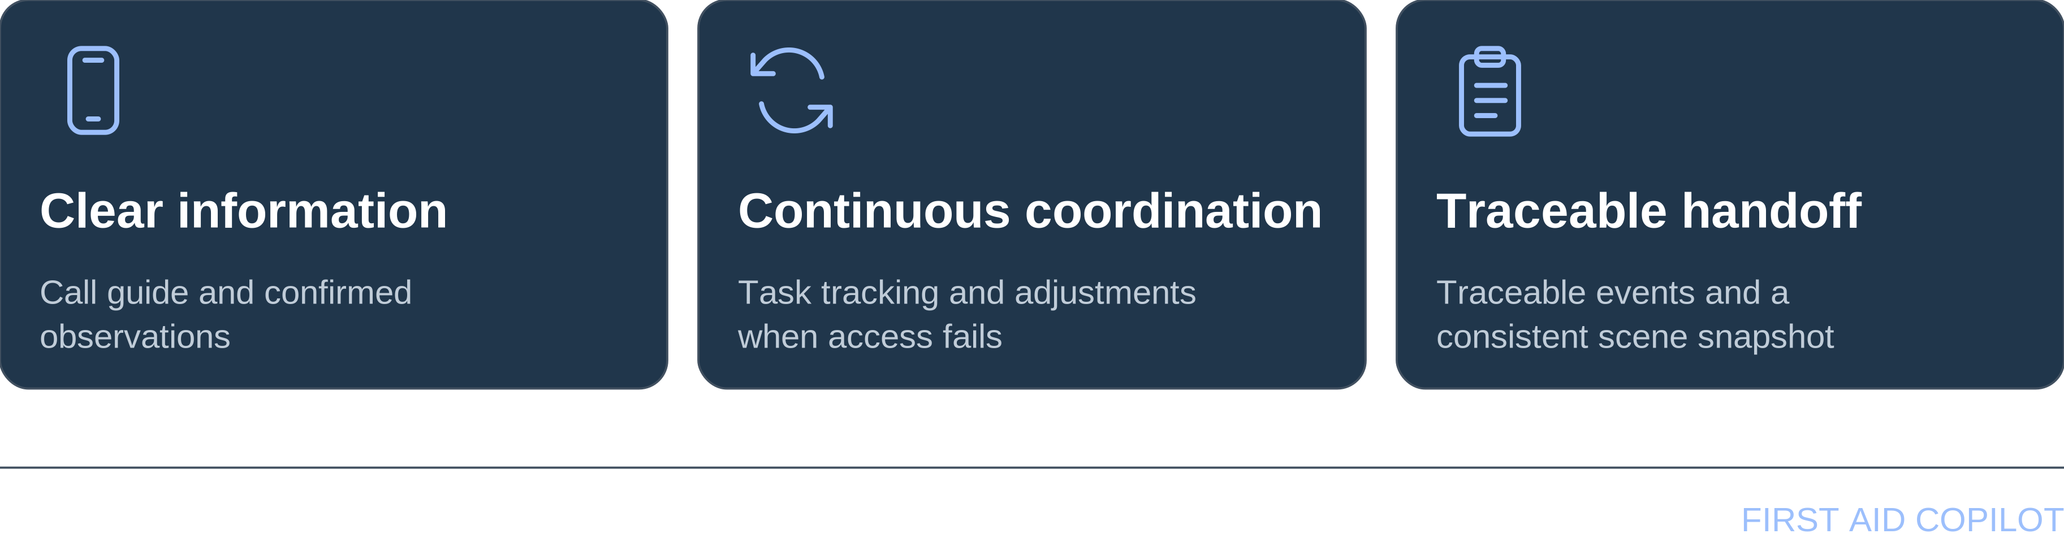
CLOSING / THE NEXT STEP IN ON-SCENE COORDINATION
09 / 12
Everyone helping
knows the next step.
Core value: traceable information and task coordination that support on-scene responders.
Sources: README, product positioning; summary of the project's design goals
FIRST AID COPILOT
Notes:
第 9 頁｜收束 / Slide 9: Closing
建議單語講述時間：20 秒 / Suggested time in one language: 20 seconds.
中文與英文擇一朗讀；方括號提示及參考資料不朗讀。 / Read one language. Do not read cues or reference material aloud.
【中文逐字稿｜繁體中文】
我們的目標很簡單：報案資訊說得清楚，狀況改變時任務接得下去，紀錄也能延續到交接。急救副駕是支持現場的人，不是取代派遣員。派遣員指揮，Agent 輔助。謝謝。
【English Verbatim Script】
Our goal is simple: clearer emergency-call information, coordinated tasks that can continue when conditions change, and records that carry through to handoff. First Aid Copilot supports the people at the scene. The dispatcher leads; the Agent assists. Thank you.
【操作提示｜Stage Cues — 不朗讀 / Do Not Read Aloud】
最後一句稍作停頓，停留在本頁等候提問。／Pause before the final line, and leave this slide on screen for questions.
第 10–12 頁只在問答需要時使用，不接著朗讀。／Use slides 10–12 only when a question calls for them.
【實作與證據邊界｜Reference Only — 沿用原簡報】
此頁收束設計目標，不增加新的已完成功能或成效主張。
【評分／題目對應｜Reference Only】
收束新穎性、獨特性與潛在影響；不是第一次提出關鍵主張。
【來源｜Sources — 不朗讀 / Do Not Read Aloud】
S2: README.md 產品定位與核心功能。

Slide 10
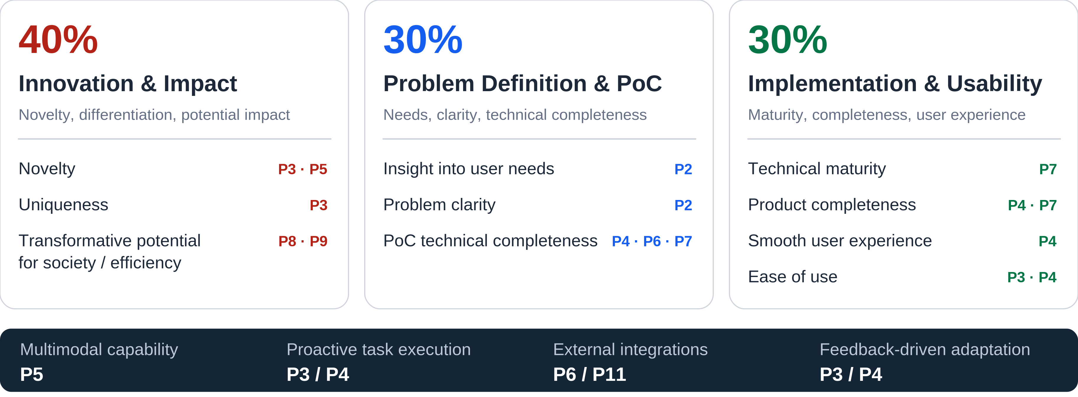
APPENDIX / JUDGING CRITERIA
10 / 12
Every judging criterion has a slide
Original category weights are preserved. Subcriteria are mapped to slides, not assigned new scores.
Backup | Mapping a capability to a slide does not mean the capability is complete.
Sources: Google challenge brief, pp. 1 and 4; slide numbers refer to this 12-slide deck
FIRST AID COPILOT
Notes:
第 10 頁｜評分與題目要求對照 / Slide 10: Mapping to the Judging Criteria
備用頁｜依提問選讀，不計入 6 分鐘主簡報。 / Backup slide; use for questions, outside the six-minute pitch.
中文與英文擇一朗讀；方括號提示及參考資料不朗讀。 / Read one language. Do not read cues or reference material aloud.
【中文逐字稿｜繁體中文】
評分分成三大類。創新與影響力占百分之四十：新穎性在第三頁與第五頁，獨特性在第三頁，潛在影響則在第八頁與第九頁。
問題定義與 PoC 占百分之三十。使用者需求與問題清晰度都在第二頁；技術完整性由第四頁的情境、第六頁的架構，以及第七頁的證據一起說明。
實作與易用性占另外百分之三十。技術成熟度在第七頁，產品完整性在第四頁與第七頁，體驗流暢度在第四頁，易用性則在第三頁與第四頁。
題目要求的能力另外對照：Gemini 與多模態能力在第五頁；主動執行與回饋後調整在第三頁與第四頁；外部服務在第六頁與第十一頁。簡報有說明這項能力，不代表能力已經完成，仍要看對應的實作狀態。
【English Verbatim Script】
The judging criteria have three categories. Innovation and Impact is forty percent: novelty is covered on slides three and five, uniqueness on slide three, and potential impact on slides eight and nine.
Problem Definition and PoC is thirty percent. User needs and problem clarity are on slide two. Technical completeness is addressed through the scenario on slide four, architecture on slide six, and evidence on slide seven.
Implementation and Usability is the remaining thirty percent. Maturity is on slide seven; product completeness on slides four and seven; flow on slide four; and ease of use on slides three and four.
The challenge's capability requirements are mapped separately: Gemini and multimodal capability on slide five, proactive task execution and feedback-driven adjustment on slides three and four, and external services on slides six and eleven. Coverage in the deck is not proof that a capability is finished; the implementation status still matters.
【操作提示｜Stage Cues — 不朗讀 / Do Not Read Aloud】
這是備用頁，依評審問題選讀對應段落，不必逐條念完。／This is a backup slide. Read the relevant paragraph rather than every item.
問架構切第 6 頁；問 Gemini 切第 5 頁；問自主性切第 3／4 頁；問外部服務切第 6／11 頁；問完成範圍切第 7／12 頁。／For architecture, go to slide 6; Gemini, slide 5; autonomy, slides 3–4; external services, slides 6 or 11; implementation status, slides 7 or 12.
【實作與證據邊界｜Reference Only — 沿用原簡報】
本頁不是自行新增評分或分配細項權重；能力是否完成仍依 P7/P11 實作狀態判斷。
【評分／題目對應｜Reference Only】
Innovation & Impact：新穎性 P3/P5，獨特性 P3，潛在變革力量 P8/P9。
Problem Definition & PoC：需求洞察 P2、問題定義 P2、技術完整性 P4/P6/P7。
Implementation & Usability：成熟度 P7、完整性 P4/P7、流暢度 P4、易用性 P3/P4。
【來源｜Sources — 不朗讀 / Do Not Read Aloud】
S1: Google 題目.pdf p.1、p.4。

Slide 11
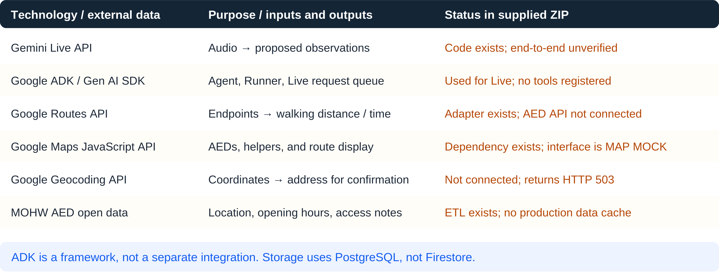
APPENDIX / GOOGLE TECHNOLOGIES AND EXTERNAL DATA
11 / 12
Which technologies, and how far are they integrated?
Distinguish models, frameworks, external APIs, and data sources. Service count is not integration evidence.
Backup | External service outputs must actually inform task or information updates.
Sources: Live provider; routing.py; MapPlaceholder.tsx; data/aed/README.md; INTEGRATION
FIRST AID COPILOT
Notes:
第 11 頁｜Google 與外部資料清單 / Slide 11: Google Technologies and External Data
備用頁｜依提問選讀，不計入 6 分鐘主簡報。 / Backup slide; use for questions, outside the six-minute pitch.
中文與英文擇一朗讀；方括號提示及參考資料不朗讀。 / Read one language. Do not read cues or reference material aloud.
【中文逐字稿｜繁體中文】
這一頁把模型、開發框架、外部 API 和資料來源分開。
Gemini Live 的用途，是把語音轉成待確認的觀察。接入程式已存在，但端到端呼叫仍待驗證。ADK 和 Gen AI SDK 支援 Agent 與 Live session，不另外算一項外部資料串接；目前也沒有註冊工具。
Routes 的轉接器已寫好，目標是回傳步行距離與時間，但還沒接到現行 AED API。Maps JavaScript 已有依賴，畫面仍然是示意。Geocoding 尚未接通，位置描述端點目前回傳 HTTP 503。
AED 的外部資料來源是衛福部。資料匯入程式已存在，但這份 ZIP 沒有附下載後的正式資料快取。
最後，資料庫是 PostgreSQL，不是 Firestore。我們要分清楚「有依賴或轉接器」和「完整服務流程已驗證」，真實模型與外部服務的回應，仍是需要補上的證據。
【English Verbatim Script】
Here we separate models, frameworks, external APIs, and data sources.
Gemini Live is intended to turn audio into proposed observations. Its connection code exists, but end-to-end calls need validation. ADK and the Gen AI SDK support the Agent and Live session; they are not separate external-data integrations, and tools are not registered.
The Routes adapter has been written, but the current AED API does not use it yet. It is intended to return walking distance and time. The Maps JavaScript dependency exists, but the interface is still a mock. Geocoding is not connected, and the location-description endpoint returns HTTP five-oh-three.
For AED data, the Ministry of Health and Welfare is the external source. The ingestion code exists, but the ZIP contains no downloaded production cache.
Finally, the database is PostgreSQL, not Firestore. We should distinguish a dependency or adapter from a verified service workflow. Real model and service responses are the missing evidence.
【操作提示｜Stage Cues — 不朗讀 / Do Not Read Aloud】
依提問選讀對應服務；每列都說明用途與狀態，避免只念技術名稱。／Select the relevant service and explain both its purpose and its status, not just its name.
不新增未被來源確認的 Gemini 型號、Google AI Studio、Vertex AI、Cloud Run 或 Firebase 採用主張。／Do not add unverified model versions or adoption claims for Google AI Studio, Vertex AI, Cloud Run, or Firebase.
【實作與證據邊界｜Reference Only — 沿用原簡報】
Routes transport 可注入；本次領域測試使用替身。Maps 前端仍為 MAP MOCK；Geocoding 回 503；正式 AED 下載快取未附於 ZIP。ADK 沒有額外帶來一項外部資料服務。
【評分／題目對應｜Reference Only】
題目：與第三方服務連動。PoC 與實作成熟度：服務接口、完成狀態和證據分開。
【來源｜Sources — 不朗讀 / Do Not Read Aloud】
S5: agent/app/agent/live_provider.py；agent/pyproject.toml optional dependencies。
S6: agent/app/services/aed/routing.py GoogleRoutesProvider。
S7: data/aed/README.md。
S8: web/package.json；web/src/components/maps/MapPlaceholder.tsx。
S4: agent/INTEGRATION.md。

Slide 12
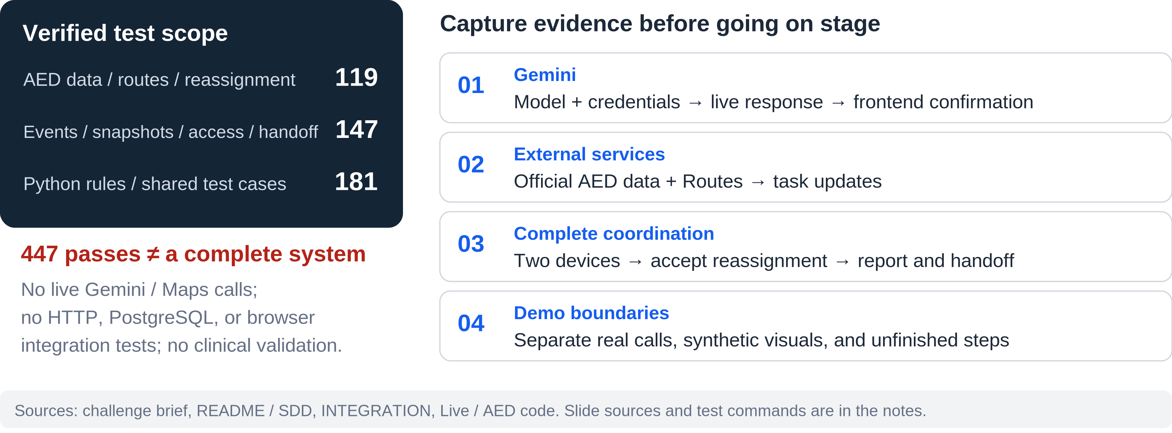
APPENDIX / VALIDATION AND DEMO READINESS
12 / 12
Connect reproducible evidence to a demonstrable workflow
Based on the supplied ZIP. Code existence alone does not establish deployment, integration, or measured results.
Backup | Six-minute main pitch, including a 90-second storyboard. Official time limit not yet provided.
Sources: recorded pytest results; docs/sdd.md, Section 12; see speaker notes for commands and per-slide sources
FIRST AID COPILOT
Notes:
第 12 頁｜驗證邊界與上台前檢查 / Slide 12: Validation Boundaries and Demo Readiness
備用頁｜依提問選讀，不計入 6 分鐘主簡報。 / Backup slide; use for questions, outside the six-minute pitch.
中文與英文擇一朗讀；方括號提示及參考資料不朗讀。 / Read one language. Do not read cues or reference material aloud.
【中文逐字稿｜繁體中文】
可以重現的證據，是這組領域測試：AED 一百一十九項、事件一百四十七項、規則一百八十一項，合計四百四十七項。
在展示真實完整流程之前，我們還需要留下 Gemini 真實回應與前端確認、正式 AED 資料與路線結果，以及兩個裝置之間接受任務、改派、回報和交接的證據。通話模式切換與斷線恢復，也需要驗證。
完成這些項目後，再把情境示意換成實際操作或錄影。在那之前，我們會把真實服務呼叫、合成畫面與尚未完成的功能分開。領域測試通過，不等於端到端流程或臨床有效性已經驗證。
【English Verbatim Script】
The reproducible evidence is the domain-test result: one hundred and nineteen AED tests, one hundred and forty-seven incident tests, and one hundred and eighty-one rule tests, for a total of four hundred and forty-seven.
Before presenting a live workflow, we need evidence for real Gemini responses and frontend confirmation, official AED data and route results, and a two-device sequence covering task acceptance, reassignment, reporting, and handoff. We also need to test call-mode switching and reconnection.
Once those steps are verified, the storyboard can be replaced with a live demonstration or recording. Until then, we keep real service calls, synthetic visuals, and unfinished features clearly separated. The domain tests alone do not establish end-to-end operation or clinical validity.
【操作提示｜Stage Cues — 不朗讀 / Do Not Read Aloud】
這是備用檢查表，不是新增的已完成成果。／This is a readiness checklist, not a list of additional completed results.
需要重現測試時，使用下方來源區的原始測試指令；不要說本次加逐字稿又重新測試了一次。／Use the original command in the source section to reproduce the tests. Do not imply this notes update reran them.
單語主簡報配置為 15、35、35、90、45、45、45、30、20 秒，共 360 秒；實際時長仍以彩排為準。／The single-language main-deck allocation is 15, 35, 35, 90, 45, 45, 45, 30, and 20 seconds: 360 seconds in total. Actual duration depends on rehearsal.
【實作與證據邊界｜Reference Only — 沿用原簡報】
本次執行範圍僅 agent/tests/aed、agent/tests/incident、agent/tests/rules。未安裝或執行全部後端／資料庫／前端測試；未連外驗證任何服務；未進行臨床驗證。原始碼沒有被本次簡報製作流程修改。
【評分／題目對應｜Reference Only】
支援技術成熟度、PoC 與產品完整性；為展示前驗證清單，不是已完成結果。
【來源｜Sources — 不朗讀 / Do Not Read Aloud】
S9: evidence/domain-tests.log 與 domain-tests.xml。
S3: docs/sdd.md §12 Verification and Acceptance。
完整來源目錄另見 Speaker_Notes_and_Sources.md。

