Slide 1
τ₁
τ₂
e₁
e₂
e₃
e₄

Slide 2
Δ
ε
δ
τ₁
τ₂
ε
δ
τ₁
acquire
p
0
1
1
1
0
-1
-1
-1
-1
g
0
0
1
0
0
0
1
0
0
+1
0
-1

Slide 3
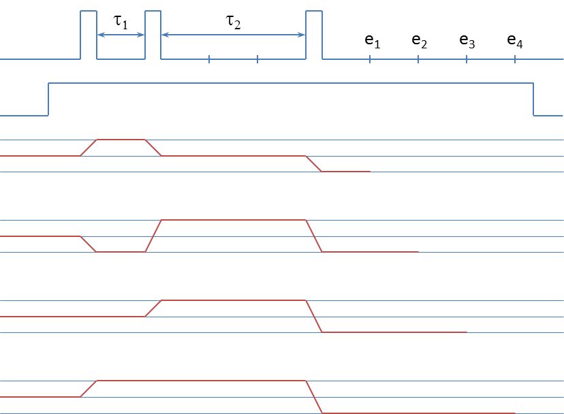

Slide 4
constant gradient
τ₁
τ₂
τ₃
p₀
p₁
p₂
p₃
p₄
echo
p₀
p₁
p₂
p₃
p₄
1
2
3
4
5
6
7
8
9
10
11
12
13
0
0
0
0
0
0
0
0
0
0
0
0
0
1
-1
0
1
-1
0
1
-1
0
1
-1
0
1
0
1
1
1
-1
-1
-1
0
0
0
1
1
1
0
0
0
0
1
1
1
1
1
1
1
1
1
-1
-1
-1
-1
-1
-1
-1
-1
-1
-1
-1
-1
-1

