Slide 1

ReactIt
Eric Vara, Gino Townsend, Hunter Risse, Madison Schweikert

Slide 2
Tech Stack
Front-End
Back-End
React
React Bootstrap
Axios
Express
JWT
RDS with PostgreSQL

Slide 3
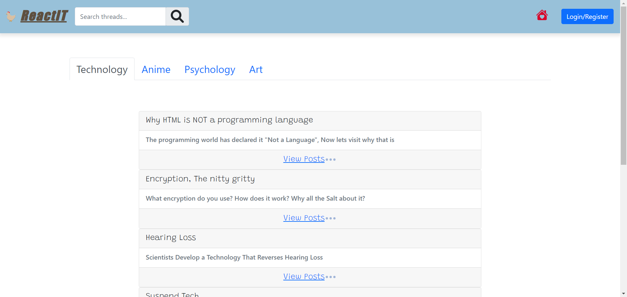
Frontpage

Slide 4

Demo
ReactIt Demo

Slide 5


Thank You

