Slide 1

ReactIt
Eric Vara, Gino Townsend, Hunter Risse, Madison Schweikert

Slide 2
Tech Stack
Front-End
Back-End
React
React Bootstrap
Axios
Express
JWT
RDS with PostgreSQL

Slide 3
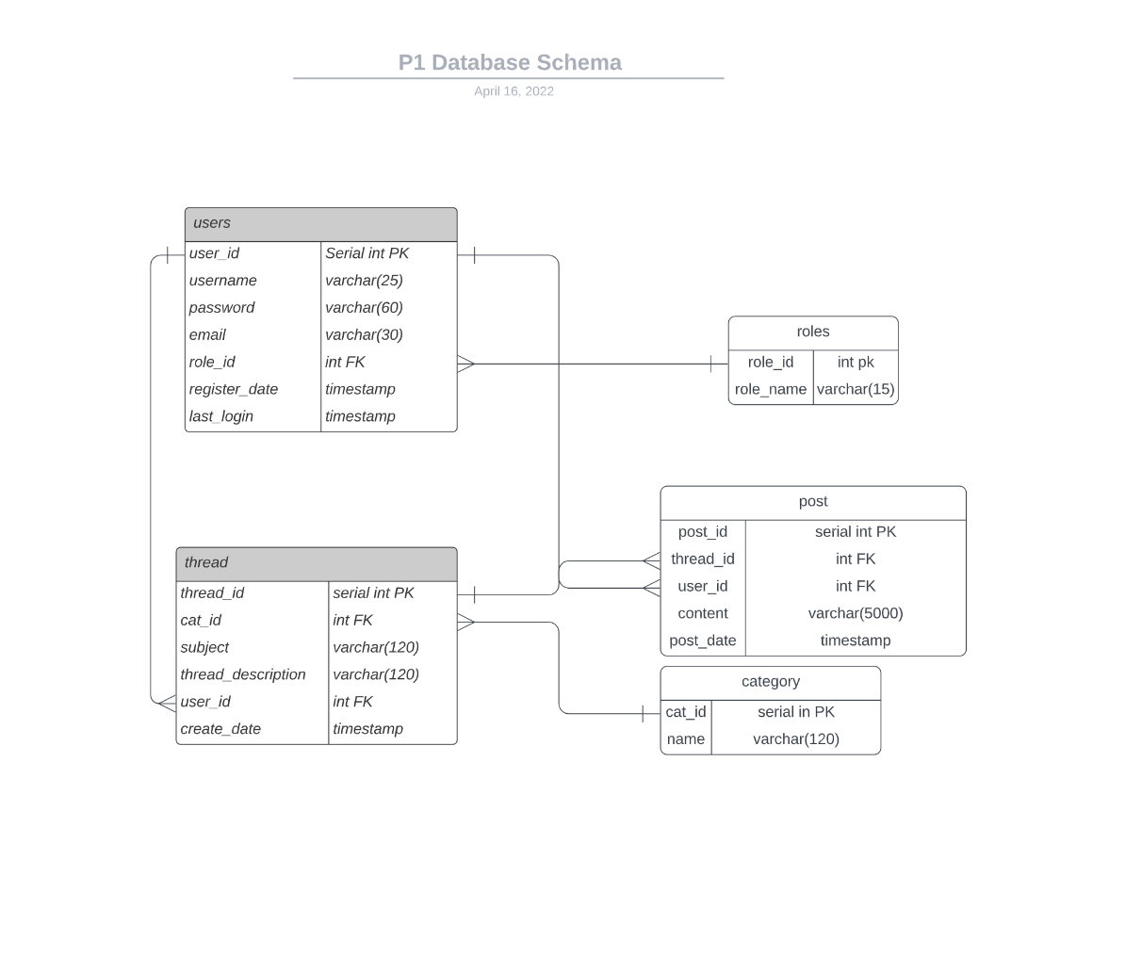
Entity-Relationship Diagram

Slide 4
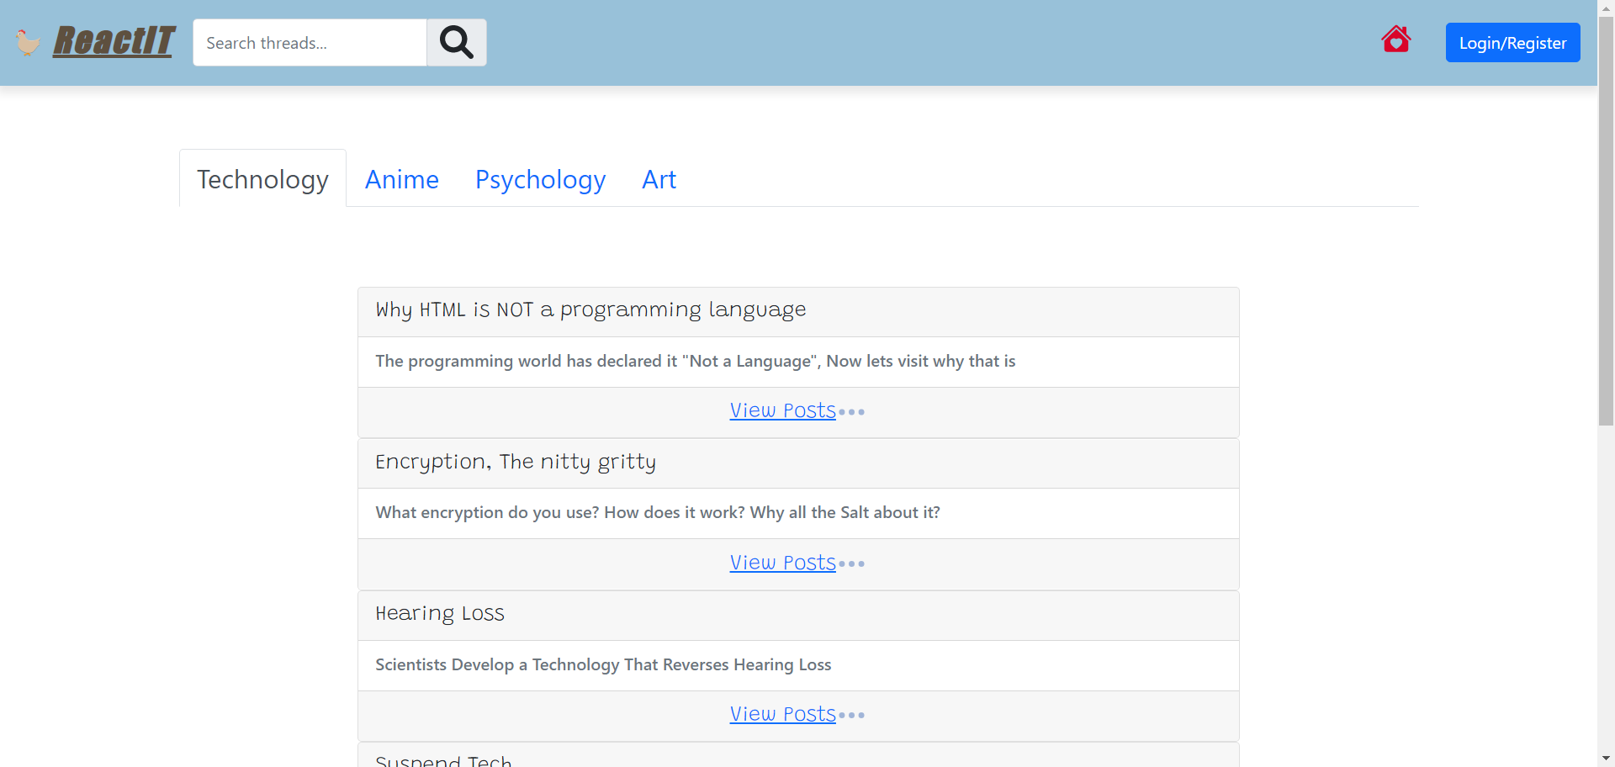
Frontpage

Slide 5

Demo
ReactIt Demo

Slide 6


Thank You

