Slide 1
Hidden Markov Models in DNA Sequencing
Michael Marino & Eric Marti

Slide 2
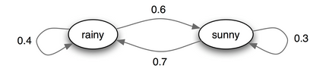
Markov Process
Stochastic process satisfying the Markov Property
Probability distribution of future states dependent on present and past states depends only on present state
Image source: http://www.math.cornell.edu/~numb3rs/blanco/Undercurrents.html

Slide 3
Hidden Markov Model
Assume behavior of unobservable hidden states to be a Markov process
Requires knowledge regarding emission and transmission probabilities
Emission probabilities – probability of observation given the system is in a particular state
Transmission probabilities – probability distribution of next state given current state

Slide 4
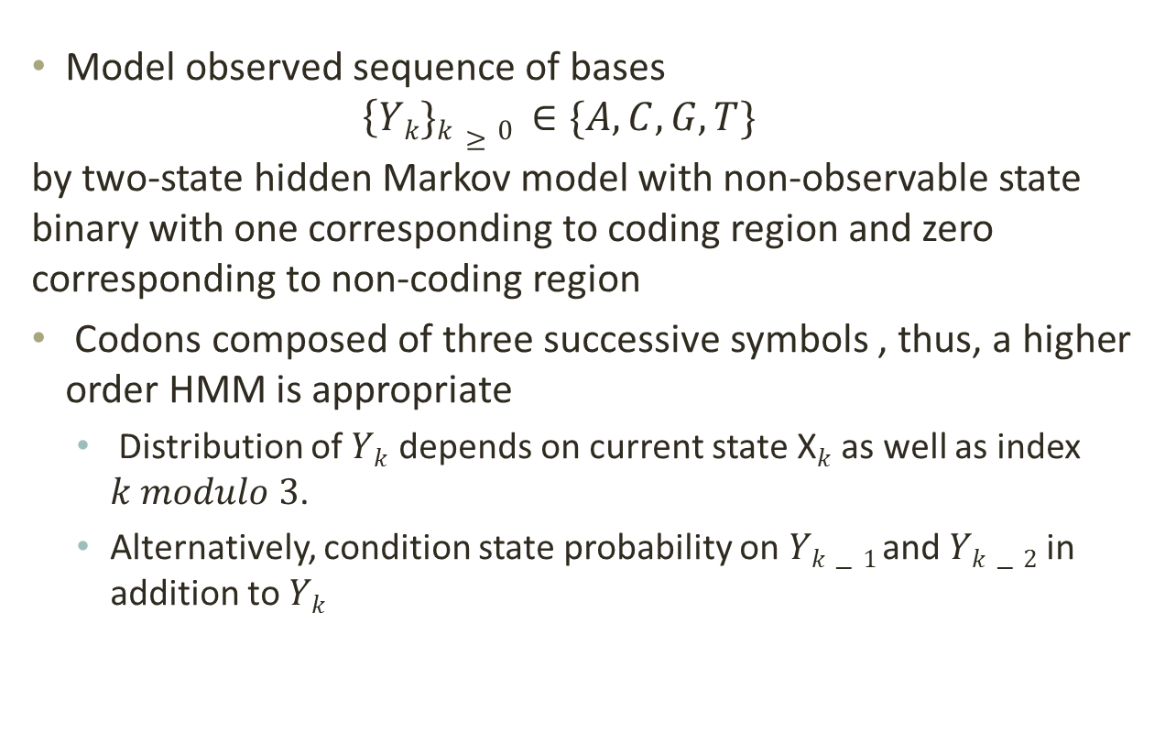
Example
Model observed sequence of bases
$$\left\{Yk\}k≥0 ∈\{A,C,G,T\} \right.$$
by two-state hidden Markov model with non-observable state binary with one corresponding to coding region and zero corresponding to non-coding region
Codons composed of three successive symbols , thus, a higher order HMM is appropriate
Distribution of $Yk$ depends on current state X$k$ as well as index $k modulo 3$.
Alternatively, condition state probability on $Yk−1$and $Yk−2$ in addition to $Yk$

Slide 5
FragGeneScan
Developed in 2010 by researches at Indiana University School of Informatics and Computing in collaboration with the Center for Genomics and Bioinformatics
Probablistic model combines sequencing error models and codon usages to improve accuracy in predicting protein-coding regions
Unique features
Finding genes fragmented by boundary of given input sequences
Correcting frameshifts caused by indel errors in reads

Slide 6
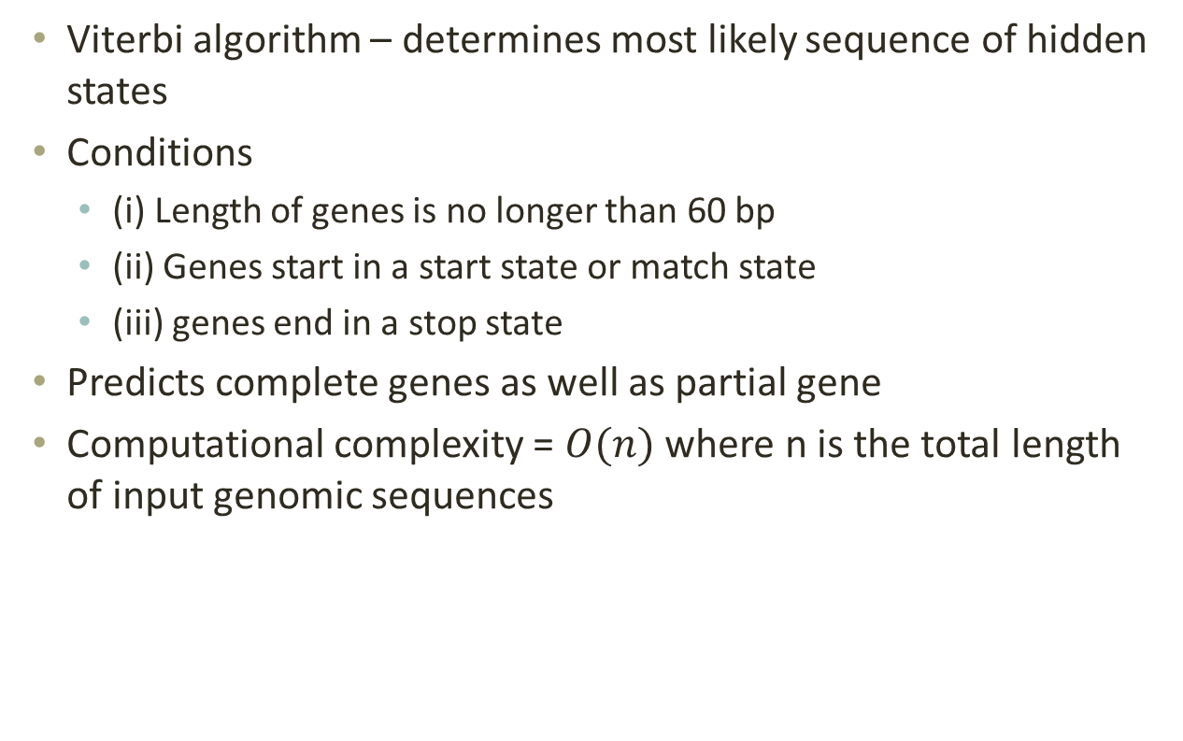
FragGeneScan Algorithm
Viterbi algorithm – determines most likely sequence of hidden states
Conditions
(i) Length of genes is no longer than 60 bp
(ii) Genes start in a start state or match state
(iii) genes end in a stop state
Predicts complete genes as well as partial gene
Computational complexity = $O(n)$ where n is the total length of input genomic sequences

Slide 7
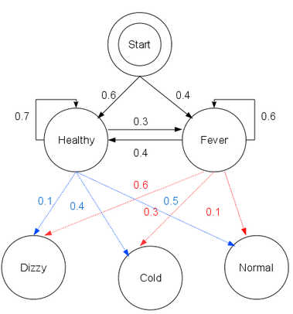
Viterbi Algorithm
Image source - http://en.wikipedia.org/wiki/Viterbi_algorithm

Slide 8
Viterbi Algorithm
Observation matrix – {normal, cold, dizzy}
Most likely generated by states - {Healthy, Healthy, Fever}
Image source - http://en.wikipedia.org/wiki/Viterbi_algorithm

Slide 9
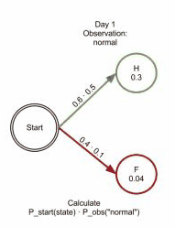
Viterbi Algorithm
Image source - http://en.wikipedia.org/wiki/Viterbi_algorithm

Slide 10
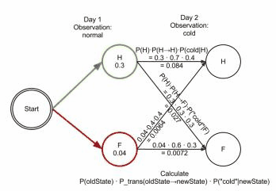
Viterbi Algorithm
Image source - http://en.wikipedia.org/wiki/Viterbi_algorithm

Slide 11
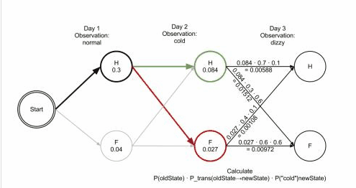
Viterbi Algorithm
Image source - http://en.wikipedia.org/wiki/Viterbi_algorithm

Slide 12
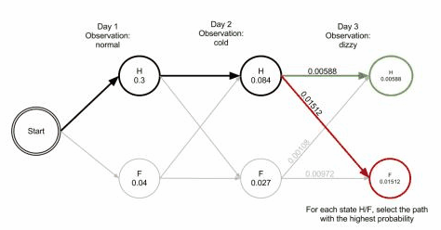
Viterbi Algorithm
Image source - http://en.wikipedia.org/wiki/Viterbi_algorithm

Slide 13
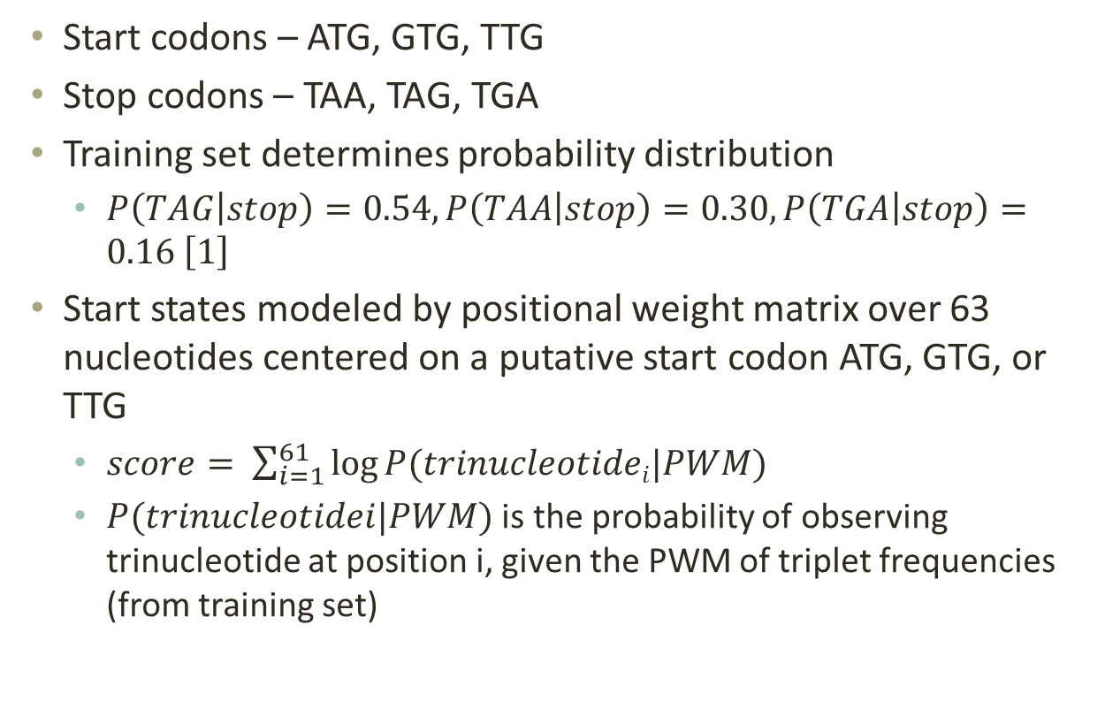
FragGeneScan Algorithm
Start codons – ATG, GTG, TTG
Stop codons – TAA, TAG, TGA
Training set determines probability distribution
$P\left(TAG | stop\right)=0.54, P\left(TAA | stop\right)=0.30, P\left(TGA | stop\right)=0.16 \left[1\right]$
Start states modeled by positional weight matrix over 63 nucleotides centered on a putative start codon ATG, GTG, or TTG
$score= \sum_{i=1}^{61}{\log{P(trinucleotidei|PWM)}}$
$P(trinucleotidei|PWM)$ is the probability of observing trinucleotide at position i, given the PWM of triplet frequencies (from training set)

Slide 14
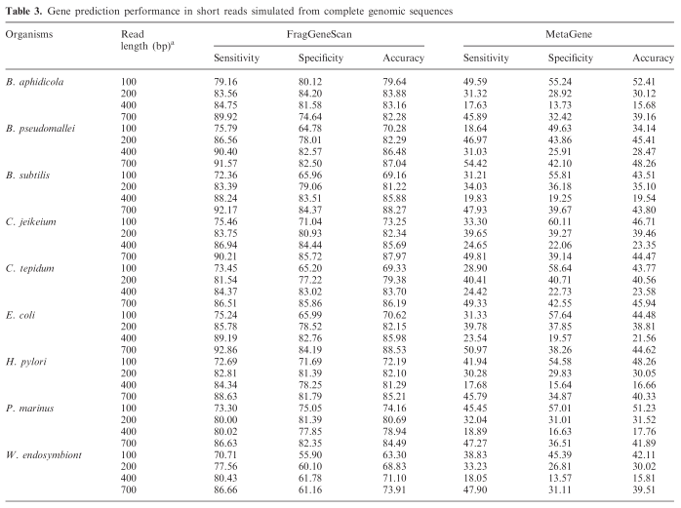
Sensitivity – ratio of true positives to all annotated genes
Specificity – ratio of true positives to all predicted genes
Image from [1]

Slide 15
FragGeneScan
Accuracy of FragGeneScan for 100 bp only 5% lower than for longer reads
MetaGene shows 22% decrease in accuracy for shorter reads
FragGeneScan shows consistently better performance by up to 65%
Increased accuracy comes at expense of increased computation time

Slide 16
HMMER
Project of Howard Hughes Medical Institute
Identify homologous protein and nucleotide sequences
Core utility for protein family databases such as Pfam and InterPro
HMMER3 is complete rewrite of HMMER2 optimized for speed

Slide 17
HMMER3
Implements a heuristic acceleration algorithm in order to optimize for speed (not for all Pfam models)
Limits search model with heuristic filter
Use of vector instructions
Protein queries – approximately as fast as BLAST
DNA queries – less than 10x slower than BLAST
Utilizes Smith-Waterman algorithm (similar to Viterbi)

Slide 18
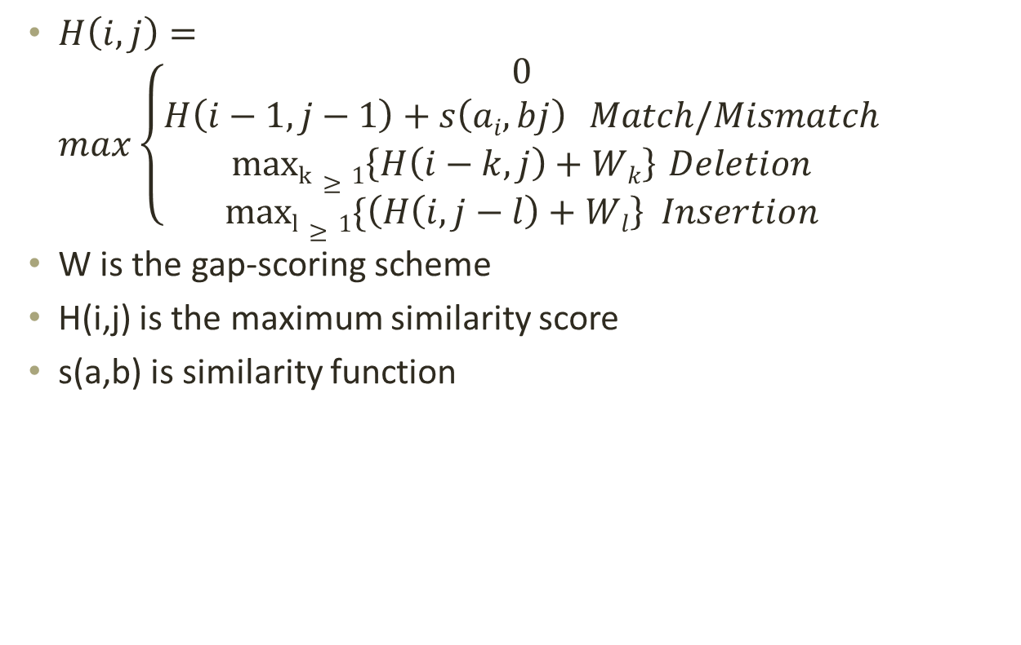
Smith-Watermann Algorithm
$H\left(i,j\right)=max\left\{\begin{aligned}0 \\ H\left(i−1,j−1\right)+s\left(ai,bj\right) Match/Mismatch \\ maxk≥1\left\{H\left(i−k,j\right)+Wk\right\} Deletion \\ maxl≥1⁡\{\left(H\left(i,j−l\right)+Wl\right\} Insertion\end{aligned}\right.$
W is the gap-scoring scheme
H(i,j) is the maximum similarity score
s(a,b) is similarity function

Slide 19
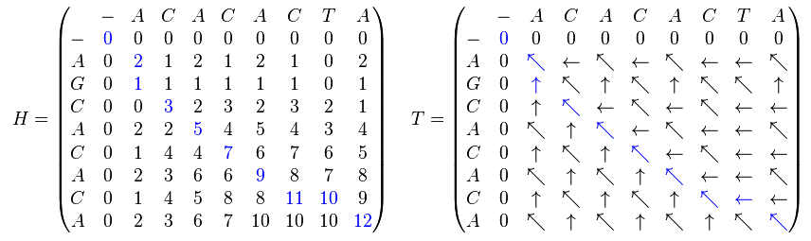

Smith-Watermann Algorithm
Sequence 1 = ACACACTA; sequence 2 = AGCACACA
s(a,b) = +2 for $a=b$ and -1 for$a≠b$
Result – sequence 1 = A-CACACTA; sequence 2 = AGCACAC-A
Image source -http://en.wikipedia.org/wiki/Smith%E2%80%93Waterman_algorithm

Slide 20
HMMer Algorithm[2]
Match and insert states emission probabilities learned during model estimation
Insertions and deletions modeled by transition probabilities to them
New algorithm limits transition possibilities to optimize for speed (from nine to seven)
Uses Dirichlet mixture model
L-parameter family of probability densities over (L-1)-dimensional space
Mathematically convenient for multinomial space to assume prior is a Dirichlet distribution
Components weighted probabilistically for each column given the amino acid frequency and combined with observed frequencies

Slide 21
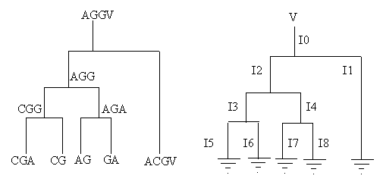
HMMER Algorithm [2]
Small group of sequences in training sequence that are highly similar may lead to overspecialization
Sequence weighting techniques designed to overcome this
Sequence weighting gives outlier sequence additional importance in calculating model parameters
Image source -http://compbio.soe.ucsc.edu/ismb99.handouts/KK185FP.html#seq_weight

Slide 22
Sequence Weighting
Weight assigned to a sequence determines its influence on final HMM
Relative weights determined and then scaled to sum to the total weight
HMMer groups sequences by single-linkage clustering and counts number of clusters above a specified level of identity
Sequence can be scored locally to entire profile (global/local) or part (local/local)
local/local can result in multiple hits per sequence

Slide 23
Programs in HMMER
Hmmalign – align sequences to existing model
Hmmbuild – build a model from a multiple sequence alignment
Hmmconvert – convert a model file into different formats
Hmmemit – emit sequences probabilistically from a profile hmm
Hmmfetch – get a single model from an HMM database
Hmmpress – format an HMM database into a binary format for hmmscan
Hmmscan – search a sequence against a profile HMM database

Slide 24
Programs in HMMer
Hmmsim – collect score distributions on random sequences
Hmmstat – show summary statistics for each profile in a HMM database
Phmmer – search a sequence against a sequence database (similar to BLAST)
Hmmsearch – search a sequence database for matches to an HMM
Jackhmmer – iteratively search a sequence against a database

Slide 25
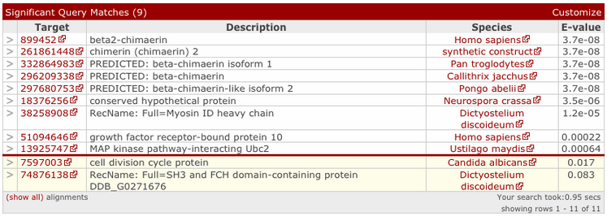
Output

Slide 26
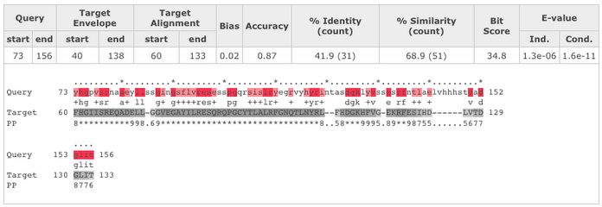
Output
Query start/end – start/end of the maximum expected accuracy (MEA) alignment with respect to the profile HMM
Target Envelope – defines a subsequence for which there is substantial probability supporting a homologous domain/hit
Target Alignment – start/end of MEA alignment of this domain with respect to the target sequence
Bias – bias composition correction is bit score difference contributed by null2 model; high bias scores represent potential false positives
Accuracy – measure of the reliability of the overall alignment
% Identity – precentage of identical residues between query and target
% similarity – similar to identity but using sum of identical and similar residues

Slide 27
References
[1] Rho, Mina, Haixu Tang, and Yuzhen Ye. "FragGeneScan: predicting genes in short and error-prone reads." Nucleic acids research 38.20 (2010): e191-e191.
[2] Wistrand, Markus, and Erik LL Sonnhammer. "Improved profile HMM performance by assessment of critical algorithmic features in SAM and HMMER." BMC bioinformatics 6.1 (2005): 99.
[3] Sinha, Swati, and Andrew Michael Lynn. "HMM-ModE: implementation, benchmarking and validation with HMMER3." BMC research notes 7.1 (2014): 483.
[4] http://hmmer.janelia.org/help

Slide 28
For further information see
https://github.com/ericJmarti/ECES490-Tutorial-9/blob/master/README.md

