Slide 1

Object-Oriented Programming Discussion, Lecture, & Lab Eric Pogue
Monday, December 2nd from 2 to 2:50pm CST:
Friendly Conversation Topic – Electric Cars, Tesla, and Autonomous Driving
Assignment
Retrospective
Sprint Planning
Lab
Discussion & Questions welcome at any time… please be present with no phones or email during our time together

Slide 2
Friendly Conversation Topic – Electric Cars, Tesla, and Autonomous Driving

Slide 3
Assignment
All assignments due Sunday, December 1st by 11:59pm CT… grace period until noon Monday

Slide 4
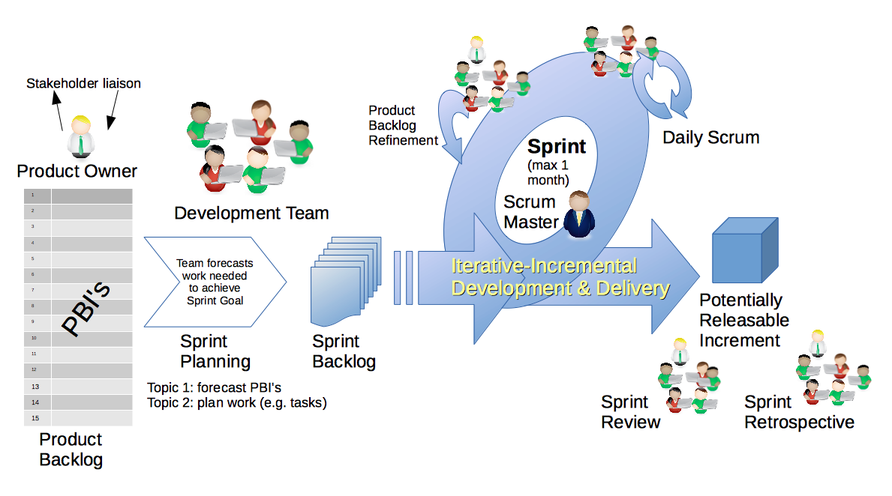
Scrum Process & Roles – Sprint Retrospective
By Dr ian mitchell - Own work, CC BY-SA 4.0, Link
Notes:
Announcement
Activities List
Lab
Discussion Board

Slide 5
Your Feedback from Sprint 7?

Slide 6
Remaining Schedule

Slide 7
Final Projects Presentation Schedule

Slide 8
Scrum Process & Roles – Sprint Planning
By Dr ian mitchell - Own work, CC BY-SA 4.0, Link

Slide 9
Assignment
Final Project, Final Project, and more Final Project
Oh yes, and complete Quiz 8
Everything is due by noon on Thursday, December 12th

Slide 10
Lab
As A Scrum Team:
Final Project II
Report out at 2:48
Team Report Out Guidelines
Scrum Master will stand up, give your name, your team name, and briefly answer the following questions:
What did you accomplish since the last meeting? And what will you be working on until the next meeting?
Is the team committed to completing assignments? All/Most/Some
What is getting in your way or keeping you from completing the assignments?

Slide 11
End of Session

