Slide 1

Object-Oriented Programming Lecture, Discussion, & Lab Eric Pogue
Agenda for Tuesday, February 24th
Prework & Announcements
Friendly Conversation Topic
Thursday Demos
Sprint 3 Retrospective
Sprint 4 Planning
Assignment for Next Class
Lab
Discussion & Questions welcome at any time… please be present with no phones or email during our time together

Slide 2
Prework
ALL Sprint 2 Assignments & Activity List Items are due Sunday.
FaceDraw v2 complete by the start of class on Thursday, February 20th
Notes:
Grace period until Monday morning a 6am CT

Slide 3
Friendly Conversation Topic

Slide 4
Network Architecture & Protocols – Part 3

Slide 5
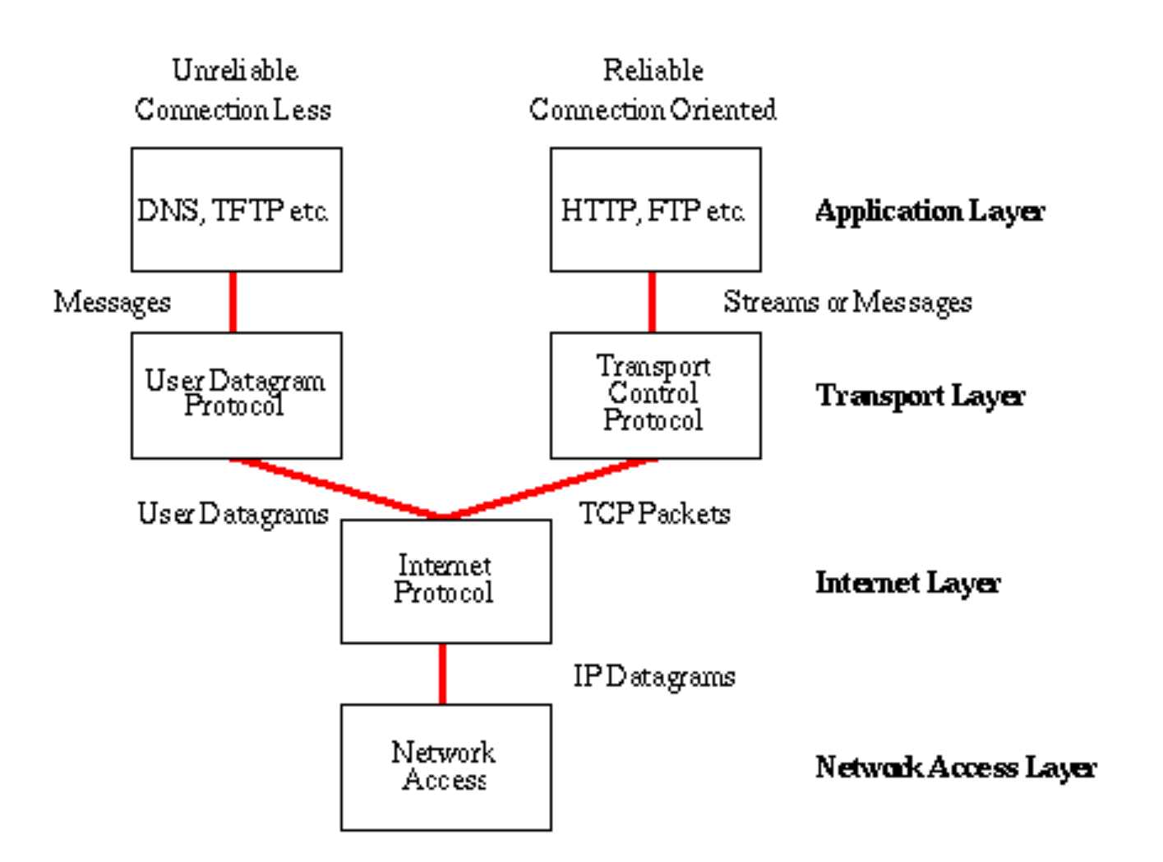
Network Architecture – The Internet
The Internet [link]
IP (Internet Protocol) [link]
TCP (Transmission Control Protocol) [link]
TCP/IP
UDP (User Datagram Protocol) [link]
UDP/IP
TCP/IP or UDP/IP Socket [link]
TCP and UDP Protocols & Port Numbers [link]

Slide 6
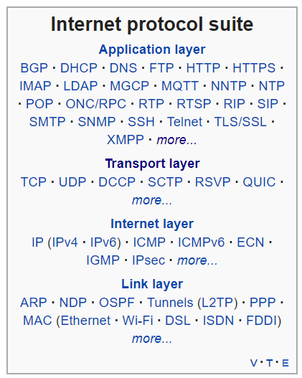
Network Architecture – The Web
The Web [link]
HTTP (Hypertext Transfer Protocol) [link]
DNS (Domain Name System) [link]
HTML (Hypertext Markup Language) [link]
CSS (Cascading Style Sheets) [link]
JavaScript [link]
Internet Protocol Suite [link]

Slide 7
Network Architecture – Distributed Computing
RPC (Remote procedure call) [link]
… SOA (service-oriented architecture) version 1
Java RMI (Java remote method invocation) [link]
DCOM (Distributed Component Object Model) [link]
CORBA (Common Object Request Broker Architecture) [link]
… [The Web takes over the world]
XML (Extensible Markup Language) [link]
XML-RPC (XML & HTTP) [link]
Internet Protocol Suite [link]

Slide 8
Network Architecture – Web Services
Web Services [link]
…SOA (service-oriented architecture) version 2
XML (Extensible Markup Language) [link]
XML-RPC (XML & HTTP) [link]
SOAP (Simple Object Access Protocol) [link]
JSON (JavaScript Object Notation) [link]
REST (Representational State Transfer) [link]
Internet Protocol Suite [link]

Slide 9
Network Architecture – Back to the Future
Web Services [link]
…SOA (service-oriented architecture) version 2 [link]
JSON (JavaScript Object Notation) [link]
REST (Representational State Transfer) [link]
gRPC [link] Or https://grpc.io/faq/
REST vs gRPC
REST vs. gRPC: Battle of the APIs [link]
Evaluating Performance of REST vs. gRPC [link]
Internet Protocol Suite [link]

Slide 10
Upcoming Demos
Demos will be the first Thursday of each sprint.

Slide 11
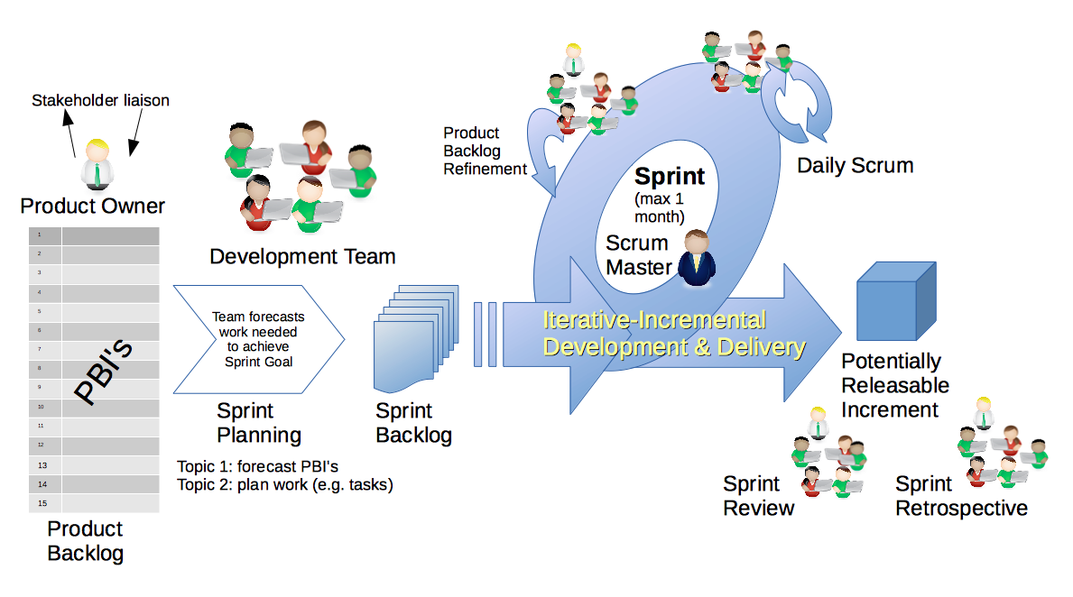
Scrum Process – Sprint Retrospective
By Dr ian mitchell - Own work, CC BY-SA 4.0, Link
Notes:
Calendar, Activities List, and Assignments

Slide 12
Start working early on assignments… and submit something!

Slide 13
Feedback?

Slide 14
Scrum Process & Roles – Sprint Planning
By Dr ian mitchell - Own work, CC BY-SA 4.0, Link

Slide 15
Planning
Planning Topics
Calendar
Syllabus
Activities List
Discussion Board
Quiz
Programming Assignment
Notes:
Grace period until Monday morning a 6am CT

Slide 16
Assignment
Complete Activities List items through item 4
Be ready for Sprint 3 demos including having completed Class Forum postings
Be ready to complete DB4 as a team
Notes:
Grace period until Monday morning a 6am CT

Slide 17
Lab
As A Team:
Review of the sprint 2 activities list and assignments in detail
Mosaic Lite
Team report out by Scrum Master
Report Out Guidelines
Scrum Master stand up, give your name, your team name, and briefly answer the following questions:
What did you accomplish since the last meeting? And what will you be working on until the next meeting?
Is the team committed to completing assignments? All/Most/Some
What is getting in your way or keeping you from completing the assignments?

Slide 18
End of Session

