Slide 1

Object-Oriented Programming Discussion, Lecture, & Lab Eric Pogue
Agenda for Wednesday, August 28th from 2 to 2:50pm CST:
Review Assignment from Last Class
Friendly Conversation Topic
Q&A: Course Syllabus
Q&A: Programming Assignment 1
Q&A: Quiz 1
Assignment for Next Class
Lab
Wrap-up and Final Questions/Comments
Discussion & Questions welcome at any time… please be present with no phones or email during our time together

Slide 2
Assignment for This Class
Complete Activity List items 1 through 8 before our next class and be prepared to discuss them
Be ready to form Scrum teams that each have a mix of skill sets during our next lab/lecture session
Take your name tags with you and bring them back to class through the end of Sprint 2

Slide 3
Today’s “Friendly Conversation” topic
Agile Manifesto
“We are uncovering better ways of developing software by doing it and helping others do it. Through this work we have come to value:
Individuals and interactions over processes and tools
Working software over comprehensive documentation
Customer collaboration over contract negotiation
Responding to change over following a plan
That is, while there is value in the items on the right, we value the items on the left more.”
Notes:
This was kind of “hippy-ish” and egalitarian in its day… quite controversial in its day
“Everyone is a team member and is responsible for the work getting done”… we don’t need no titles or positions… self-organizing… we will make our own commitments… transparency (let’s share the information)… flexible/organic teams, organic architecture (minimal documentation/standards)… no contracts (let’s talk it over)
The flip side:
We will actively and voluntarily play important roles on our team
The rules (rituals) that we do have… we WILL follow
We will create, demo, and release working software/products
We will utilize practical processes, tools, documentation, and planning
When we make commitments, we will live up to those commitments… as a team (“No winners on a losing team, and no losers on a winning team”)
We will be responsive and continuously improve (Retrospectives)
We will be transparent with how WE work and share our information

Slide 4
Discussion: Scrum

Slide 5
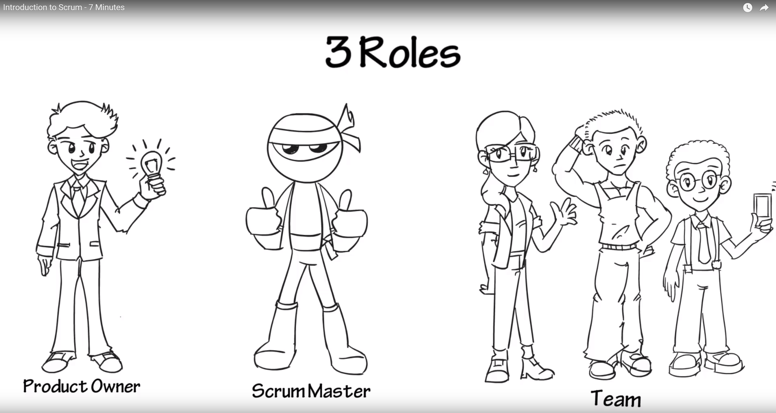
Scrum Roles from Introduction to Scrum - 7 Minutes YouTube video [link]

Slide 6
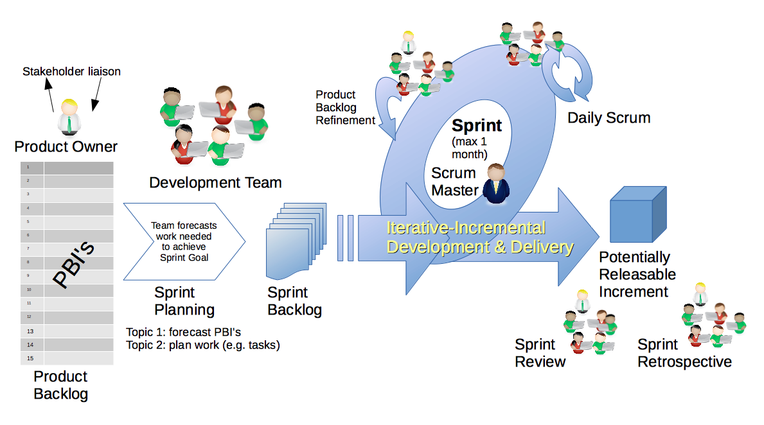
Scrum & Scrum Roles – Sprint Planning
By Dr ian mitchell - Own work, CC BY-SA 4.0, Link

Slide 7
Q&A: Syllabus Overview

Slide 8
Q&A: Programming Assignment 1

Slide 9
Q&A: Quiz 1

Slide 10
Assignment for Next Class
Complete Activity List items though 10 and be prepared to discuss in our next class

Slide 11
Lab
Organize into Scrum teams (10 minutes):
Split up into “two pizza sized” teams (3-7 people)
Make sure that the team has a mix of programming experience levels
MacOS users may want to be on the same team
Identify a Scrum Master
Select a adjective/noun team name (i.e. Brown Bears, Backrow Bobcats, etc.)
Co-locate your team
Add your team name to your name card
Take a team picture (with name cards)

Slide 12
Lab
As A Scrum Team:
Discuss the assignment for next class
Identify two team members (not the Scrum Master) who will each lead the discussion of a OOP Concept starting at 2:34pm
Discuss “Object-Oriented Programming Concepts & Practices”
Team report-out by Scrum Master 2:48
Team Report-out Guidelines
Scrum Master stand up, give your name, your team name, and briefly answer the following questions:
What did you accomplish since the last meeting?
What will you working on until the next meeting?
Is the team committed to completing assignments? All/Most/Some
What is getting in your way or keeping you from completing the assignments?

Slide 13
Wrap-up and Final Questions/Comments Take your name tags with you and bring them back to class through the end of Sprint 2
Notes:
Optimism, good natured humor, and effectively working together is immensely important to delivering good software… and likely equally important to delivering just about any quality product
Even if you don’t intend to be a professional software developer, many of the things that we learn will be valuable in related areas.
Soooo… We have 16 weeks to learn something valuable and interesting. Let’s enjoy our time together and make the most out of it.

Slide 14
End of Session

