Slide 1

Object-Oriented Programming Discussion, Lecture, & Lab Eric Pogue
Agenda for Thursday, January 16th at 2pm CT:
Assignment
Friendly Conversation Topic
Scrum Roles, Rituals, and Artifacts
Introductions*
Course Overview
Review Course Syllabus
Assignments for Next Class
Preview Week 1 / Sprint 1 Activities & Assignments
Lab… starting no later than 2:45pm CT
Discussion & Questions welcome at any time… please be present with no phones or email during our time together

Slide 2
Assignment for Today
Complete Activity List items through item 8 before our next class and be prepared to discuss them
Take your name tags with you and bring them back to class through the end of Sprint 2

Slide 3
Friendly Conversation Topic – The Agile Manifesto

Slide 4
Agile Manifesto
“We are uncovering better ways of developing software by doing it and helping others do it. Through this work we have come to value:
Individuals and interactions over processes and tools
Working software over comprehensive documentation
Customer collaboration over contract negotiation
Responding to change over following a plan
That is, while there is value in the items on the right, we value the items on the left more.”
Notes:
This was kind of “hippy-ish” and egalitarian in its day… quite controversial in its day
“Everyone is a team member and is responsible for the work getting done”… we don’t need no titles or positions… self-organizing… we will make our own commitments… transparency (let’s share the information)… flexible/organic teams, organic architecture (minimal documentation/standards)… no contracts (let’s talk it over)
The flip side:
We will actively and voluntarily play important roles on our team
The rules (rituals) that we do have… we WILL follow
We will create, demo, and release working software/products
We will utilize practical processes, tools, documentation, and planning
When we make commitments, we will live up to those commitments… as a team (“No winners on a losing team, and no losers on a winning team”)
We will be responsive and continuously improve (Retrospectives)
We will be transparent with how WE work and share our information

Slide 5
Agile Manifesto
Agile Team Commitments:
Everyone is a team member and is responsible for getting the work done (we don’t need titles)
We will actively and voluntarily play important roles on our team
The rules (rituals) that we do have… we WILL follow
We will create, demo, and release working software products
We will utilize practical processes, tools, documentation, and planning
When we make commitments, we will live up to those commitments as a team (“No winners on a losing team, and no losers on a winning team”)
We will be responsive and continuously improve
We will be transparent with how we work and share our information
Notes:
Agile Team Commitments
Everyone is a team member and is responsible for the work getting done
we don’t need no titles or positions
self-organizing
we will make our own commitments
transparency (let’s share the information)
flexible/organic teams, organic architecture (minimal appropriate documentation/standards)
no contracts (let’s talk it over)

Slide 6
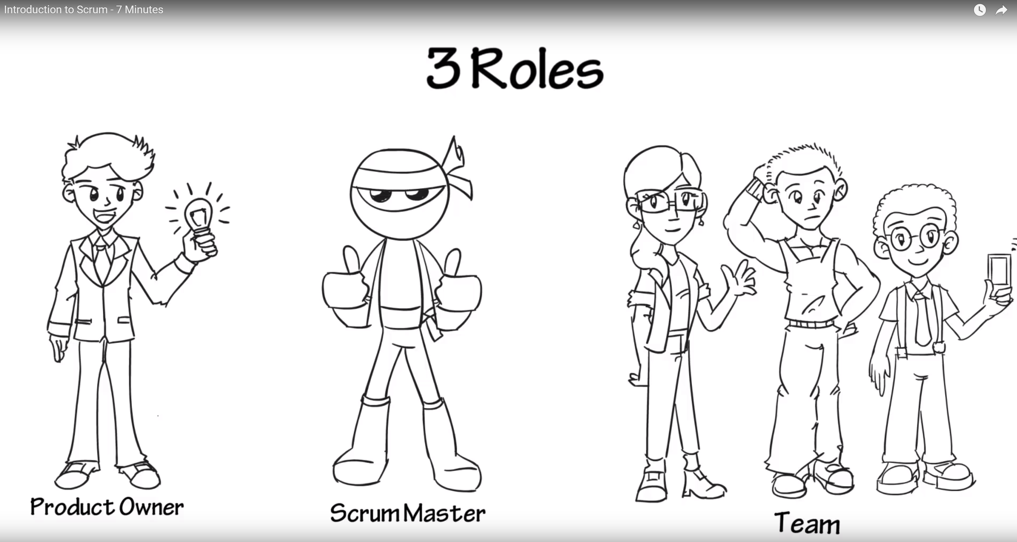
Scrum Discussion from Introduction to Scrum - 7 Minutes YouTube video [link]
Notes:
Other roles exist like developer, tester, etc.
Individuals are expected to play multiple roles as needed.
Three Artifacts:
Product Backlog
User Stories
Burndown Chart
Three Rituals:
Sprint Planning
Daily Scrum
Sprint Review or Retrospective

Slide 7
Scrum Roles, Rituals, and Artifacts
Three Roles:
Product Owner
Scrum Master
Team Member
Three Rituals:
Sprint Planning
Daily Scrum
Sprint Review or Retrospective
Three Artifacts:
Product Backlog
User Stories
Burndown Chart

Slide 8
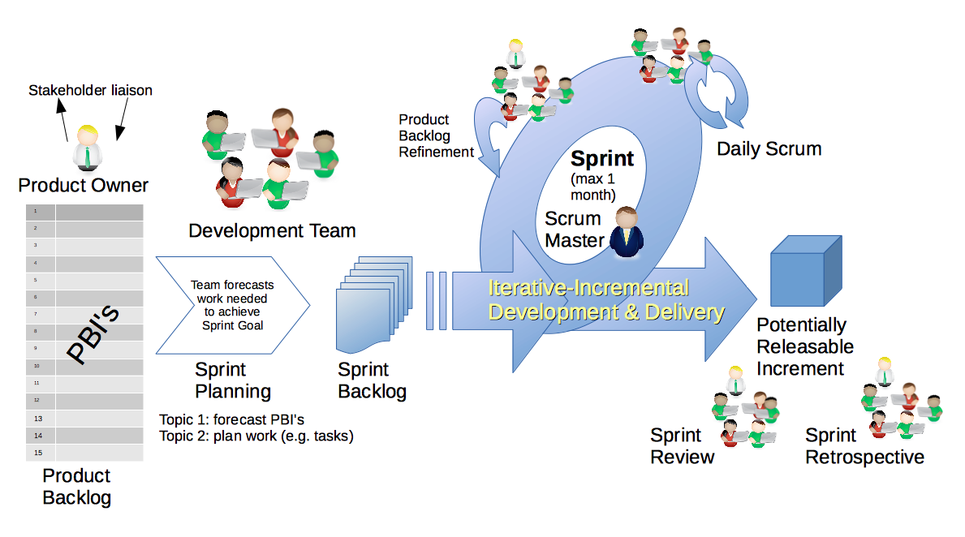
Scrum Process & Roles – Sprint Planning
By Dr ian mitchell - Own work, CC BY-SA 4.0, Link

Slide 9
Results from: Any Volunteers to try to set up GitHub using Office 365 Login Credentials? … stop up after class.

Slide 10
Assignment for Next Class
Complete Activity List items through item 12 before our next class and be prepared to discuss them
Take your name tags with you and bring them back to class through the end of Sprint 2

Slide 11
Lab
As A Scrum Team:
Identify your topic speaker for the day (not the scrum master who will doing the report-out)
Discuss the “Big Three” Object-Oriented Concepts
Answer the question, “What is the difference between Implementation Inheritance and Interface Inheritance?”
Analyze Programming Assignment 1, Quiz 1, and Discussion Board 1 and document any questions
Complete Discussion Board 1
Complete your first attempt at Quiz 1... you can take it again later
Team Report Out Guidelines
Scrum Master will stand up, give your name, your team name, and briefly answer the following questions:
What did you accomplish since the last meeting? And what will you be working on until the next meeting?
Is the team committed to completing assignments? All/Most/Some
What is getting in your way or keeping you from completing the assignments?

Slide 12
Wrap-up and Final Questions/Comments

Slide 13
End of Session

