Slide 1

Object-Oriented Programming Discussion, Lecture, & Lab Eric Pogue
Agenda for Friday, September 20^{h} from 2 to 2:50pm CST:
Review Assignment from Last Class
Friendly Conversation Topic – Software Licenses & Copyrights
Q&A: Sprint 2 Activity List and Assignments
Q&A: OOP Principles
Assignment – All sprint 2 activities and assignments need to be complete Sunday
Lab
Discussion & Questions welcome at any time… please be present with no phones or email during our time together

Slide 2
Assignment
Complete all items on the Activities List with the possible exceptions of the Programming Assignment and Quiz. You should have a solid start on both items, but it is okay if you need to spend time over the weekend to complete them.

Slide 3
Software Licenses & Copyrights

Slide 4
Q&A: Sprint 2 Activity List and Assignments

Slide 5
Q&A: OOP Principles

Slide 6
Assignment
All sprint 2 activities and assignments need to be complete Sunday

Slide 7
Lab
As A Scrum Team:
Same Scrum Master for sprint 3
Programming Together by Request… FaceDrawLite?
Sprint 2 Assignments
Team report out by Scrum Master at 2:46
Team Report Out Guidelines
Scrum Master will stand up, give your name, your team name, and briefly answer the following questions:
What did you accomplish since the last meeting? And what will you be working on until the next meeting?
Is the team committed to completing assignments? All/Most/Some
What is getting in your way or keeping you from completing the assignments?

Slide 8
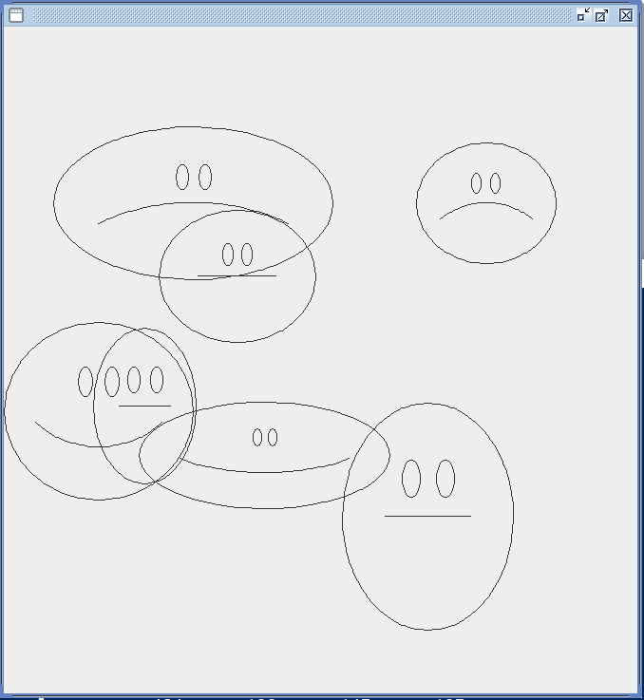
Foreshadowing FaceDraw
In the sprint 3 FaceDraw assignment, you will need to:
Create an graphical Java application
Draw 3 to 10 random faces on a window
Make each face a random width and height
Give each face a random emotion
Make it all visually appealing
And more
It will be challenging!

Slide 9
End of Session

