Slide 1
Discussion & Lecture Session Sound & Recording Check
Participants:
Log into Join.me
Announce yourself in the chat session or via audio
Provide your full name in your profile so that we can tell who is talking
For viewing my screen and/or sharing your screen your Chrome or FireFox browser
For Audio either:
Utilize your computer computer microphone and speakers
OR dial in with your phone utilizing Dial-in Number: (857) 444-6500 & Access Code: 332-234-179#
Host:
Test recording
Check recording sound when video is released by Join.me
Notes:
Be ***Sure*** to start recording!

Slide 2

Object-Oriented Programming Discussion & Lecture Eric Pogue
Agenda for Tuesday, April 14th
Friendly Conversation Topic
Prework & Announcements
Sprint 6 Demo Preview
Sprint 6 Metrics
Sprint 6 Retrospective
Sprint 7 Planning Q&A
Assignment
Lab
Discussion & Questions welcome at any time… please be present with no phones or email during our time together
Notes:
Be ***Sure*** to start recording!

Slide 3
Friendly Conversation Topic Final Project Idea: React JavaScript Programming
Notes:
Java Servlets
Java Servlets with Spring

Slide 4
Prework & Announcements
All sprint 6 Assignments and Activity List items need to be complete by Sunday 11:59pm CT
Sprint 7 Planning completed Monday
Notes:
Grace period until Monday morning a 6am CT

Slide 5
Sprint 6 Demos for Thursday, April 16th
Notes:
Everyone else should have their demo completed by the end of class today

Slide 6
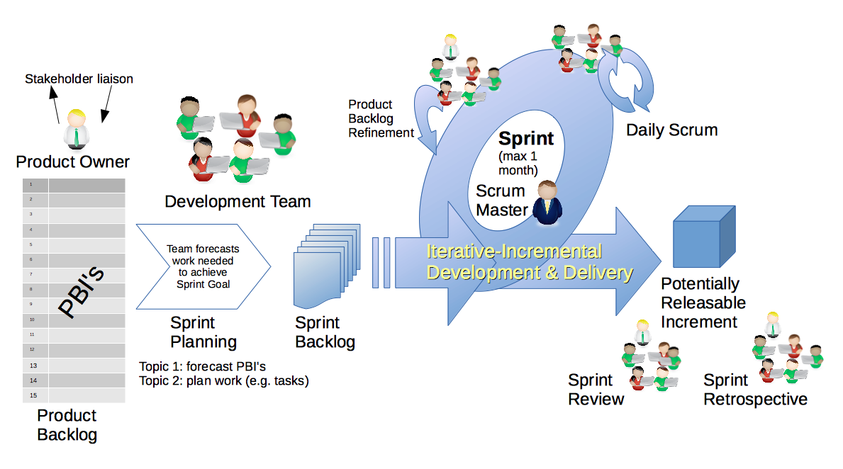
Scrum Process – Sprint Retrospective
By Dr ian mitchell - Own work, CC BY-SA 4.0, Link
Notes:
Calendar, Activities List, and Assignments

Slide 7
Metrics Sprint 5 Percent Submission: 84% Sprint 6 Percent Submission: 68%
Notes:
22 Enrolled
19 Participating
16 out of 19 Submitted All Sprint 5 Assignments by Monday morning at 6am CT

Slide 8
Metric Goals Sprint 5 Percent Submission: 84% Sprint 6 Percent Submission: 68% Goal for Sprint 7 is 84% Goal for Sprint 8 is 95% (18 out of 19)
Notes:
22 Enrolled
19 Participating
16 out of 19 Submitted All Sprint 5 Assignments by Monday morning at 6am CT
Spicy Chalupa Challenge

Slide 9
Feedback
Notes:
My attempt to bring in some Scrum requirements gathering techniques (Epics and Stories) didn’t go as well as I had hoped. I likely wont do that again.

Slide 10
Feedback?
Notes:
My attempt to bring in some Scrum requirements gathering techniques (Epics and Stories) didn’t go as well as I had hoped. I likely wont do that again.

Slide 11
Scrum Process & Roles – Sprint Planning
By Dr ian mitchell - Own work, CC BY-SA 4.0, Link
Notes:
Calendar, Activities List, and Assignments

Slide 12
Sprint 7 Planning Q&A

Slide 13
Assignment
Thunderbird minimum viable product (MVP) [link] by Thursday class
Notes:
Grace period until Monday morning a 6am CT

Slide 14
Lab
As A Group:
Complete Discussion Board 7
Thunderbird MVP Headstart
Thunderbird, Thunderbird, and more Thunderbird

Slide 15
End of Session

