Slide 1

Object-Oriented Programming Lecture, Discussion, & Lab Eric Pogue
Agenda for Thursday, February 27th
Prework
Demos
Friendly Conversation Topic
Sprint 3 Q&A
Assignment for Next Class
Lab
Discussion & Questions welcome at any time… please be present with no phones or email during our time together

Slide 2
Prework
Complete Activities List items through item 4
Be ready for Sprint 3 demos including completing Class Forum postings
Be ready to complete DB4 as a team
Notes:
Grace period until Monday morning a 6am CT

Slide 3
Demo Adjustment Browse to “join.me/ericjpogue”

Slide 4
Demos
Demos will be the first Thursday of each sprint.

Slide 5
Browse to “join.me/ericjpogue”

Slide 6
Demos
Demos will be the first Thursday of each sprint.

Slide 7
Friendly Conversation Topic

Slide 8
Network Architecture & Protocols – Part 3

Slide 9
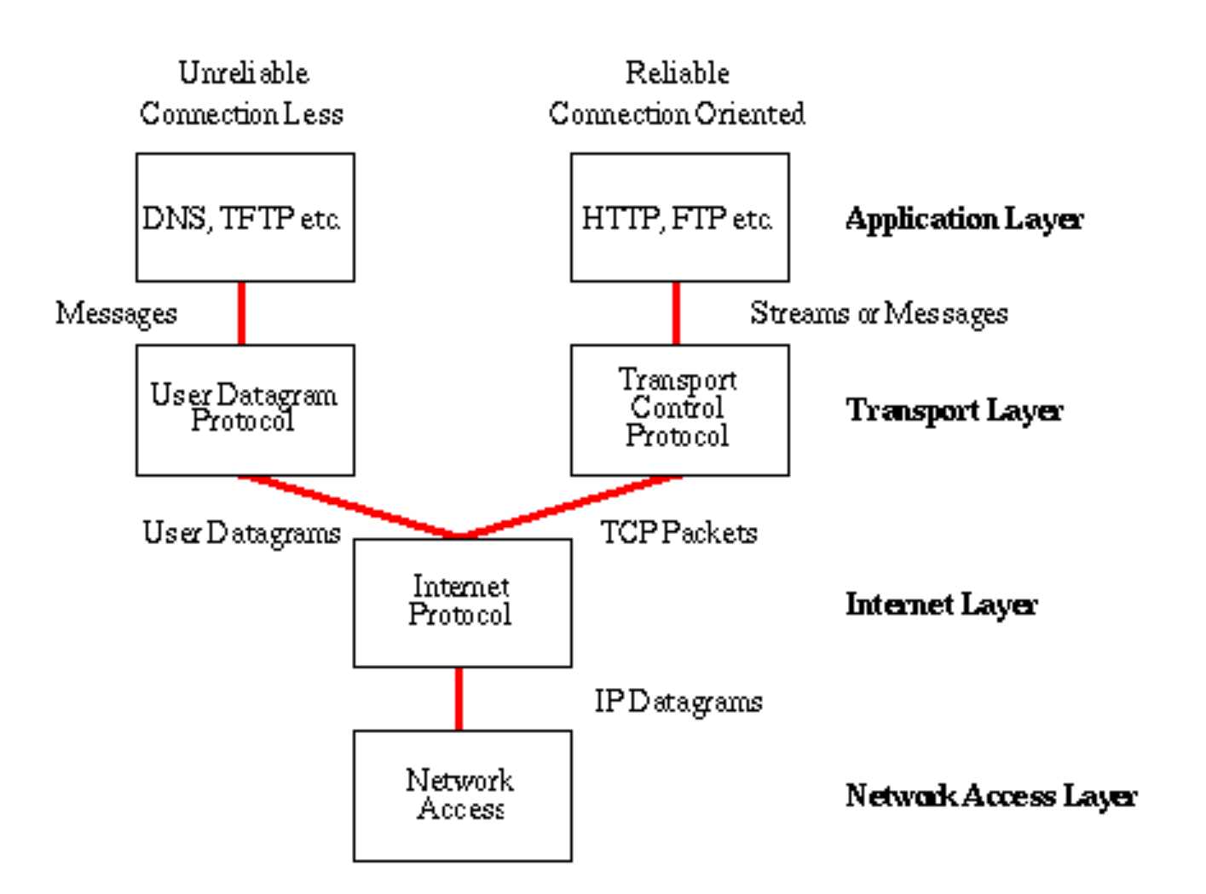
Network Architecture – The Internet
The Internet [link]
IP (Internet Protocol) [link]
TCP (Transmission Control Protocol) [link]
TCP/IP
UDP (User Datagram Protocol) [link]
UDP/IP
TCP/IP or UDP/IP Socket [link]
TCP and UDP Protocols & Port Numbers [link]

Slide 10
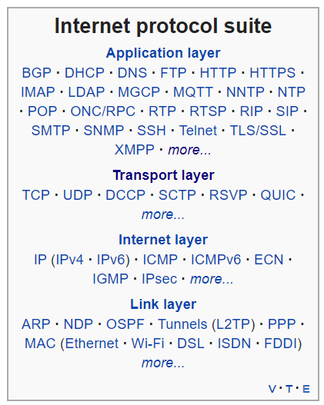
Network Architecture – The Web
The Web [link]
HTTP (Hypertext Transfer Protocol) [link]
DNS (Domain Name System) [link]
HTML (Hypertext Markup Language) [link]
CSS (Cascading Style Sheets) [link]
JavaScript [link]
Internet Protocol Suite [link]

Slide 11
Network Architecture – Distributed Computing
RPC (Remote procedure call) [link]
… SOA (service-oriented architecture) version 1
Java RMI (Java remote method invocation) [link]
DCOM (Distributed Component Object Model) [link]
CORBA (Common Object Request Broker Architecture) [link]
… [The Web takes over the world]
XML (Extensible Markup Language) [link]
XML-RPC (XML & HTTP) [link]
Internet Protocol Suite [link]

Slide 12
Network Architecture – Web Services
Web Services [link]
…SOA (service-oriented architecture) version 2
XML (Extensible Markup Language) [link]
XML-RPC (XML & HTTP) [link]
SOAP (Simple Object Access Protocol) [link]
JSON (JavaScript Object Notation) [link]
REST (Representational State Transfer) [link]
Internet Protocol Suite [link]

Slide 13
Network Architecture – Back to the Future
Web Services [link]
…SOA (service-oriented architecture) version 2 [link]
JSON (JavaScript Object Notation) [link]
REST (Representational State Transfer) [link]
gRPC [link] Or https://grpc.io/faq/
REST vs gRPC
REST vs. gRPC: Battle of the APIs [link]
Evaluating Performance of REST vs. gRPC [link]
Internet Protocol Suite [link]

Slide 14
Sprint 4 Q&A

Slide 15
Assignment
Complete Activities List items through item 7
Mosaic v1 complete by the start of class on Tuesday
Notes:
Grace period until Monday morning a 6am CT

Slide 16
Lab
As A Group:
Complete Discussion Board 4 as a team (14 minutes):
Assign a note taker and presenter
Discuss DB4 as a team
Identify team name, participants, and key discussion points
Share notes with team and have each team member copy/paste notes into their individual DB4 post and submit DB4
Present overview
Mosaic, Mosaic, and more Mosaic
Team Report-out topics should include a team status on DB4, MosaicLite, and Mosaic
Report Out Guidelines
Scrum Master stand up, give your name, your team name, and briefly answer the following questions:
What did you accomplish since the last meeting? And what will you be working on until the next meeting?
Is the team committed to completing assignments? All/Most/Some
What is getting in your way or keeping you from completing the assignments?

Slide 17
End of Session

